Slide 1
Intro Slide Title 1
Improving Gender Balance Through a Combined STEM Degree
E. McPherson, A. Clarke, A.M. Gallen, M. Keys & P. Wolf
19th April 2023

Slide 2
Improving Gender Balance Through a Combined STEM degree
Research Background
In 2017 the Open University introduced a ‘BSc Combined STEM’ degree (R28).
Due to the relaxation of ELQ (Equivalent Level Qualification) funding, R28 enables students who already have a degree to access loans for studying a degree that allows them to change careers (England, for details see here).
The proportion of women registering on this combined degree is comparatively higher than expected; notably in those disciplines where the proportion of women is typically lowest (for example, engineering and computing key introductory modules).
The aim of the study was to better understand why the proportion of women is higher on the Combined STEM degree than other STEM-based qualifications.
Notes:
Mary

Slide 3
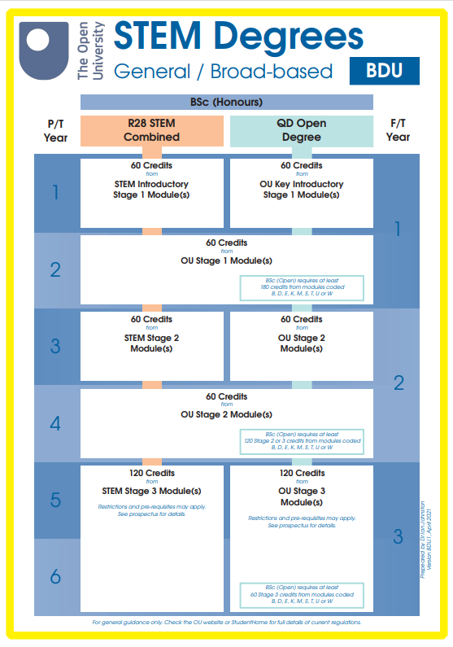
Improving Gender Balance Through a Combined STEM degree
Comparison R28 STEM Combined vs. QD Open Degree
Notes:
Mary
What differentiates Combined STEM from the Open degree?
R28
Stage 1
o Students select 60 credits from the STEM key introductory modules including:
▪ 60 credit modules - E117, S111, SDK100, U101 or U116
▪ 30 credit modules - M140, MST124, MU123, T192, T193, T194, TM111 or TM112
o Students then select 60 credits from free choice OU level 1 modules from a variety of subjects across all faculties
• Stage 2 –
o Students study 60 credits from the STEM Level 2 modules – again from across all faculties
o Students then select 60 credits from free choice Level 2 modules from a variety of subjects.
• Stage 3 – students will select 120 credits from STEM Level 3 module options only
QD
This degree has three stages, each comprising 120 credits. For your BA/BSc (Honours) Open degree you can:
study a broad range of subjects; or
specialise in one subject area, and pick from a wide range of subjects to complete your qualification; or
specialise in two subject areas, dividing your time equally between both.

Slide 4
Improving Gender Balance Through a Combined STEM degree
Table 1. Data for student intake October 2019
Module | % of female students on module | % of female Combined STEM students
Mathematics entry module 1 | 31.3% (n=2012) | 42% (n=63)
Mathematics entry module 2 | 32.9% (n=2018) | 50% (n=96)
Engineering entry module | 16.4% (n=1123) | 33% (n=64)
Computing entry module | 26.6% (n=2663) | 42% (n=77)
Natural Sciences entry module | 45.4% (n=1386) | 46% (n=107)
Environment entry module | 59.4% (n=1148) | 67% (n=62)
Notes:
Mary
Highlight engineering and computing percentages and numbers

Slide 5
Improving Gender Balance Through a Combined STEM degree
Literature review
Multiple bodies of knowledge are implicated in the research questions, therefore three areas in the literature were investigated that offer insights into current thinking regarding mature, female students and their engagement with STEM subjects.
Women’s participation in STEM (gender and culture)
Mature students
Combined degrees
Notes:
Petra
Academic literature that explores the three topics above is quite descriptive and does not seek to explain the data reported with the help of specific theories. There are some exceptions such as Talley and Martinez Ortez (2017) and Gonzalez-Perez, Mateos de Cabo and Sainz, (2020) who draw on Eccles value-expectancy theory mainly looking at interest and self-concept. Other articles use a critique of rational choice theory such as Gonzales-Arnal and Kilkey, (2009) and Dashper et al. (2020) who argue that the omission of emotion from rational choice and a prioritisation of relationships leads to the failure of the government’s HE policies.
Abu-Lail et al. (2012) applied Charles and Bradley’s Gender-Essentialist and Self-Expressive Value Systems Framework to their analysis of gender inequity in the US. While “gender-essentialist refers to ‘cultural beliefs in fundamental and innate gender differences’”, “self-expressive value systems refer to the value systems frequently expressed in western economically developed countries as the expectation to pursue individual interests when making career choice” (Abu-Lail et al., 2012: 25.1036.5). In other words, Abu-Lail et al. (2012) are suggesting that in individualistic societies gender normativity trumps social policy and women are unlikely to violate gender norms in favour of taking up socially valuable employment.
Developed nations have been found to have a higher degree of gender inequality, for example countries such as Sweden, Finland and Norway have a significant higher gender gap in relative strength in science than the United Arab Emirates, Jordan or Algeria (Saavedra-Acuna and Quezada-Espinoza 2021; OECD 2019; Abu-Lail et al., 2012). Equally, the percentage of women among STEM graduates is higher in Tunisia or Turkey than in Belgium or the Netherlands (OECD, 2019). The influence of culture even shows within country. For example, in Australia, male and female students from a non-English speaking background were found to be more likely to choose STEM than their native English speaking counter parts (Justman and Mendez 2018).
While return to education is perceived as valuable, mature students take a higher risk when re-entering education – these risks evolve around four areas: “risk of academic failure, economic and material risk, risk to personal relationships and risk to class identity” This means that a re-engagement with education is a fraught with insecurity and uncertainty and the slightest mishap can have significant consequences.
Combined degrees US research reports on the state of things but not underlying reasons
UK research employability and transferable skills further research is recommended;
Research has shown that combined degrees have the potential to lead to better employment outcomes, the broader scope seems to appeal to women and minorities here in the UK and the US.

Slide 6
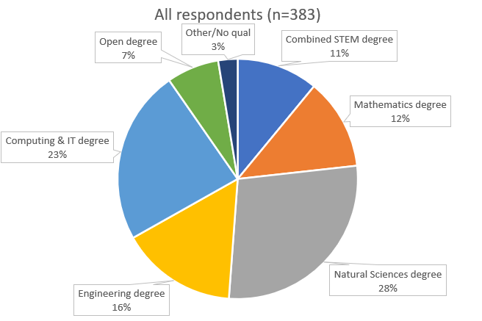
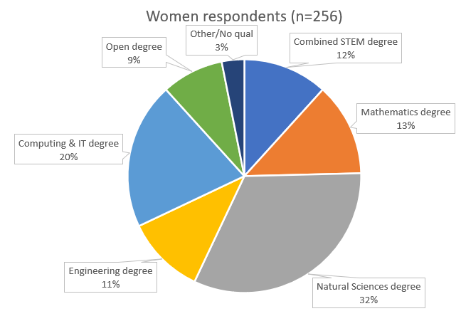
Improving Gender Balance Through a Combined STEM degree
Research Methods - Survey
Target group: students studying the STEM Access module and STEM entry modules.
The surveys ran 3 times between September 2020 and October 2021
Notes:
Petra
Across the three rounds of surveying, 1557 students invited to participate
Students were registered on a range of qualifications including the Combined STEM degree.
383 survey responses were received including 256 (self-identified) women,
116 (self-identified) men and 11 students who chose not to identify as women or men.
Of the 256 women, 30 were studying the Combined STEM degree
Just under 25% response rate
No incentive to participate in survey. No upfront incentive to participate in interviews but students were given £20 amazon voucher after interview.

Slide 7
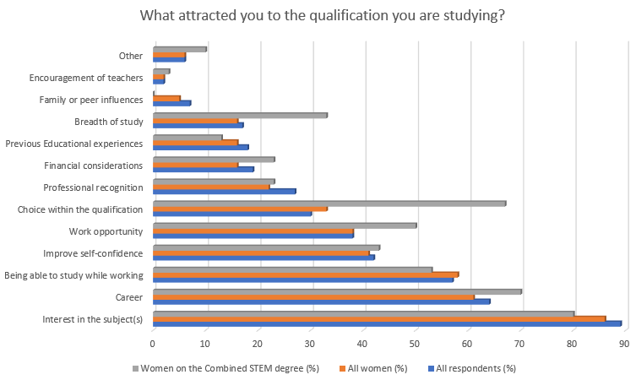
Improving Gender Balance Through a Combined STEM degree
Research Methods - Survey Results
In the survey, students were asked ‘What attracted you to the qualification you are studying?’
Notes:
Petra
The largest difference was in the number of women selecting ‘Choice within the qualification’ (33% of women versus 67% of women on the Combined STEM degree). Despite small numbers of women respondents on the Combined STEM degree (n=30), this large difference may indicate something significant about that cohort. It may suggest that there is a cohort of adult women learners (less likely to have HE qualifications) for whom choice is important.
This is backed up by some of the open comments made by Combined STEM women students about why they chose that degree. Reasons included, “...the option to choose relevant and interesting modules is one of the first attractions I encountered” and “…this gave me more options”. They also stated that single honours degrees “Limited module choices” and “Modules were too fixed”.
Of interest specifically to our university, almost half of the students surveyed who were studying single honours degrees had been unaware of the Combined STEM degree when they registered and, only 10% of students on single honours degrees had considered it as an option.
Of the respondents studying the Combined STEM degree about 40% said that they planned to study only one STEM discipline with the majority planning to study more than one STEM discipline and less than 20% saying that they planned to include non-STEM modules (and of these only two were women). This may indicate that for most students the appeal of the Combined STEM degree is more about choice of modules within STEM rather than being able to include non-STEM modules.

Slide 8
Improving Gender Balance Through a Combined STEM degree
Research Methods - Interviews
Using VOIP to record interviews, 9 women were interviewed (2021) for transcription and later analysis. Questions focused on why the students had chosen the qualifications they were studying.
The interviews and surveys were uploaded into NVIVO and the analysis revealed a number of themes across the free text questions in the survey as well as the interview transcripts.
“…I googled for a while … and then I was going through the OU website looking at all of different degrees, I had a notebook full of notes on different ones, spoke to people about which one to do...” (Combined STEM degree)
“I spoke to someone over the university chat, I attended the Open Uni open days
and watched the YouTube channel...” (Combined STEM degree)
“…finding it online… have a look at what kind of information it includes… then I start
to talk to people around me” (Engineering degree student)
Notes:
Petra
Codes used in NVivo were:
Affirmation of choice: Positive reasons for choosing their degree
Career: Chose degree to enhance current career
Employers: Choice influenced by employer and/or qualification paid for by employer
Interest in subject: Chose degree because of interest in discipline content (e.g., enjoys computing)
Confidence: Chose degree as unsure about what they wanted to study or whether they were capable or comments about their degree improving their confidence
Disability: Choice influenced by additional requirements relating to disability
Staff: OU staff/teachers influenced choice
Other students/ friends/ family as advisors: Choice influenced by other students (either within or external to OU) or friends or family members
Previous qualifications: Motivated by previous study or knowledge
Time management: Choice influenced by time constraints
Why the OU: Specific reasons for part-time distance at the OU
Women in that career path: Choice influenced specifically by a woman in that role or career i.e., teacher, lecturer, family, friend or other professional
Specific drivers: Identified another specific driver for choice
They discussed having made the choice of qualification carefully and of initially using resources on the internet before talking to people about it: - a lot of effort is put into finding the right choice

Slide 9
Improving Gender Balance Through a Combined STEM degree
Research Methods - Interviews
Women studying the Combined STEM degree spoke about valuing its flexibility and the ability to combine subjects:
“...I was in two minds on enrolling on a single honours maths degree …
I thought it might just be a bit narrow and I do enjoy other areas of science...” (Combined STEM student)
“I was torn between biology and history and then obviously I found the Combined [STEM], so that was just better for me” (Combined STEM student)
This also included the flexibility of being able to avoid unappealing modules on a single honours degree:
“... I looked into the higher-level modules, there were one or two
that I didn’t want to do...” (Combined STEM degree)
Notes:
Petra
One possible motivation for choosing the Combined STEM degree, the availability of credit transfer, did not come up in the survey or interviews, probably because the focus of this project was students on the entry modules who were less likely to have transferred credit from another institution.
The negatives mentioned by students on the Combined STEM degree were around the difficulty in articulating the concept of a ‘Combined STEM’ degree to others:

Slide 10
Improving Gender Balance Through a Combined STEM degree
Impact
Gender balance is an issue across the sector for specific STEM curriculum areas and many of the qualifications/schools within STEM are exploring ways to address this. This project makes the recommendation that placing more emphasis on aspects such as module/subject choice and flexibility during qualification design and in qualification descriptors may be useful in encouraging engagement of women in STEM subjects where they are traditionally underrepresented.
We recommend that when OU STEM qualifications are designed or revised that level of module choice and flexibility is maximised. We further recommend that careful consideration is given to highlighting that flexibility in the qualification descriptions.
An additional recommendation from this project is that the Open Programme explore further with Marcomms how enquirers can be better informed about the full range of qualifications, including R28.
Notes:
Petra
RE: marcomms – working to update both print and online prospectus and feeding into the new re-platforming work. Animation.

Slide 11
Slide Title 30
Thank you

