Slide 1

Pathways and Intersections:
Investigating awarding gaps on cross-faculty modules and degree programmes
Sarah Davies, Elaine McPherson (EEES),
Mary Keys (Open Degree),
Debra Croft, Russ Rimmer
19 April 2023

Slide 2
BACKGROUND DATA
DST206 Environment:
sharing a dynamic planet
S206 Environmental
science
SDT306 Environment:
responding to change
Awarding gaps for students taking the same modules but on different degree pathways
Concerns this might be particularly evident for certain groups of students, e.g. black students, low socio-economic status backgrounds and students with disabilities (mental health issues)

Slide 3
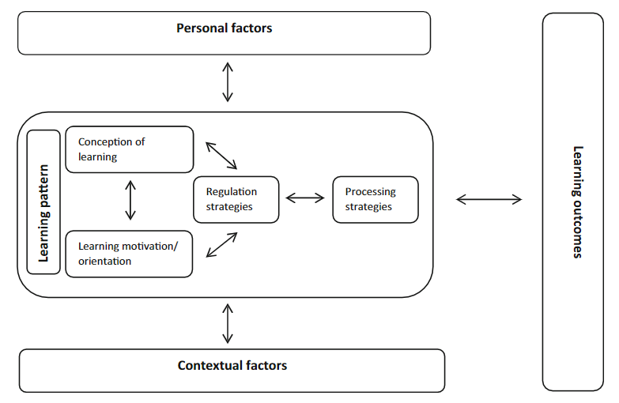
PROJECT OVERVIEW
Vermunt & Donche’s (2017) model of student learning
Aims
A better understanding of issues faced by students on different pathways through OU modules and degrees in order to improve our teaching and support
Approach
Analysis of student data : 18J, 19J,20J
Exploration of student experiences:
survey: DST206, S206, SDT306 21J : 118 responses.
interviews: 12 students across DST206, S206 & SDT306 21J
Focus group with MTCs and Qualification Leads
Notes:
avoid anything that could be construed as the deficit model
looking for ways to improve our teaching and support not looking for ‘problems’ with the students.
how can we prepare students for these modules (e.g. at level 1) (rather than their lack of preparedness for HE study.)

Slide 4
FINDINGS
Data: Awarding gaps: confirmed for black students, students from low socioeconomic status backgrounds and students with disabilities, including mental health
Engagement with study: For black students, the possibility of passing is reduced substantially. Despite greater engagement with continuous assessments than occurs among other students.
LEARNING MOTIVATIONS/ORIENTATIONS
Why this module:
  compulsory in the qualification 62%
  interest in the subject matter 60%
  enjoyment studying about the environment in previous modules 35%
  job or career plans 27%
Survey problem: difficulty in getting our target student groups to engage with the survey.
Learning sources
  72% read around the topic (as well as learning from module materials),
  BUT 28% only use the module materials;
  comments indicate this is often due to time pressure
Notes:
Possibly those students are more time poor or less trusting of the anonymity and use of surveys?

Slide 5
CONCEPTIONS OF LEARNING
Views and beliefs about learning and teaching
Preparedness: difference in perceptions between staff and students
Students thought they were well prepared for each of the modules
Staff less convinced, especially around a perceived science/social science divide.
Notes:
i.e., the views and beliefs they hold about learning and teaching, interact with the learning strategies they use. These can be reflected in the difficulties encountered, help-seeking behaviours and how prepared students felt for study
Is this an artificial divide created by the nature of the cohort who answered our survey or is there really a disconnect in perception between staff and students?

Slide 6
CONCEPTIONS OF LEARNING
Views and beliefs about learning and teaching:
Help-seeking behaviour
Notes:
i.e., the views and beliefs they hold about learning and teaching, interact with the learning strategies they use. These can be reflected in the difficulties encountered, help-seeking behaviours and how prepared students felt for study

Slide 7
REGULATION STRATEGIES
  Planning, how students check own understanding

Slide 8
PROCESSING STRATEGIES
How the subject material connects to their life experiences
How students approach their study
  Overall, 90% of students agreed that their learning in their module relates to the world around them

Slide 9
CONTEXTUAL FACTORS: ECO-ANXIETY
56% of students agreed studying their module made them anxious about the environment and climate change
Fewer Q52 students are worried (39%) than QD and R28 students (85% and 71%)
S206 are less worried (44%) than DST206 and SDT306 (75% and 63%)
Comments indicate:
Feelings of fear, worry and overwhelm:
“it may be that I have eco-anxiety anyway. Doing these courses and then seeing the news is worrying. I have turned into a fun-sponge.”
but also empowerment
“… I also feel empowered as hopefully this module will help me in gaining employment in the area of environment and so I might be able to make an impact.”
ecoanxiety can negatively affect learning and support is needed

Slide 10
PATHWAYS AND INTERSECTIONS
Pilot study over 6 months: needs further exploration
Useful information for modules and qualifications across the environmental sciences
Understanding of issues faced by students who design their own learning pathways should have wider relevance across the external HE sector where there is increasing interest in personal learning journeys, microcredentials and portability of learning.

Slide 11
Slide Title 30
Thank you

