Slide 1

Intro Slide Title 2
Designing more inclusive project modules
Nicole Lotz and Muriel Sippel
E&I STEM
19 April 2023

Slide 2
Inclusion, mental health, wellbeing and project work
Wellbeing
Social perspective of mental health ‘holds society accountable for change’ (Lister 2022, 13). Lister argues that the design and delivery of distance learning could enable or create barriers to wellbeing for distance learners. The shift in responsibility to changing the systems rather than making change as the individual’s sole responsibility is significant for the conception of mental health, because it introduces the perspective that educators and institutions can actively support students’ wellbeing.
Project assessments
Assessment is a key threat to student wellbeing: “high-stakes assessment practices particularly threatened wellbeing by heightening consciousness and anxiety of failure.” (Jones et al. 2020, 441) Design assignments can be considered high stakes. They tend to be project- and problem-based. The entire design process, regardless of what is assessed at the end, takes up a large part of a course, and it involves the individual deeply. Design projects are often ill-defined and become more complex at higher levels of study. Heightened uncertainty and stress offer additional challenges to learners with a mental health disability (Kendall 2016).

Slide 3
Slide Title 9
Pass and awarding gaps in Design project modules
Aims of eSTEeM project
Focus on
Gain a deeper understanding of the specific issues experienced by Design students with mental health disabilities throughout their study.
Develop recommendations that could inform the learning design of modules in production and positive interventions in presentation to reduce the awarding gap and facilitate progression.
Intersecting factors:
Discipline (knowledge and skills, coursework, assessment),
Personal circumstances (work and family, caring commitments, life events),
Support received during their studies from OU and elsewhere

Slide 4
Approach
Experiential, qualitative, and longitudinal over 4-5 months
4 passionate interviewers, working each with 2 students from one module (levels 1-3)
Aim to build a conversational, trusting relationship, but not as a tutor, more like a friend with a good listening ear!
2 online interviews, an experience sample and a diary study (using instant messenger)
Student selection: aim for diversity
  Prev. high and low achieving
  Mix of gender and background (e.g. age, ethnicity)
  Low sample size at higher levels challenging
Recruited 7 students who stayed with us, except for one who dropped earlier

Slide 5


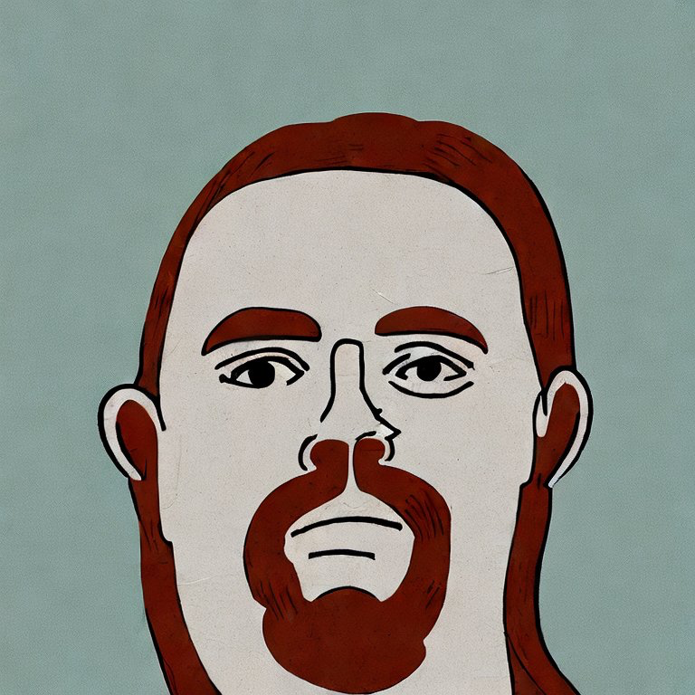
Slide Title 15
Our participants levels 2-3
I am originally from the Philippines. I study the second level module Design Essentials. I have been recently diagnosed with a Personality Disorder. I also experience Anxiety and Depression.
Anna
Isobel
I am a carer for my partner, so I don’t work, but I volunteer a lot. I have Bipolar Disorder. I study the third level module Design Innovation.
I work as engineer. I study the second level module Design Essentials. I have phases of Depression, Anxiety and OCD.
Harry

Slide 6

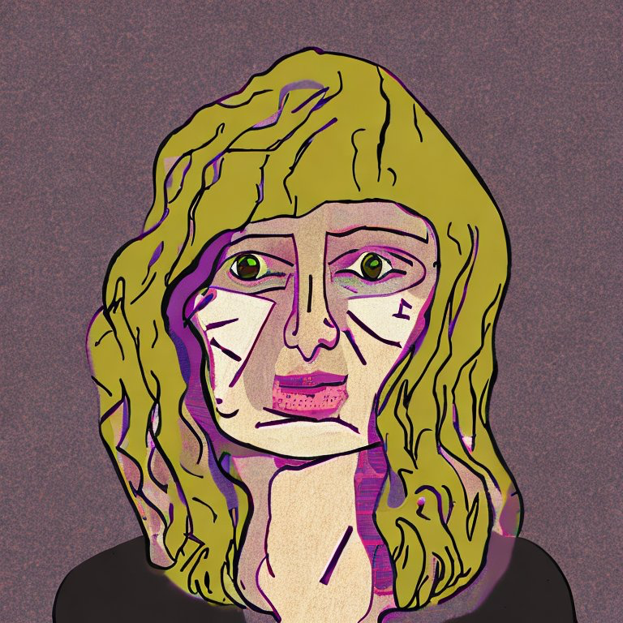


Slide Title 15
Our participants level 1
Zoe
I am a D&T technician at school and want to become a teacher. I am about to get married. I have Anxiety. I just started Design Thinking.
Charlotte
I live with my parents. I have an Eating Disorder, Anxiety and Depression. I love to draw. I study Design Thinking.
Jake
I lost my job due to COVID and live with my mum. I have chronic pain and suffer episodes of strong Depression.
Ben
I live with my partner. I have had PTSD, OCD, Anxiety and ED for a long time. I am a creative person. I love the level 1 module.

Slide 7
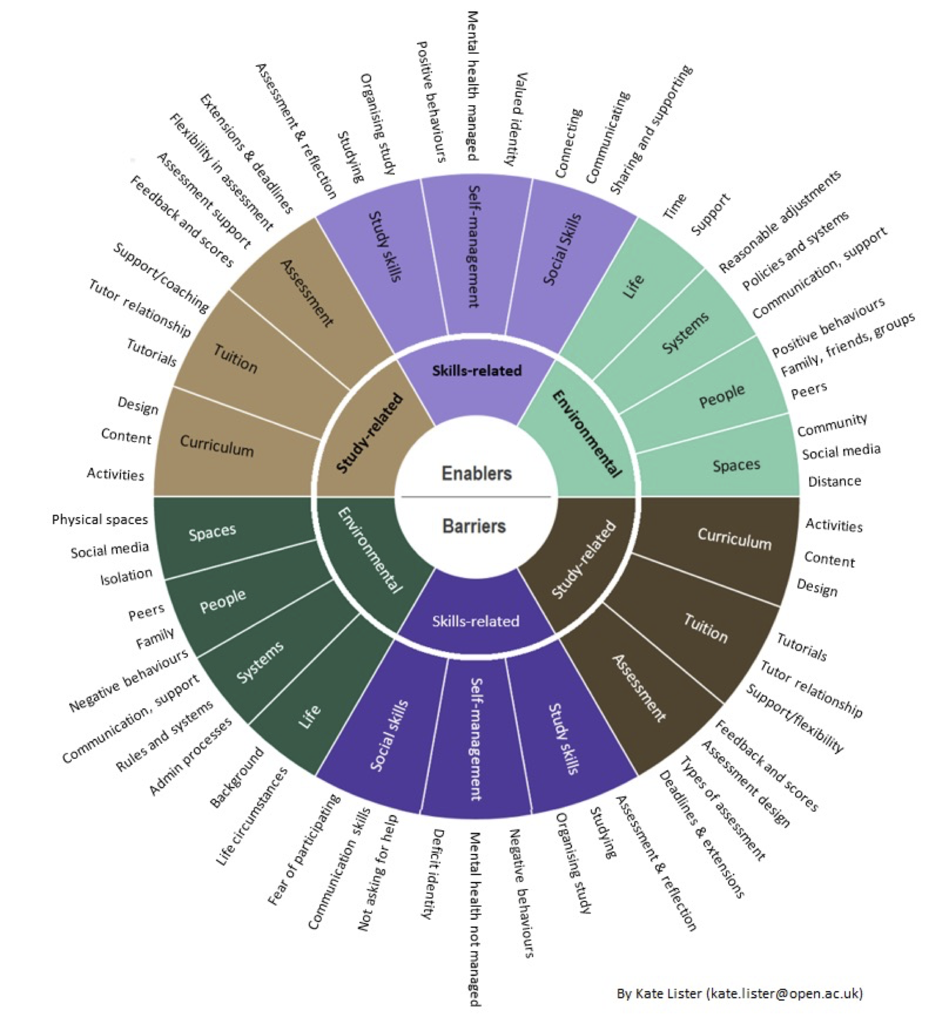
Slide Title 22
Barriers and Enablers
to wellbeing by Kate Lister
Informed interview protocol and analysis
Social model of disability: barriers and enablers to participation, success, and wellbeing
Deemphasises the dominant personal deficit perspective.
Thematic qualitative data analysis that revealed :
  ‘tensions’ - conflicts between student experiences and the requirements of the design and delivery of learning
  Students reported how tensions were resolved to move a barrier to being an enabler

Slide 8
Slide Title 13
Tensions related to
Study
Openness of design project assignments and the fear of misinterpretation
Delayed but more valuable tutor feedback and immediacy of others’ feedback
Support for wellbeing and on design project work
Skills
Working towards deadlines and adjusting study rhythms
Independence and social learning
Following the flow of creativity and knowing when to stop or move on
Environment
Study environments for practical and creative work

Slide 9
Slide Title 3
01
02
How are tensions resolved to support learning?
What else can we do?

Slide 10
Slide Title 9
Student suggestions about “What else we could do”
Assessment feedback and tuition
Maximum openness in Project assignments to give scope for the individual interests and values to be embedded into the project.
Soft deadlines and no high stakes in Project assessments
Flexibility in submission formats.
Choice to involve partners or family in collaborative learning tasks instead of peers.
Frequent and timely formative feedback from any module tutor not necessarily their own tutor and given in a safer, smaller space than the module forum.
Feedback triage system involving discursive AI.
A mini tutor group on WhatsApp.
A peer group on WhatsApp (with mental health focus with MHFA trained tutor)
Audio or video instructions and feedback to highlight the important project improvements to be made in tutor feedback.
Workshop tutorials offered flexibly or multiple times for those who are ahead and those who are late in their study.
Proactive tutor support possibly using early indicators dashboard

Slide 11
Slide Title 9
Student suggestions about “What else we could do”
Curriculum design
Design focused wellbeing activities in curriculum and VLE tools
Materials highlight certain creativity techniques also enabling wellbeing
Make aware of the problems with over-criticality and that it can sometimes inhibit decision making
Completing small, active tasks fast without worrying about quality encourages quick evaluation
Dedicate more time to discuss the study space and routines in students’ home learning environments
Label in the study planner where in the week is a focus on theory and practical work, social or independent learning, so they can adjust or tailor their study patterns.
Show workload in study planner in addition to the study materials.
Qualification glossary of terms with examples of use could introduce consistency in language across modules

Slide 12
References
Barnes, C. (1996) Theories of disability and the origins of the oppression of disabled people in western society. In Bartin, L. (ed) Disability and Society, Longham: London
Boden, M. (2003) The Creative Mind: Myths and Mechanisms, London: Routledge.
Csikszentmihalyi, M. (1990) Flow: the psychology of optimal experience. New York: Harper & Row.
Erez, M., & Nouri, R. (2010) Creativity: The influence of cultural, social, and work contexts. Management and Organization Review, Vol. 6 No. 3, pp. 351–370.
Glăveanu, V. P. (2022) Not Knowing, in Beghetto, R. A. & Jaeger, G. J. [Eds] Uncertainty: A Catalyst for Creativity, Learning and Development, Cham: Springer, pp. 7–21.
Gomez-Lanier, L. (2018) The Role Stress Has on the Creative Process of Problem-Solving Projects: A Case Study of Individuals and Collaboration. International Journal of Social Science Studies, Vol. 6, No. 5, https://doi.org/10.11114/ijsss.v6i5.3234
Houghton, A.M. & Anderson, J. (2017) Embedding mental wellbeing in the curriculum: maximising success in higher education, York: Higher Education Academy.
Jones, E., Priestley, M., Brewster, L. & Spanner, L. (2020) Student wellbeing and assessment in higher education: the balancing act, Assessment & Evaluation in Higher Education, Vol. 0, No. 0, pp.1–13.
Kendall, L. (2016) Higher education and disability: Exploring student experiences, Cogent Education, Vol. 3, No. 1, 1256142
Lister, K. (2022) Mental Wellbeing in Distance Learning: Barriers, Enablers and Solutions. EdD thesis, Milton Keynes: The Open University.
McClean, D., Holgate, P., Bloice, L., & Murray, I. (2019). Mental health in UK architecture education: An analysis of contemporary student wellbeing. Aberdeen: Robert Gordon University
Myin-Germeys I, Kasanova Z, Vaessen T, Vachon H, Kirtley O, Viechtbauer W, & Reininghaus U. (2018) Experience sampling methodology in mental health research: new insights and technical developments. World Psychiatry. Vol 17, No. 2, pp. 123–132.
Oliver, M. (1983) Social work with disabled people. Basingstoke: Macmillans.
Seligman, M. E. and Csikszentmihalyi, M. (2000) Positive psychology. An introduction., The American psychologist, Vol. 55, No. 1, pp. 5–14.
Simon, H. A. (1956) Rational choice and the structure of the environment. Psychological Review, Vol. 63, No. 2, pp. 129–138.
WHO (2013) Mental Health Action Plan 2013-2020. Geneva: World Health Organisation.
Zielińska, A. and Karwowski, M. (2022) Living with Uncertainty in the Creative Process: A Self-Regulatory Perspective, in Beghetto, R. A. & Jaeger, G. J. [Eds] Uncertainty: A Catalyst for Creativity, Learning and Development, Cham: Springer, pp. 81–102.

Slide 13
Slide Title 30
Thank you

