Slide 1


eSTEeM Pre-bidding Workshop
Trevor Collins
Tuesday, 26th July 2022
Via MS Teams
Website: www.open.ac.uk/esteem
Email: esteem@open.ac.uk
Call for projects - https://bit.ly/3NRPrv2
Twitter: @OU_eSTEeM

Slide 2

Overview
Defining scholarship
About eSTEeM
Proposal and project workflow
21st call for projects
Key information
Things to consider
Timeline and planning
Sources of support
Notes:
Trevor: Defining scholarship + About eSTEeM + Proposal and project workflow
Mark: 20th call for projects + Key information
Trevor: Things to consider
Mark: Timeline and planning + Sources of support

Slide 3
Defining scholarship
Defining scholarship as the Scholarship of Teaching and Learning (SoTL)
  “systematic and ethically reasoned investigation of aspects of teaching and student learning by applying disciplinary knowledge, resulting in reflections and outcomes that are publicly shared for peer-review and for others to build upon” (SoTL in STEM BOC – Minocha and Butler, 2021)
SoTL is important in three ways
  For students allowing us to evaluate our teaching to improve the quality of student learning
  For academic disciplines and institutions ensuring we base future development on robust evidence enabling our teaching and learning to be recognised externally for its excellence and impact
  For practitioners allowing staff to develop their professional practice in the field of teaching and learning
Notes:
Trevor: Defining scholarship + About eSTEeM + Proposal and project workflow

Slide 4
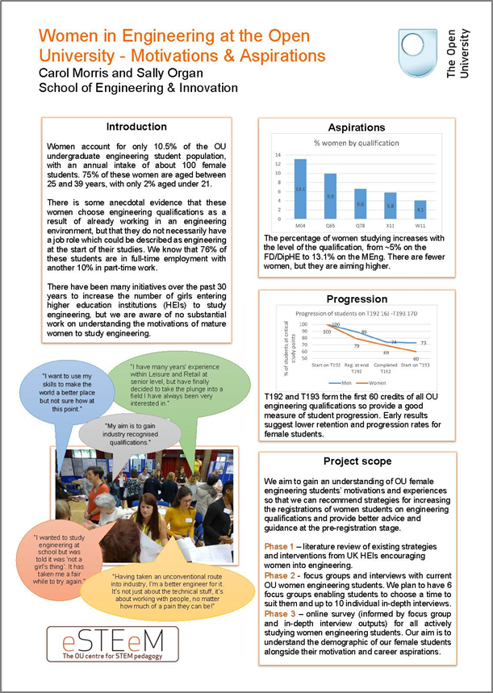
About eSTEeM
The OU centre for STEM pedagogy (Dec 2010)
Scholarship to enhance learning and teaching practice and strategy
Over 220 projects supported since 2011
Over 70 currently in progress
Individuals, groups and cross-disciplinary
project teams
Professional development and support for project team – Applaud (HEA Fellowship)
External influence in HE STEM environment

Slide 5
From ideas to projects
Project idea – discuss with School Scholarship Lead or eSTEeM Directors
Project proposal form completed, endorsed by Scholarship Lead and signed by HOS to approve workload
Proposal submitted by advertised deadline
eSTEeM Coordination Group meeting to evaluate proposals – accept, revise or decline
Project proposers informed of decision
Where necessary, plans revised. Final sign-off by eSTEeM Directors

Slide 6
Progress and completion
Ethics review, SRPP/SSPP approval, Data Protection compliance
Induction workshop
- project begins
Mentoring and ongoing project management and support
Ongoing staff development events
Short reports approx. twice a year
Dissemination - eSTEeM Annual Conference, internal and external events
Final Report, outputs and publications uploaded to eSTEeM website/ Scholarship Exchange/ ORO

Slide 7
21st call for projects
Access, Participation and Success: Projects which investigate issues around registration, tuition, completion and awarding with respect to students from under-represented groups in STEM.
Assessment and feedback: Exploring the challenges, opportunities, and drawbacks of remote exams and online exams, as compared to face-to-face exams.
Employability: The University continues to work closely with employers to ensure that our curriculum provides graduates with suitable employability skills including the importance of accreditation by professional bodies and what effect this has on student motivation and engagement.
Notes:
Mark: 3rd call for AL led projects + Key information

Slide 8
21st call for projects – continued
National context: Scholarship that considers the higher education policy in each of the four nations and addresses issues in STEM teaching and learning within Scottish, English, Welsh or Northern Irish and Irish contexts.
Retention and progression: To meet the OU’s goal of enabling success for our students, we are actively seeking scholarship projects that investigate and implement strategies to enhance student continuation and completion, such as sense of community/belonging.
Or other scholarship projects that fit within the eSTEeM portfolio.

Slide 9
Key information
eSTEeM projects normally run to completion within 18 months with each team member expected to commit a minimum of 10 days
Central and regional staff time must be signed-off by Head of School
AL colleagues time must be approved by lead line manager. ALs must be able to fulfil this role within the maximum working allowance of 1.3FTE (ALs are issued an additional duties contract)
eSTEeM may provide support for conference attendance and expenses to attend eSTEeM community events
Scholarship skills development and project mentoring will be provided by eSTEeM

Slide 10
Key information
Endorsement from your School Scholarship Lead and approval from your HOS (central and regional staff) or Lead Line Manager (Associate Lecturers). Please ensure you have contacted your relevant Scholarship Lead by 12th August at the latest
All eSTEeM funded project teams are required to submit interim short reports and a final project report within two months of completion
We particularly encourage projects that involve students as collaborators/co-investigators on the project (and not just as participants in a study) and draw upon the experience of colleagues in the Student Support Team

Slide 11
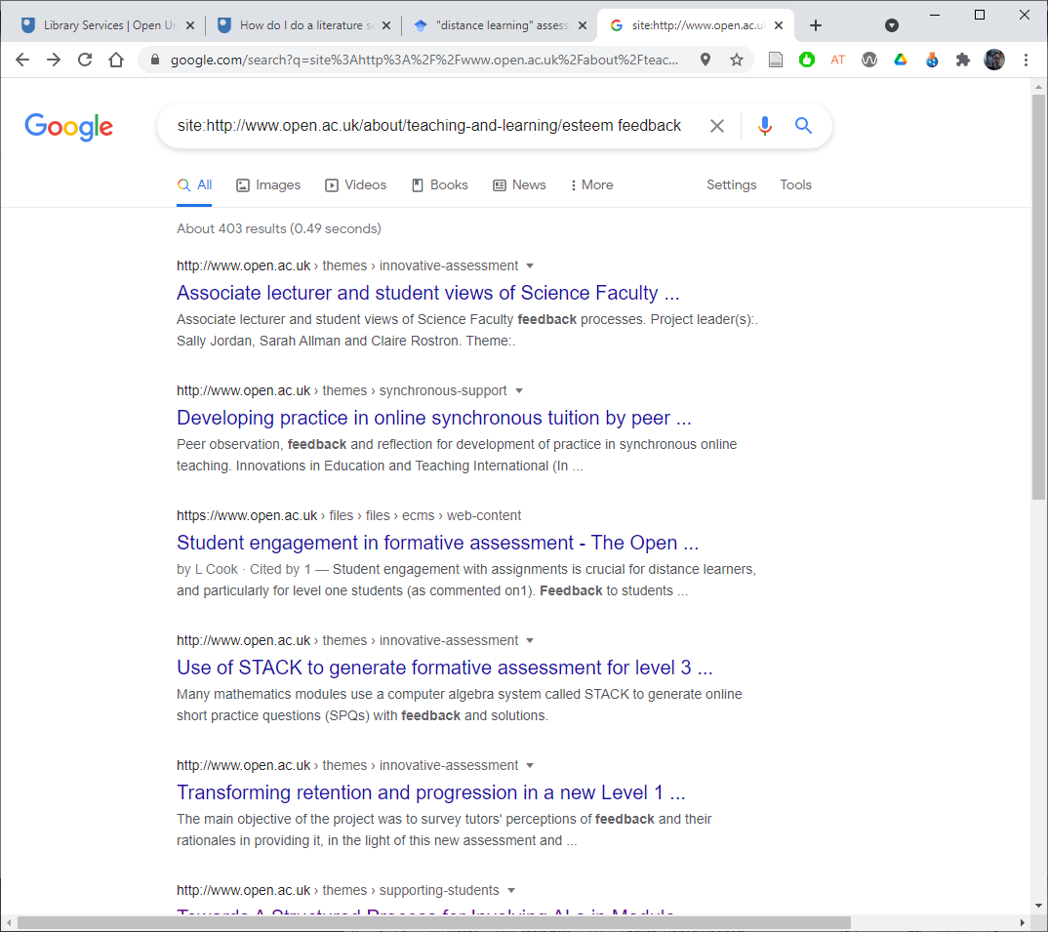
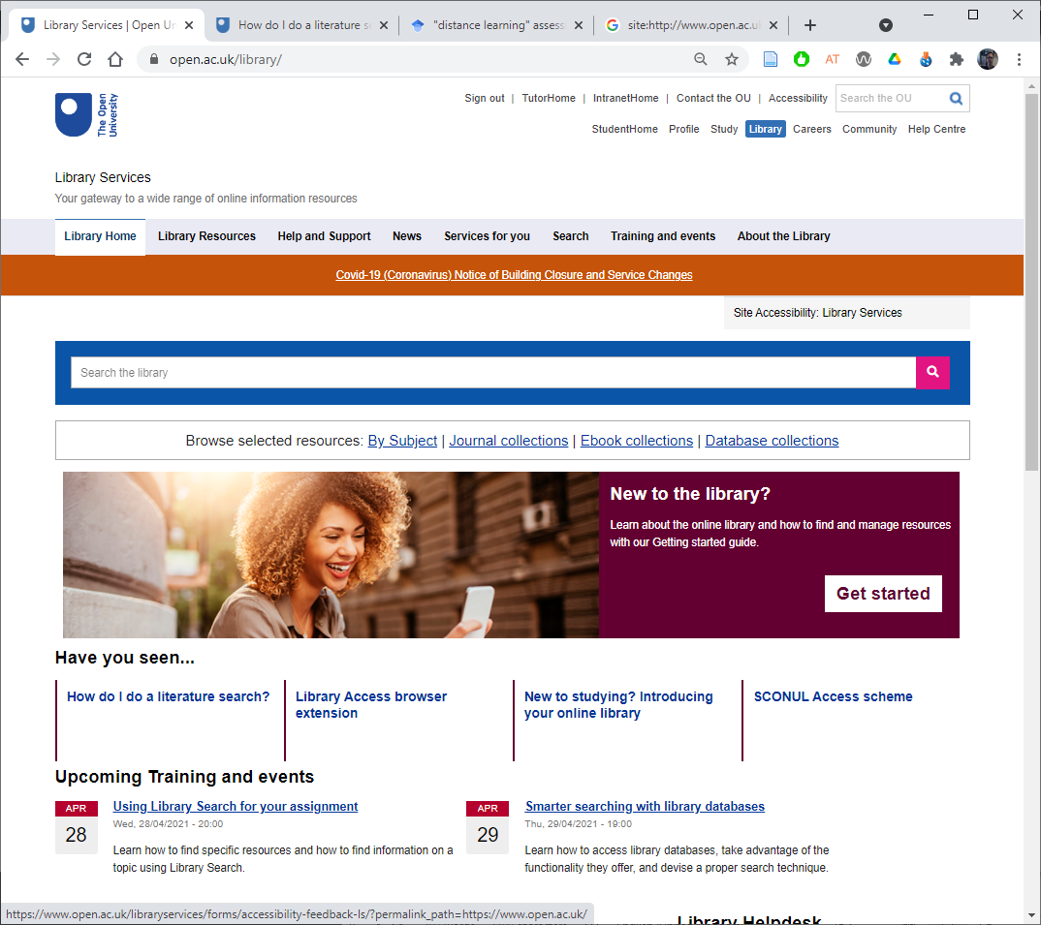
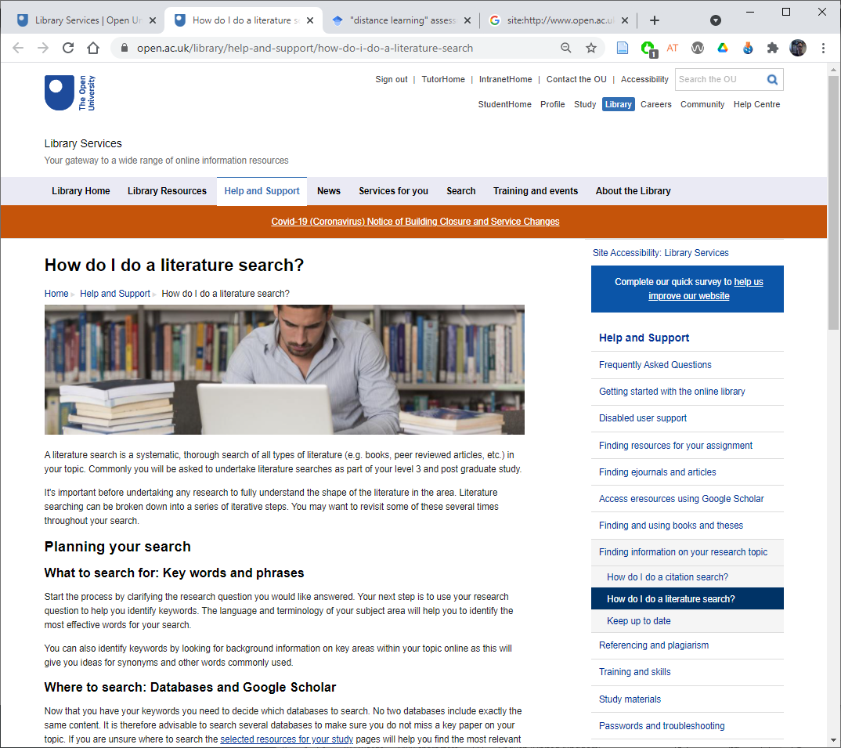
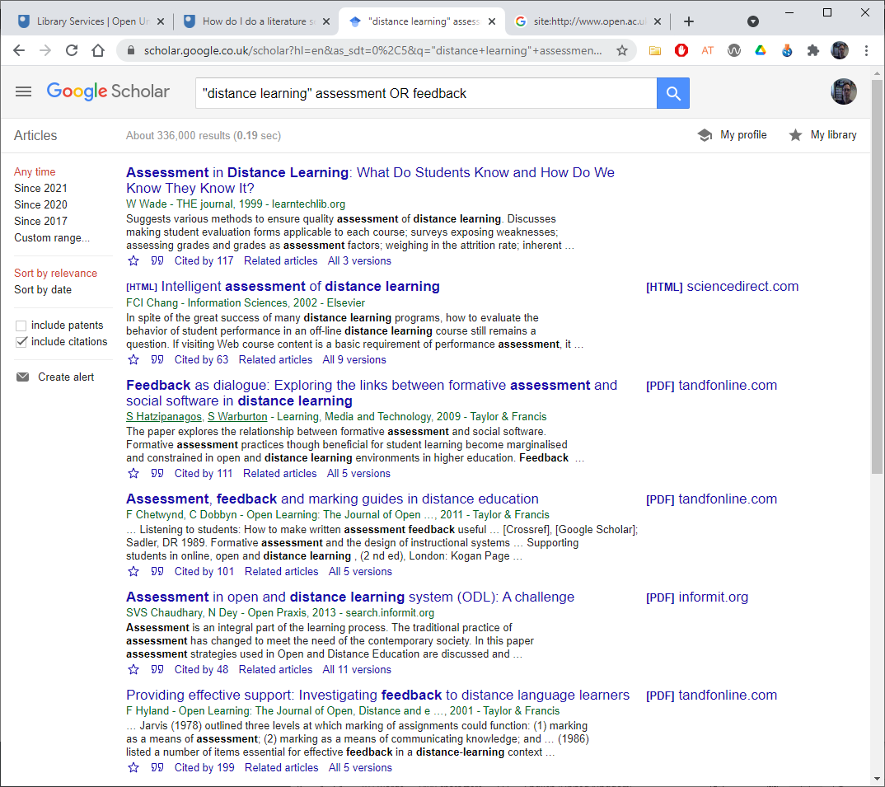
Things to consider in your proposal
Is the project consistent with the aims of eSTEeM?
Which theme(s) does it address?
Have you considered the literature?
Are you aware of related projects?
  Use the ‘site’ filter in google e.g., “site:http://www.open.ac.uk/about/
  teaching-and-learning/esteem keywords”
Explain how your project builds on the prior work?
Notes:
Trevor: Things to consider

Slide 12
Things to consider in your proposal
Would your project benefit from student involvement at any stage (other than as participant in your research)?
Do you have any specific development needs to enable you to undertake this project? How will you address this?
Will the project produce significant deliverables/outputs within a reasonable timeframe and what might these be?
Is there an evaluation and dissemination plan, including dissemination to students?

Slide 13
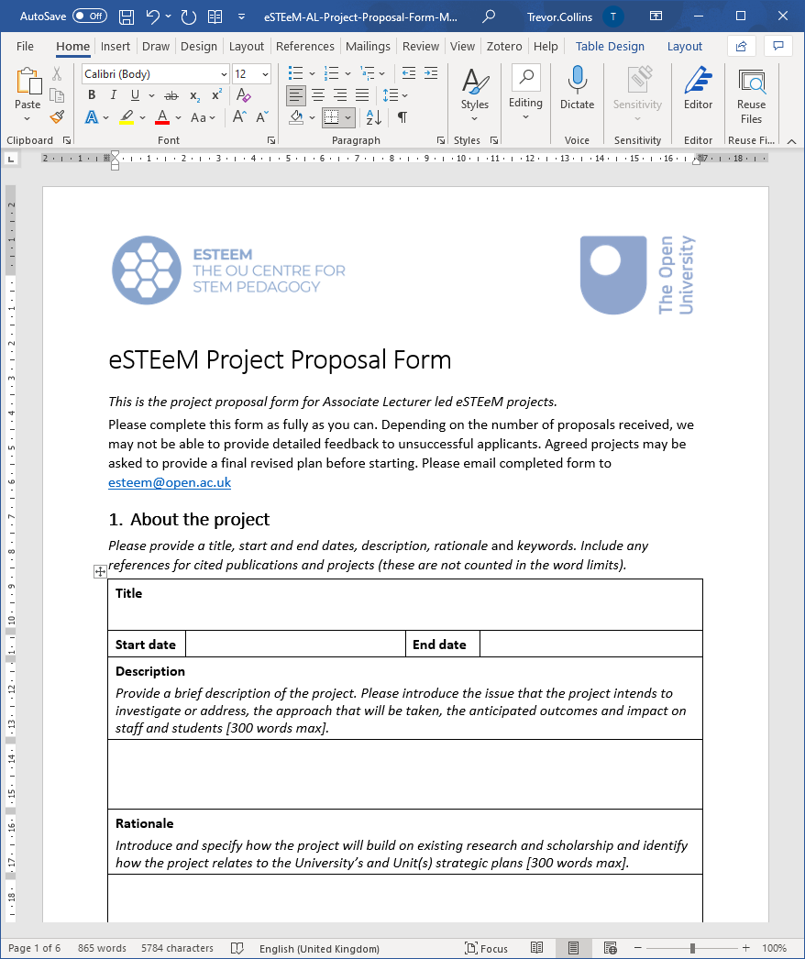
Checking your proposal
Is there a clear and realistic project plan with actions, responsibilities and timescales?
Will the project impact favourably on student experience and/or faculty effectiveness?
Is there a realistic workload allocation for staff?
eSTEeM Project Proposal Form
eSTEeM Project Plan Information

Slide 14
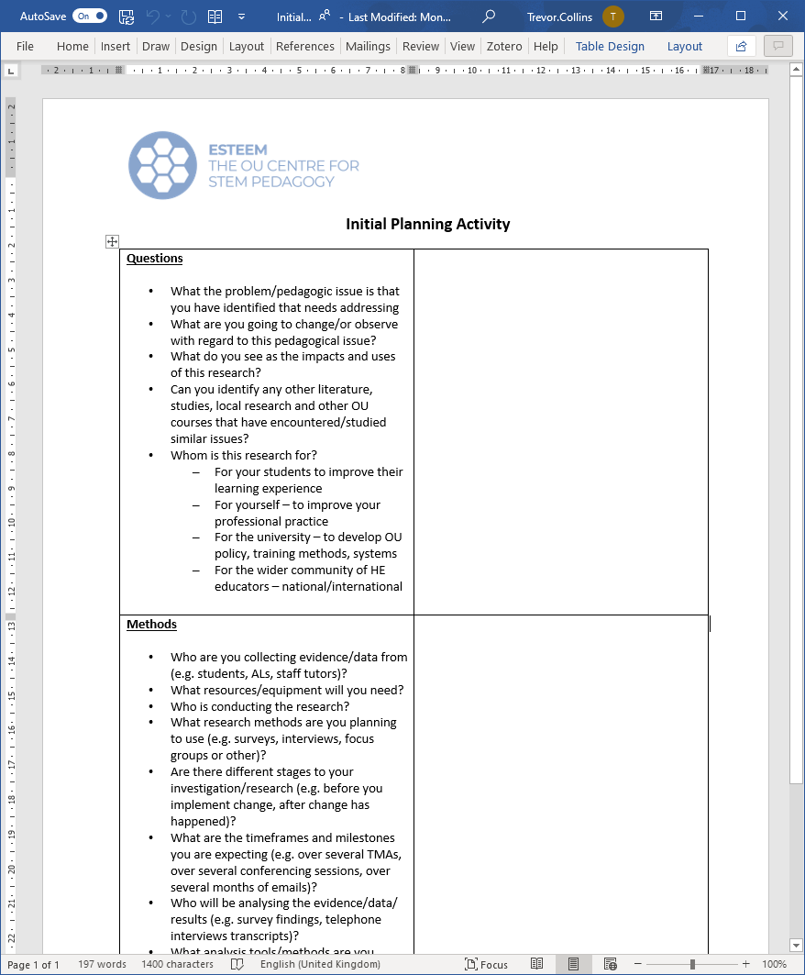
Timeline and planning
Timeline
  Deadline for project proposals
  17.00 Friday, 16th September 2022
  Proposals scrutinised by the eSTEeM Coordination Group in mid-October
  Informed of their decision by end of October
  Attend induction in November
Planning activity
  Complete the Initial Planning Activity
  Sharing our plans/ideas so far
  Questions or further comments
Notes:
Mark: Timeline and planning + Sources of support

Slide 15
Sources of support
eSTEeM Management Team
  Director: Trevor Collins
  Deputy Director: Mark Jones
  Senior Manager: Diane Ford
  Support Assistant: Rachel Redford (returning mid-August 22)
  Project Officer: Jonathan Evans
Further information and contact
  Web: www.open.ac.uk/esteem
  Email: esteem@open.ac.uk
  Twitter: @OU_eSTEeM
School Scholarship Leads
  C&C: Shailey Minocha
  E&I: Daphne Chang
  EEES: Fiona Aiken
  LHCS: Duncan Banks
  M&S: Susan Pawley
  SPS: Jimena Gorfinkiel / Jonny Nylk

Slide 16
eSTEeM Pre-bidding Workshop
Trevor Collins
Tuesday, 26th July 2022
Via MS Teams
Website: www.open.ac.uk/esteem
Email: esteem@open.ac.uk
Call for projects - https://bit.ly/3NRPrv2
Twitter: @OU_eSTEeM

