Slide 1


eSTEeM Induction for STEM Staff Tutors
Mark Jones and Trevor Collins
Wednesday, 6 April 2022
Via MS Teams
While waiting to start, please introduce yourself at
https://padlet.com/esteem/STinduction

Slide 2
Our purpose is to promote and empower practitioner-led, evidence-informed scholarship in open and distance STEM education.

Slide 3
Scholarship of Teaching and Learning
Scholarship of Teaching and Learning (SoTL) is a:
  systematic and ethically reasoned investigation of aspects of teaching and student learning by applying disciplinary knowledge, resulting in reflections and outcomes that are publicly shared for peer-review and for others to build upon.
  (Minocha, 2021)
eSTEeM facilitates such investigations through practitioner-led projects

Slide 4
From scholarly teaching to scholarship
Teaching
Scholarly Teaching
Scholarship of Teaching and Learning
Research
Evidence-informed teaching
Evidence-informed teaching made public and open to critique
Discipline based educational research

Slide 5
Example SoTL project titles
Assessing The ‘Open Field Lab’: Evaluating Interactive Fieldcasts for Enhancing Access to Fieldwork
Decolonising Computing: A Resource for Educators
Early start MU123
SiSE only tutor groups and the effect on SiSE students and their tutors
These are eSTEeM projects led by practitioners

Slide 6
Benefits of SoTL
Students
Staff
Scholarship of Teaching and Learning
Institution

Slide 7
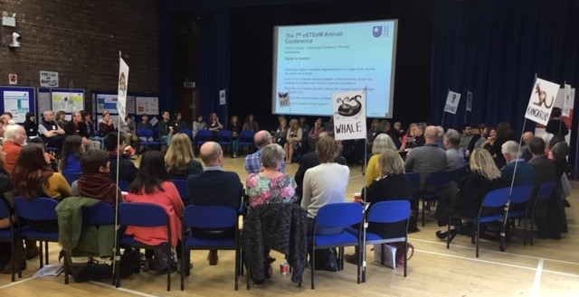
Staff engagement in SoTL
Testing ‘what works’
Develops understanding of complex issues
Benefits from collaboration and partnership working
Basis of an academic community around teaching and learning
Enhances professional identity, professional recognition and forms evidence that can be used for promotion cases

Slide 8
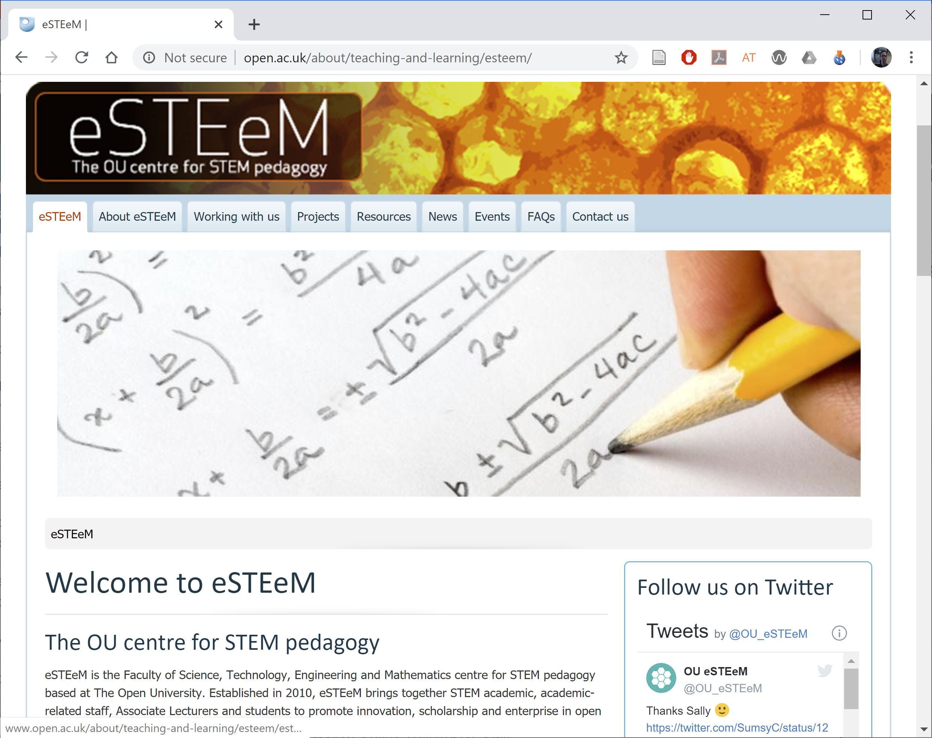
Impact of SoTL on the institution
Informs decisions about approaches in teaching and student support (Module Teams, Boards of Study, Faculty, University).
Supports a culture of responsiveness and innovation that is open to scrutiny. (Quality Enhancement)
Develops staff skills and builds an extended academic community.
Has the potential for external impact on the sector.

Slide 9
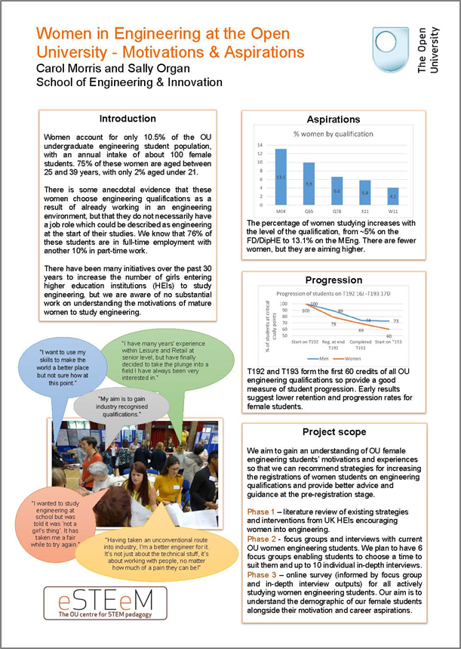
About eSTEeM
The OU centre for STEM pedagogy (Dec 2010)
Scholarship to enhance learning and teaching practice and strategy
Over 200 projects supported since 2011
Over 60 currently in progress
Individuals, groups and cross-disciplinary
project teams
Professional development and support for project team – Applaud (HEA Fellowship)
External influence in HE STEM environment

Slide 10
eSTEeM people
Management Team
  Director: Trevor Collins
  Deputy Director: Mark Jones
  Senior Manager: Diane Ford
  Support Assistant: Nick Hook
  Project Officer: Jonathan Evans
School Scholarship Leads
  C&C: Shailey Minocha
  EEES: Sarah Davies / Fiona Aiken
  E&I: Daphne Chang
  KMi: Trevor Collins
  LHCS: Duncan Banks
  M&S: Sue Pawley / Martina Gibbons
  SPS: Jimena Gorfinkiel

Slide 11
From ideas to projects
Project idea – discuss with School Scholarship Lead or eSTEeM Directors
Project proposal form completed, endorsed by Scholarship Lead and signed by HOS to approve workload
Proposal submitted by advertised deadline
eSTEeM Coordination Group meeting to evaluate proposals – accept, revise or decline
Project proposers informed of decision
Where necessary, plans revised. Final sign-off by eSTEeM Directors

Slide 12
Progress and completion
Ethics review, SRPP/SSPP approval, Data Protection compliance
Induction workshop held - project begins
Mentoring and ongoing project management and support
Ongoing staff development events
Short reports approx twice a year
Dissemination - eSTEeM Annual Conference, internal and external events
Final Report, outputs and publications uploaded to eSTEeM website/ Scholarship Exchange/ ORO

Slide 13
Project framework – key information
eSTEeM puts out project calls twice a year (January and July)
eSTEeM projects normally complete within 18 months.
Each team member expected to commit at least 10 working days
Central and regional staff time must be signed-off by Head of School
AL colleagues time must be approved by lead line manager. ALs must be able to fulfil role within 1.3FTE (ALs are issued an additional duties contract)
eSTEeM may provide support for conference attendance and expenses to attend eSTEeM community events

Slide 14
Project framework – key information
Endorsement from your School Scholarship Lead and approval from your HoS (central and regional staff) or Lead Line Manager (Associate Lecturers).
All eSTEeM funded project teams are required to submit interim short reports and a final project report within two months of completion
We particularly encourage projects that involve students as collaborators/co-investigators on the project (and not just as participants in a study)
Scholarship skills development and project mentoring will be provided by eSTEeM

Slide 15
Involvement in an eSTEeM project
Becca Whitehead, School of Physical Sciences

Slide 16
MY INVOLVEMENT IN eSTEeM
I worked as an AL teaching on a pre-module prep summer project that provided targeted support (in the form of Headstart and Bootcamp) getting the students ready for the module
Project generated a lot of data over a number of years
I was invited to join an eSTEeM project as an AL where the MTC was the PI
On the proposal we included a number of days to cover my time analysing the data, attending project meetings and presenting our findings where useful
We identified very useful themes that have been able to be used in the module to help aid retention and performance

Slide 17
WHAT DID WE DO IN OUR PROJECT
identified a need
provided tools to help
analysed and evaluated the effectiveness of the tools used
provided a framework to guide current and future students to greater success

Slide 18
WHAT I HAVE GAINED FROM IT
Really enjoyable experience
I’ve worked with other teams such as Analytics for Action (A4A) which has broadened my perspective of the OU
I have been able to be part of a team that has looked critically at our teaching practice and pushed to make it better
It has helped enormously with my professional development in guiding me from AL to ST
I have just been part of a bid for another eSTEeM project – this time as a ST
I hope to be PI on an eSTEeM project soon
I’d like to use my eSTEeM experience to help gain HEA accreditation as part of my ongoing staff development

Slide 20
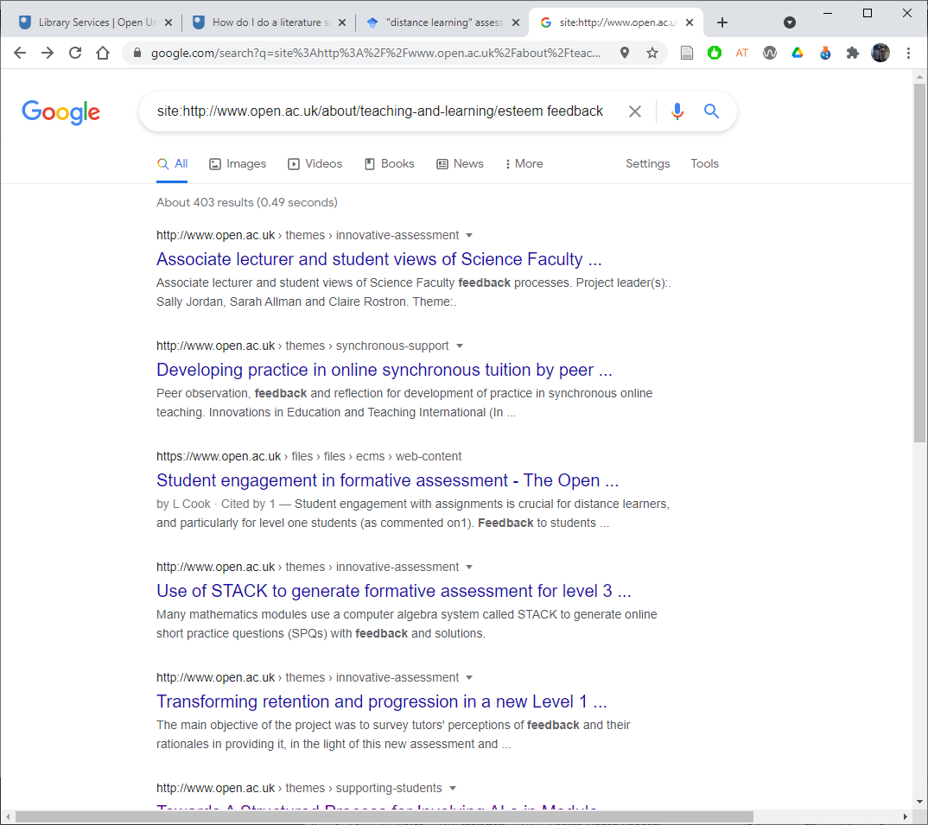
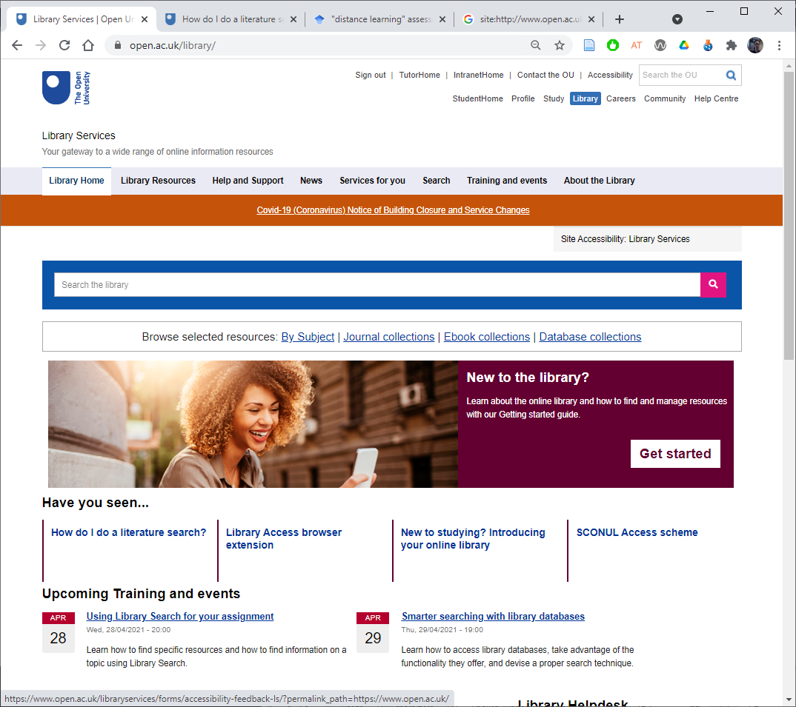
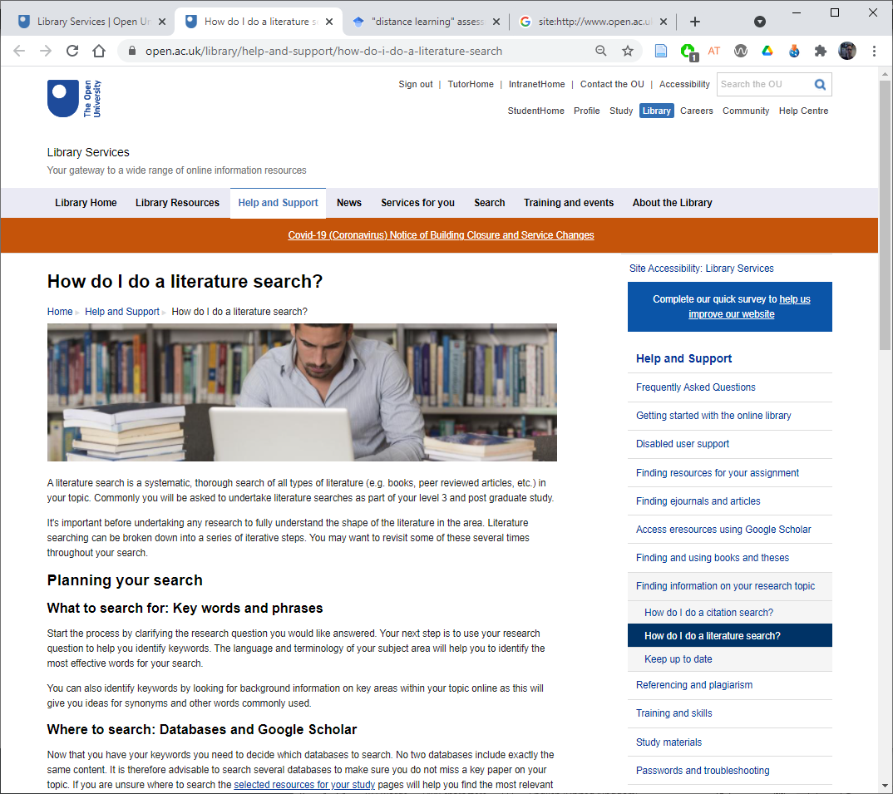
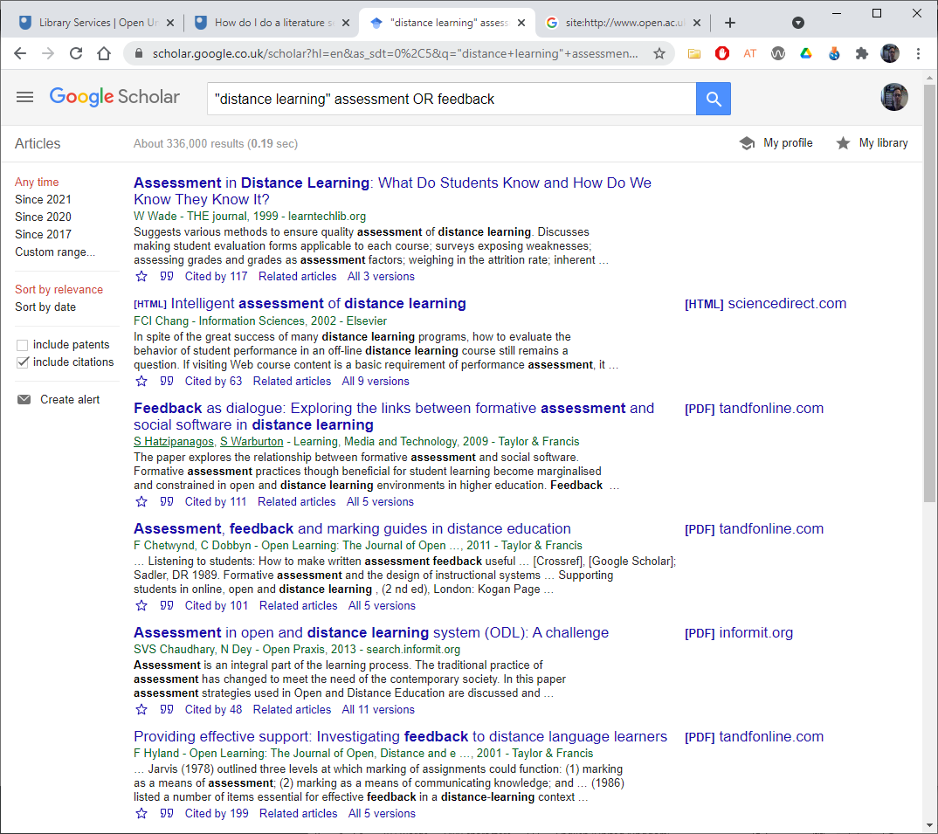
Things to consider in a proposal
Is the project consistent with the aims of eSTEeM?
Which theme(s) does it address?
Have you considered the literature?
Are you aware of related projects?
  Use the ‘site’ filter in google e.g., “site:http://www.open.ac.uk/about/
  teaching-and-learning/esteem keywords”
Explain how your project builds on the prior work?
Notes:
Trevor: Things to consider

Slide 21
Things to consider in a proposal
Would your project benefit from student involvement at any stage (other than as participant in your research)?
Do you have any specific development needs to enable you to undertake this project?
Will the project produce significant deliverables/outputs within a reasonable timeframe and what might these be?
Is there an evaluation and dissemination plan, including dissemination to students?

Slide 22

eSTEeM Community Support
Professional development sessions
BOC: SoTL in STEM
Seminar series – monthly
Nvivo self-help group
Annual eSTEeM conference

Slide 23
Other support for scholarship
SHARE – OU, cross faculty forum for scholarship for Region/Nation academic staff https://learn3.open.ac.uk/course/view.php?id=300463
Schools have their own scholarship plans – keep an eye out for initiatives within your own school.
Pan-university scholarship calls – support for projects that cross faculty boundaries.
The Scholarship Exchange is a repository of OU scholarship reports
Pages - Search the Scholarship Exchange (sharepoint.com)

Slide 24
Summary
Scholarship of Teaching and Learning has multiple benefits.
  For students, SoTL should lead to improvements in their learning experiences.
  For staff, SoTL provides a way to engage with teaching and learning that is open to scrutiny and wider academic debate.
  For the institution, SoTL generates a culture of evidenced quality enhancement.
eSTEeM provides a supported mechanism to enable staff to run SoTL projects.
We hope you’ll be inspired to start on your scholarship journey with us!

Slide 25
eSTEeM people
eSTEeM Management Team
  Director: Trevor Collins
  Deputy Director: Mark Jones
  Senior Manager: Diane Ford
  Support Assistant: Nick Hook
  Project Officer: Jonathan Evans
School Scholarship Leads
  C&C: Shailey Minocha
  E&I: Daphne Chang
  EEES: Sarah Davies/Fiona Aiken
  LHCS: Duncan Banks
  M&S: Susan Pawley/Martina Gibbons
  SPS: Jimena Gorfinkiel
Further information and contact
  Web: www.open.ac.uk/esteem
  Email: esteem@open.ac.uk
  Twitter: @OU_eSTEeM

Slide 26
Thank you!
esteem@open.ac.uk

