Slide 1


Getting Started with Scholarship
Trevor Collins and Mark Jones
Wednesday, 8th December 2021
https://bit.ly/gsws-dec-2021-slides
esteem@open.ac.uk
www.open.ac.uk/esteem
@OU_eSTEeM

Slide 2
Overview
Welcome and introductions (https://padlet.com/esteem/gsws_dec_2021)
Definitions of Scholarship (of Teaching and Learning)
Interrelationships of teaching and research
Stages of Scholarship of Teaching and Learning (SoTL)
Thinking about your own project
Further info – SoTL in STEM BOC, websites and journals
Notes:
Mark – Slides 1 to 7
Trevor – Slides 8 to 15
Mark – Slides 16 to 20
Trevor – Slides 21 to 25

Slide 3
Activity 1: Defining Scholarship
How would you define scholarship?
Are there any other terms you would associate with scholarship?

Slide 4
Definitions of Scholarship
Scholarship (of Teaching and Learning)
  is focused on improving and supporting learning through teaching practices
  includes reflection on our teaching and the learning of our students, … and the implementation of improvements
  requires knowledge of the discipline-specific area that is being taught, and about learning and teaching
  involves dissemination of teaching practices for public/peer scrutiny
Scholarship at the OU
  Scholarship is a term used to cover activities that lead to evidence-informed development of our learning and teaching
Other terms associated with scholarship
  Action Research
  Educational Inquiry
  Pedagogic Research

Slide 5
Interrelationships of teaching and research
Teaching
Scholarly Teaching
Scholarship of Teaching and Learning
Research
Evidence-informed teaching
Evidence-informed teaching made public and open to critique

Slide 6
Activity 2: What is SoTL for?
What is your impetus for being interested in SoTL?
What does SoTL offer?

Slide 7
What is SoTL for?
What SoTL can do
  Offers space to understand issues around teaching and learning
  Provide evidence to identify and address issues in module design and delivery
  Provide a basis for determining whether an intervention or change in practice is successful
What SoTL can’t do
  Provide a silver bullet to overcome issues of retention and attainment
  Provide absolute evidence of cause and effect
Notes:
Mark to finish this slide and handover

Slide 8

Stages of Research
Starting from what you know…
  Thinking about your own discipline areas, what are the stages of research?
  How might they compare to the stages for pedagogic research?
Notes:
Trevor

Slide 9
Stages in SoTL
7 Steps to Pedagogic Research (PedRIO)
Six unfolding stages (Glassick et al., 1997)
Identify a research question
Consider theoretical underpinnings
Formulate a research methodology
Obtain ethical approval
Analyse data appropriately
Disseminate your findings
Collaborate
Clear goals
Adequate preparation
Appropriate methods
Significant results
Effective presentation
Reflective critique
Charles Glassick, Mary Taylor and Gene Maeroff (1997) Scholarship Assessed: Evaluation of the Professoriate. San Francisco: Jossey-Bass.

Slide 10
Activity 3: Goals and preparation
Think about a potential project you are interested in…
What are the goals of your project?
What initiated your interest in this project?
What is already known about the topic
  From existing evidence
  From shared practice
  From the research literature
What would be your question(s) at this stage of the research?

Slide 11
Other factors to consider
What are the intended outcomes of the project?
  To inform module development
  For dissemination amongst colleagues
  For external publication
How many people will be involved?
How much time do you have?

Slide 12
Identifying the issues
When you have a research question and clear goals…
  What data already exists?
  What do you still need to know?
  What methods might be appropriate?

Slide 13
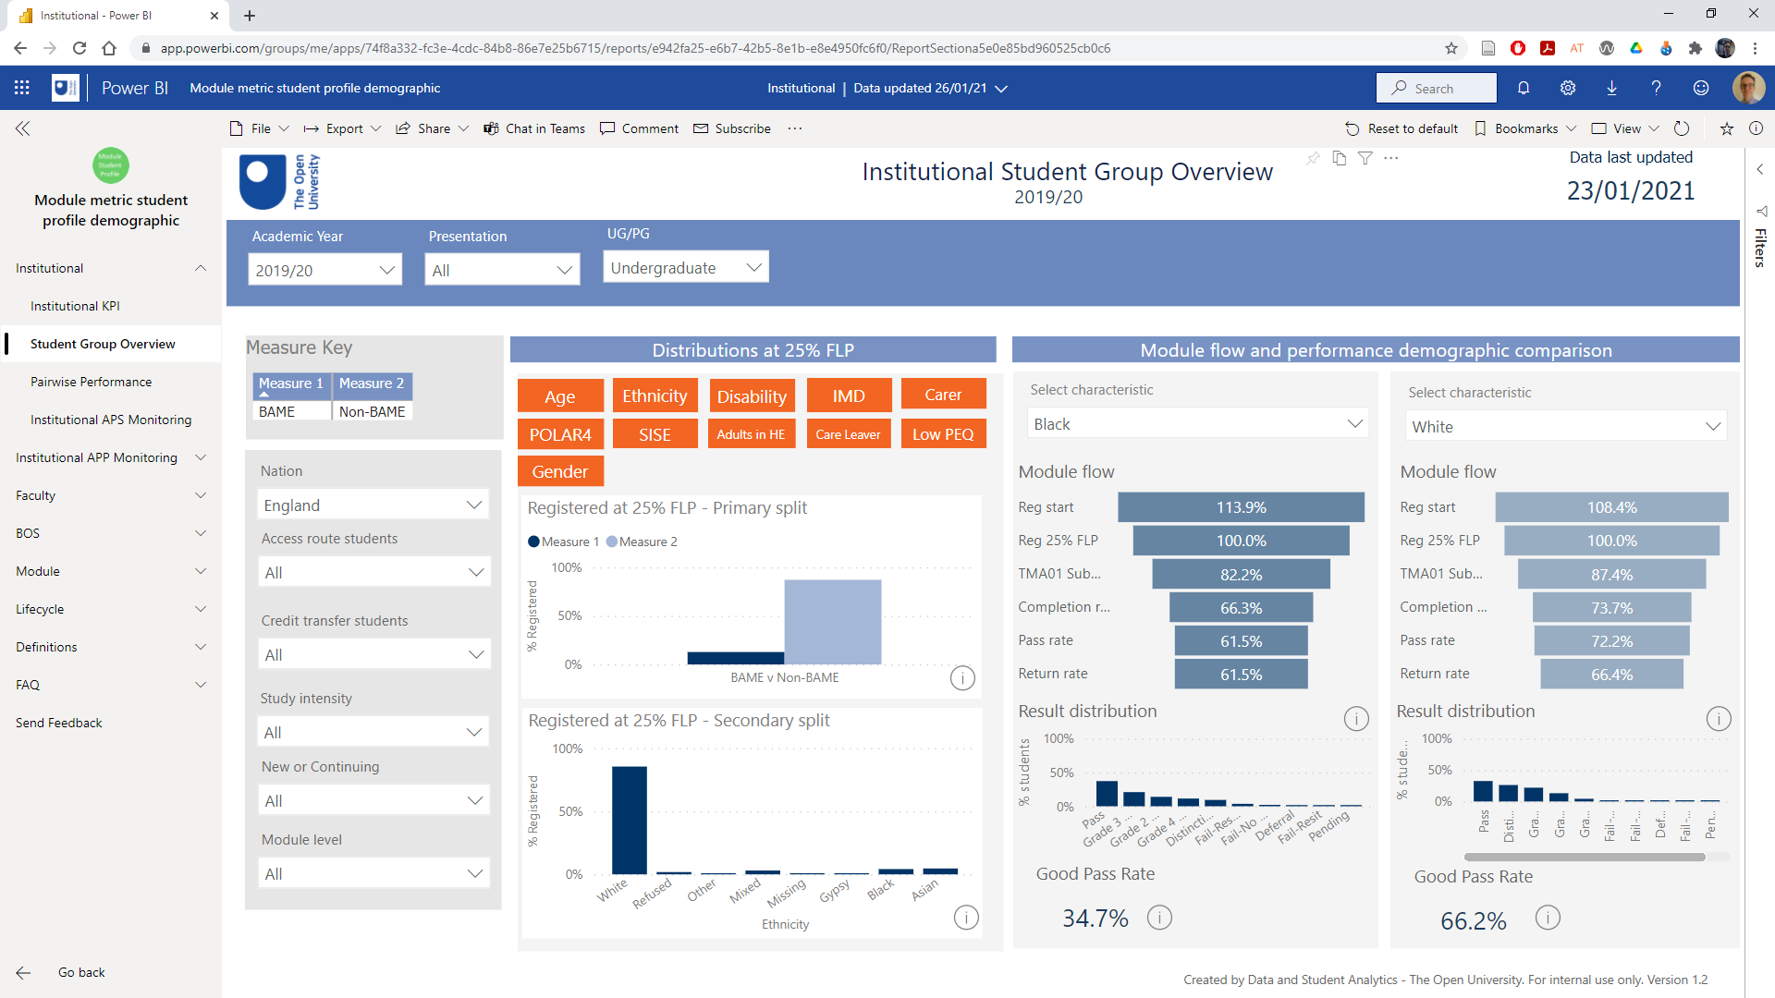
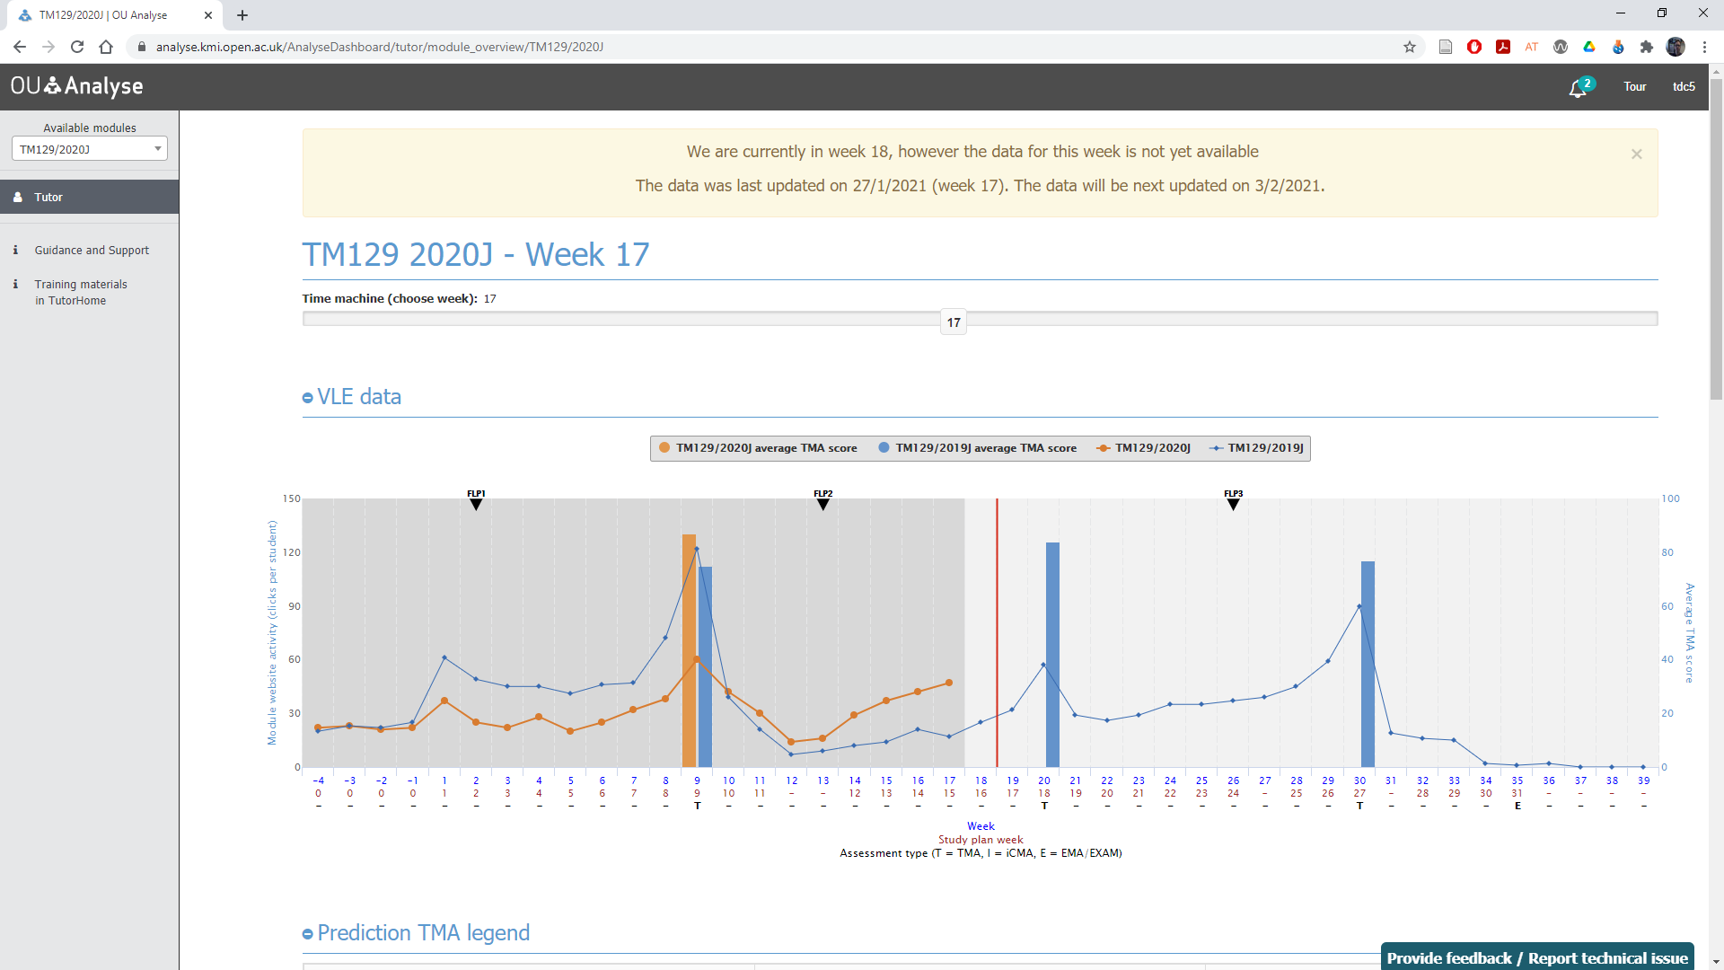
Finding Institutional Data
OU student data
  https://openuniv.sharepoint.com/sites/mi/data-and-student-analytics
Learning Analytics
  Analytics 4 Action
    A4A Home
  OU Analyse
    OU Analyse website
    OU Analyse Dashboard

Slide 14
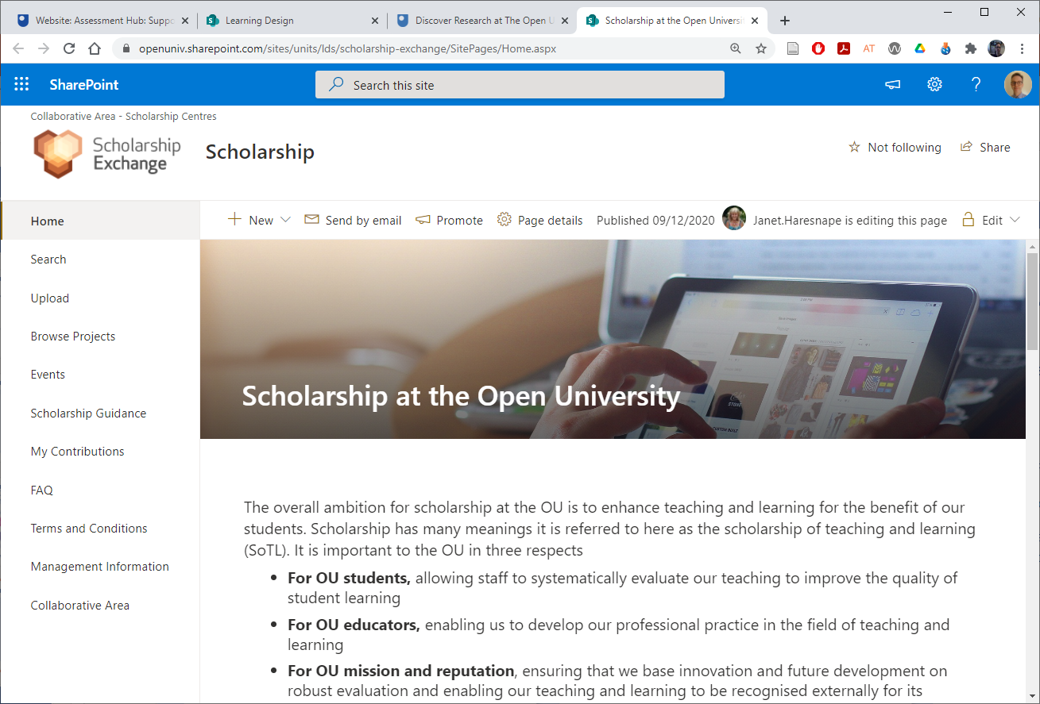
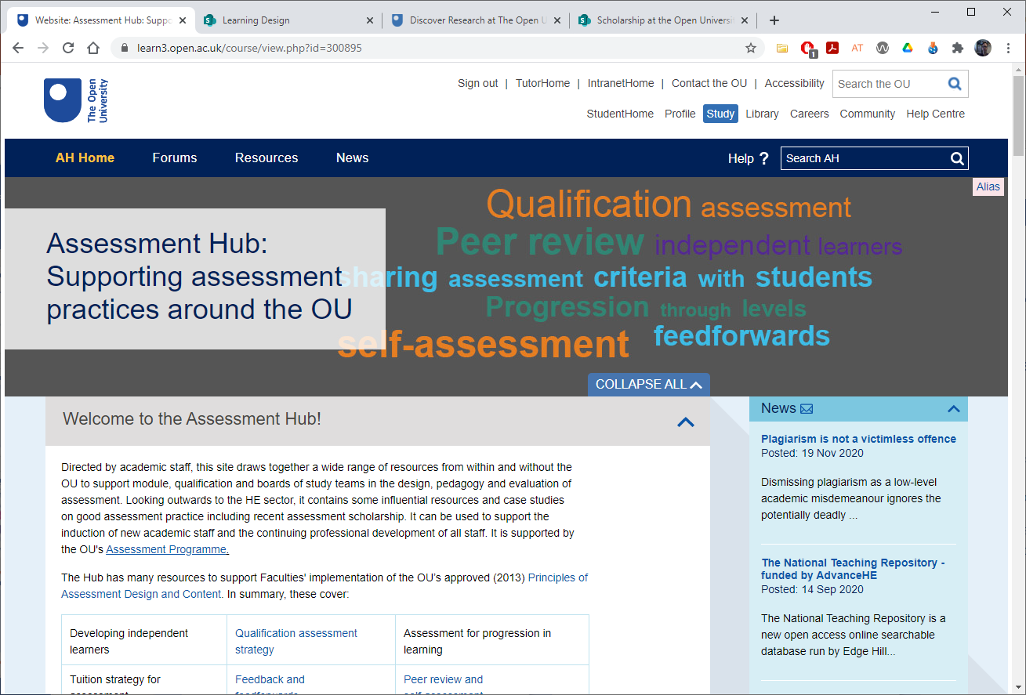
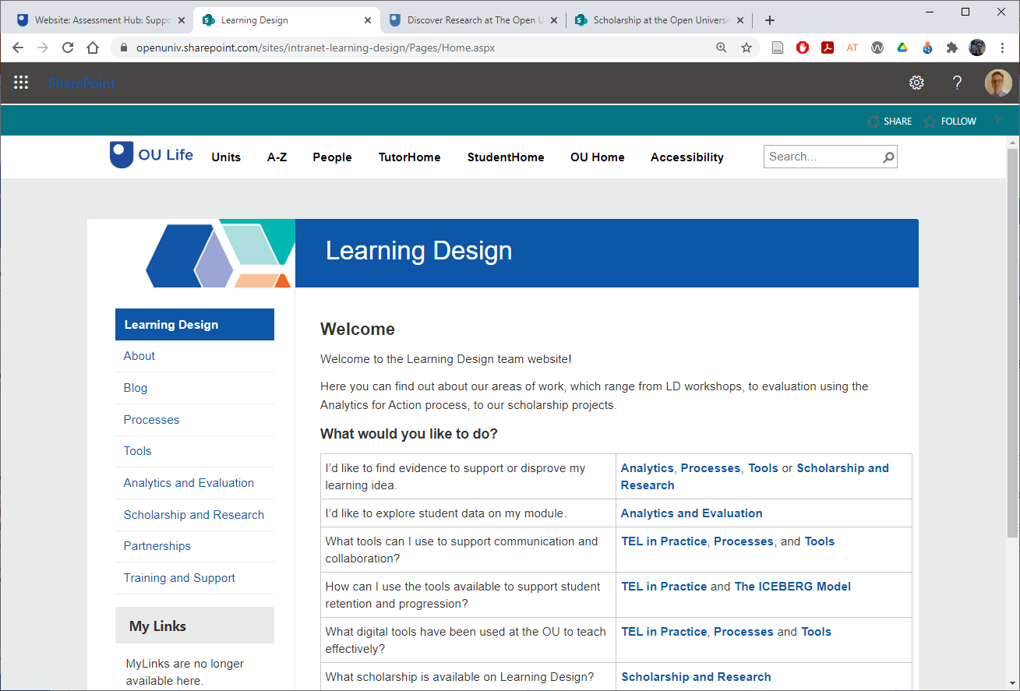
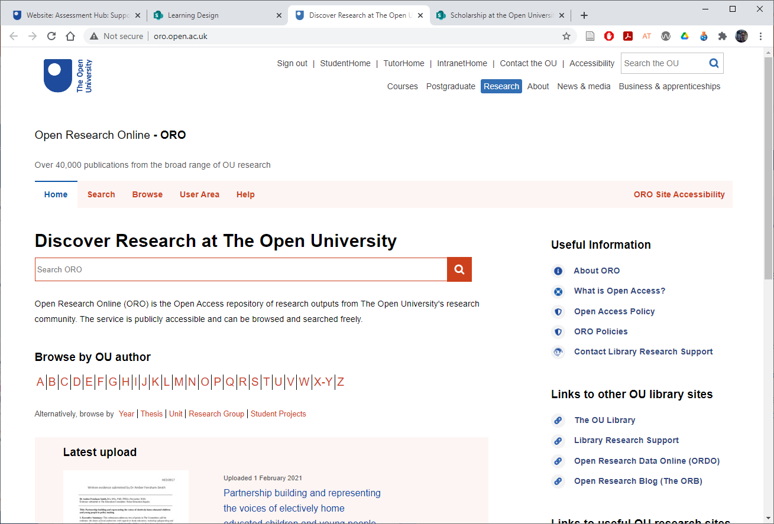
Finding OU Knowledge
OU Intranet – A to Z…
  Assessment Hub
  Learning Design
  Open Research Online
  Scholarship Exchange

Slide 15
HE Research, Policy and Practice
HE funding councils/regulators
  https://officeforstudents.org.uk
  https://www.sfc.ac.uk
  https://www.hefcw.ac.uk
  https://www.economy-ni.gov.uk/
  topics/higher-education
Quality Assurance Agency for Higher Education (QAA)
  http://www.qaa.ac.uk
Higher Education Statistics Agency
  https://www.hesa.ac.uk
Advance HE
  https://www.advance-he.ac.uk
Jisc
  https://www.jisc.ac.uk
Notes:
Trevor to finish this slide and handover

Slide 16
Choosing appropriate methods
What the methods can be used for and when…
  Questionnaires: Useful for getting snapshots in time, getting quantifiable data, identifying the situation before and after a change. Not so good for identifying feelings and attitudes.
  Observations (face to face and online): Useful for understanding what students actually do (rather than what they say they do in activities).
  Interviews/focus groups: Useful for gathering in-depth data, including feelings and attitudes. Can be used at any point in the research cycle. Generates a lot of data to analyse.
Notes:
Mark

Slide 17
Choosing appropriate methods
What the methods can be used for and when…
  Documentary evidence: Useful for identifying the current state of play and whether any changes have occurred after making changes (e.g., teaching and assessment materials, student assignments, policy documents).
  Learning analytics: Provides data on student activity, can be used at any time in research cycle.
  Research diaries by students: Useful for gathering data over time and gives some control to the student.
  Research diaries by researcher: Useful for gathering data over time and provides a basis for analytical notes.

Slide 18
Practical considerations and approvals
Ethics
  The OU’s Human Research Ethics Committee website has an ethics checklist and guidance (see HREC website)
Access to Students
  The Student Research Project Panel oversees the involvement of students in research (e.g. max 4 times per year) see SRPP website for application form and guidance
Data Protection
  Freedom of Information and GDPR compliance – Information Governance Liaison Officers (IGLOs) record OU datasets in the Information Asset Register (IAR)
Staff Survey Project Panel
  Approval required for surveys with more than 30 staff (see SSPP website for guidelines and application form)

Slide 19
Activity 4: Knowledge and skills gaps
For your chosen area of interest
  What data already exists?
  What do you still need to know?
  What methods might be appropriate?
Needs analysis
  What knowledge and skills do you already have in relation to
    Planning your scholarship project
    Identifying and reviewing the literature
    Selecting appropriate methods
  What skills do you need to acquire or develop?

Slide 20
Dissemination (and reflective critique)
OU events
  School or faculty seminars
  e-Learning and OpenTEL events
  eSTEeM conference talks and workshops
External events
  Horizons in STEM Conference (June)
  Advance HE Conference (July)
Publications
Notes:
Mark to finish this slide and handover

Slide 21


Further information – SoTL in STEM BOC
www.open.ac.uk/scholarship-of-teaching-and-learning-in-STEM
Notes:
Trevor

Slide 22
External websites on SoTL
Getting Started in Pedagogic Research within the STEM Disciplines
  https://www.heacademy.ac.uk/system/
  files/pedagogic_research_guide_final_
  version_0.pdf
University of Edinburgh SoTL
  https://www.ed.ac.uk/institute-academic-development/learning-teaching/staff/sotl
Heriot Watt University Learning and Teaching Academy SoTL guides
  https://lta.hw.ac.uk/resources/scholarship-of-teaching-and-learning/
Plymouth University Pedagogic Research
  https://www.plymouth.ac.uk/research/
  pedagogic-research
University of York SoTL Network
  https://www.york.ac.uk/staff/teaching/
  develop/sotl-network
University of Central Florida SoTL and Discipline Based Educational Research
  https://fctl.ucf.edu/sotl-and-dber/
Vanderbilt University Guide to SoTL
  https://my.vanderbilt.edu/sotl/

Slide 23
Example Teaching and Learning Journals
Assessment and Evaluation in Higher Education
Distance Education
Higher Education Quarterly
Innovations in Education and Teaching International
International Journal for the Scholarship of Teaching and Learning
International Journal of Teaching and Learning in Higher Education
Journal of Further and Higher Education
Open Learning: The Journal of Open, Distance and e-Learning
Practice and Evidence of Scholarship of Teaching and Learning in Higher Education
Studies in Higher Education
Teaching in Higher Education
Also… Subject teaching and learning journals

Slide 24
Overview
Welcome and introductions (https://padlet.com/esteem/gsws_dec_2021)
Definitions of Scholarship (of Teaching and Learning)
Interrelationships of teaching and research
Stages of Scholarship of Teaching and Learning (SoTL)
Thinking about your own project
Further info – SoTL in STEM BOC, websites and journals
Notes:
Mark – Slides 1 to 7
Trevor – Slides 8 to 15
Mark – Slides 16 to 20
Trevor – Slides 21 to 25

Slide 25
Getting Started with Scholarship
Trevor Collins and Mark Jones
Wednesday, 8th December 2021
https://bit.ly/gsws-dec-2021-slides
esteem@open.ac.uk
www.open.ac.uk/esteem
@OU_eSTEeM

