Slide 1





Scholarship Conference 2021
Showcasing our research into teaching and learning at the OU
Trevor Collins, Carolin Decker-Lange, Mark Jones, Claire Saunders and Steffanie Sinclair
The Open University Scholarship and Innovation Centres
Wednesday, 17th November 2021
Notes:
Wednesday 19:00-20:30
Scholarship Conference 2021: Showcasing our research into teaching and learning at the OU
The Open University Scholarship and Innovation Centres
In this student-focused conference we’ll introduce the OU’s Scholarship Plan and showcase examples of the educational research from the four faculties. We’ll discuss the impact of our scholarship, the challenges and priorities for scholarship, and the opportunities and support available for students to get involved either as participants or researchers.

Slide 2
Outline
Part One (eSTEeM and FASSTEST)
  Mark Jones introducing Vicky Murphy’s talk about ‘Supporting students during lockdown’
  Steffi Sinclair introducing Ed Hogan’s talk about ‘The Next Chapter: understanding the career aspirations of Creative Writing students ’
  Questions and comments
Part Two (PRAXIS and SCiLAB)
  Claire Saunders introducing Jane Dorrian’s talk about ‘What is a tutorial? An exploration of ‘learning event literacy’ on student experience’
  Carolin Decker-Lange introducing Terry O’Sullivan’s talk about ‘B206 Badging employability’
  Questions and comments
Scholarship challenges and priorities discussion
Notes:
Welcome and overview (5 minutes)
2 x 10-minute project presentations (e.g. eSTEeM and FASSTEST and - 20 minutes)
Questions and discussion (10 minutes)
2 x 10-minute project presentations (e.g. PRAXIS and SCiLAB - 20 minutes)
Questions and discussion (10 minutes)
Scholarship challenges and priorities discussion (20 minutes)
Wrap-up and opportunities to participate (5 minutes)

Slide 3




The four Centres for Scholarship and Innovation at the Open University
OU Scholarship Steering Group

Slide 4

Scholarship of Teaching and Learning (SoTL) at the Open University:
Providing an evidence base for good practice in
teaching and learning
Supporting research projects at the OU that aim to find out how we can
Improve and enhance students’ learning experiences
Promote equality, diversity and inclusion
Enable more students to achieve their study goals
Enhance students’ employability and career progression

Slide 5
Scholarship of Teaching and Learning (SoTL) :
Enhancing teaching and learning by
making student voices heard
Three main ways in which students are getting involved:
as advisors helping to set priorities for scholarship activities and projects
as participants in scholarship projects (by taking part in surveys, interviews or focus groups) and in workshops, events, and conferences
as co-researchers taking an active role in helping staff to create and deliver projects

Slide 6
Scholarship of Teaching and Learning (SoTL) at the Open University
within and across subject disciplines
OU Scholarship Steering Group

Slide 7
eSTEeM

Slide 8
Student Support Networks During Lockdown
17th November 2021
Vicky Murphy

Slide 9
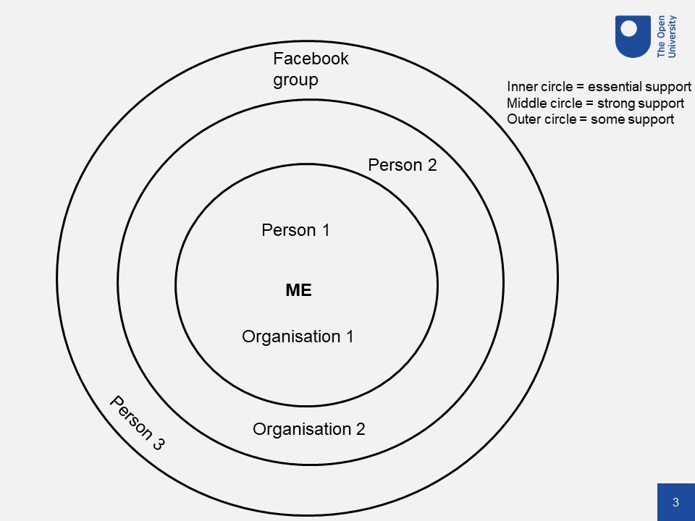
What we did
STEP 1: Network maps (16 students)
Asked about academic support
Asked about emotional support
STEP 2: Interviews (16 students)
STEP 3: 2 Focus groups (8 STEM Als, 6 OUSA)

Slide 10
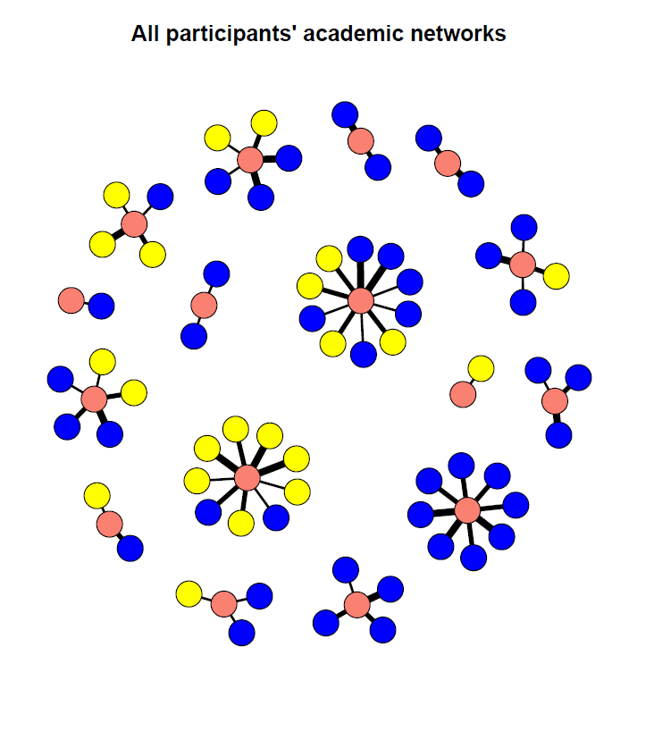
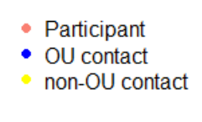
The network results

Slide 11
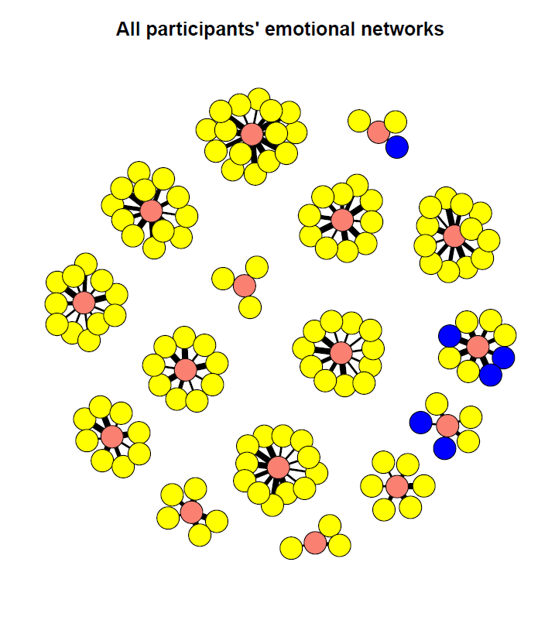
The network results

Slide 12
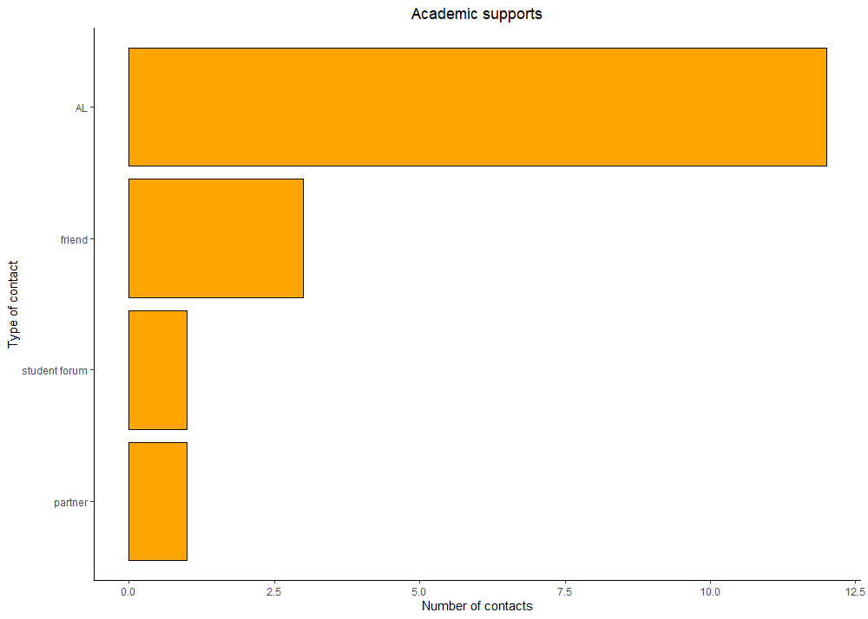
The network results: Strongest support

Slide 13
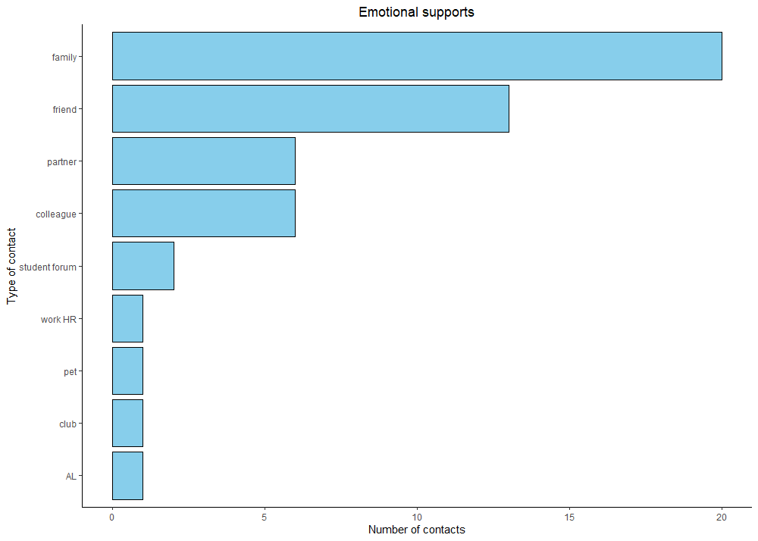
The network results: Strongest support

Slide 14
Qualitative Themes
Every Situation Is Different
“When coronavirus hit in March basically it all went quiet. I got an email saying you are not going to do your final examination part. The phones went down so you couldn’t contact the phone and of course, I haven't got the web support either. And also, when I sent an email, they said the offices aren’t open at the moment… I did send my TMA through the post but the first issue I really had was whether they ever got hold of it because they weren’t ?responding to? posts. So, I had an issue there never had any contact with my tutor whatsoever.”
Student in Secure Environment

Slide 15
Qualitative Themes
Emotional support
“I had totted up and worked out that I had about 8 times the email contact with students that I normally have, which sort of drove me underground really. Which is, it's the unpredictability of it, it made trying to plan and organize myself almost totally impossible. So, every day that I faced, I just wasn't sure what was going to happen next as to how much I'd have to do or which module I'd have to be catering for. And I think that brought with it some stresses that I hadn't even thought about”
AL

Slide 16
Qualitative Themes
Internal Communication
“It went to the students first before it went to ALs. So, we were on the back foot and made to look quite silly because we didn't know. The students were quoting things to us where it should have been the ALs first and then to the students.”
AL

Slide 17

FASSTEST

Slide 18

FASSTEST
Stefanie Sinclair
(Director of FASSTEST)
Stefanie.Sinclair@open.ac.uk
FASS-Scholarship@open.ac.uk

Slide 19

What is FASSTEST?
The Centre for Scholarship and Innovation in the Open University’s Faculty of Arts and Social Sciences (FASS)
FASSTEST stands for ‘FASS Teaching Excellence and Scholarship of Teaching’
Launched in October 2018
Aims to enhance teaching and learning in the Arts and Social Sciences
Supports educational research projects conducted by staff that are involved in module design and teaching

Slide 20
What sort of projects do we do?
Student surveys: e.g. ‘The Next Chapter: understanding the career aspirations of students on the MA in Creative Writing’
Focus groups and interviews with students: e.g. ‘Flexible Study Intensity in Arts and Humanities: Classical Studies and History’
Data analysis: e.g. ‘Academic Conduct Matters: assessing the impact of interventions on student retention and progression’

Slide 21
FASSTEST
FASSTEST Blog: www.open.ac.uk/blogs/FASS-Scholarship
Twitter: @OU_FASSTEST
Email: FASS-Scholarship@open.ac.uk
Look out for emails inviting you to be part of a FASSTEST project!

Slide 22


The Next Chapter
Understanding the career aspirations of Creative Writing students

Slide 23
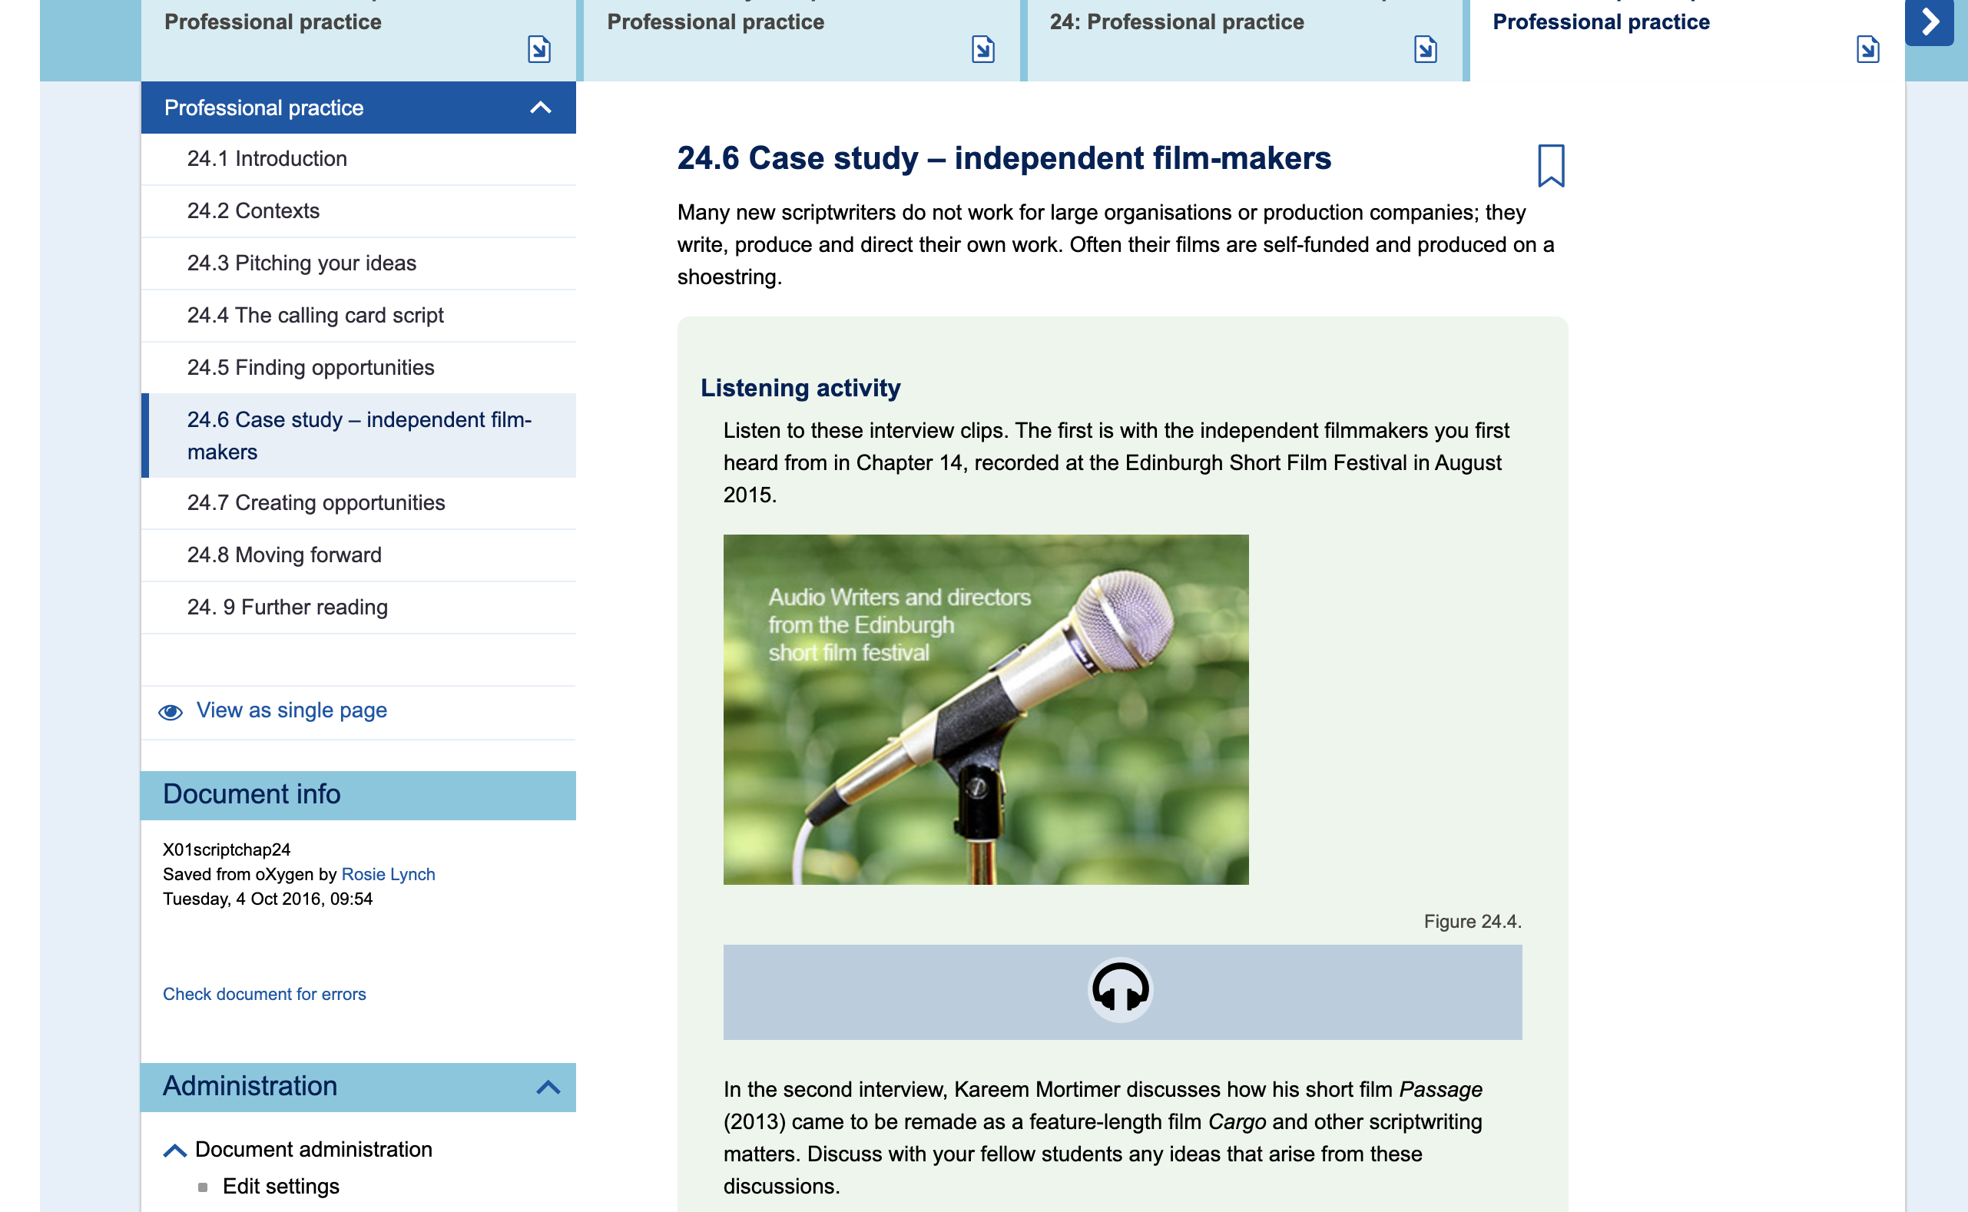

Slide 24

Why?

Slide 25

Background
Publication and performance
This Photo by Unknown Author is licensed under CC BY-SA
This Photo by Unknown Author is licensed under CC BY-SA

Slide 26
Our questions
Why do students take an MA in Creative Writing at the OU?
To what extent is publication a motivating factor?
What other factors motivate our students?
How does our teaching and assessment of this subject match up with what our students want to learn?
How much do our students engage with careers and employability at the OU?

Slide 27
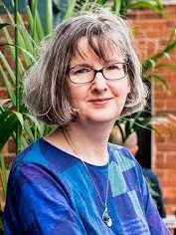
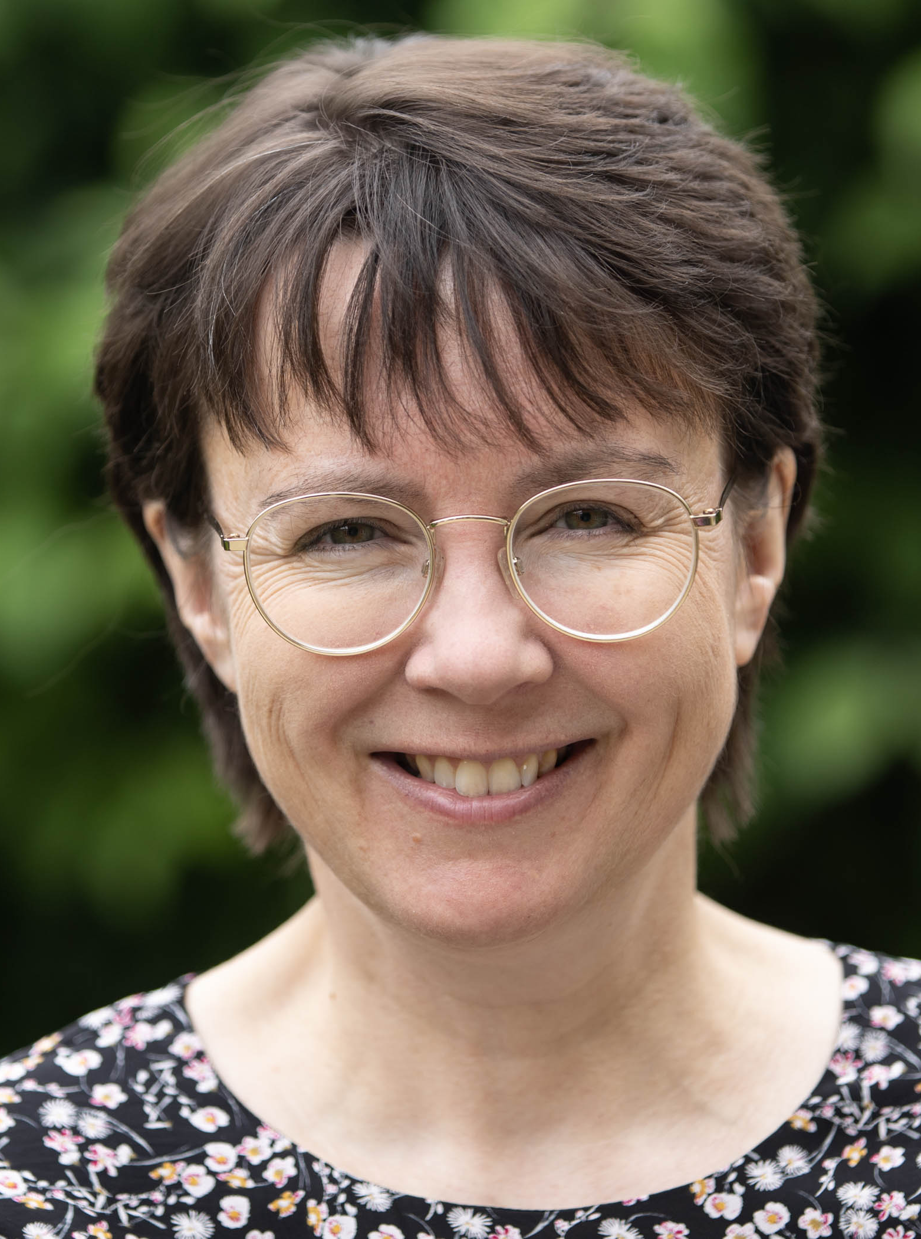

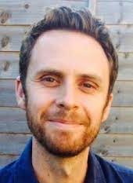

Heather Richardson – Senior Lecturer and Staff Tutor
Lindsey Smith – Curriculum Manager
Claire Blanchard – Careers and Employability Consultant
Ed Hogan – Lecturer
The Team

Slide 28
Survey areas
Initial motivations and ambitions at the beginning of the course, and how these changed.
How useful (or otherwise!) students found the current provision.
Student awareness of, and engagement with, careers services.
Transferable skills developed during the qualification.
Future plans following the MA.

Slide 29
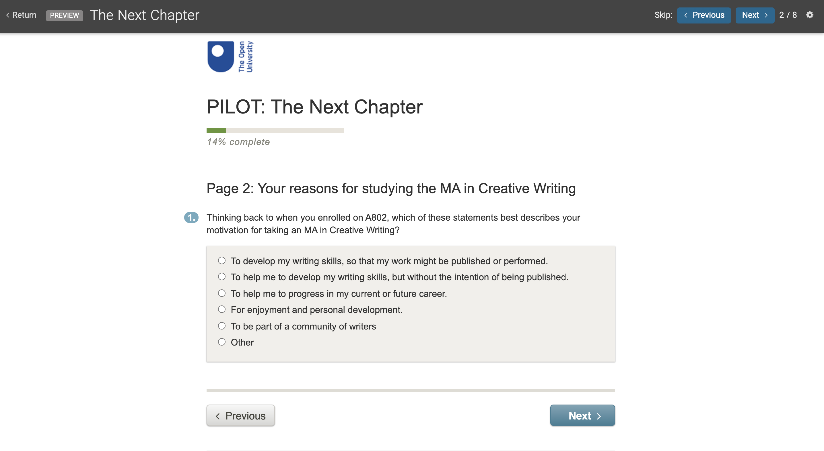

Slide 30
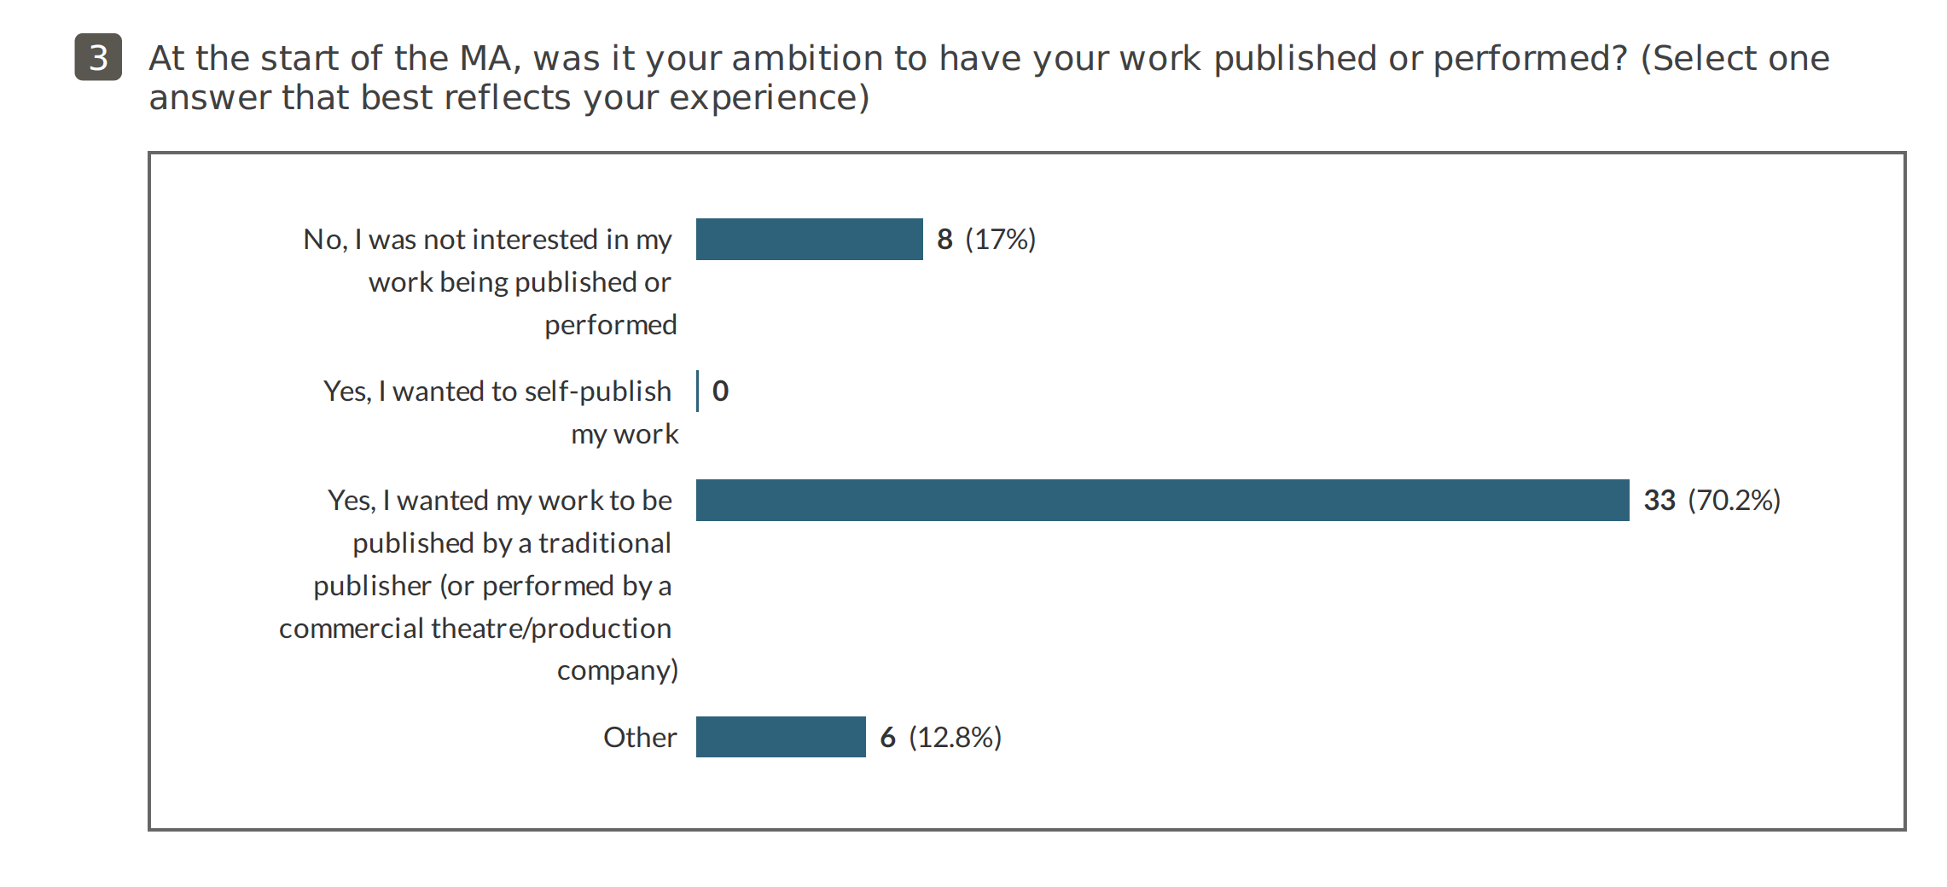
Results (so far…)

Slide 31
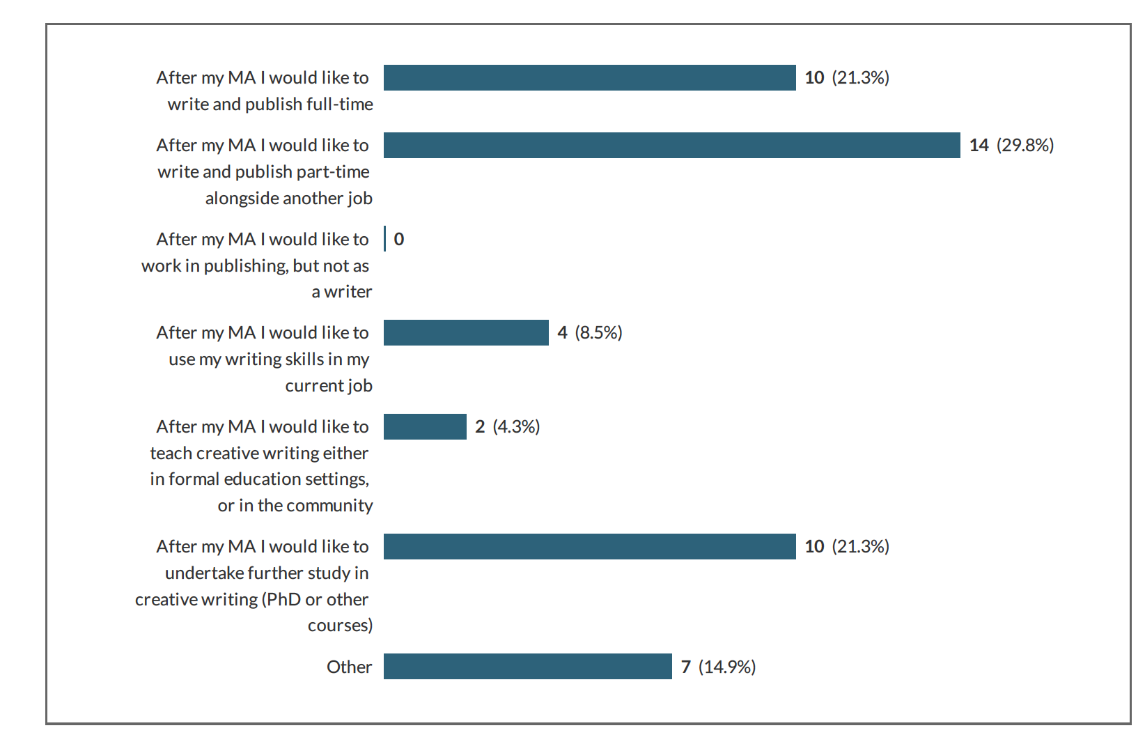
Results (so far…)

Slide 32
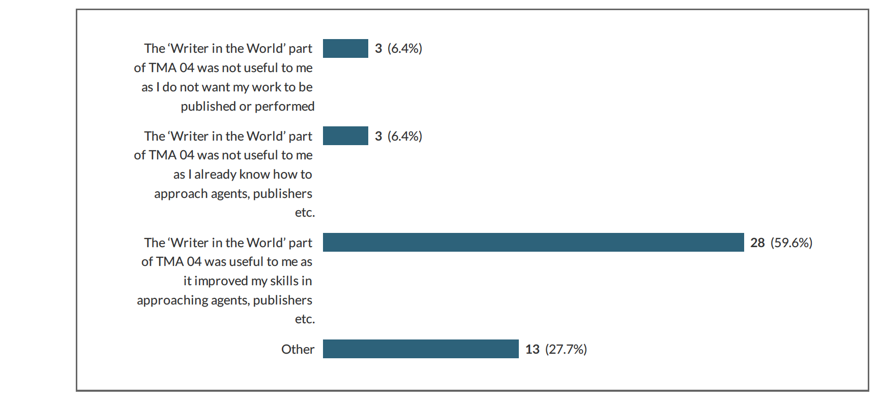
Results (so far…)

Slide 33
THANK YOU

Slide 34
Questions and comments

Slide 35

PRAXIS

Slide 36

What is a tutorial?
An exploration of ‘learning event literacy’ on student experience.
Dr. Jane Dorrian
Staff Tutor, Associate Lecturer E103
School of Education, Childhood, Youth and Sport
Faculty of Wellbeing, Education and Language Studies

Slide 37

Background
-Observing online sessions
-Dealing with student complaints

Slide 38
Research Questions
1) How are students currently supported to develop learning activity literacy*?
2) What is a tutorial?
3) What impact could the differentiation of types of learning activity have on teaching and learning?
*This project uses the term ‘learning activity literacy’ as a shorthand for the levels of knowledge and understanding students have about the purpose, delivery and content of taught sessions and their expected participation within these.

Slide 39
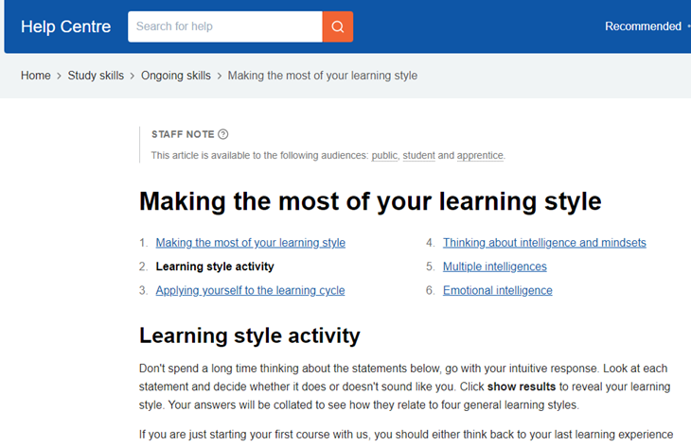
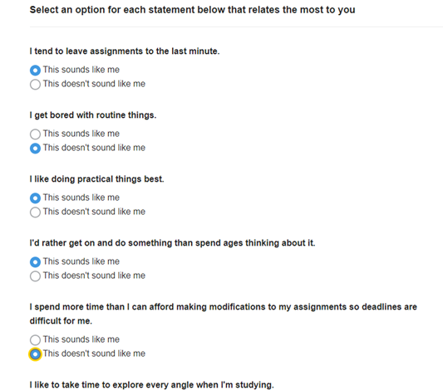
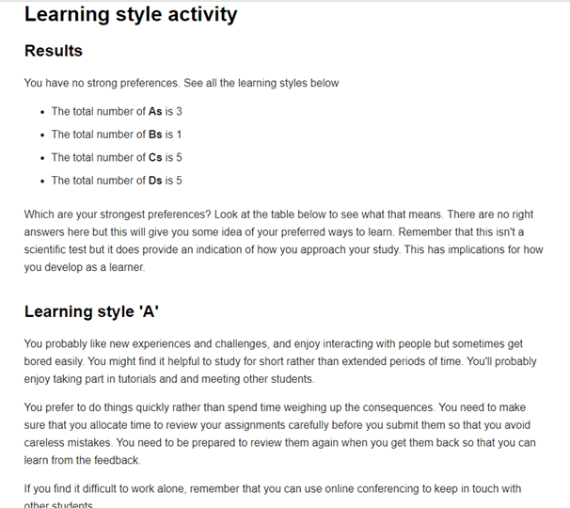
Question 1
How are students currently supported to develop learning activity literacy*?
Complete the learning style activity on StudentHome.
Ask the Student Support Team.

Slide 40
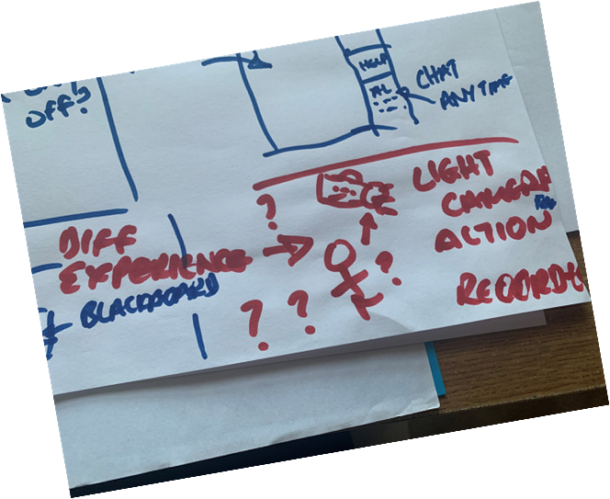
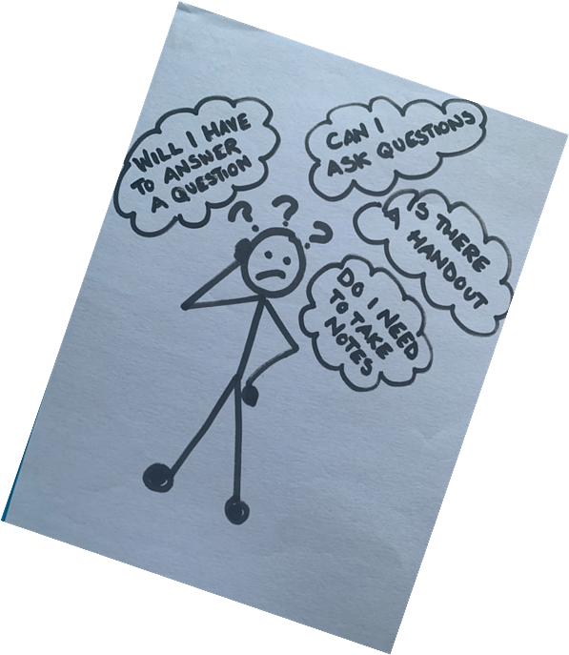
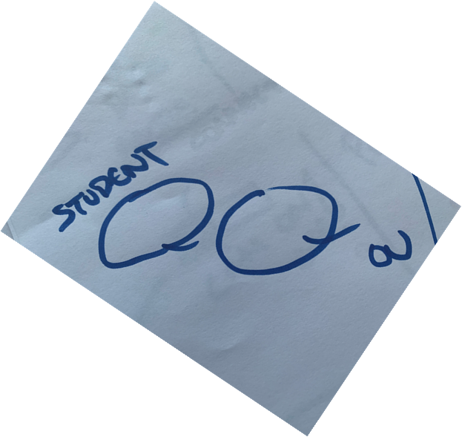
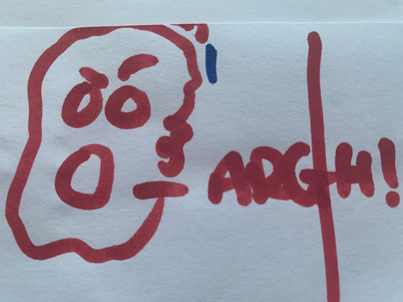
Storyboard
To capture the process and information that SST use a participatory storyboard approach is being used (Cross & Warwick-Booth, 2016)
It asks participants to create a storyboard or cartoon strip using a combination of images, stick figure sketches and minimal text to give a step-by-step explanation and exploration of their experience of dealing with student queries related to learning activities.
Individual SST colleagues are being asked to create a storyboard that represents the type of questions they are asked whilst describing the process they go through to find information and the answers they give, and then share their storyboards with each other.
Cross, R. & Warwick-Booth, L. (2016) Using storyboards in participatory research. Nurse Researcher Vol.23 (3), p.8-12

Slide 41
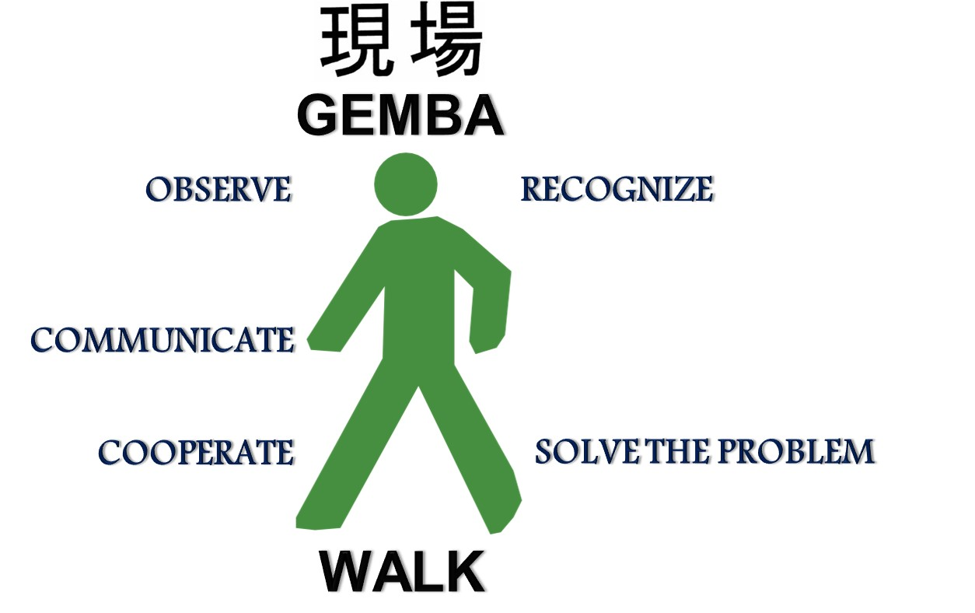
Question 2
What is a tutorial?
The Gemba Walk (taken from the Japanese ‘gemba’ meaning ‘the real place’) is a management technique based on managers immersing themselves in the day to day activities of their business by spending time as an employee or customer to observe the reality of a situation. The approach has become popular in schools where it is known as a Learning Walk (Baker and King 2013) which involves staff members or other stakeholders such as governors attending a lesson or event to observe what happens in order to develop an understanding of why the situation is the way it is.
The OU has a policy of recording a selection of module tutorials held within a teaching block to allow students to access the taught content if they are unable to attend the actual session. These recordings provide a useful resource to explore the pedagogic approaches and techniques used in sessions and also to identify what is actually happening, who is contributing to the session and who is not, whose voices are heard and whose are not. This project will use a Gemba Walk approach using a series of recordings of tutorials within the same teaching block on a module run in the 20J presentation to capture data around the range of approaches being used, the levels of engagement apparent, types of contribution and any other relevant factors.
Baker, W.J. & King, H. (2013) Participatory Learning Walks: reflective practice for the conductor-music educator Australian Journal of Music Education No. 2, p.35-45

Slide 42


Slide 43
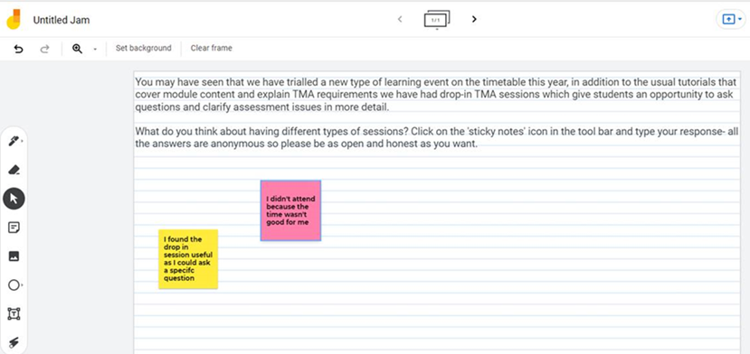
Question 3
What impact could the differentiation of types of learning activity have on teaching and learning?
Using data gathered from the Gemba Walk alongside information from the SST and external sources a theoretical ‘Portfolio of Learning Activities’ will be drafted that outlines the different types of learning that could be available across a module, based on the activities observed.
The portfolio will be placed on a virtual graffiti wall (Google Jamboard) and the link will be shared with students, ALs and other relevant stakeholders via relevant forums and communication streams asking them to comment on how useful or not they feel this would be. The participants will have had experience of the trial of the drop-in workshop and will be able to use their experiences of this to inform their responses too. Using a graffiti wall technique allows anonymity which encourages participation without judgement or pressure.

Slide 44
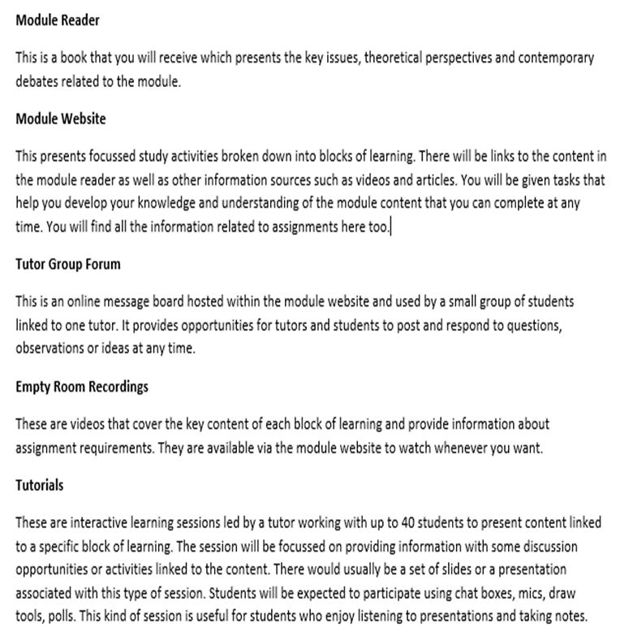
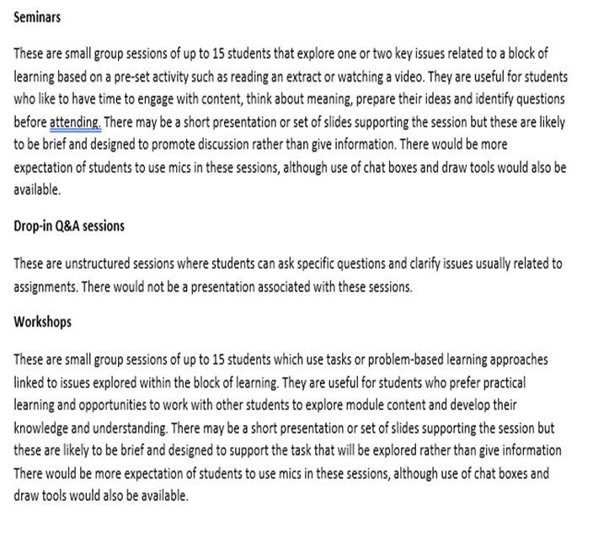
Example Portfolio

Slide 45
Summary
Problem Statement
The lack of a range of clearly defined learning activities within a tuition strategy could affect students’ expectations and limit the pedagogical approaches available to ALs. Presenting students with a portfolio of provision that offers them choice from a suite of activities with clearly defined and differing pedagogic approaches and delivery could help to manage these expectations and improve teaching, learning and the overall student experience.
Project Objectives
On completion, the project will have:
1) Explored the information sources that students use to develop their learning activity literacy
2) Determined and classified the characteristics of learning activities currently taking place in tutorials
3) Proposed a portfolio of definitions that could be used to label learning activities

Slide 46
Diolch
THANK YOU
☺

Slide 47

SCiLAB

Slide 48

Scilab project:
B206 Badging employability
Scholarship Conference 2021: Showcasing our research into teaching and learning at the OU 17.11.21
Image with thanks to Scott Gustavson

Slide 49


B206 – 60 credit online module on customer behaviour at OU Level 2. Activity-based pedagogy
Problem: uneven engagement with learning activities to promote skills
Opportunity: reflection on skills development and enhanced employability
Solution: Digital badge as incentive to do more and be recognised for it
Credit MicroSoft image

Slide 50

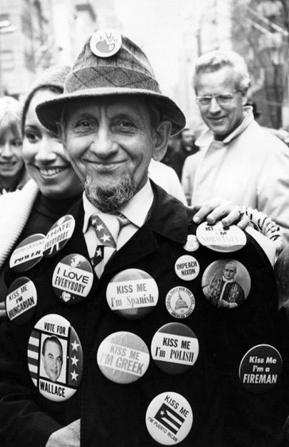
B206 Badging employability
Pilot study
June – August 2021
Emailed students on 19J and 20J presentations
Write five reflections on learning activities related to OU Employability framework
B206 Badge track page on FutureYou linked to Moodle Quiz
Manual verification
Authorisation of badge from Open Bage Factory
CREDIT Peter Keegan / Hulton Archive / Getty Images / Universal Images Group
Rights Managed / For Education Use Only

Slide 51

Top line results from survey
(October 2021)
70% of respondents were unaware of the offer
6% of respondents earned a badge from the offer
22% felt that badges were not relevant to them
8% already held at least one digital badge at the time of the offer
63% would like to earn badges in future as part of OU study
50% would like to earn badges for activities such as volunteering with the OU
Imange: National Cancer Institute UNSPLASH

Slide 52

Next steps: The beaupeep project student opportunities available
Newsletter
Internship, survey and/or evidence cafes
Please email BEAUPEEp@open.ac.uk
Image with thanks to Scott Gustavson

Slide 53
Questions and comments

Slide 54
Scholarship Challenges and Priorities

Slide 55
Scholarship Conference 2021
Showcasing our research into teaching and learning at the OU
Thank you for attending
Wednesday, 17th November 2021
Notes:
Thank you, we hope you’ve found this session interesting and enjoyable!

