Slide 1


Qualitative analysis for scholarship projects
Trevor Collins and Mark Jones
eSTEeM Management Team
Slides: http://bit.ly/esteem-2021-qualitative-analysis
esteem@open.ac.uk
@OU_eSTEeM
http://www.open.ac.uk/esteem
Notes:
eSTEeM APD: Qualitative analysis for scholarship projects
Facilitators – Trevor Collins and Mark Jones
Overview: In this introductory session we will explain the basics of qualitative methods to inform scholarship of teaching and learning. It will cover research design; different methodological approaches and their relative benefits and disadvantages; and also ask attendees to consider how to choose the most appropriate method(s) to use in their scholarship activities. The session will contain a mix of presentation and discussion.
Learning objectives
- To understand the underlying principles of qualitative research
- To understand some of the methods of qualitative analysis
UKPSF/Applaud principles A5, K5, K6, V3

Slide 2

Welcome and introductions
Introduce yourself, your scholarship interests and what you would like to get from this session…

Slide 3
Overview
Research aims and research questions
Research approaches, designs and methods
  Quantitative (representative and generalisable)
  Qualitative (valid and reliable)
  Mixed Methods
Qualitative analysis and interpretation
  Data collection types
  Sequential steps of analysis
  Coding, interpretation, validity and reliability
Reporting qualitative findings

Slide 4
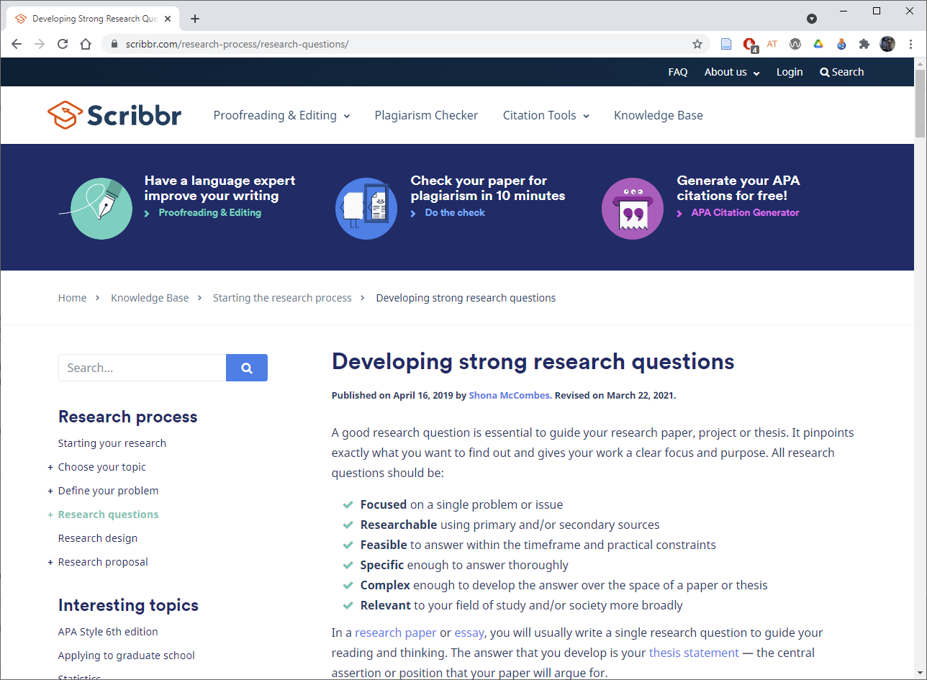
Research aims and research questions
Research aims | Research question formulations
Describing and exploring | What are the characteristics of X? How has X changed over time? What are the main factors in X? How does X experience Y? How has X dealt with Y?
Explaining and testing | What is the relationship between X and Y? What is the role of X in Y? What is the impact of X on Y? How does X influence Y? What are the causes of X?
Evaluating and acting | What are the advantages and disadvantages of X? How effective is X? How can X be achieved? What are the most effective strategies to improve X? How can X be used in Y?
https://www.scribbr.com/
research-process/research-questions/

Slide 5
Research approaches
Quantitative: “An approach for testing objective theories by examining the relationships between variables. … building in protections against bias, controlling for alternative or counterfactual explanations, and being able to generalize and replicate the findings.” (representative and generalisable)
Qualitative: “An approach for exploring and understanding the meaning individuals and groups ascribe to a social or human problem. … focus on individual meaning and the importance of reporting the complexity of the situation.” (valid and reliable)
Mixed methods: “An approach to inquiry involving collecting both quantitative and qualitative data, integrating the two forms of data … the integration of qualitative and quantitative data yields additional insight beyond the information provided by either the quantitative or qualitative data alone.”
Quotations taken from (Creswell and Creswell, 2018)

Slide 6
Research designs
A continuum of research approaches from quantitative (numbers) to qualitative (words) with mixed methods combining the two
Quantitative | Qualitative | Mixed methods
Experimental designs Nonexperimental designs, such as surveys Longitudinal designs | Narrative research (humanities) Phenomenology (philosophy and psychology) Grounded theory (sociology) Ethnographies (anthropology and sociology) Case study (many disciplines) | Convergent Explanatory sequential Exploratory sequential Complex designs with embedded core designs

Slide 7
Research methods
The specific forms of data collection, analysis and interpretation
Quantitative methods | Qualitative methods | Mixed methods
Pre-determined | Emerging methods | Both predetermined and emerging methods
Instrument based questions | Open-ended questions | Both open- and closed-ended questions
Performance data, attitude data, observational data, and census data | Interview data, observation data, document data, and audio-visual data | Multiple forms of data drawing on all possibilities
Statistical analysis | Text and image analysis | Statistical, text and image analysis
Statistical interpretation | Themes, patterns interpretation | Across databases interpretation

Slide 8
Qualitative analysis and interpretation
Data collection types | Options | Advantages | Limitations
Observations | Complete participant, observer as participant, participant as observer, complete observer | Researcher has first hand experience with participant, record info as it occurs, explore topics that are uncomfortable to discuss | Researcher may be seen as obtrusive, requires attention and observation skills, some private information may not be reported
Interviews | Face-to-face one-to-one, telephone/online one-to-one, focus group, email interview | Useful when participants cannot be observed, participants can provide historical info, researcher controls questioning | Indirect info filtered by interviewees, researcher may bias responses, relies on people being articulate and perceptive
Documents | Public documents (meeting minutes, newspapers), private documents (diaries, letters) | Language and words of participants, unobtrusive access | Requires discovery, may be incomplete, may not be authentic or accurate
Audio visual digital materials | Photos, videos, art objects, computer messages, sounds, film | May be unobtrusive, participants directly share their reality | May be difficult to interpret, researcher’s presence may be disruptive and affect responses
(Creswell and Creswell, 2018)

Slide 9
Qualitative analysis and interpretation
Simultaneous procedures: Data analysis in qualitative research happens at the same time as data collection and writing-up the findings (iterate until saturated)
Winnowing the data: Focusing in on some of the data and disregarding other parts; aggregate the data into themes (typically five to seven themes)
Qualitative Data Analysis Software: Hand coding is laborious and time consuming, computer tools can help (e.g. NVivo)

Slide 10
Qualitative analysis: Sequential steps…
Organise and prepare your data for analysis: Transcribe, type up notes, catalogue visual material, sort and arrange
Read and look at all the data: Get a sense of what is being said; what is the tone, depth, credibility, etc. Make notes and sketches
Start by coding all of the data: Coding organises the data into chunks and gives them category labels
Generate a description and themes: Describe the setting or people as well as the categories or themes for analysis
Representing the description and themes: Visuals, figures, tables, narrative discussion of themes

Slide 11
Qualitative analysis and interpretation
Coding: three common categories
  Expected codes: from the literature or common sense
  Surprising codes: findings not anticipated before the study
  Codes of unusual or conceptual interest: unusual or interesting ideas
Simultaneous procedures
  Iteration: Cycles of data collection, analysis and reporting
  Saturation: Stop collecting data when the themes are saturated
  (comes from grounded theory)

Slide 12
Qualitative analysis and interpretation
Interpretation
  Summarising the overall findings
  Comparing the findings to the literature
  Discussing a personal view of the findings
  Stating limitations and future research
Validity and reliability: Checks made for accuracy and credibility
  Qualitative validity checks for accuracy of the findings (triangulation, member checking, rich and thick descriptions, clarify biases, present negatives, auditor)
  Qualitative reliability indicates consistency of approach across researchers and projects (check transcripts, check drift in definition of codes, coder communication, cross-check codes)

Slide 13
Reporting qualitative findings
Develop descriptions and themes from the data
  Convey multiple perspectives of participants and detailed description of the setting or individuals
Qualitative strategies of inquiry
  A chronological narrative of an individual’s life (narrative research)
  A detailed description of their experiences (phenomenology)
  A theory generated from the data (grounded theory)
  Detailed portrait of the culture within a group (ethnography)
  In depth analysis of one or more cases (case study)

Slide 14
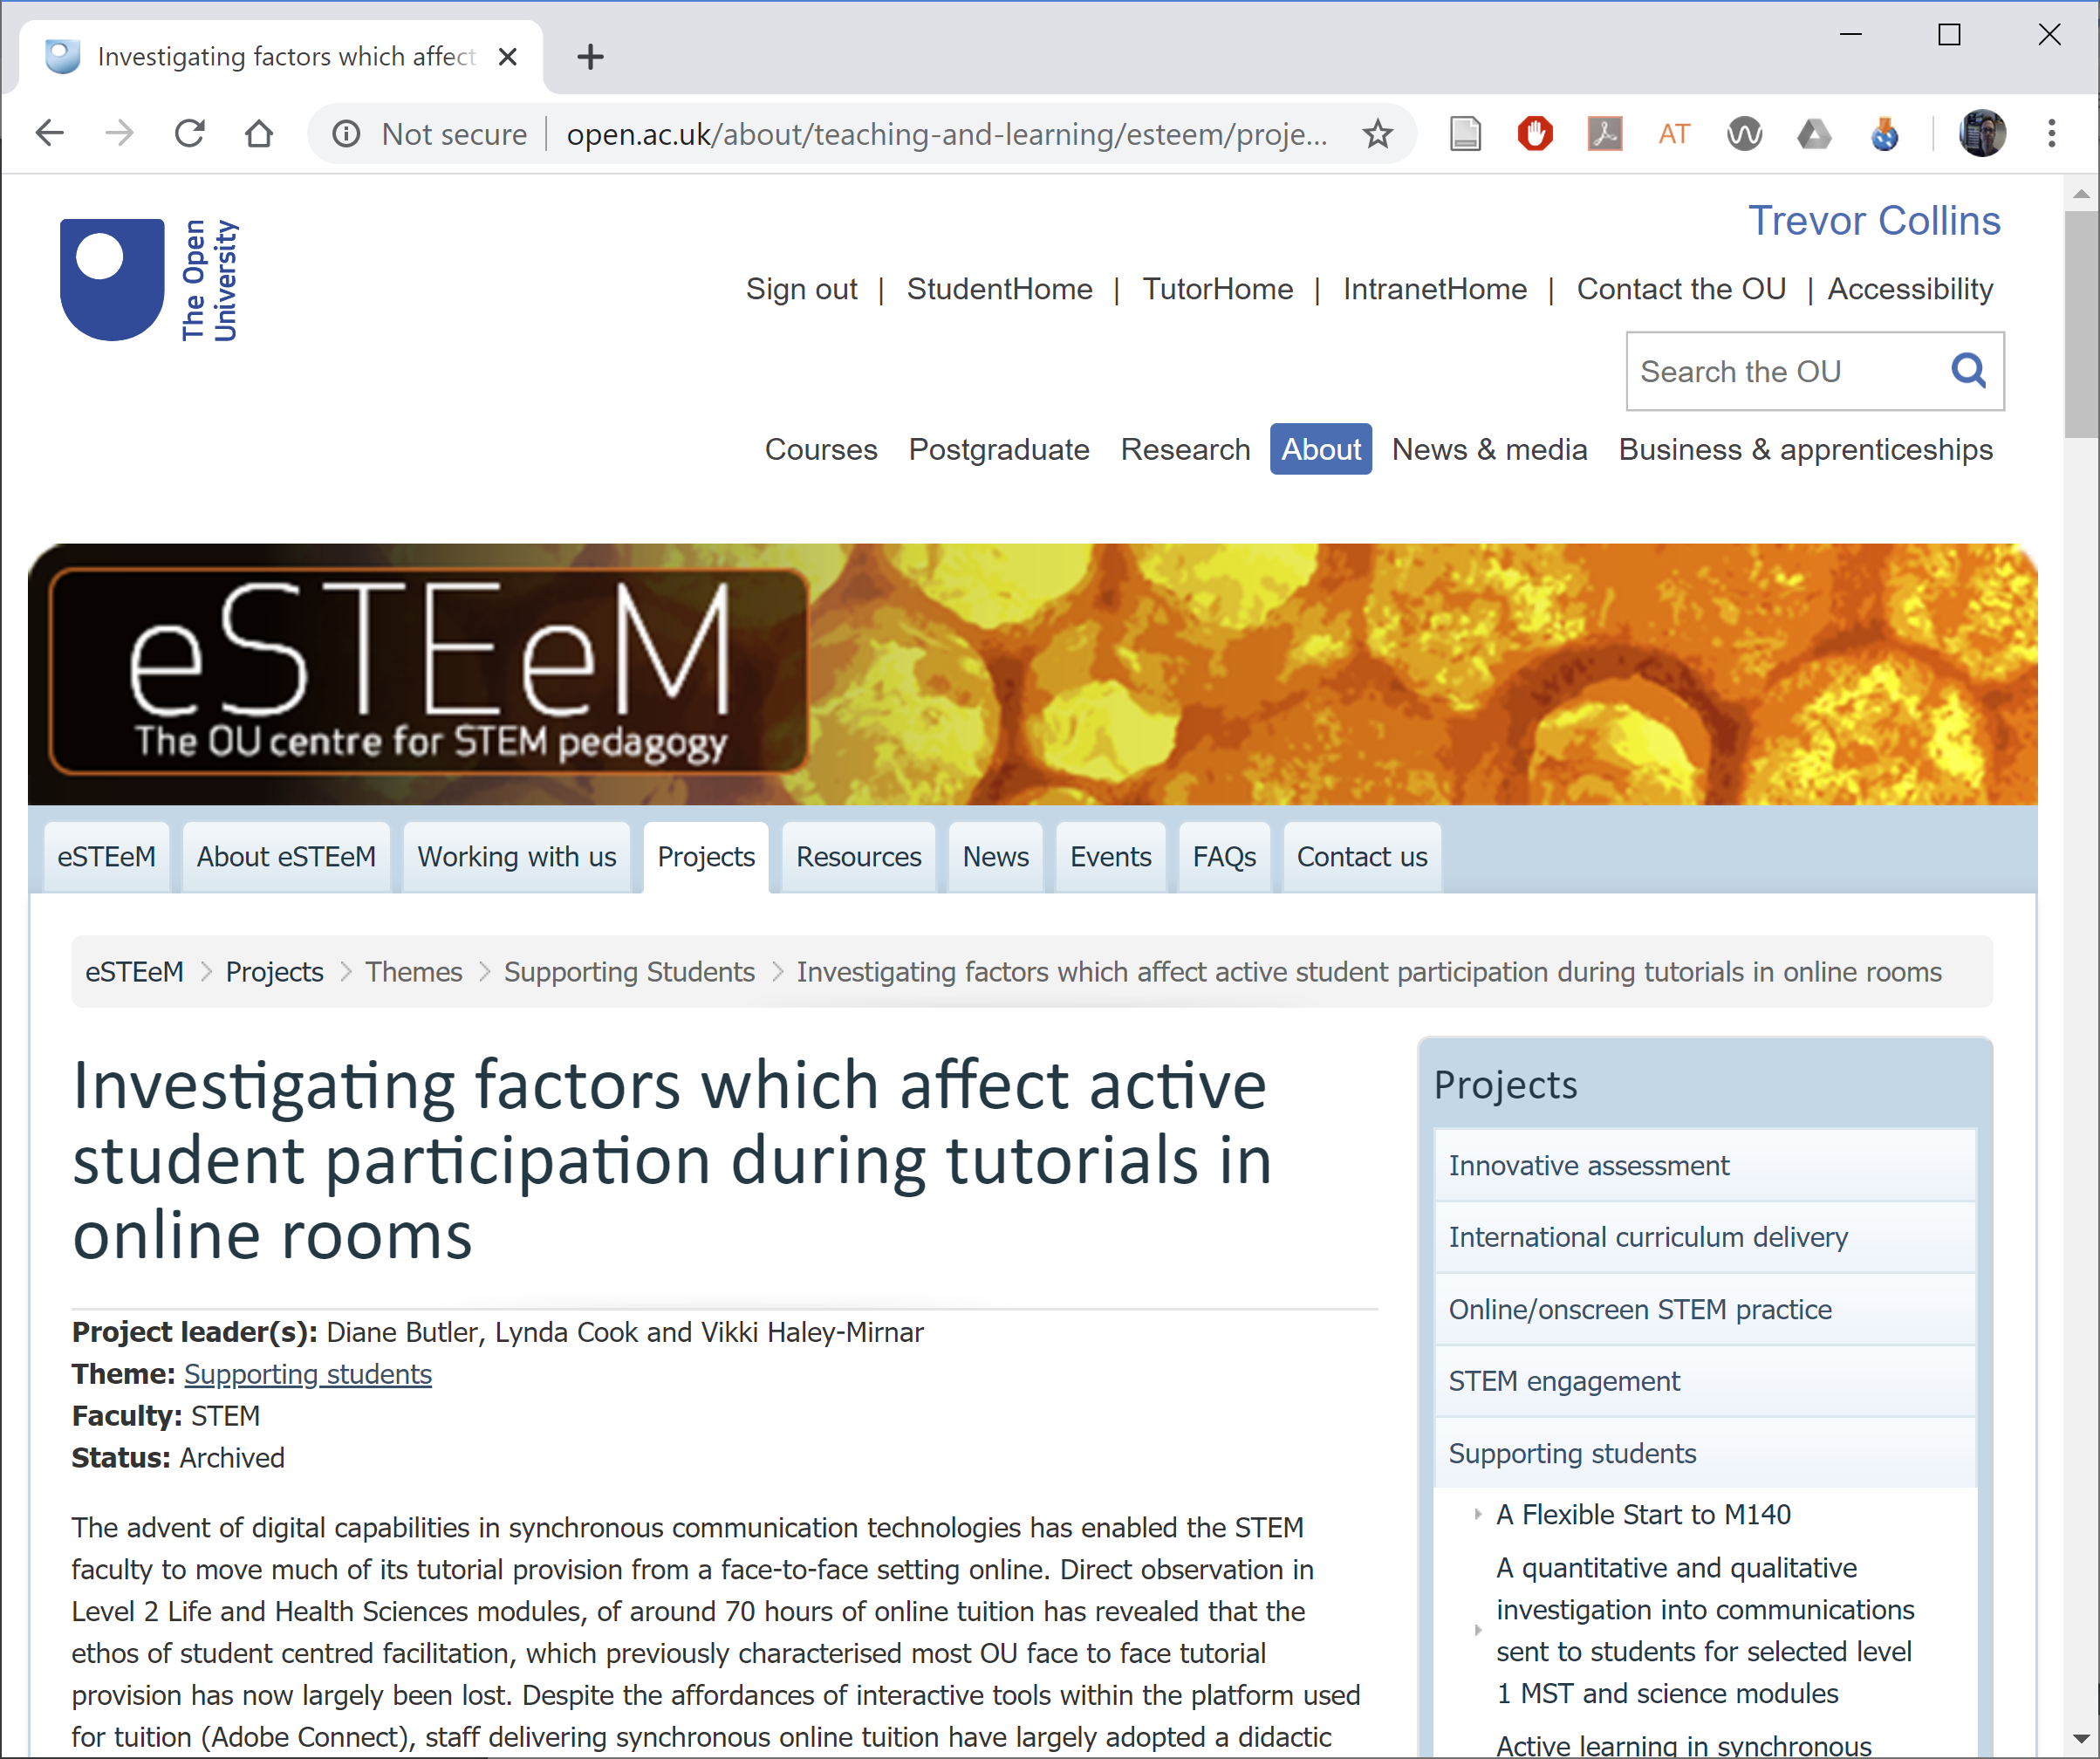
Practical example
https://bit.ly/butler-cook-and-haley-mirnar-2018

Slide 15
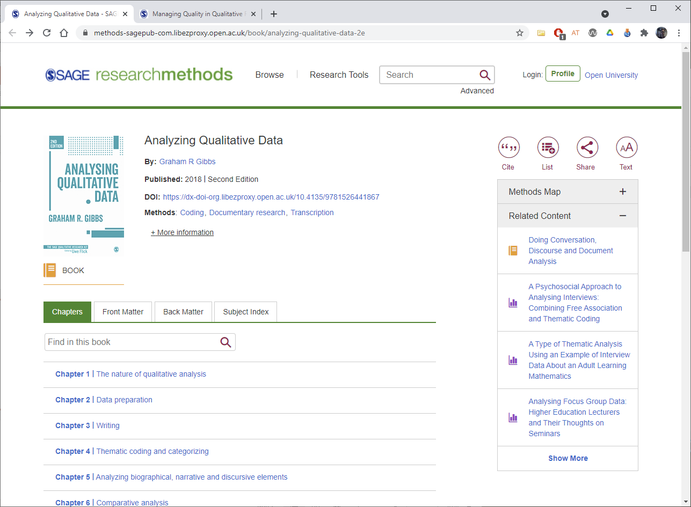
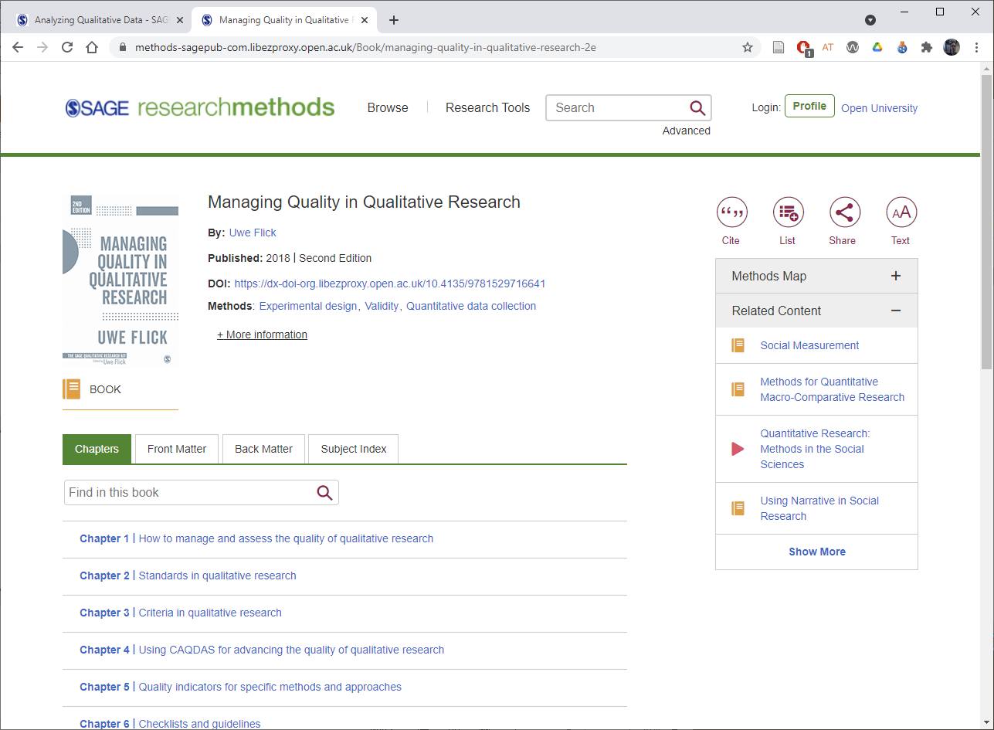
Further info (SAGE research methods site)
Graham Gibbs (2018). Analysing Qualitative Data. Sage.
Uwe Flick (2018). Managing Quality in Qualitative Research. Sage.

Slide 16
References
Butler, D., Cook, L. and Haley-Mirnar, V. (2018) Achieving student centred facilitation in online synchronous tutorials. eSTEeM Final Report. Available online at: https://bit.ly/butler-cook-and-haley-mirnar-2018 (last accessed 25th May 2021).
Creswell, J.W. and Creswell, J.D. (2018). Research Design: Qualitative, Quantitative, and Mixed Methods Approaches. 5th Edition. Sage Publishing ISBN: 978-1-5063-8676-8
Creswell, J.W. and Poth, C.N. (2018). Qualitative Inquiry and Research Design (International Student Edition). 4th Edition (14 May 2017). Sage Publishing ISBN: 978-1-5063-6117-8

Slide 17
Qualitative analysis for scholarship projects
Trevor Collins and Mark Jones
eSTEeM Management Team
Slides: http://bit.ly/esteem-2021-qualitative-analysis
esteem@open.ac.uk
@OU_eSTEeM
http://www.open.ac.uk/esteem
Notes:
eSTEeM APD: Qualitative analysis for scholarship projects
Facilitators – Trevor Collins and Mark Jones
Overview: In this introductory session we will explain the basics of qualitative methods to inform scholarship of teaching and learning. It will cover research design; different methodological approaches and their relative benefits and disadvantages; and also ask attendees to consider how to choose the most appropriate method(s) to use in their scholarship activities. The session will contain a mix of presentation and discussion.
Learning objectives
- To understand the underlying principles of qualitative research
- To understand some of the methods of qualitative analysis
UKPSF/Applaud principles A5, K5, K6, V3

