Slide 1


Gaining approvals for your scholarship project
Trevor Collins and Mark Jones
eSTEeM Community Event
Academic Professional Development
Thursday, 25th February 2021
esteem@open.ac.uk
www.open.ac.uk/esteem
@OU_eSTEeM

Slide 2
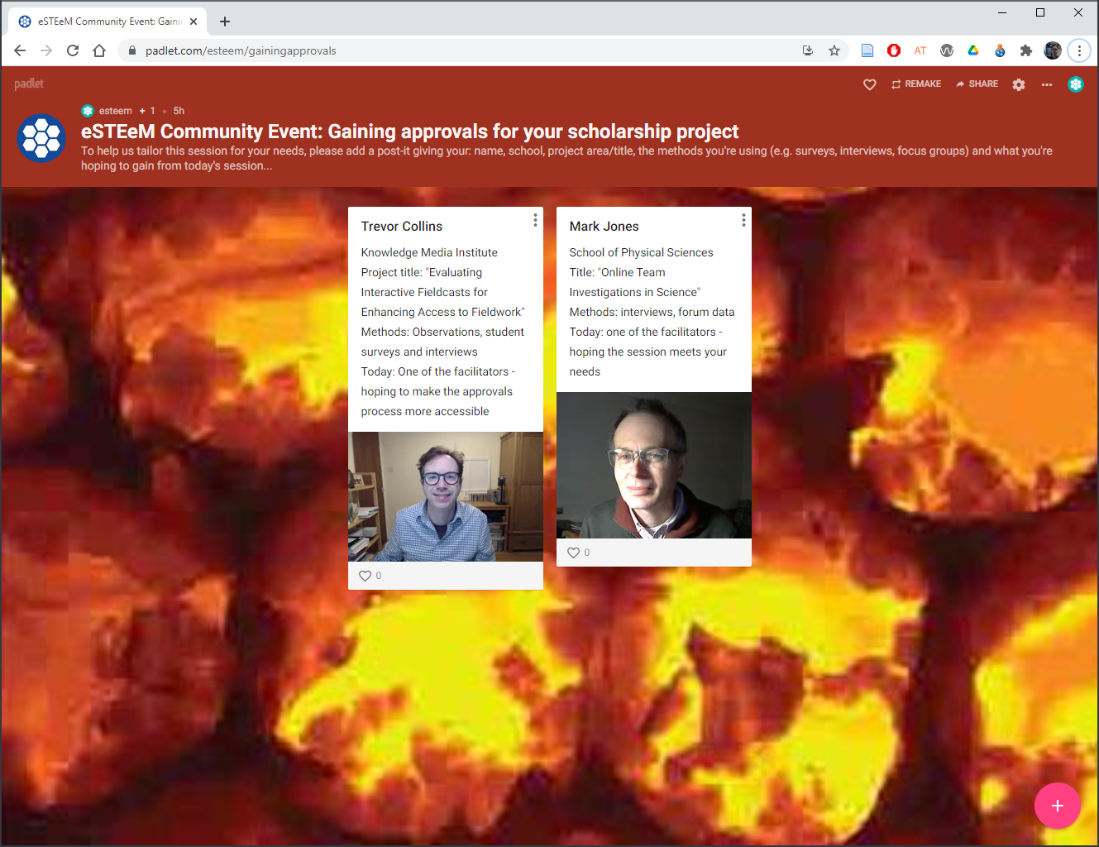
Gaining approvals – Session plan
Welcome and introductions
Project workflow
Data management
Approval processes
Questions and next steps
https://padlet.com/esteem/gainingapprovals

Slide 3
Project workflow
Research design
Data management planning
Approvals
  Data Protection (GDPR)
  Human Research Ethics Committee (HREC)
  Student Research Project Panel (SRPP)
  Staff Survey Project Panel (SSPP)
Data collection
…

Slide 4

Research design
Work out what you are going to do before seeking approval to do it
  What has been done before in your area that you can build on?
  What new data do you need to collect for your study?
  How will you go about collecting, analysing and presenting the data?
  How will you manage participants’ anonymity/identity?

Slide 5
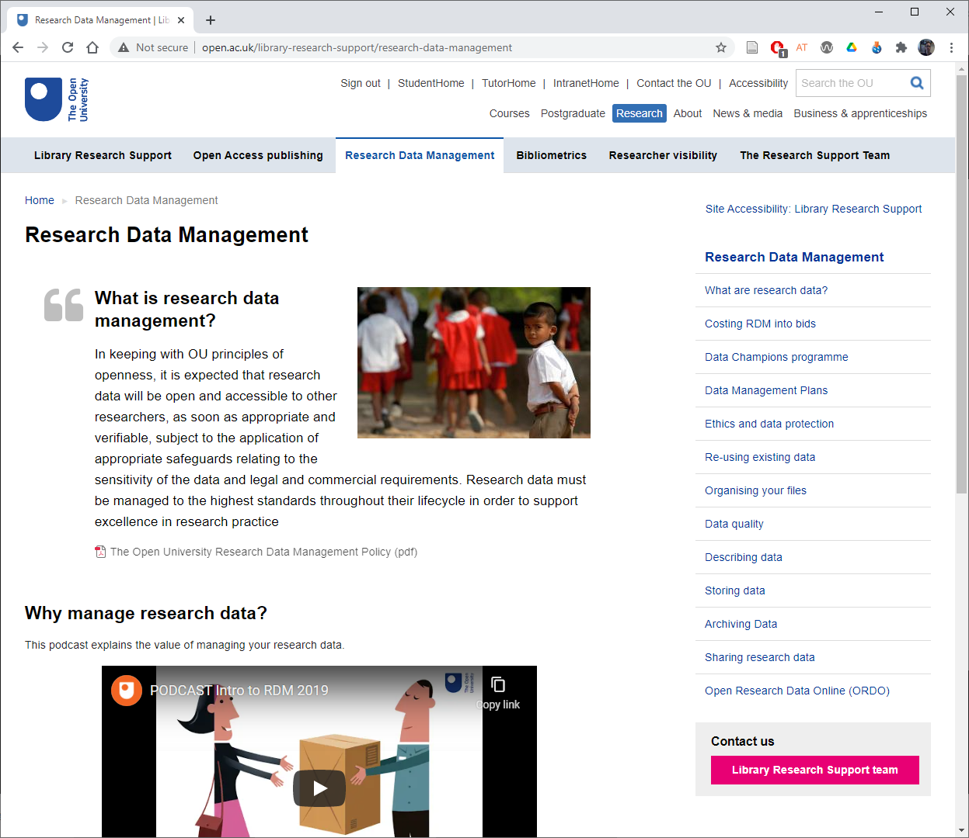
Data management planning
Think through what data you need to collect and how you will look after it
  What data do you need to collect?
  Do you have to store any personal data?
  How will you store the data securely?
  Would the data be of use to anyone else?
  When will the data no longer be needed?
More info
  OU Research Data Management Policy
  Library Research Data Management pages
  Data storage for OU research projects comparison table PDF | Word

Slide 6
Approval processes
Approvals for…
  Data protection: General Data Protection Regulations (GDPR)
  Ethical research: Human Research Ethics Committee (HREC)
  Access to OU students: Student Research Project Panel (SRPP)
  Access to OU staff: Staff Survey Project Panel (SSPP)
Keep a record of your approvals and include in eSTEeM final report
  Data protection registration number
  HREC reference number
  SRPP application number

Slide 7
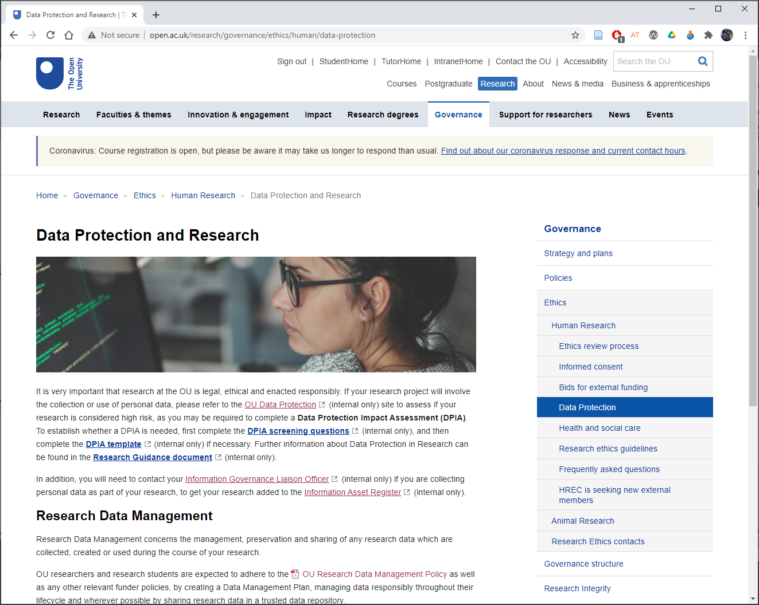
Data protection
Legal frameworks
  Freedom of Information Act 2000
  Data Protection Act 2018
  General Data Protection Regulations (GDPR)
http://www.open.ac.uk/research/governance/ethics/human/data-protection

Slide 8
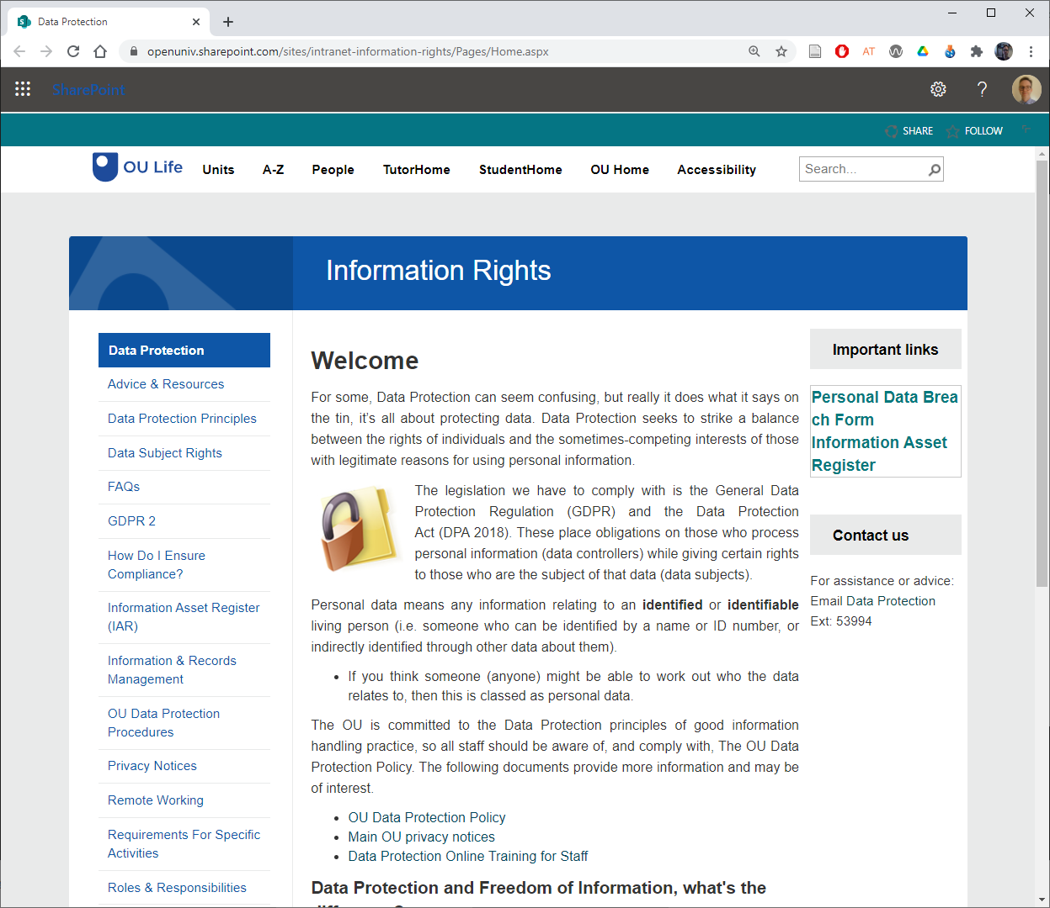
Data protection
Will your project involve the collection or use of personal data?
  If Yes, then it needs to be logged so that any personal data requests can be met (e.g. Right to Access and Right to Erasure Requests)
  Contact an Information Governance Liaison Officer (IGLO) to add your research to the Information Asset Register (IAR) (i.e. email STEM-GDPR@open.ac.uk)
More info: Information Rights

Slide 9
Data protection
Will you collect any new personal data or significantly change the way you process personal data?
  If Yes, then the University needs to adjust its records to include the new data and process
  Complete the Data Protection Impact Assessment (DPIA) screening questions to check if you need to complete the DPIA template
  If yes to any of the screening questions then complete the DPIA template
IMPORTANT: Email data-protection@open.ac.uk your completed screening questions and/or DPIA template for review and the issuing of a data protection registration number (needed for the SRPP form)
More info: Research Guidance

Slide 10
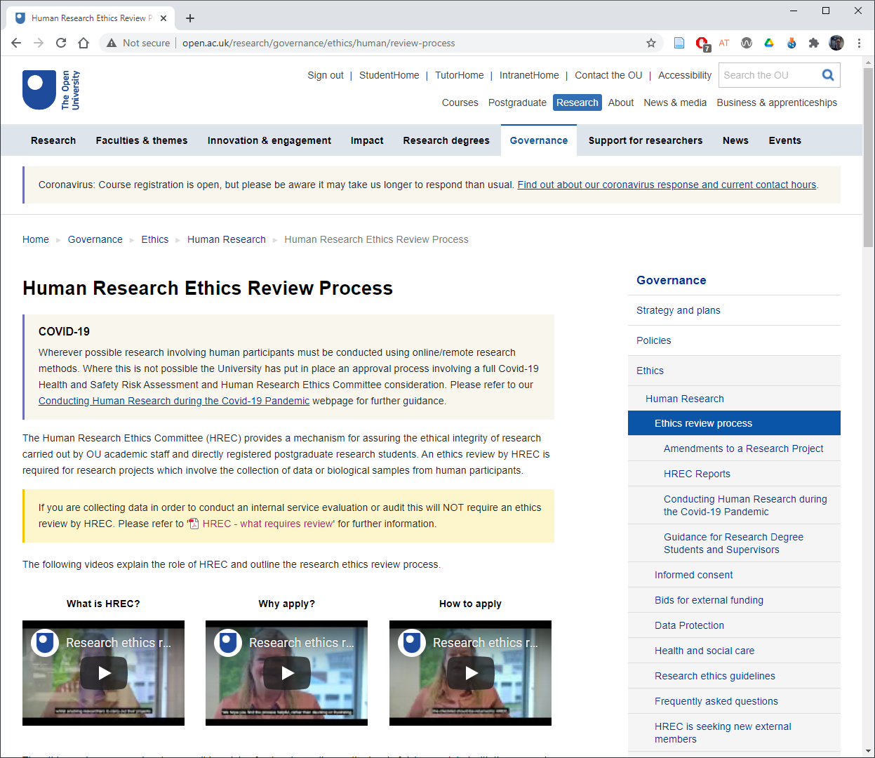
Human Research Ethics Committee (HREC)
Any research involving data collection from human participants requires ethics review by HREC
  Complete the HREC Project Registration and Risk Checklist plus documentation related to your project (e.g. consent form, participant information sheet, or questionnaire; response 7 days)
  If required, complete HREC application form plus docs (response up to 3 weeks)
Website: Templates, guides and FAQs
http://www.open.ac.uk/research/governance
/ethics/human/review-process
Email: Research-REC-Review@open.ac.uk
Notes:
http://www.open.ac.uk/research/governance/ethics/human/review-process

Slide 11
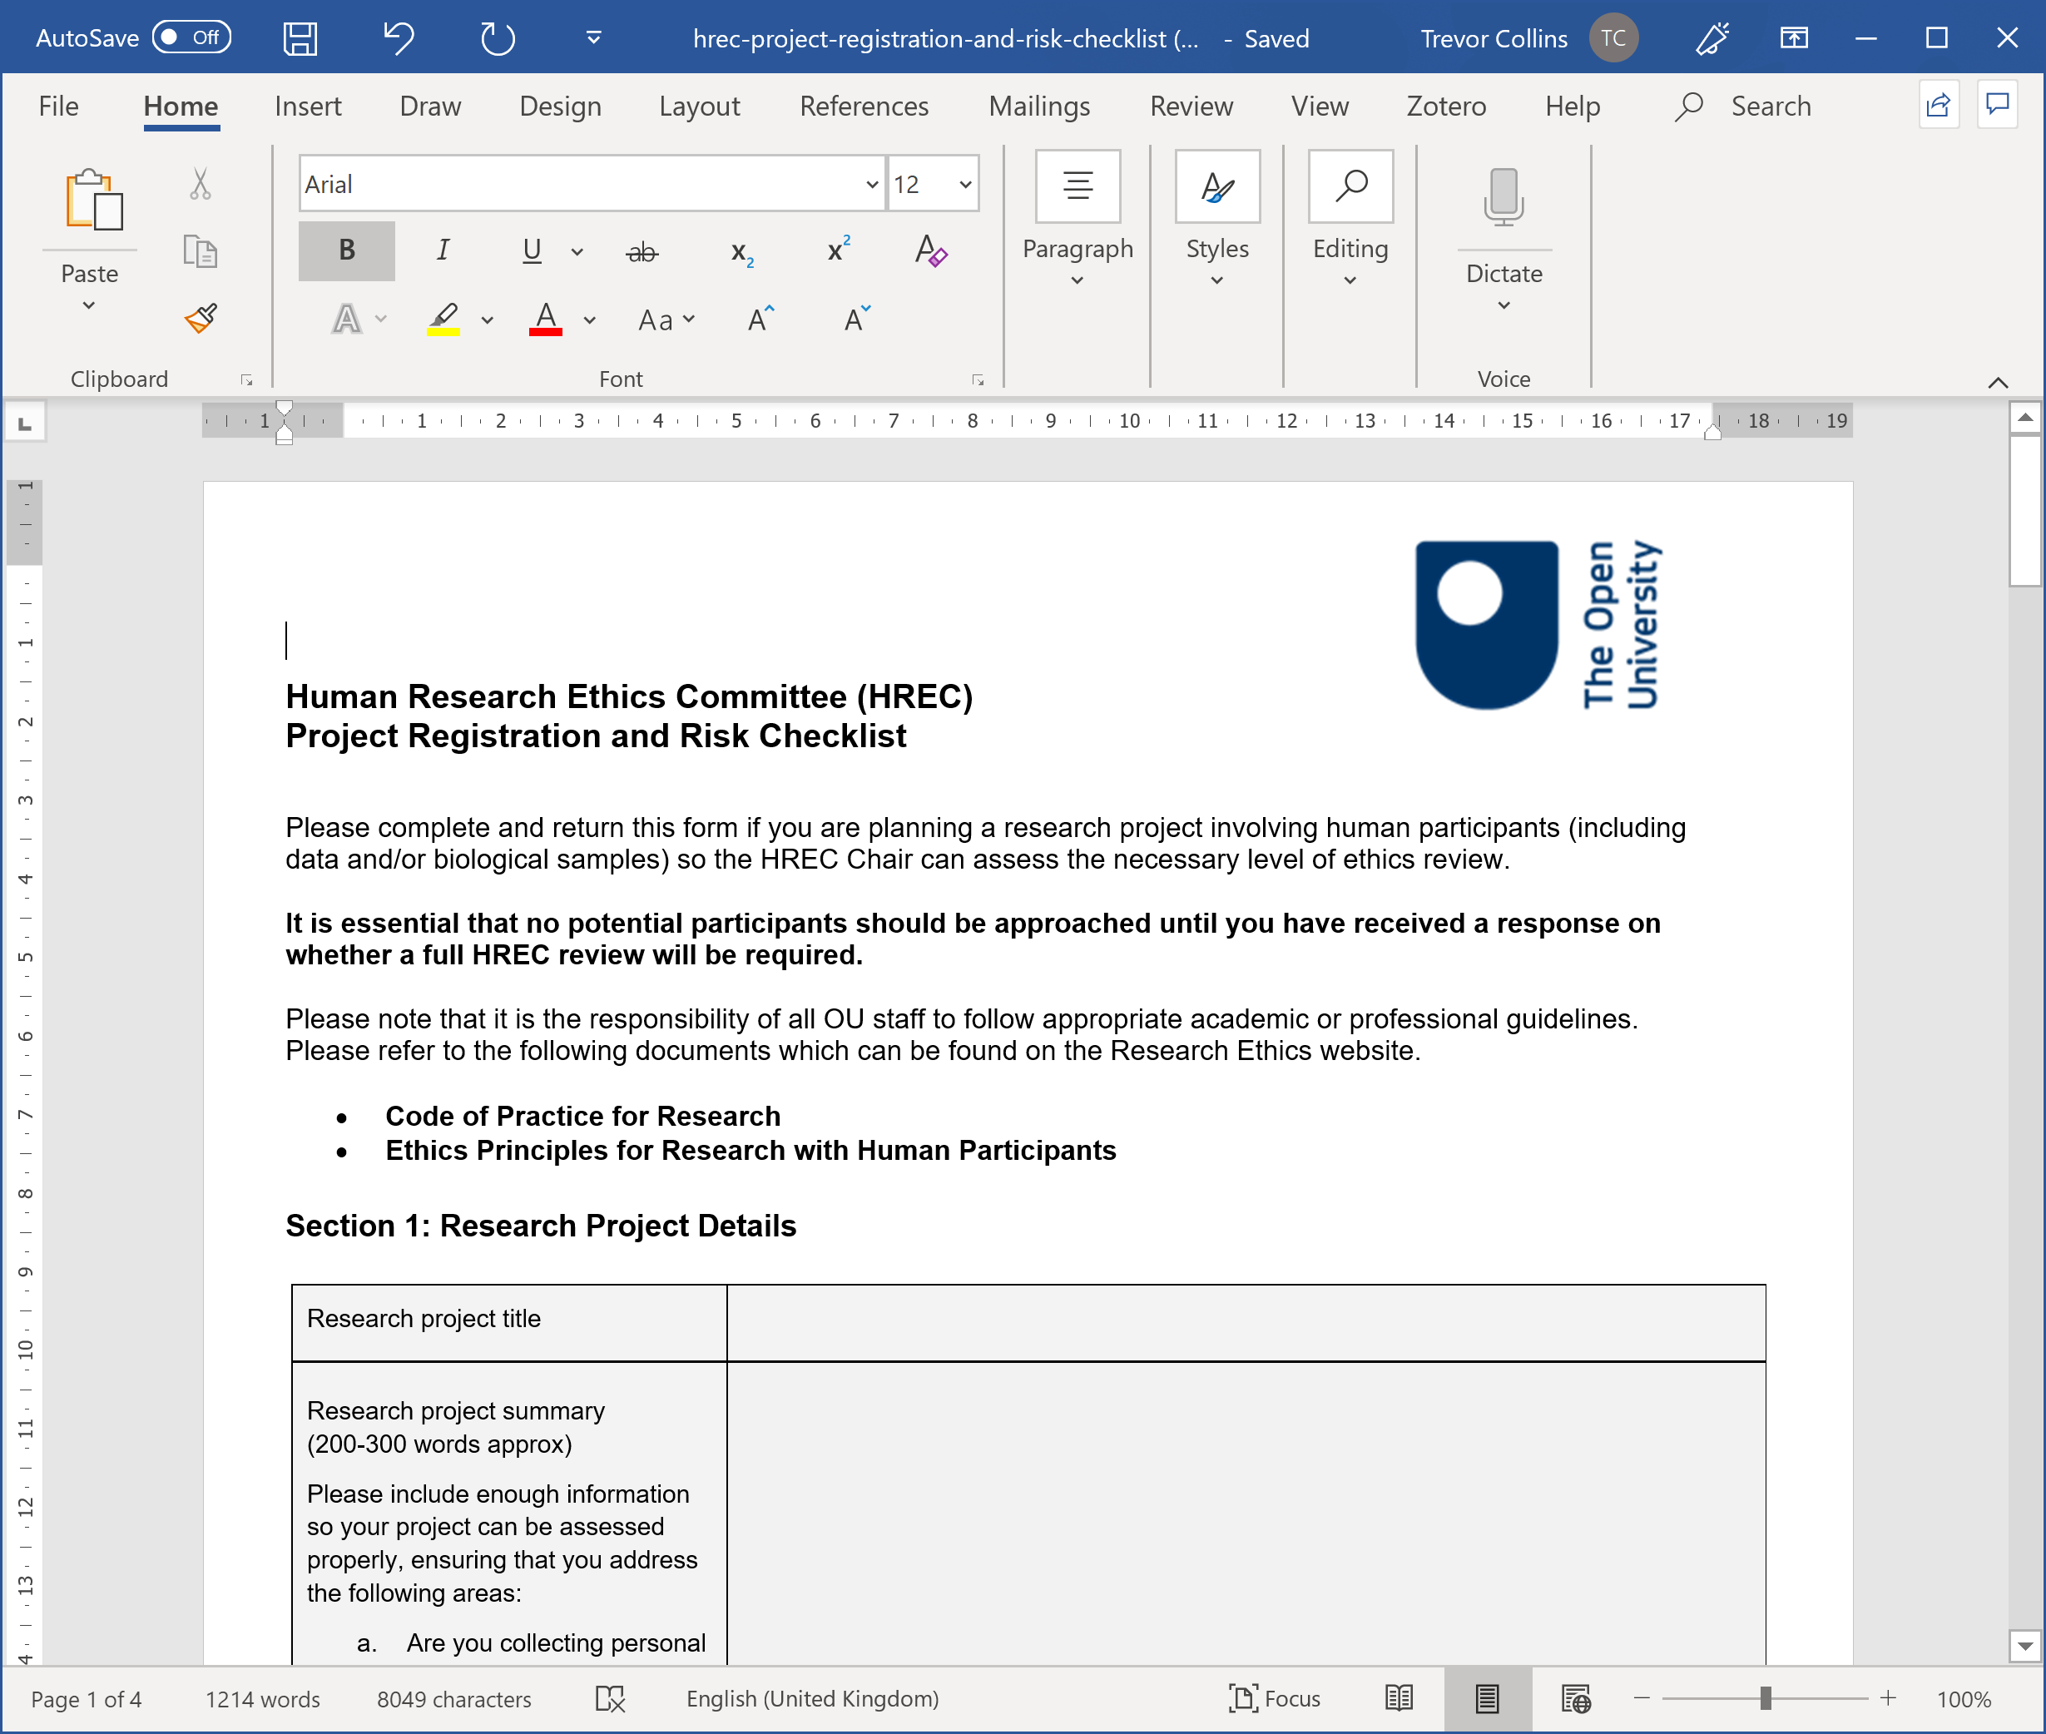
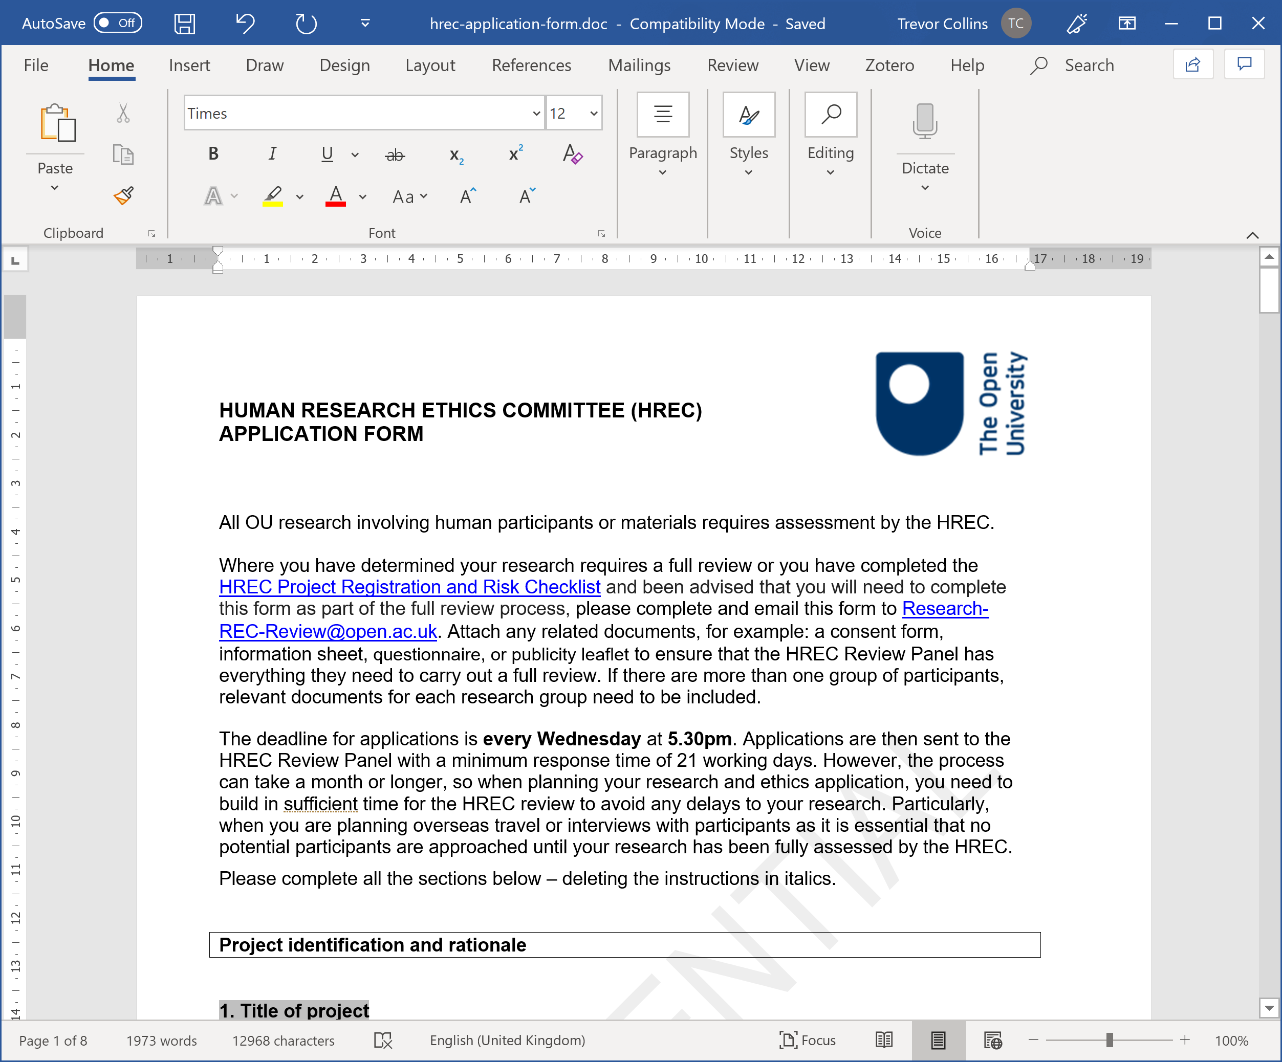
Activity – Check the ethics for your project
Checklist activity
  For your project (or future project)
  Review and answer the Higher Risk, Lower Risk and Health Research Authority questions
Walkthrough the HREC form
  Abstract (max 200 words)
  Methodology
  Recruitment procedures
  Risk of harm
  Benefits and knowledge transfer
Questions / comments
http://www.open.ac.uk/research/governance
/ethics/human/review-process
Email: Research-REC-Review@open.ac.uk
Notes:
http://www.open.ac.uk/research/governance/ethics/human/review-process

Slide 12
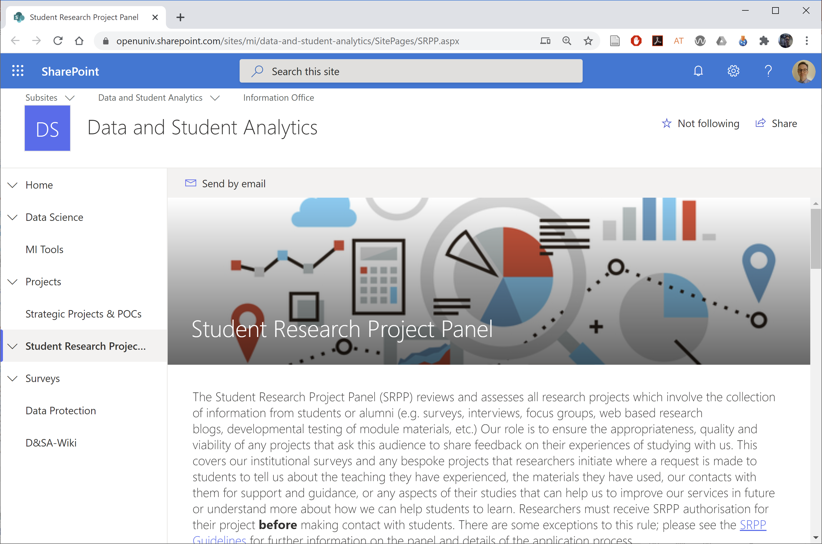
Student Research Project Panel (SRPP)
Any research which involves making contact with current students, alumni or enquirers needs to be approved by SRPP
Check out the examples when drafting your application
SRPP review applications fortnightly (allow three weeks for a response)
  4pm 10th Mar (decision 18th Mar)
  4pm 24th Mar (decision 1st Apr)
  4pm 7th Apr (decision 15th Apr)
https://openuniv.sharepoint.com/sites/mi/
data-and-student-analytics/SitePages/SRPP.aspx
Email: srpp@open.ac.uk
Notes:
https://openuniv.sharepoint.com/sites/mi/data-and-student-analytics/SitePages/SRPP.aspx

Slide 13
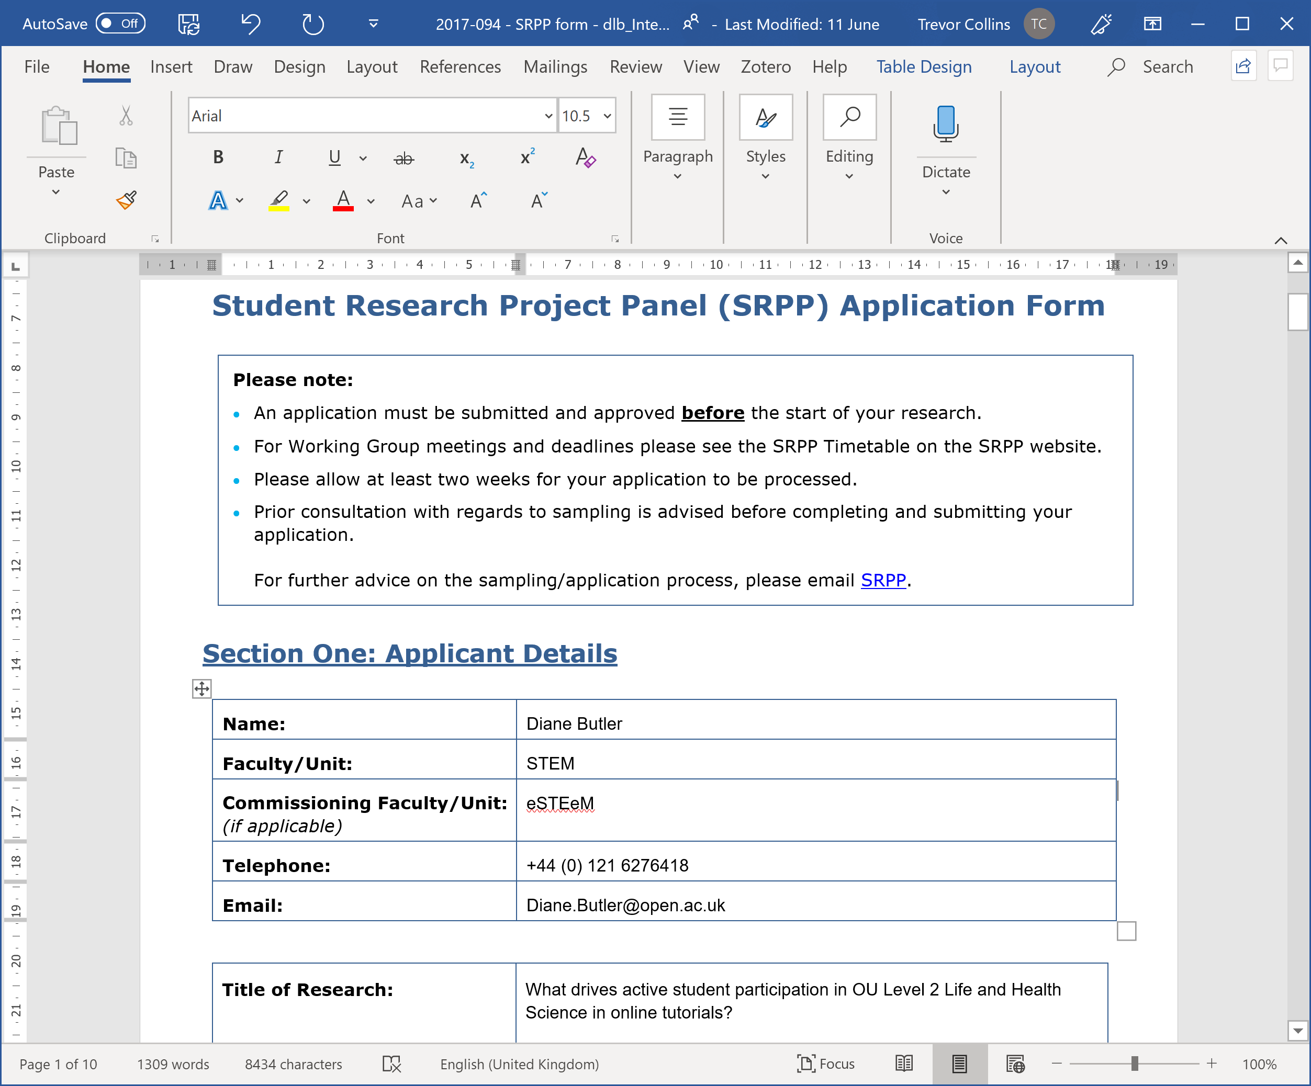
Activity – Reviewing an example
CRITERIA | EVALUATION
Working group member | A.N. Commenter
Rationale and approach | Clear link from objectives to research questions, of strategic benefit to the university
Questionnaire / interview schedule | Generally fine – but could this be shorter? Q11: Typo in ‘agree’ Q12: Use standard ‘very / fairly / not very / not at all’ scale
Invitation | Re-order to give background details about researcher before information about confidentiality. Add standard data protection wording.
Sample / demographics | Perhaps add ethnicity to demographics?
Approve / Reject | Approve
http://bit.ly/srpp-db-2017
Notes:
In pairs or threes: discuss and critique this (random) example ~ 15 minutes
Plenary feedback: discuss critiques ~ 15 minutes

Slide 14
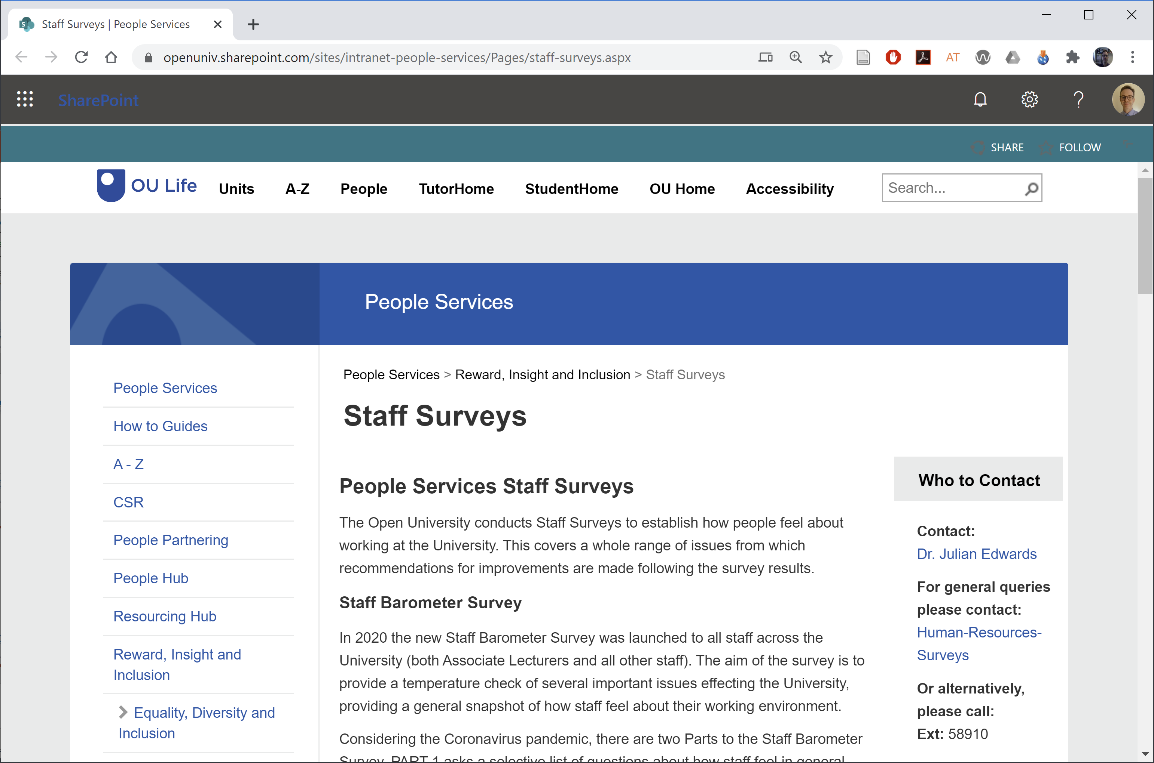
Staff Survey Project Panel (SSPP)
Who needs to apply?
“Small-scale surveys that require less than 30 responses from staff do not need approval from the SSPP” (SSPP guidelines)
For example: Surveying 30 or more associate lecturers
https://openuniv.sharepoint.com/sites/
intranet-people-services/Pages/staff-surveys.aspx
Email: Julian.Edwards@open.ac.uk
Notes:
https://openuniv.sharepoint.com/sites/intranet-people-services/Pages/staff-surveys.aspx

Slide 15
Gaining approvals for your scholarship project
Trevor Collins and Mark Jones
eSTEeM Community Event
Academic Professional Development
Thursday, 25th February 2021
esteem@open.ac.uk
www.open.ac.uk/esteem
@OU_eSTEeM

