Slide 1


Gaining approvals for your scholarship project
Diane Butler and Trevor Collins
eSTEeM Centre for STEM Pedagogy
Academic Professional Development
Tuesday, 28th July 2020
eSTEeM

Slide 2
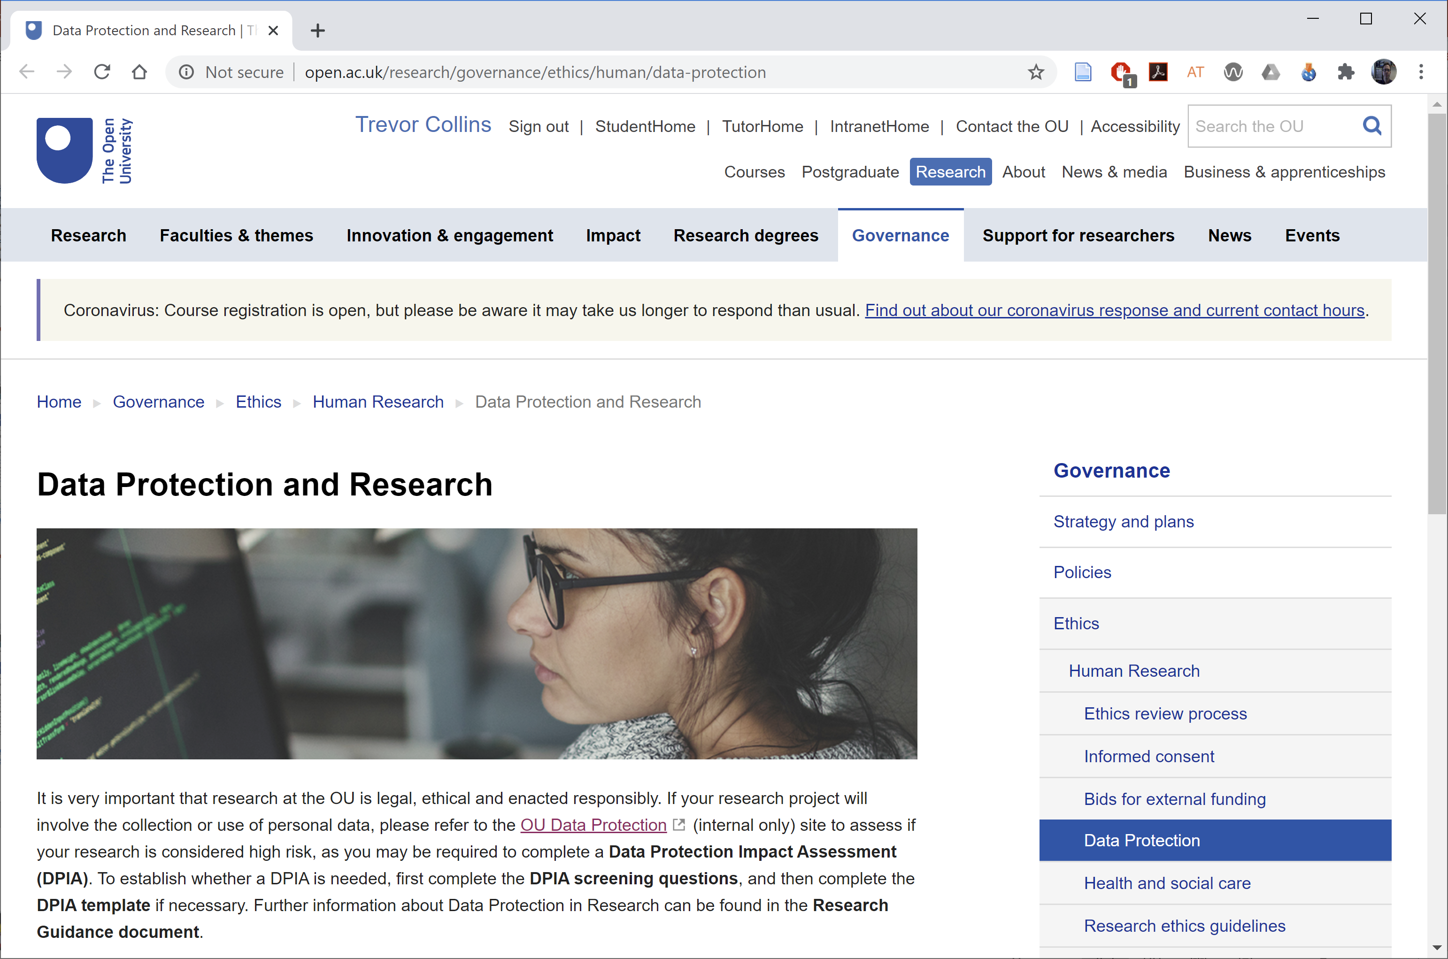
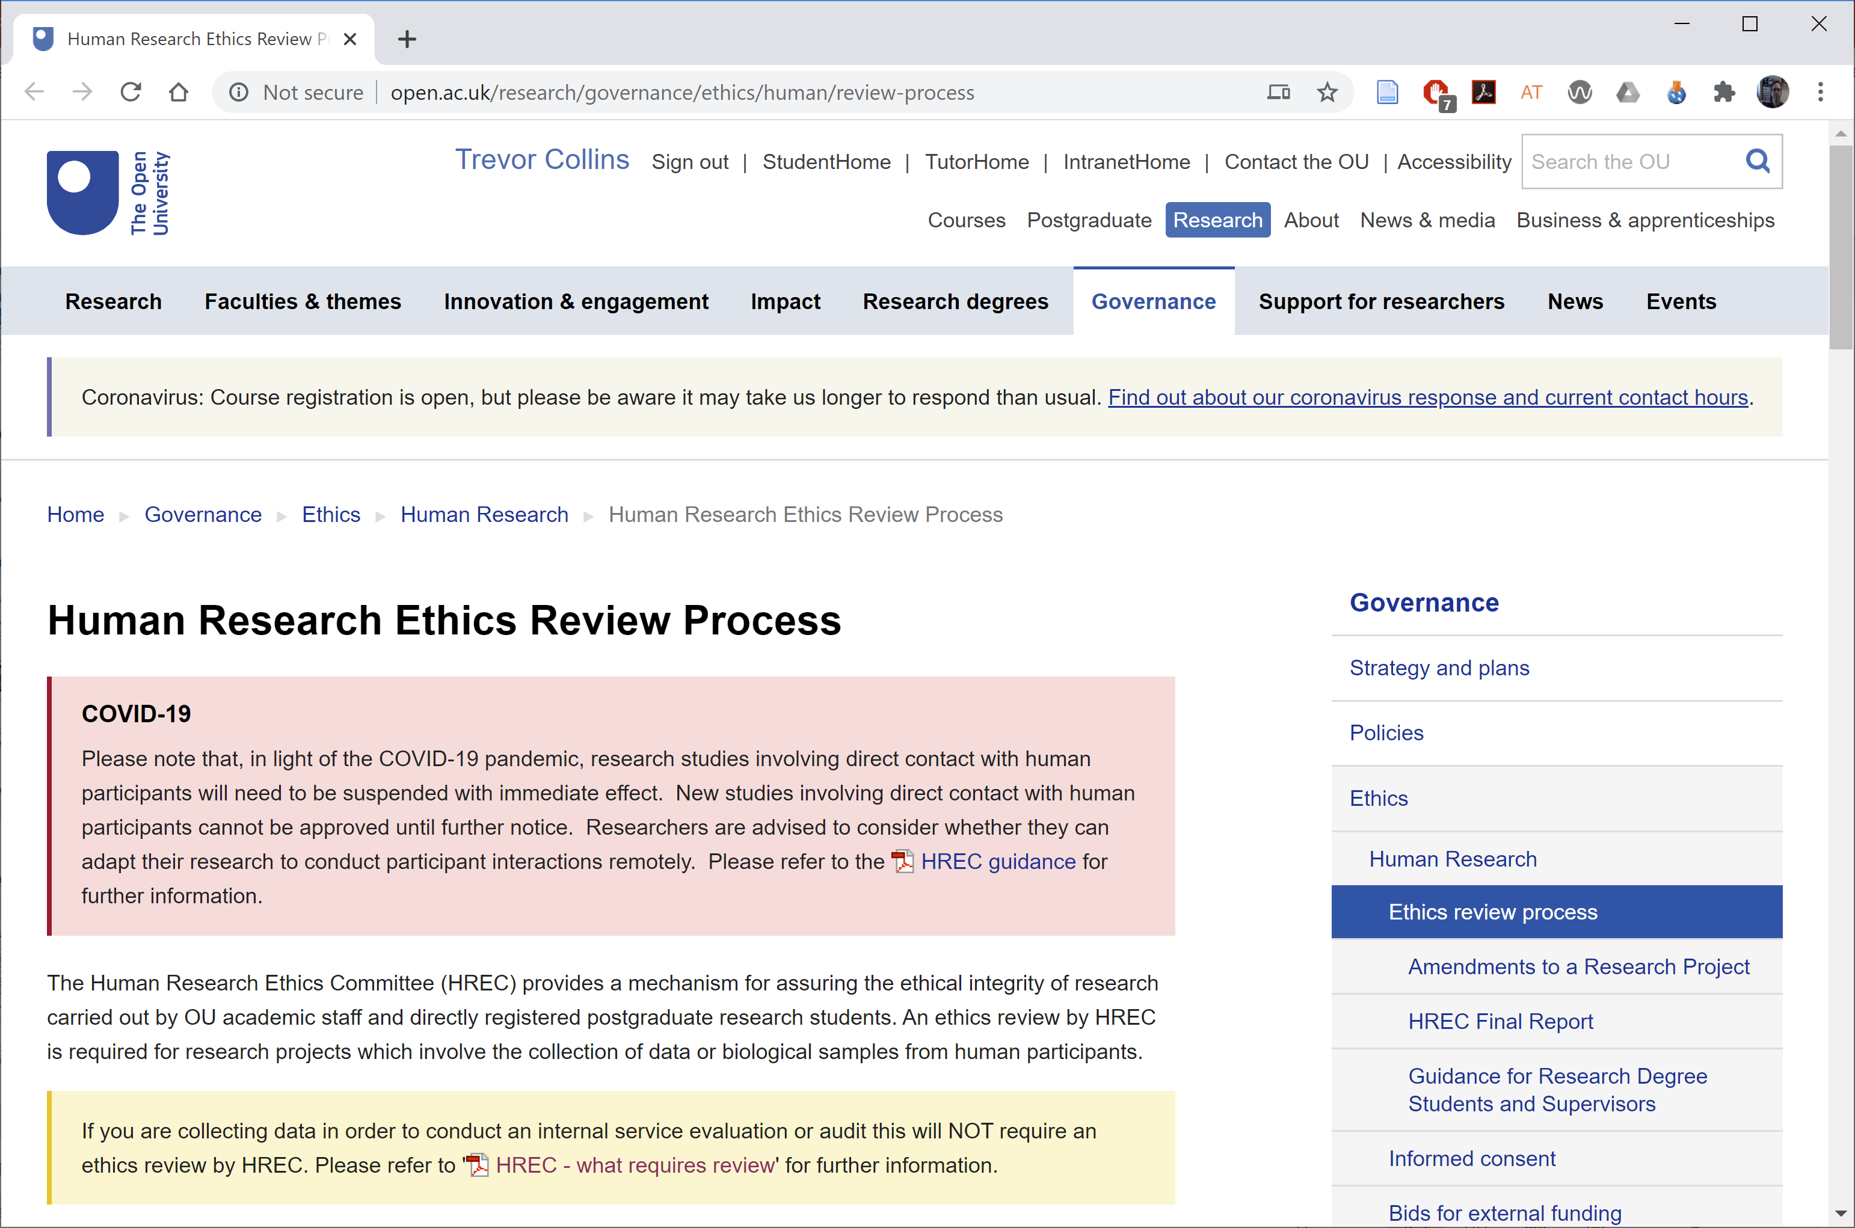
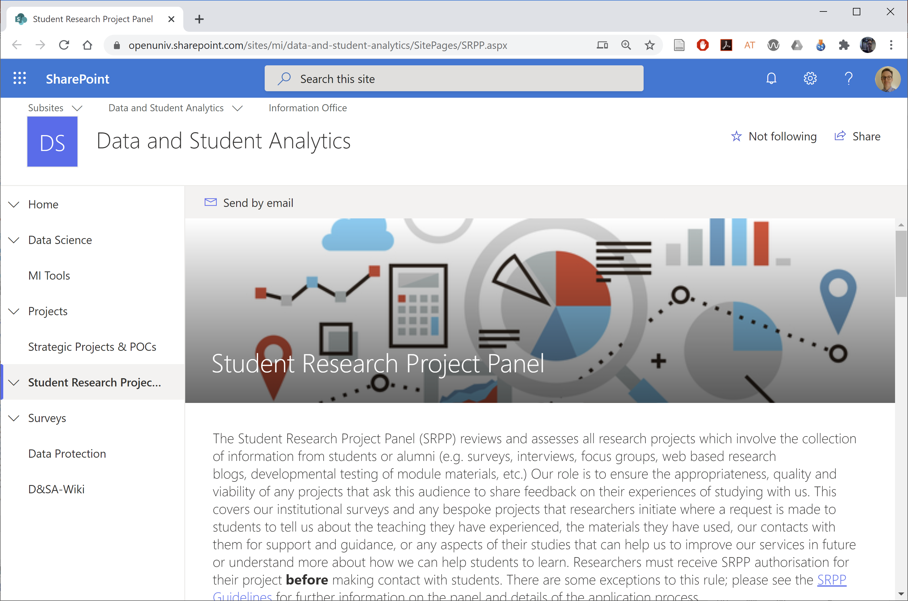
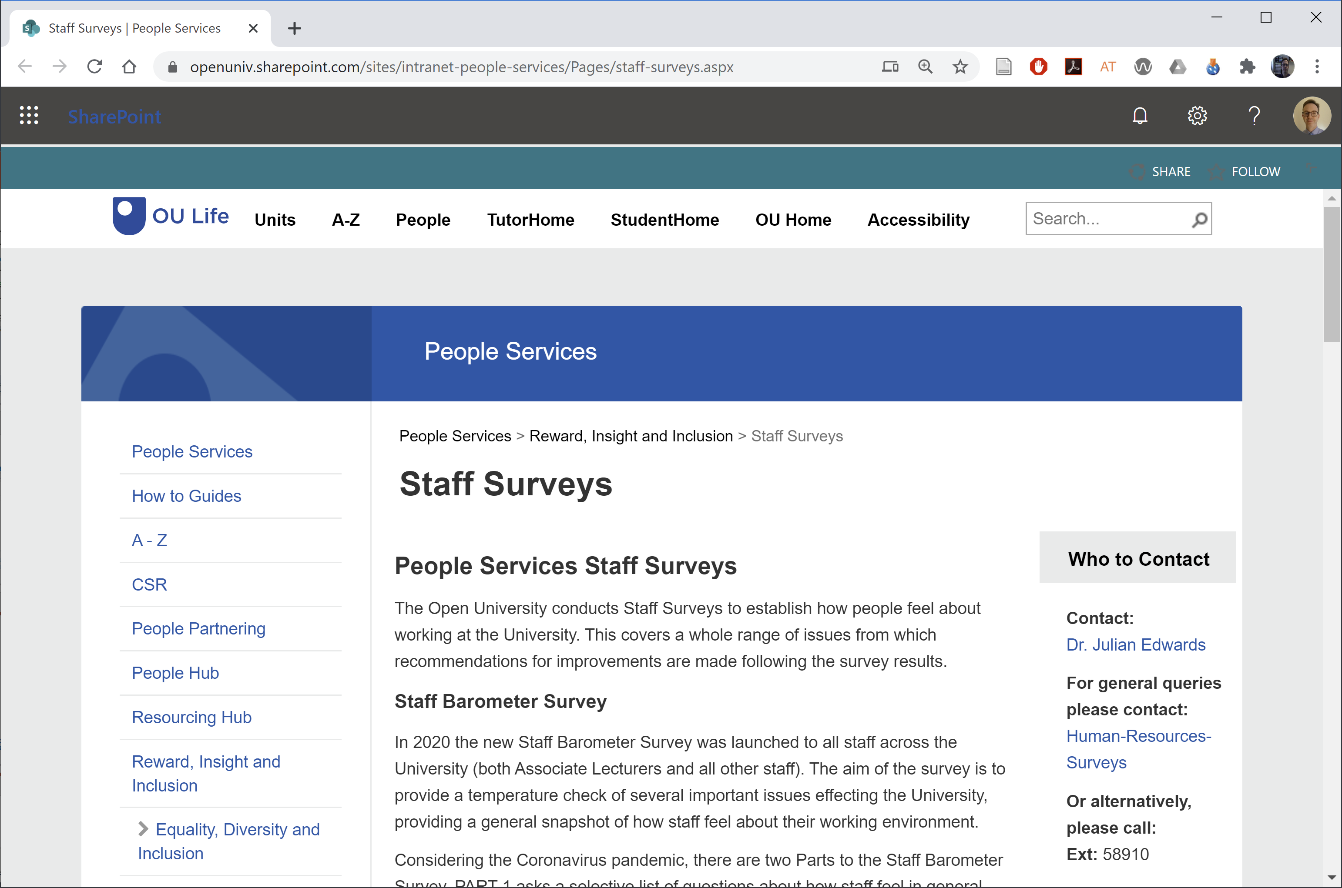

Overview
Introductions
  Introduce yourself, your role and your project
Gaining approvals for your project
  Human Research Ethics Committee
  Student Research Project Panel
  Data Protection and Research
  Staff Survey Project Panel
Questions and next steps
Notes:
Introductions [Trevor]
Introduce: You, your role and your project
Approvals
HREC [Trevor]
SSRP [Diane]
Data protection [Trevor]
SSPP [Diane]
Questions and next steps [Diane]

Slide 3
Human Research Ethics Committee (HREC)
Any research involving data collection from human participants requires ethics review by HREC
1. Complete the ‘HREC Project Registration and Risk Checklist’ plus documentation related to your project (e.g. consent form, participant information sheet, or questionnaire; response 7 days)
2. If required complete ‘HREC application form’ plus docs (response up to 3 weeks)
http://www.open.ac.uk/research/governance
/ethics/human/review-process
Notes:
http://www.open.ac.uk/research/governance/ethics/human/review-process

Slide 4
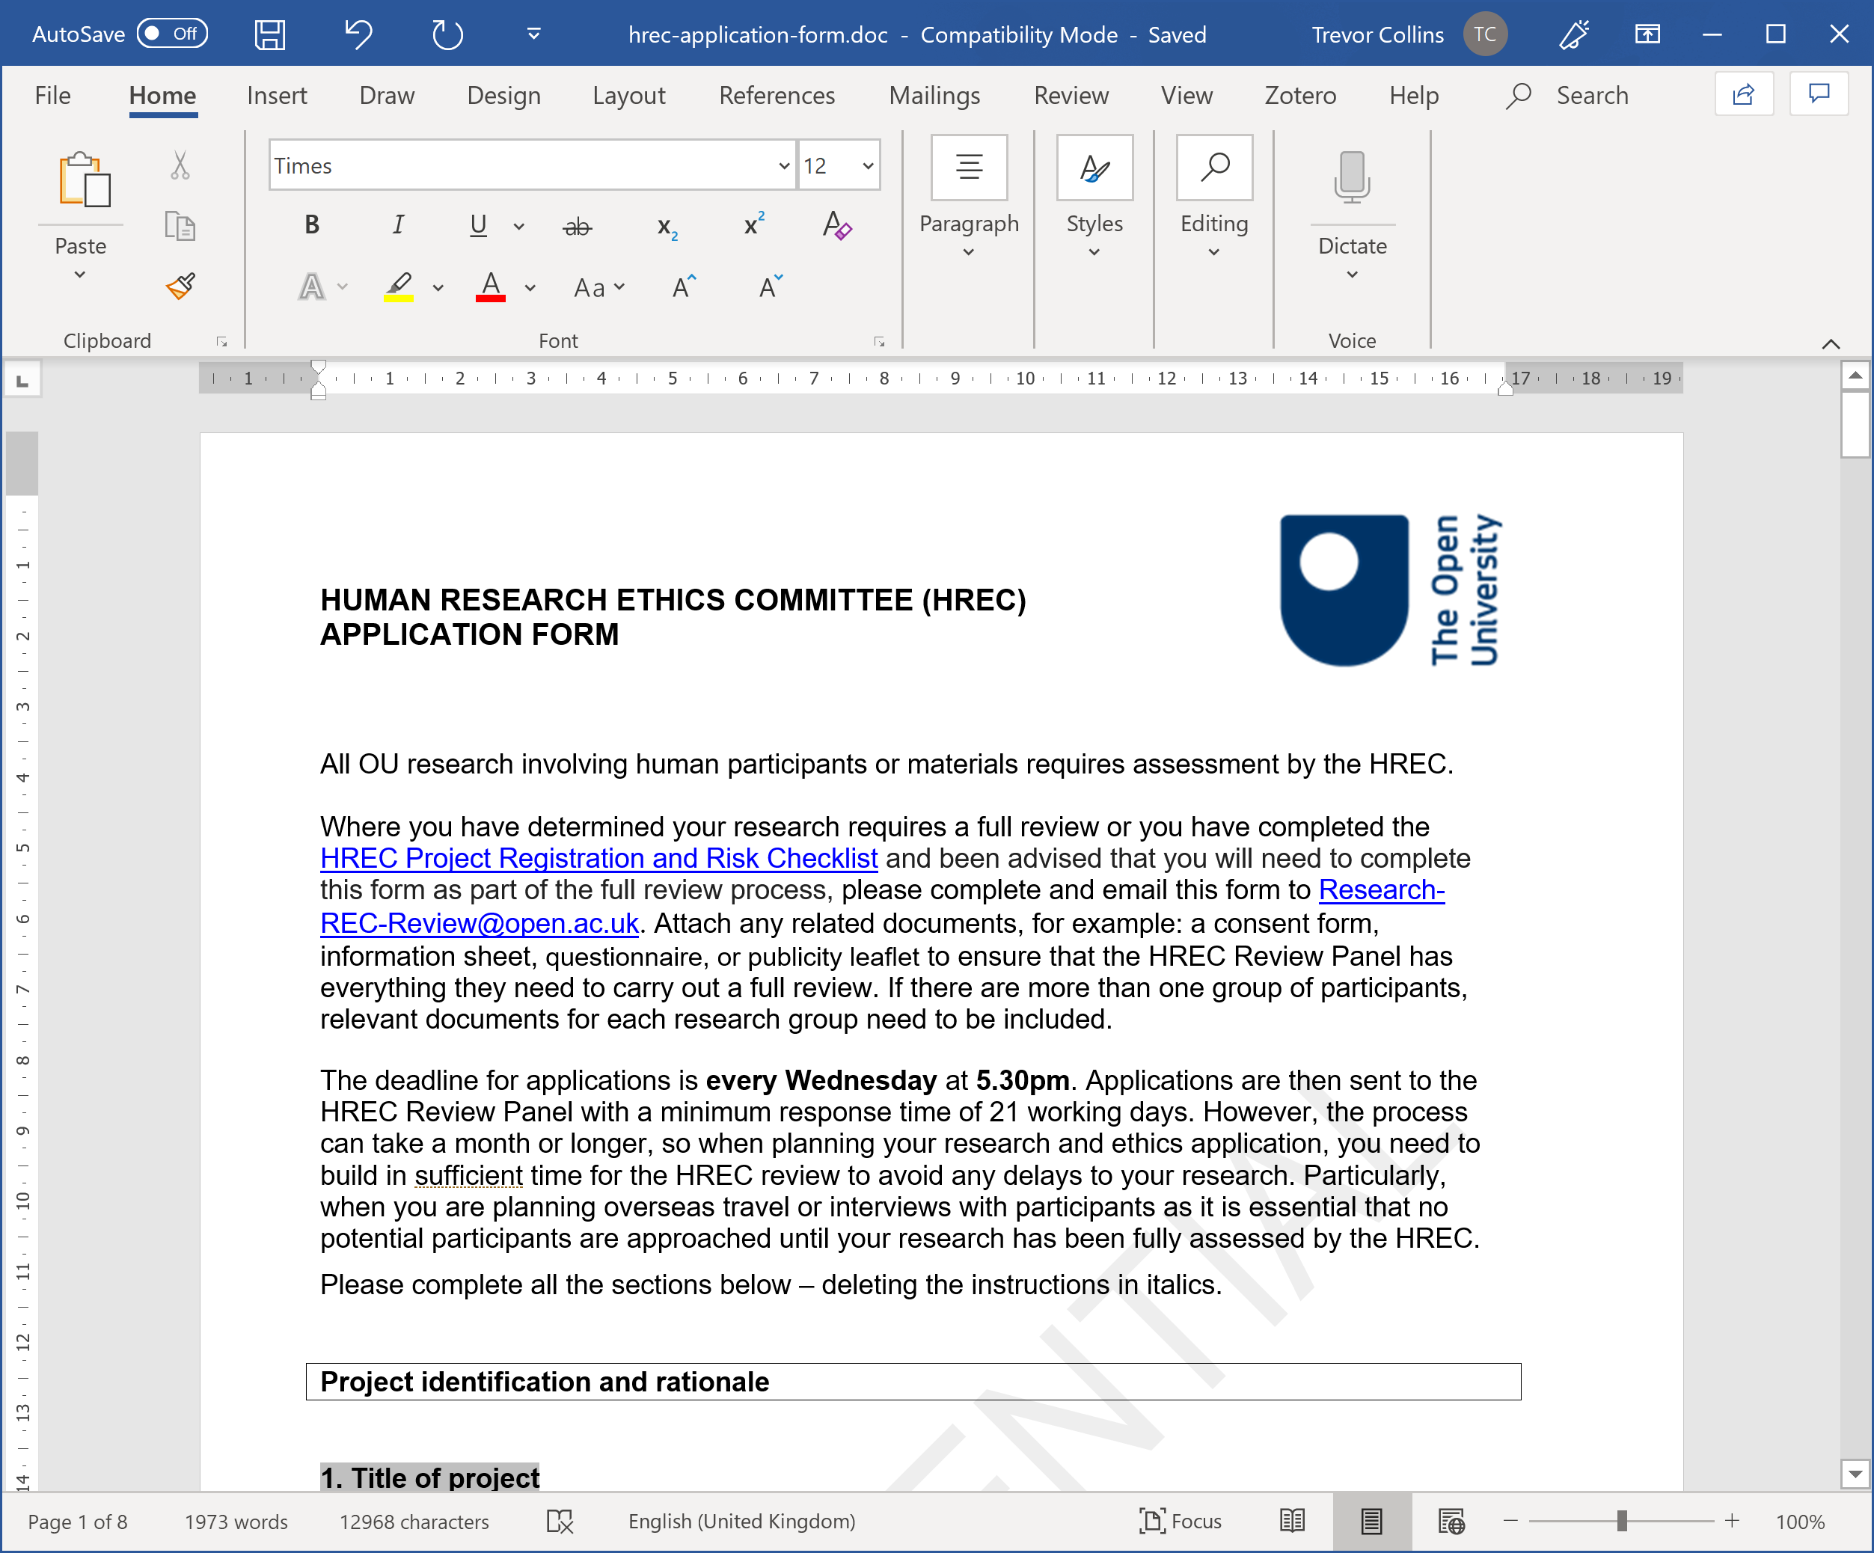
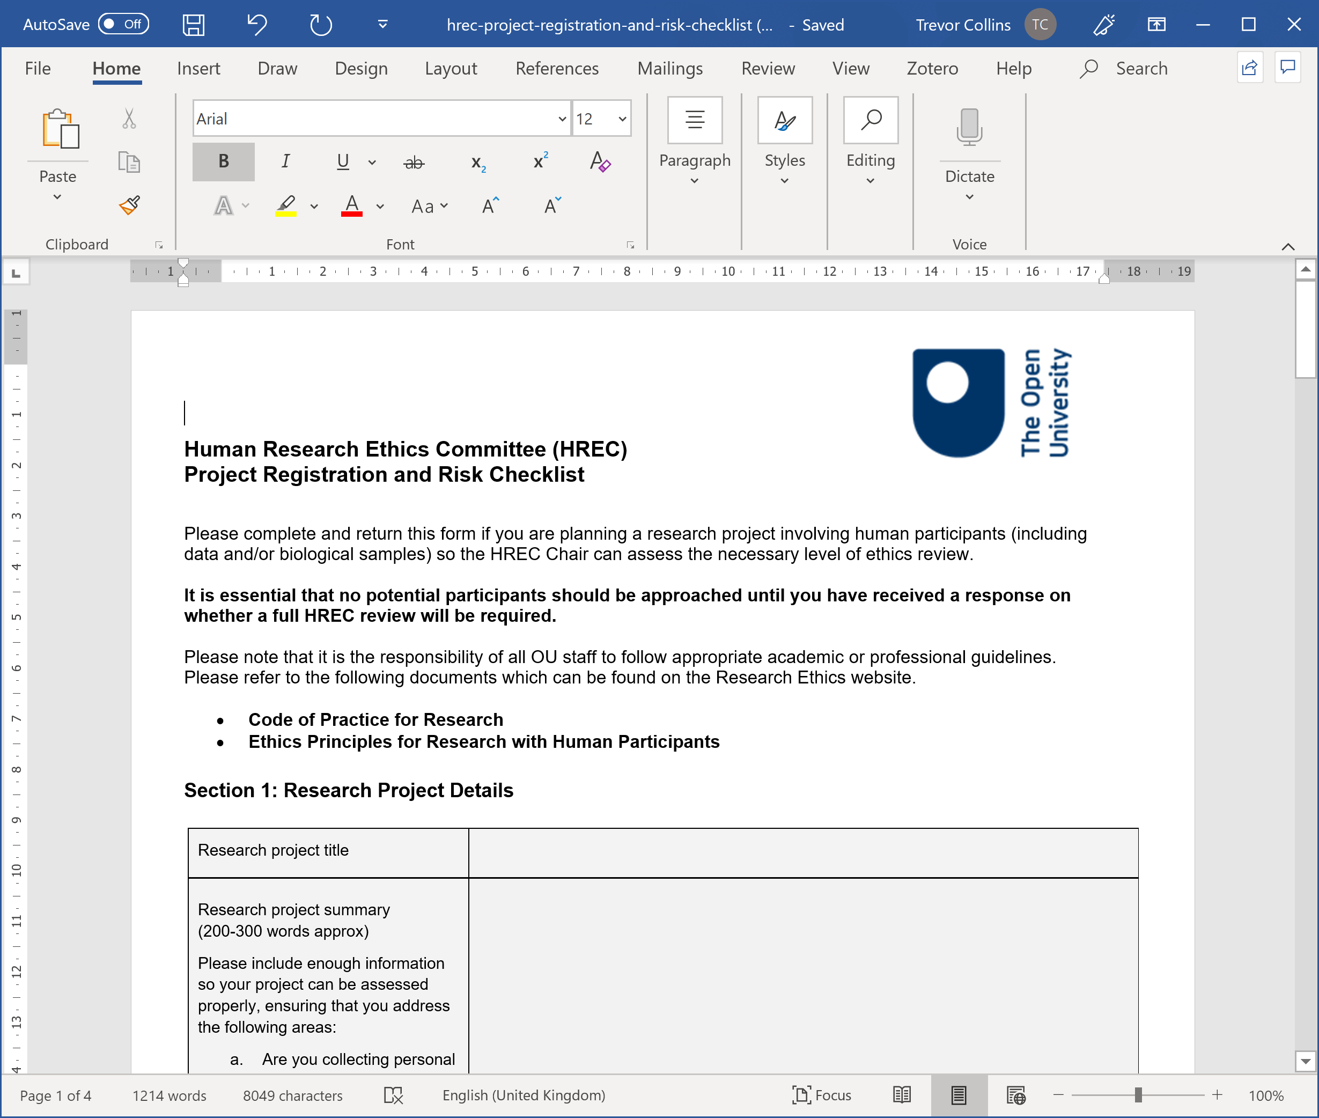
Activity – Check the ethics for your project
Checklist activity
  For your project (or future project)
  Review and answer the Higher Risk, Lower Risk and Health Research Authority questions
  Any questions / comments
Walkthrough the HREC form
  Abstract (max 200 words)
  Methodology
  Recruitment procedures
  Risk of harm
  Benefits and knowledge transfer
http://www.open.ac.uk/research/governance
/ethics/human/review-process
Notes:
http://www.open.ac.uk/research/governance/ethics/human/review-process

Slide 5
Student Research Project Panel (SRPP)
Any research which involves making contact with current students, alumni or enquirers needs to be approved by SRPP
Check out the examples when drafting your application
SRPP review applications fortnightly (allow three weeks for a response)
  4pm 5th Aug (decision 13th Aug)
  4pm 19th Aug (decision 27th Aug)
  4pm 2nd Sep (decision 10th Sep)
https://openuniv.sharepoint.com/sites/mi/
data-and-student-analytics/SitePages/SRPP.aspx
Notes:
https://openuniv.sharepoint.com/sites/mi/data-and-student-analytics/SitePages/SRPP.aspx

Slide 6
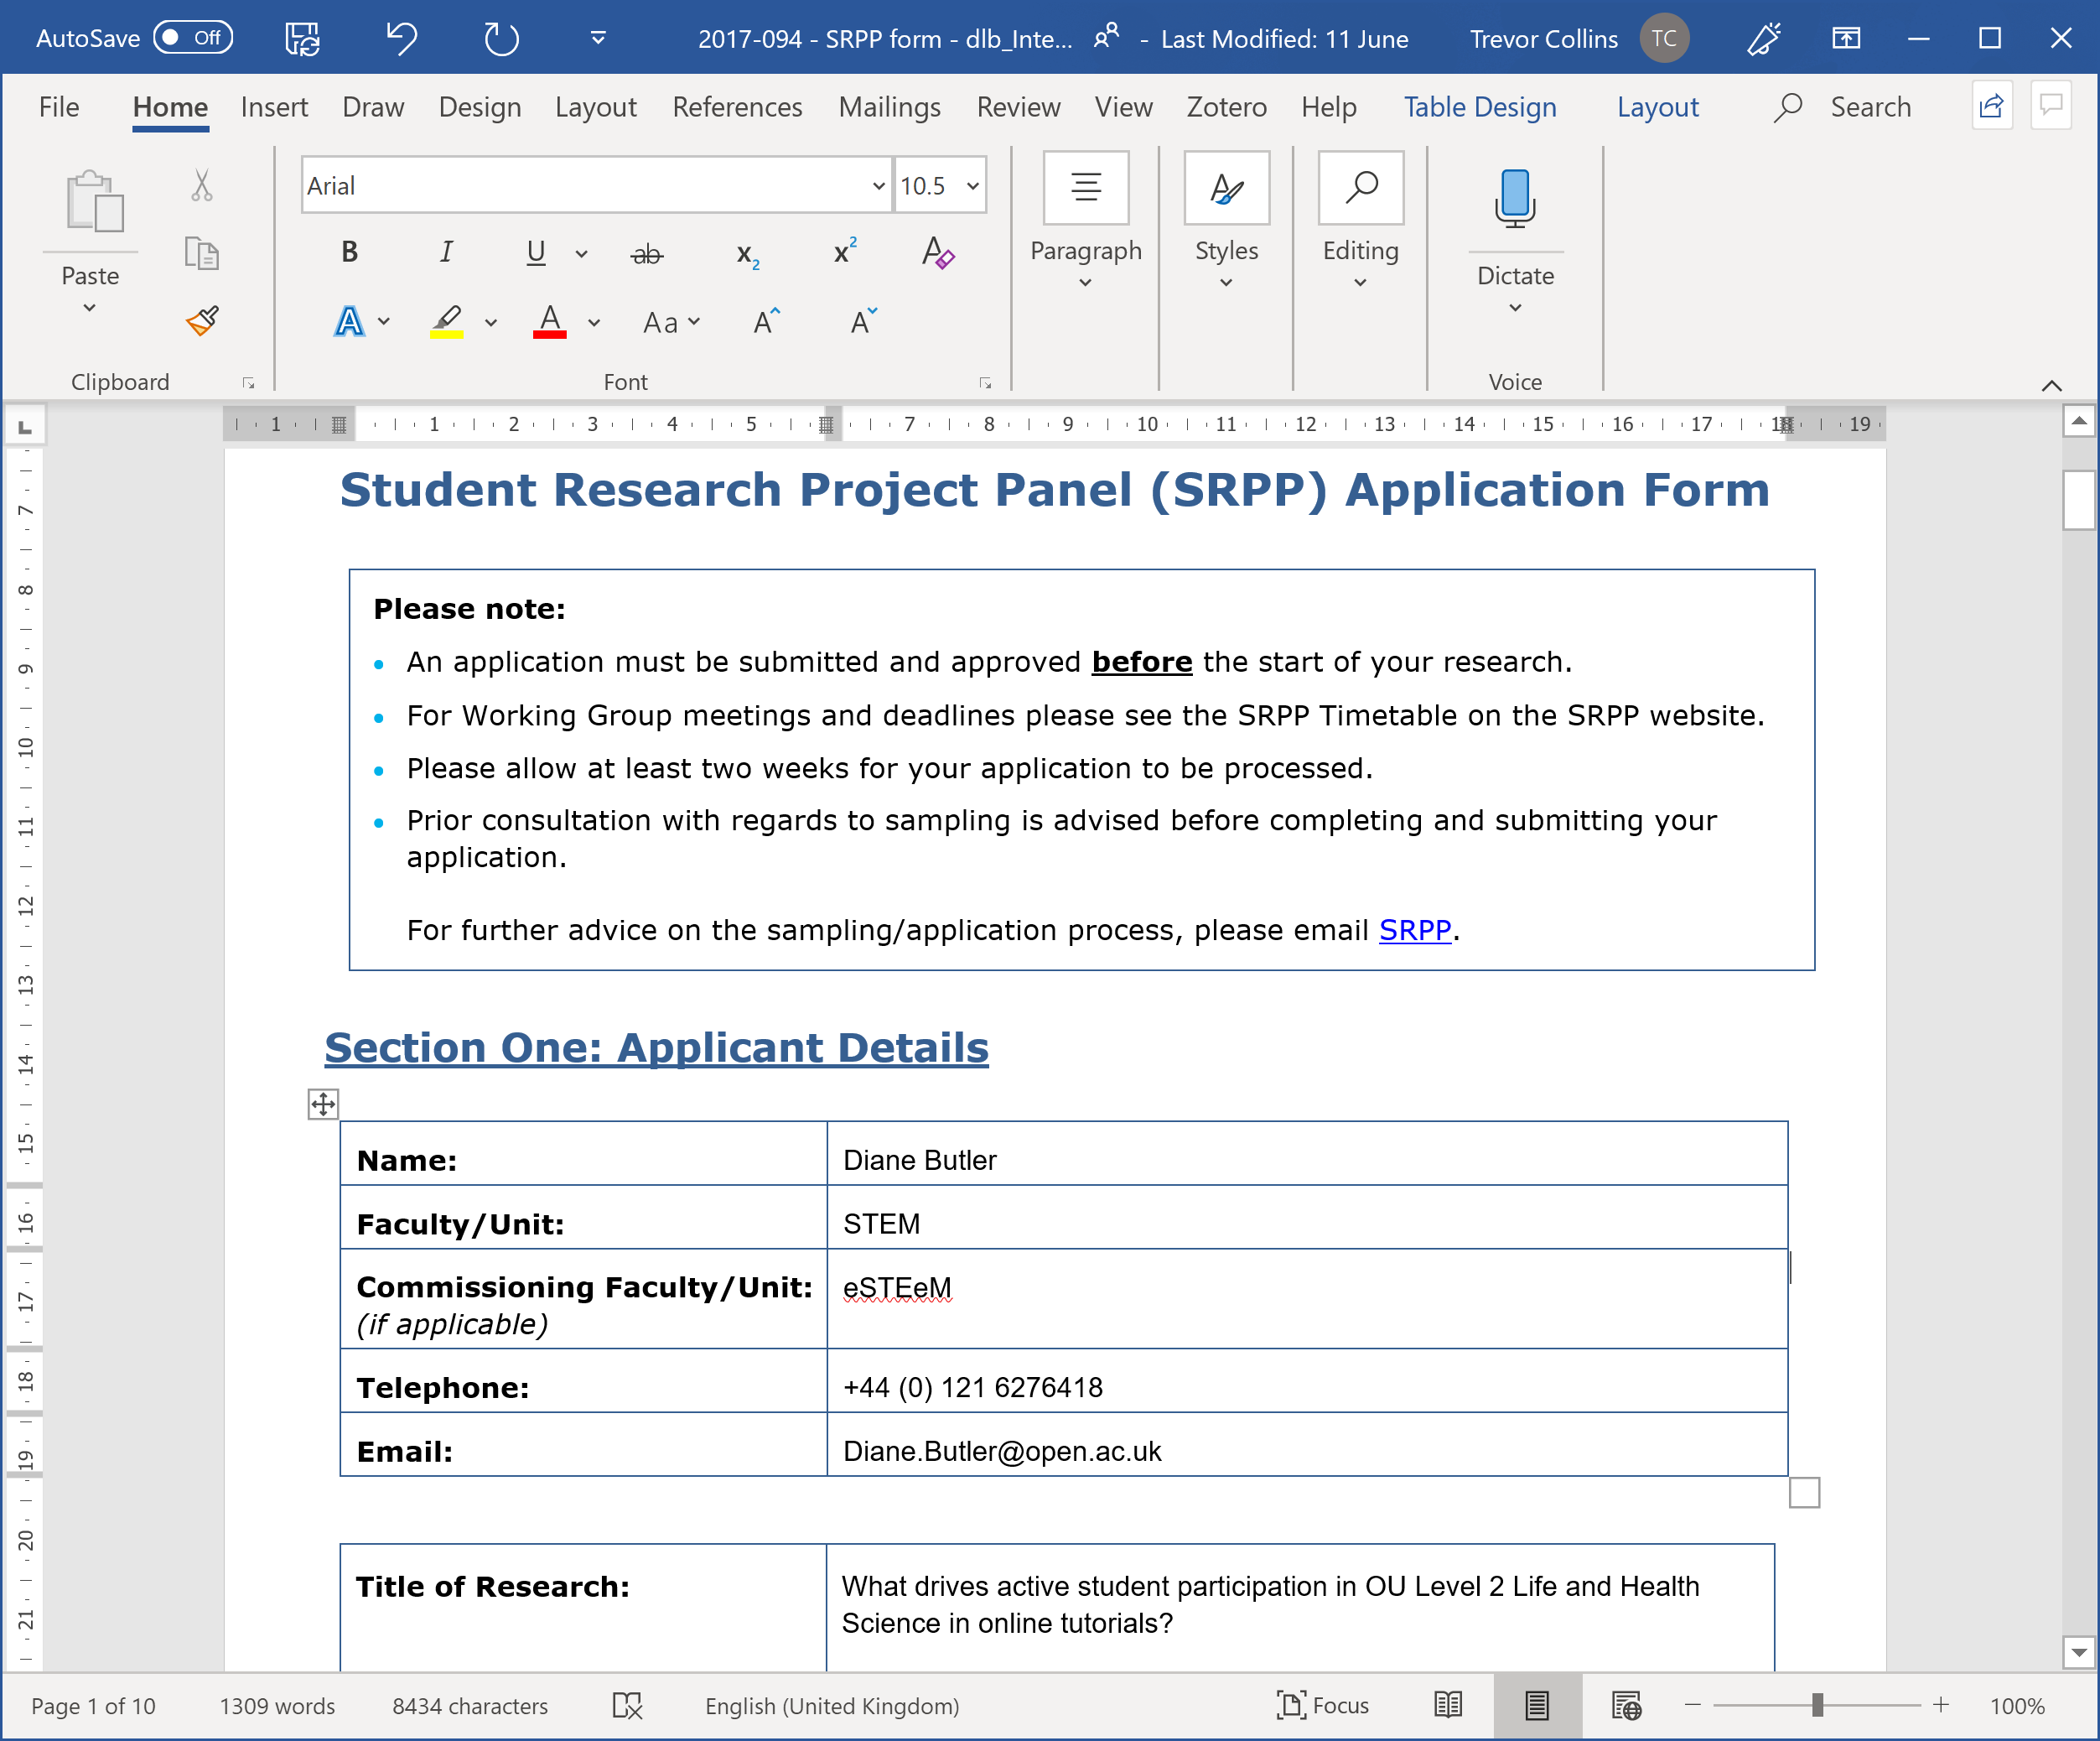
Activity – Critiquing an example
CRITERIA | EVALUATION
Working group member | A.N. Commenter
Rationale and approach | Clear link from objectives to research questions, of strategic benefit to the university
Questionnaire / interview schedule | Generally fine – but could this be shorter? Q11: Typo in ‘agree’ Q12: Use standard ‘very / fairly / not very / not at all’ scale
Invitation | Re-order to give background details about researcher before information about confidentiality. Add standard data protection wording.
Sample / demographics | Perhaps add ethnicity to demographics?
Approve / Reject | Approve
Notes:
In pairs or threes: discuss and critique this (random) example ~ 15 minutes
Plenary feedback: discuss critiques ~ 15 minutes

Slide 7
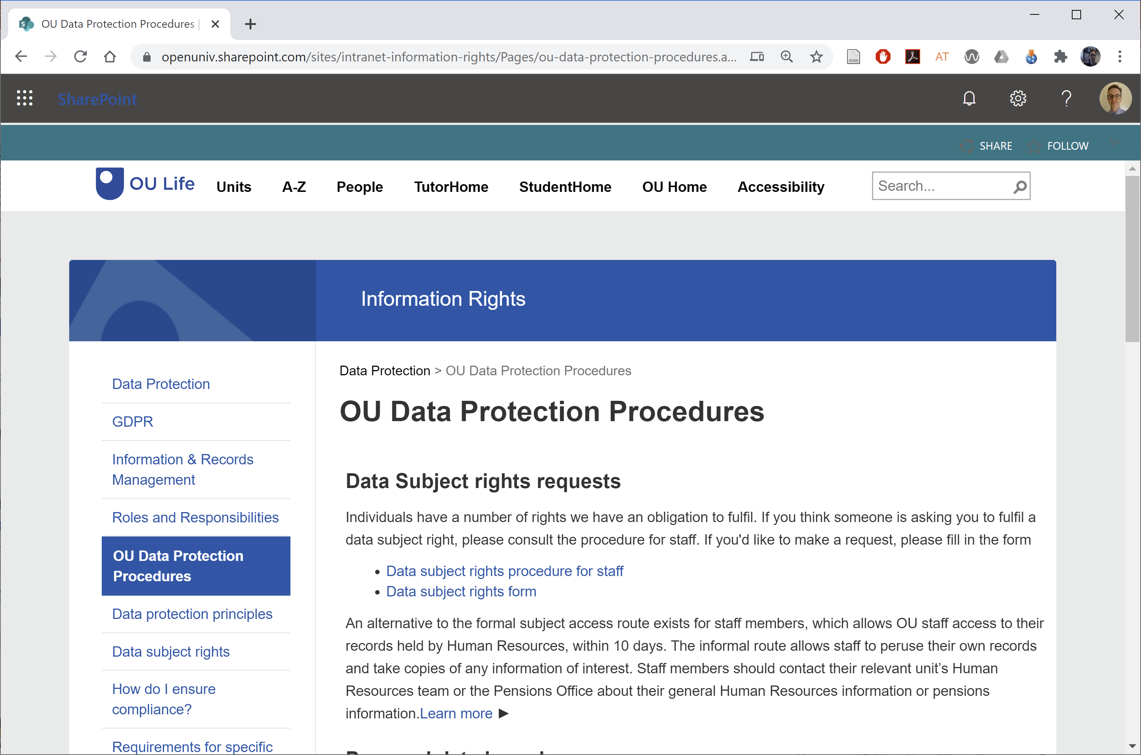
Data Protection and Research
http://www.open.ac.uk/research/governance/
ethics/human/data-protection
https://openuniv.sharepoint.com/sites/
intranet-information-rights/Pages/
ou-data-protection-procedures.aspx

Slide 8
Staff Survey Project Panel (SSPP)
Who needs to apply?
“Small-scale surveys that require less than 30 responses from staff do not need approval from the SSPP” (SSPP guidelines)
For example: Surveying 30 or more associate lecturers
https://openuniv.sharepoint.com/sites/
intranet-people-services/Pages/staff-surveys.aspx
Notes:
https://openuniv.sharepoint.com/sites/intranet-people-services/Pages/staff-surveys.aspx

Slide 9
Questions and next steps

