Slide 1
How useful are the Are You Ready for Your Studies Quizzes?
Soraya Kouadri Mostéfaoui and Oli Howson
School of Computing and Communications
Notes:
Welcome and introductions – random, introduce if speak, or if in a breakout room introduce yourself. Ask facilitators to introduce themselves. Explain why we have several people present – C&E WG from AGIG.
Cameras on to reduce transactional distance and to support creating a psychologically safe environment – explain that some of the initial slides colleagues who attended the first session will recognise but that we’re including these in all the sessions as it’s important to remind ourselves of the terms of engagement.
What do you want to get out of the session today?

Slide 2
Context and aims
The Are You Ready for Your Studies Quizzes have been implemented within the school of Computing & Communications to help students decide whether they are ready to study a module.
The quizzes are usually in three parts each with a varying number of questions.
  In Part 1 students are asked a few general questions about their previous experiences.
  In Part 2 students are asked more specific questions related to the module content.
  In Part 3 they are asked about how they found the test. After they are done, students are given a score and a general impression of whether they are ready for the module.

Slide 3
Context and aims
To evaluate the usefulness of the ARFY quizzes for the core level 2 modules.
Are the quizzes really assessing the students’ readiness to begin studying their level 2 modules?
Do the quizzes give an accurate indication of future success?
The study focuses particularly on programming heavy modules with low retention and/or student satisfaction. Modules M250, TT284 and M269 were investigated, along with TM255 which was used as a comparator module as it is Level 2 with non-programming content.

Slide 4
Data collection
The research data includes:
  two focus groups of module team members and tutors of the level two modules investigated (n=9);
  A survey of level two students (n=74);
  and a follow up in depth interview with five of the survey respondents.
These three sets of data were considered separately before a triangulation of the results was performed.

Slide 5
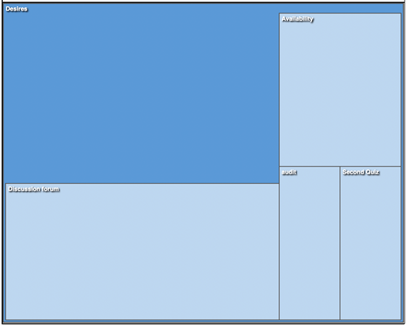
Data analysis –focus group with educators-

Slide 6
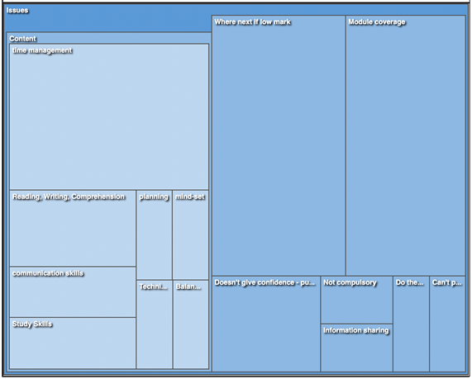
Data analysis –focus group with educators-

Slide 7
Data analysis - focus group with educators
Five advantages were identified, with only module coverage, and the potential for highlighting needs, identified more than once, and technical thinking, boost confidence, and non-threatening each appearing once.
The desires for (future iterations of) the quizzes included a discussion forum where students could discuss the quiz questions; availability; a second quiz; and an audit.
The most common specific desire was for students to have the opportunity to discuss the quizzes and their results.

Slide 8
Data analysis –students’ survey
The online survey received 74 responses
Results discussed below should be considered in conjunction with the knowledge that:
  many respondents (56%) took the quiz after registering for the module, 7% of these took it after the module had started.
  38% of respondents took the quiz before registration,
  The remaining 15% could not remember when they took it.

Slide 9
Data analysis –students’ survey
 | Question | % agree | % ambivalent | % disagree
4 | feedback helpful on question fail or low result | 71 | 22 | 7
6 | felt less anxious about starting the module | 54 | 33 | 13
7 | single question per topic is sufficient | 42 | 21 | 37
8 | would prefer two questions per topic | 63 | 27 | 10
9 | would prefer two questions per topic at different levels | 71 | 18 | 11
10 | overall felt it assessed readiness to study | 62 | 28 | 10
11 | recommend use of such diagnostic quizzes | 76 | 18 | 6
 | average | 63 | 24 | 13

Slide 10
Data analysis –students’ interviews-
To make the quizzes better it was suggested that:
More focused feedback on errors could be provided
The quizzes should be tailored to represent the content of the module more accurately, for example so that they do not give unwarranted confidence, specifically: where a module has a large reporting element, that should be represented in the quiz
Harder questions could be included that are more representative of course content
A larger pool of questions could be drawn from so that the quizzes can be used for preparation for the module
Longer questions could be included

Slide 11
Data analysis –students’ interviews-
‘I found it's reassuring in in in that I could answer all the questions correctly’
‘it sort of pointed out which bits I knew and which bits
I kind of needed to go back and have another look at’
‘It led me to go and and do some specific preparation, particularly from TM250 in terms of learning a bit of Java’
‘thought I looked at them as I was looking at which modules I was going to choose so it also gave me an opportunity as I was looking at the modules to take over what was there and what it was going to be involved’.

Slide 12
Data analysis –ARFY and Module results analyses
Of the completed survey responses, 66 could be matched with course grade,
39 could be matched with both grade and ARFY quiz results (when considering the data from the 2020J students).
Course grade could be matched with quiz results for 1,403 who were taking M250, M269, TT284 or TM255.

Slide 13
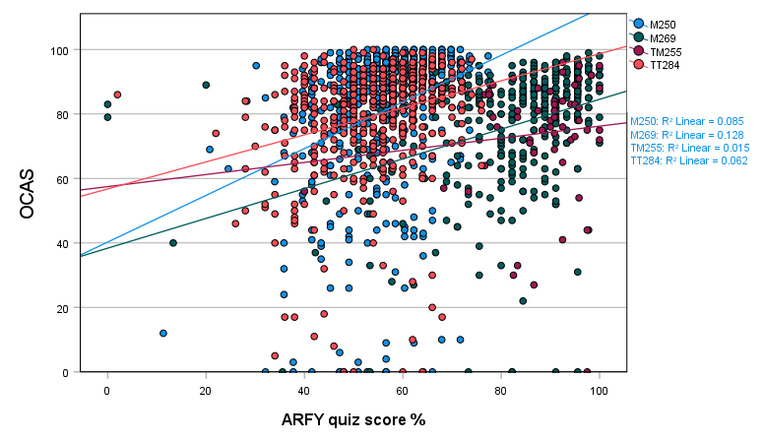
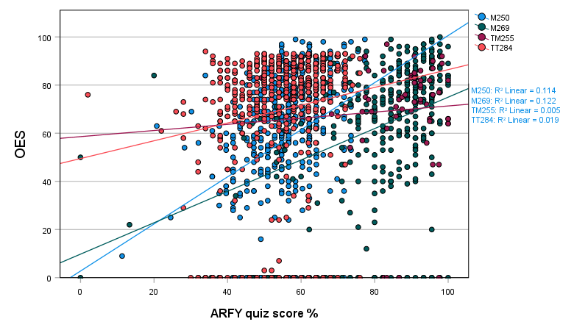
Data analysis –ARFY and Module results analyses

Slide 14
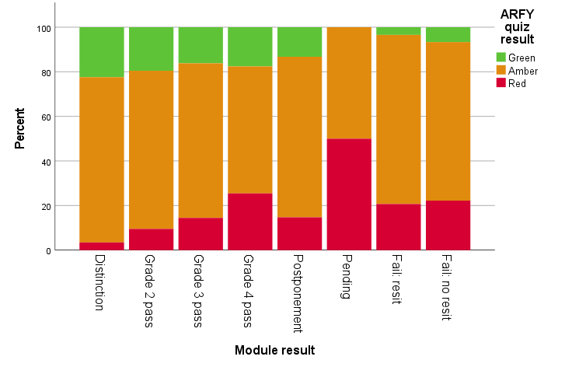
Data analysis –ARFY and Module results analyses
Those who achieved a ‘Green’ result on the ARFY quiz were more likely to achieve a distinction on their course, χ²(14)=83.61, p<0.001; 35.4% of those achieving a ‘Green’ result achieved a distinction,
30.1% of those who got Amber and only 8.8% of those who got Red managed the same.
Of those who failed the course, only 5.9% had achieved a Green result on the ARFY quiz, while 72.2% had got Amber and 21.8% had got Red.

Slide 15
Data analysis -3-
A statistical analysis was carried out to measure linear correlation for each module between quiz results and final grades using Pearson’s correlation coefficient.
It is reasonable to use the AYRF results as an indicative predictor towards final grades for three of the four modules included in this study (TT284, M269 and M250) as these all had a significant correlation at p < 0.5.
It would not be reasonable to use the TM255 AYRF results as predictors toward the module’s final results; the far lower completion rate of the AYRF quiz for TM255 led to very little data being available for analysis.

Slide 16
Findings – Educators perspective-
The issue of ‘where to go next’, if a poor result was achieved, and the lack of a discussion forum where students can discuss the quizzes and their results, emerged as themes for suggested improvements.
The availability of a second quiz midway through the module presentation to assess the students’ progress
Allowing for increased module content coverage and the inclusion of softer skills such as report writing and time management were also suggested as potential ways of better assessing the readiness of students.

Slide 17
Findings – Students’ perspective-
The most valuable aspect of the quiz for all participants is that it gives an insight into their potential for success in the module.
Most participants interviewed found that the quiz offered an opportunity to refresh information from previous modules, including identifying areas to be addressed.
The same participants also found it provided an opportunity to develop their skills before the start of the module.
Students have, suggested that the quizzes should be tailored to represent the content of the module more accurately, including harder/longer questions that are more representative of module content.

Slide 18
Slide Title 31

