Slide 1
Perceptions, Expectations and Experience of Group Tuition: towards a shared understanding amongst stakeholders (part II: the student perspective)
Anne-Marie Gallen, Senior Lecturer, Engineering and Innovation
Mark Jones, Senior Lecturer, Physical Sciences
Anne Campbell, Educational Developer, ALSPD

Slide 2



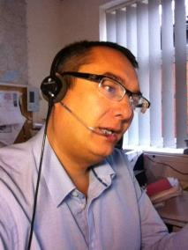


Background
Our research question
Do our students, teaching staff and other staff have common perceptions and expectations of what tutorials are for?

Slide 3

Why does a common perception matter?
Our tutorials are not mandatory. So student perception influences levels of attendance, as well as levels of participation during a tutorial.
Our authoring teams design tuition strategies, which may encourage or discourage students from attending/participating in learning activities during tutorials.
Our tutors design and run tutorials which influence student perceptions (the first tutorial can set expectations), and determine opportunities for learning.
Other stakeholders can influence university-wide policy (e.g. professional services staff), or can affect tutor perceptions (e.g. staff developers).
From the literature, for example Ogina & Mampane (2013):
“A common understanding of the role of tutor is crucial so that tutors and students know what to expect in a tutorial session.”

Slide 4

Project aims
Image: freepik.com
Broadly, to work towards identifying and developing a common understanding of the tuition of groups, within the STEM faculty and across the university more widely.
      To investigate differences in perceptions of face-to-face and online tuition between different groups.
      To understand tutor perceptions of tuition
      (Phase 1, completed & published)
      To understand student perceptions of tuition
      (Phase 2, current)
      To understand other stakeholders’ perceptions
      (Phase 3, future)
To develop faculty and institutional advice for students, tutors and other staff to address mismatches.
To disseminate to staff developers, module authoring teams, relevant professional services staff, and throughout the sector.
Notes:
Note that this is not about investigating the implementation of the group tuition strategy per se, although obviously there is a clear influence in the current investigation. The initial investigation with tutors was done before GTP implementation and we suspect that tutor perceptions have changed.

Slide 5
Methodology
Phase 1: Associate Lecturer perceptions on the role of tutorials in distance learning, completed & published (Campbell et al. 2018)
Qualitative data collection via semi-structured conversations with 19 STEM tutors teaching at Level 1 (modules in Science, Engineering & Technology, Maths).
Thematic analysis.
Phase 2: Student perceptions of group tutorials (whether having attended a tutorial or not attended any tutorials)
Quantitative and qualitative data from a student survey: answered by 263 students studying five Level 1 modules. Reported 2020 eSTEeM conference.
Qualitative data collection through in-depth semi-structured interviews with 8 student volunteers from the survey group.
Full data analysis – thematic analysis in Nvivo. Comparison with tutor perceptions from Phase 1. Initial reporting here.

Slide 6
AL Perceptions
What were ALs’ perceptions and expectations?
Saw their role being facilitators of student learning
  Building confidence and motivation
  Offering chances for student social interaction & social learning
  Tackling threshold concepts & skills and tricky topics
  Encouraging collaboration and group work
  Opportunity to intellectually challenge students
Tutors believed that students expect a didactic experience focussing on assessment tasks
Focus on lower attendance and general decline in numbers (both f2f and online)

Slide 7
Before tutorials
Many students had initial worries and misconceptions about tutorials:
Ranged from uneasiness and apprehension to anxiety
“…my initial thoughts was I was a little bit worried (laughs) if I’m honest because I thought well I don't, I don't fully understand what this is about and I wasn't sure if I was completely prepared for University”
“…fear and dread that I was going to be on the spot and asked questions…”
Several times interviewees described these anxieties in the third person, suggesting a disassociation of their fears
“my concern would be people that are struggling might not want to reach out for the help and go to a tutorial with 10/15 other people and make mistakes, because, you… you get a sort of knock to your confidence, don’t you.”
Few had any of clear idea of f-2-f tutorials but some had ideas around online
“I don’t think I remember reading any article about OU tutorials in advance”
“…that American like view room kind of thing, teacher down at front of a half-moon room type of thing. I suppose that’s in my head, that’s what I thought”
Notes:
No outright terror but bear in mind these are students who have put themselves forward for interviews so are more confident
Perception of formality
Message given by optionality
Not aware of OU information about tutorials
Initial concern alleviated by title "introduction"
No preconceptions - just hoped she might learn something
Expectation of practical work in face-to-face (expected more of a lab setting)

Slide 8
Changing perceptions
Perceptions and expectations changed rapidly once students started to attend tutorials both f2f and online:
Both f-2-f and online were more useful than initially perceived
“they are definitely more help than not having them” “I did find them really really beneficial”
“I’d probably struggle a lot more…if I didn’t have the online or the face to face” “we all come out learning something from it”
The relationship with tutors was seen as a real benefit
“I’ve found the more you show you don’t understand….. the better understanding the tutor has that maybe the module isn’t quite addressing the questions everybody has.”
Other benefits were identified including building of confidence and morale
“So actually it’s quite a lot of confidence building, I think everybody benefits”
“it turned out to be less formal which was actually quite nice”
However, some students reported shortcomings
“Sometimes I felt the tutor was doing a subject that they weren’t comfortable with. And because I’m a chemist, I know my chemistry really well, so I kind of got a bit sort of fed up”
“I think there were times when I did have to you know, go to the actual topic and to read to actually clarify what er.. the person was talking about.”

Slide 9
F2f versus online?
Choices were complex and reflected students' diverse circumstances and diverse learning styles.
Students differentiate between online and face to face and see different benefits in each.
“sometimes you just need that bit of face to face and somebody and explaining what it is you’re trying to do”
“face to face there's a lot of value add there and for me, it gives you an opportunity at a certain point where you got to in your learning to ask some questions”
“You can be at home you don't have to talk, you have a choice of how you interact with people, you can speak using your microphone or you can type a question, and I think that you know, if you don’t feel like going out or you don’t feel like it today, it’s easier to access an online tutorial and do that because you can choose to what degree you engage.”
“I've had absolutely nothing but positive experience with online”
“I think because there are no visual clues, you can't see anybody else...it's not an easy to engage in a, a naturally flowing conversation.”
“the fact that they’re recorded as well, really really helpful ‘cos you can go over things”
“I think the online ones are… are easier to say oh I’ll watch that at home, rather than actually take part.”
Notes:
Some students have experience of Skype, webinars etc. and this informs their expectations.
Some students value being able to choose whether to speak, type or 'lurk' depending on how they feel.
Some students are frustrated that so few others speak.
Lack of cues online can result in tutors labouring a point which is already understood.

Slide 10
Attending/not attending
Students saw tutorials in terms of 'cost-benefit' analysis
“I think that it’s all about whether it’s relevant to you personally if you’re going to get something out of it. I do try and look for ones for the blocks that I might want.”
The timing of live tutorials (online or f2f) was seen as key to attendance
“I think having the opportunity to do it when the kids are at school, rather than then their nagging you for toast, or whatever, in the evening would…. would be beneficial”
“my tutor’s [tutorials are] actually on a Sunday. Er…. Sunday early evening and I’ve got my daughter and trying to iron and do things and get her sorted, bath and all that. So Sunday evenings are out for me”
Geography was also important for f2f - within a reasonable distance, for long enough and relevance
“I think if we’re travelling an hour away to go somewhere for the day, it would, you know, it would be good if we had the opportunity to do things that we aren’t able to do at home.”
“it's about timing for me, because you know I don't live anywhere near where they, where they have these so for me it's an hour and a half drive on a, on a Saturday”
Notes:
Cost-benefit analysis – personal, emotional, time, economic

Slide 11
Group work and social interaction
Group work was valued by students, but not always offered
"we done a group activity where we ... were measuring and you know, drawing and that was quite nice getting a hands on feel for it, cos you actually understood the concept more by doing that"
"I haven’t been able to participate in pretty much any group activity to be honest"
Social interaction was valued within and beyond the tutorial space
"what’s great there is you've got a number of other you know peers that are learning, and they will ask a question you haven't thought of for an angle you haven't thought of and then that makes you think"
"...you feel empowered, you can ask what you think is the silliest question and you find out that everybody else was thinking the same thing, but didn’t want to ask and it’s all very friendly"
"...we have a [students only] whatsapp group… for the engineering side, we have little chats around some of the questions … day to day life you know what you're doing today that kind of thing but a lot of it's an engineering problem, or ooh you see this on TV, it's really exciting. And that's great because you get to build those relationships with people"
"there’s a core group of us, but always that are on forum [...] the ones that are in the online tutorials ... so we sort of all know each other now and there’s a sort of comfort behind [laughter] it all."
Notes:
Social aspects
Appreciation of "banter" - humour used by tutors
Value of discussing around the subject with other students
Frustration when other students don't engage or engage in the way expected.
Getting to know the tutor
Not really getting to know others students in online tutorials.
Expectation of f2f study groups.
Attend so that tutor gets to know a bit about you.
Learning styles
Appreciation of a variety of approaches to, or other explanations of, tricky topics.
Verbal summaries/presentations can be useful for some
Problem solving - good for some although perception was that they were too stressful for others (not in sample).
Value of a tutor who engages with the academic difficulties students face and can help address them

Slide 12
Perceptions and expectations: overlaps
Overlap between AL and student perceptions:
Help with "tricky topics" and (some) study challenges is a key function of tutorials
The social aspect of tutorials is important (especially f2f but also online) - but this is nuanced (next slide)
Recognition that engagement in tutorials results in benefits to motivation and confidence
Attendance is a 'cost-benefit' decision

Slide 13
Perceptions and expectations: tensions
Tensions between AL and student perceptions:
 | Student | AL
Focus on assessment | Format of and approach to assessment tasks is important | "Students too focussed on assessment"
Notes:
Assessment
From a student perspective, there is anxiety about understanding what is being asked for in terms of assessment.
Anxiety about assignments is not the same as asking about assessment.

Slide 14
Perceptions and expectations: tensions
Tensions between AL and student perceptions:
 | Student | AL
Focus on assessment | Format of and approach to assessment tasks is important | "Students too focussed on assessment" Approach vs. content? Integrated assessment?
Notes:
Assessment
From a student perspective, there is anxiety about understanding what is being asked for in terms of assessment.
Anxiety about assignments is not the same as asking about assessment.

Slide 15
Perceptions and expectations: tensions
Tensions between AL and student perceptions:
 | Student | AL
Focus on assessment | Format of and approach to assessment tasks is important | "Students too focussed on assessment" Approach vs. content? Integrated assessment?
Didactic versus active | Appreciate a mixture of approaches | "Students want presentations" (especially online)

Slide 16
Perceptions and expectations: tensions
Tensions between AL and student perceptions:
 | Student | AL
Focus on assessment | Format of and approach to assessment tasks is important | "Students too focussed on assessment" Approach vs. content? Integrated assessment?
Didactic versus active | Appreciate a mixture of approaches | "Students want presentations" (especially online) AL perception of effectiveness?

Slide 17
Perceptions and expectations: tensions
Tensions between AL and student perceptions:
 | Student | AL
Focus on assessment | Format of and approach to assessment tasks is important | "Students too focussed on assessment" Approach vs. content? Integrated assessment?
Didactic versus active | Appreciate a mixture of approaches | "Students want presentations" (especially online) AL perception of effectiveness?
Social learning | Engagement under students' control | "Interaction is important, but difficult to facilitate"
Notes:
.

Slide 18
Perceptions and expectations: tensions
Tensions between AL and student perceptions:
 | Student | AL
Focus on assessment | Format of and approach to assessment tasks is important | "Students too focussed on assessment" Approach vs. content? Integrated assessment?
Didactic versus active | Appreciate a mixture of approaches | "Students want presentations" (especially online) AL perception of effectiveness?
Social learning | Engagement under students' control Spectrum: passive, interaction with tutor, informal chat, group work | "Interaction is important, but difficult to facilitate"

Slide 19
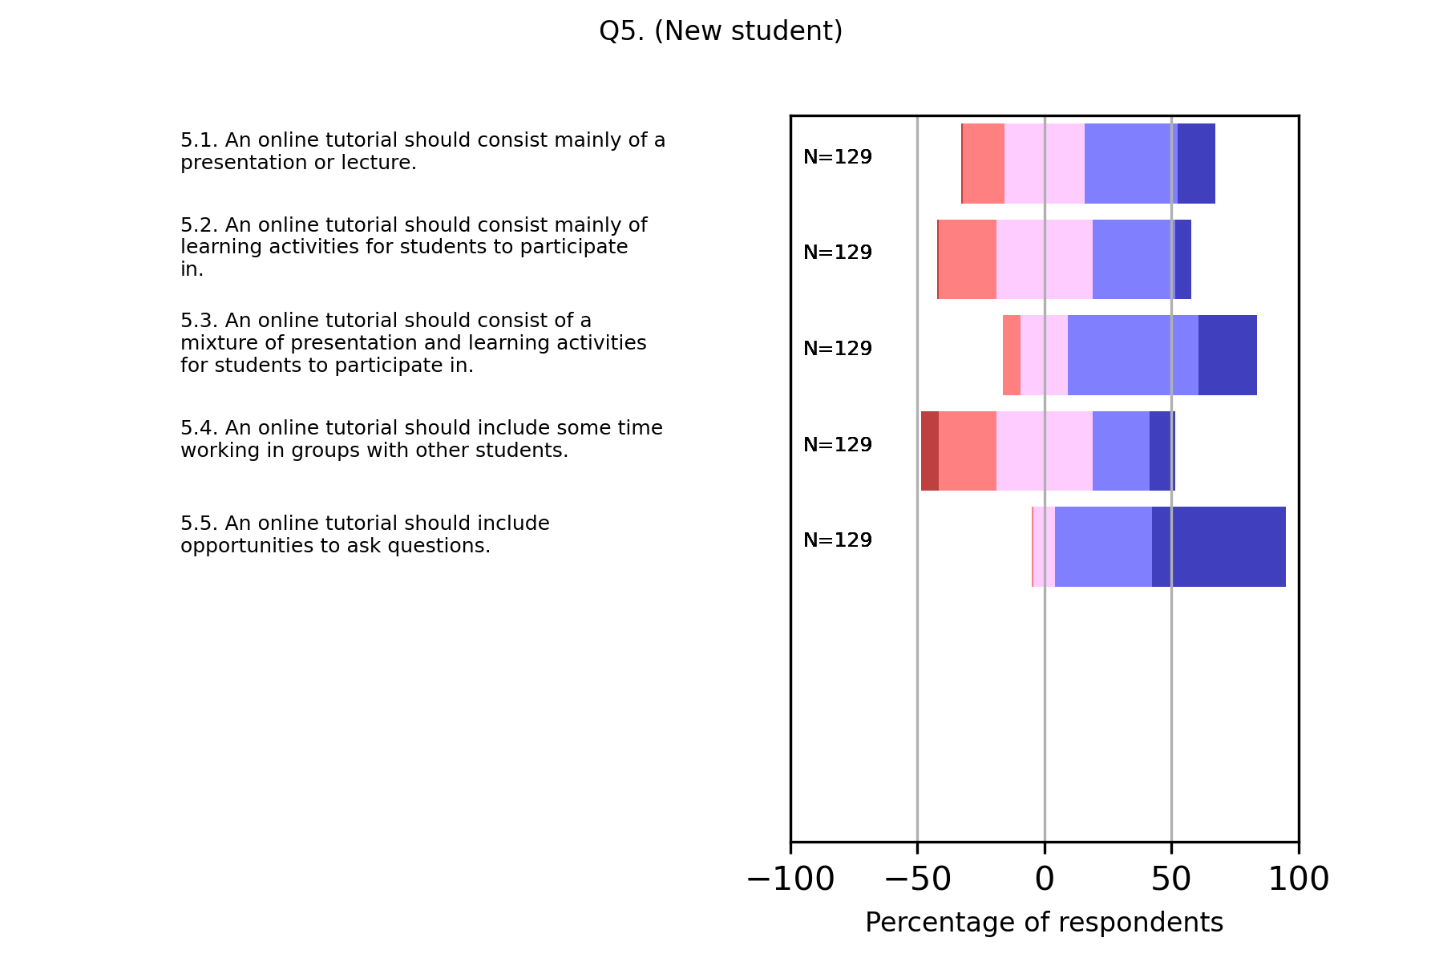
Q5 – New students

Slide 20
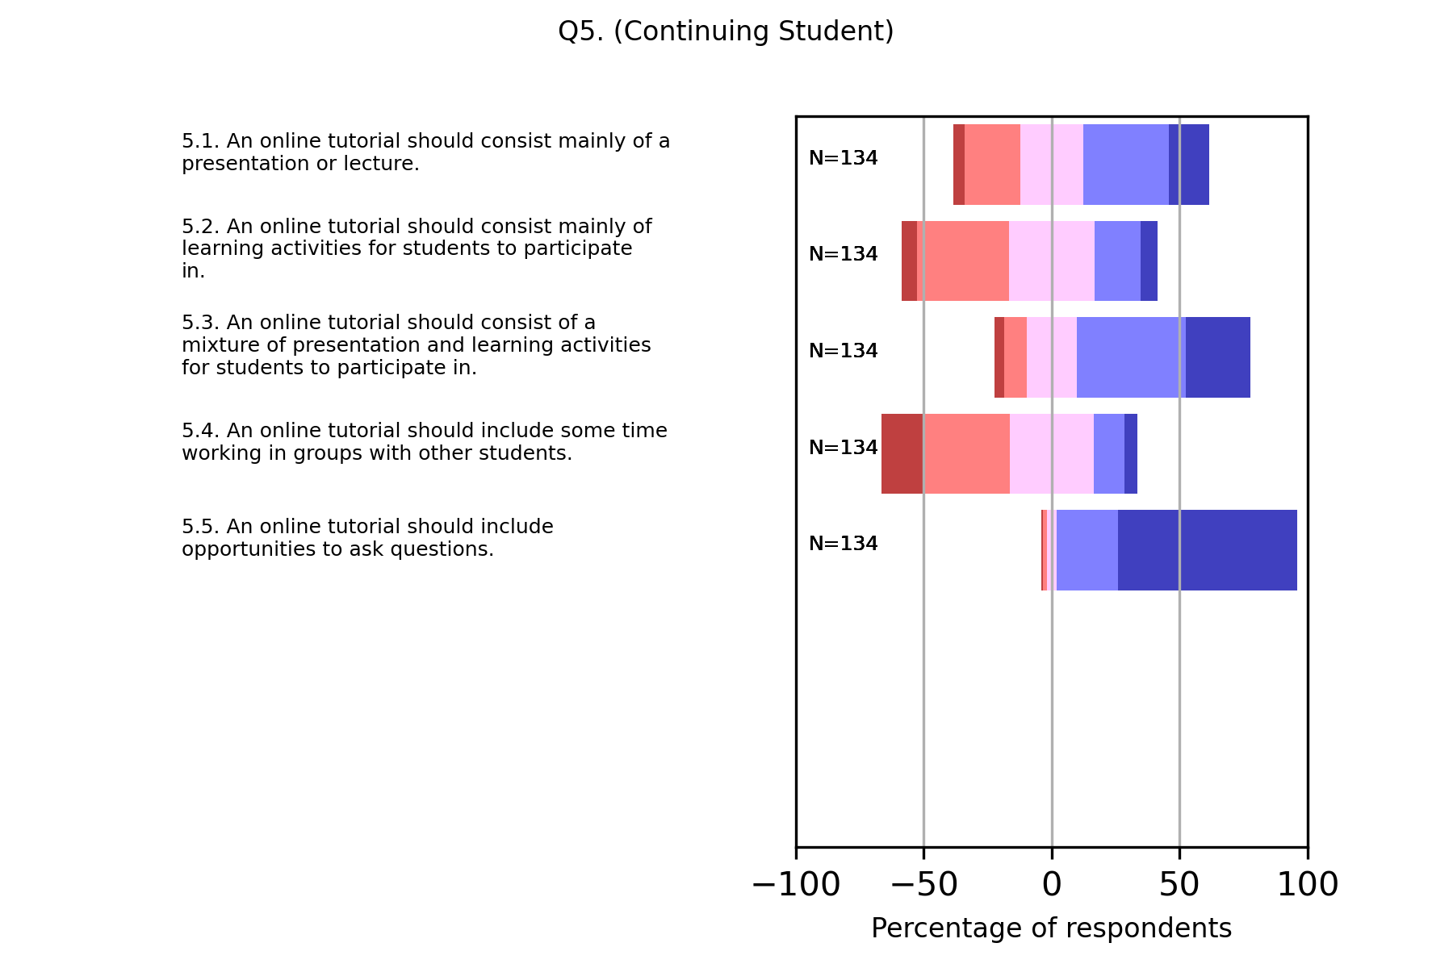
Q5 – Continuing students

Slide 21
Perceptions and expectations: tensions
Tensions between AL and student perceptions:
 | Student | AL
Focus on assessment | Format of and approach to assessment tasks is important | "Students too focussed on assessment" Approach vs. content? Integrated assessment?
Didactic versus active | Appreciate a mixture of approaches | "Students want presentations" (especially online) AL perception of effectiveness?
Social learning | Engagement under students' control Spectrum: passive, interaction with tutor, informal chat, group work | "Interaction is important, but difficult to facilitate" -ve effect of experience? Tutorial design to cater to this spectrum?

Slide 22
Thank you!
Contact details:
Anne-Marie Gallen anne-marie.gallen@open.ac.uk
Mark Jones mark.h.jones@open.ac.uk
Anne Campbell anne.campbell@open.ac.uk
Acknowledgements:
Sylvie Serpell – for the excellent interviews

