Slide 1

Title page
Consumer Rights -
Business Toolkit
This toolkit contains information for businesses making and selling products to consumers, including those selling second-hand goods

Slide 2
Disclaimer
Disclaimer: The information contained in this toolkit was prepared by undergraduate law students in March 2025. It is for general information purposes only and is not intended, nor should it be relied upon, as a source of legal advice. The information relates to the laws of England and Wales only unless otherwise specified. Whilst reasonable steps have been taken to ensure that the information provided is correct at the time of creation, no representation is made as to the accuracy of information, nor that the information provided is comprehensive.
(This toolkit is best viewed in “Slide Show” mode)

Slide 3


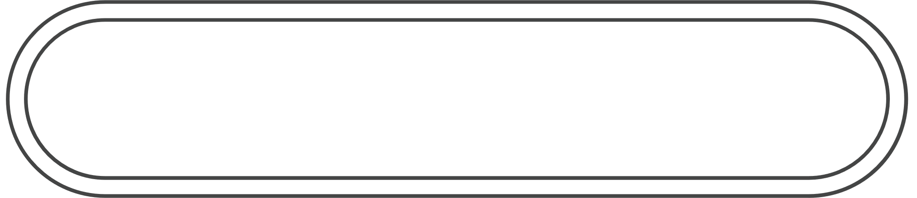
Contents
Contents
Click here | Consumer Rights Act 2015 and Remedies
Click here | Product Safety and Quality
Click here | Product Liability
Click here | Insurances
Click here | Regulatory Bodies
Click here | Case study – second-hand goods
Click here | Advertising, Marketing and Pricing
Click here | Accessibility Obligations
Click here | Data Protection
Click here | Further Resources
Note – when you see text like this in the toolkit, you can click on the link for further information

Slide 4


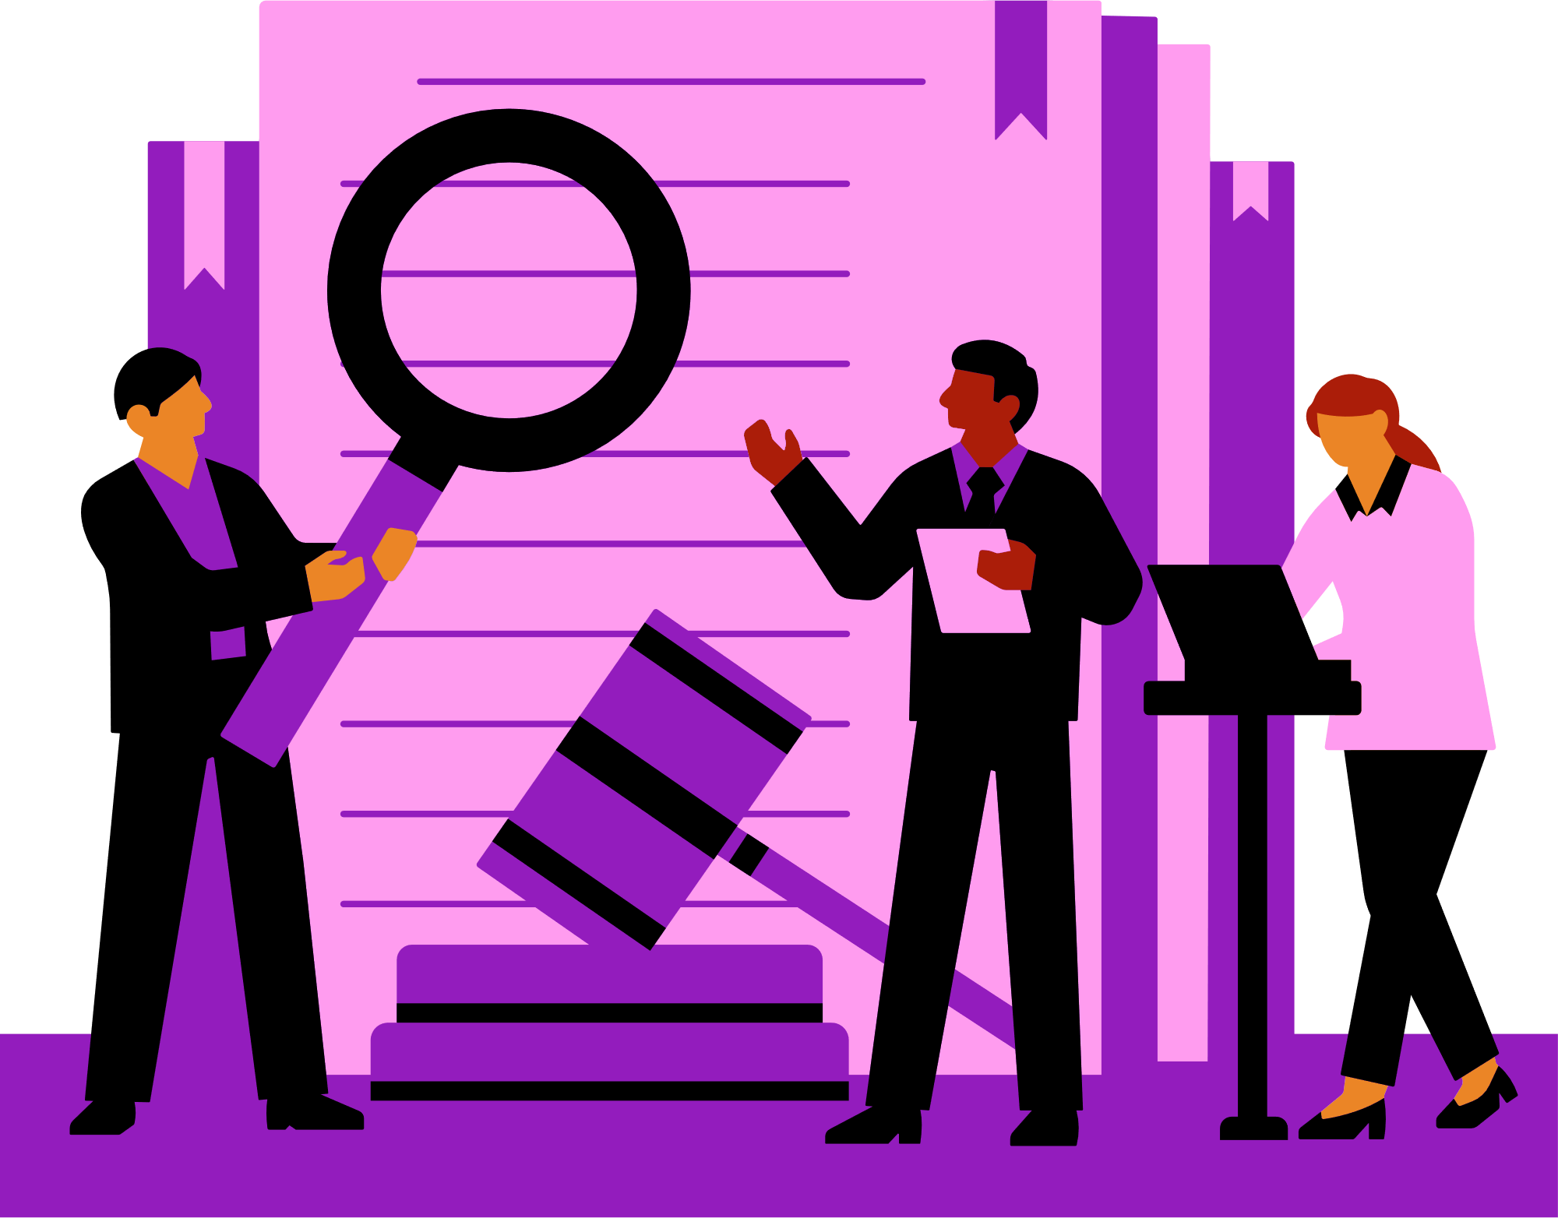
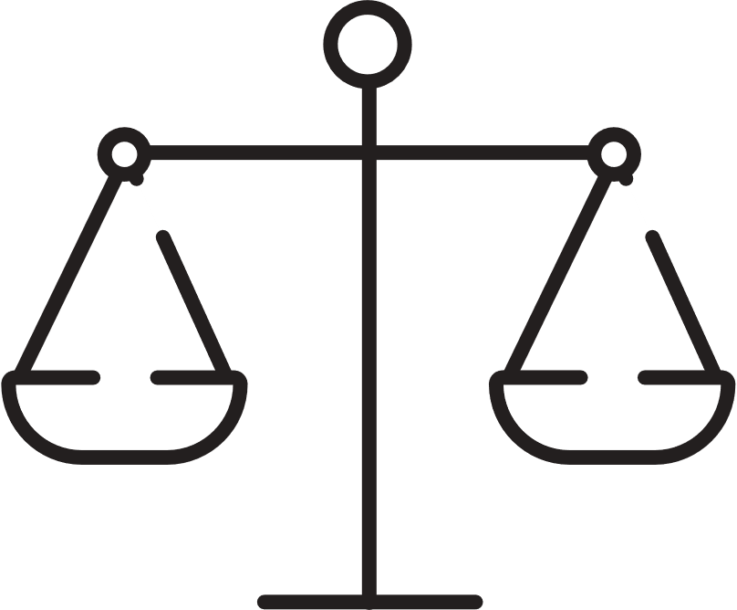



Consumer Rights Act 2015
Consumer Rights Act 2015
Consumer Rights Act 2015
What is the Consumer Rights Act 2015 (CRA 2015)?
The CRA 2015 is a UK statute that sets out the rights of consumers when buying goods, services, and digital content.
It came into force on 1st October 2015 and replaced several older consumer protection laws.
What is the purpose of the Consumer Rights Act 2015?
The law strengthens consumer protections and ensures businesses provide fair treatment when selling goods or supplying services. This toolkit focuses on businesses making and supplying goods.
What your consumers can expect?
The CRA 2015 contains statutory rights of a consumer which form part of your contract with the consumer. If the rights are not met, you will have breached the contract, and the consumer is entitled to certain forms of redress.
How does it apply to you?
When you supply goods to a consumer under a contract, the goods must meet certain standards, and you must have the right to supply the goods.
Many of the consumer rights under the Act do not apply to the sale of second-hand goods, however certain important rights do apply.
This guidance includes information specifically relevant to goods. Your obligations as a business are explained in more detail in the following sections of this guidance.

Slide 5







General requirements under the CRA
General requirements under the CRA
What are you selling?
Whatever you are selling, as a business you will need to ensure that your product complies with the CRA 2015, including it being:
  Fit for purpose
  As described
  Free from defects or faults
‘Fit for purpose’
If your product is ‘fit for purpose’ it should:
  Perform as intended: It should fulfil the specific function it was designed and sold for.
  Meet specific consumer needs: If a customer, prior to purchase, outlines specific requirements, the product must meet those needs.
  Reasonable expectations: The product should function as expected for its use, without faults, for a reasonable time.
‘As described’
If your product is as described it will:
  Match the description given by you, the seller: The product must correspond to any detail, representation or image made by the seller before the purchase.
  Be accurately represented: The product must not be different from how it was described in characteristics, quantity or quality.
  Match the model of the sample product: If a sample product has been shown then the actual product should be the same.
‘Free from defects or faults’
  No manufacturing or material defects: The product must be made correctly without any physical flaws or imperfections caused during the production process.
  No functional faults: The product must work without malfunctioning.
  No hidden or latent defects: The product must not have any underlying defects, that were not have been obvious at the time of purchase but affect its use later.

Slide 6


Consumer remedies
Consumer remedies
Consumer Remedies for Faulty Goods
If goods fail to meet the above standards, consumers are entitled to the following remedies:
  Short-term right to reject - Consumers can reject faulty goods within 30 days of purchase and claim a full refund.
  Repair or Replacement - Beyond the initial 30 days, consumers can request a repair or replacement. If these remedies are unsuccessful, they may be entitled to a price reduction or a final right to reject the goods for a refund.
Warranties and Guarantees
Any additional warranties or guarantees offered are supplementary to the consumer’s statutory rights and cannot replace or reduce them.
Even if a warranty has expired, consumers may still have rights under the Consumer Rights Act if the product is not of satisfactory quality, fit for purpose, or as described.
Used goods often have limited warranties or no warranty at all, unless you explicitly offer one.

Slide 7
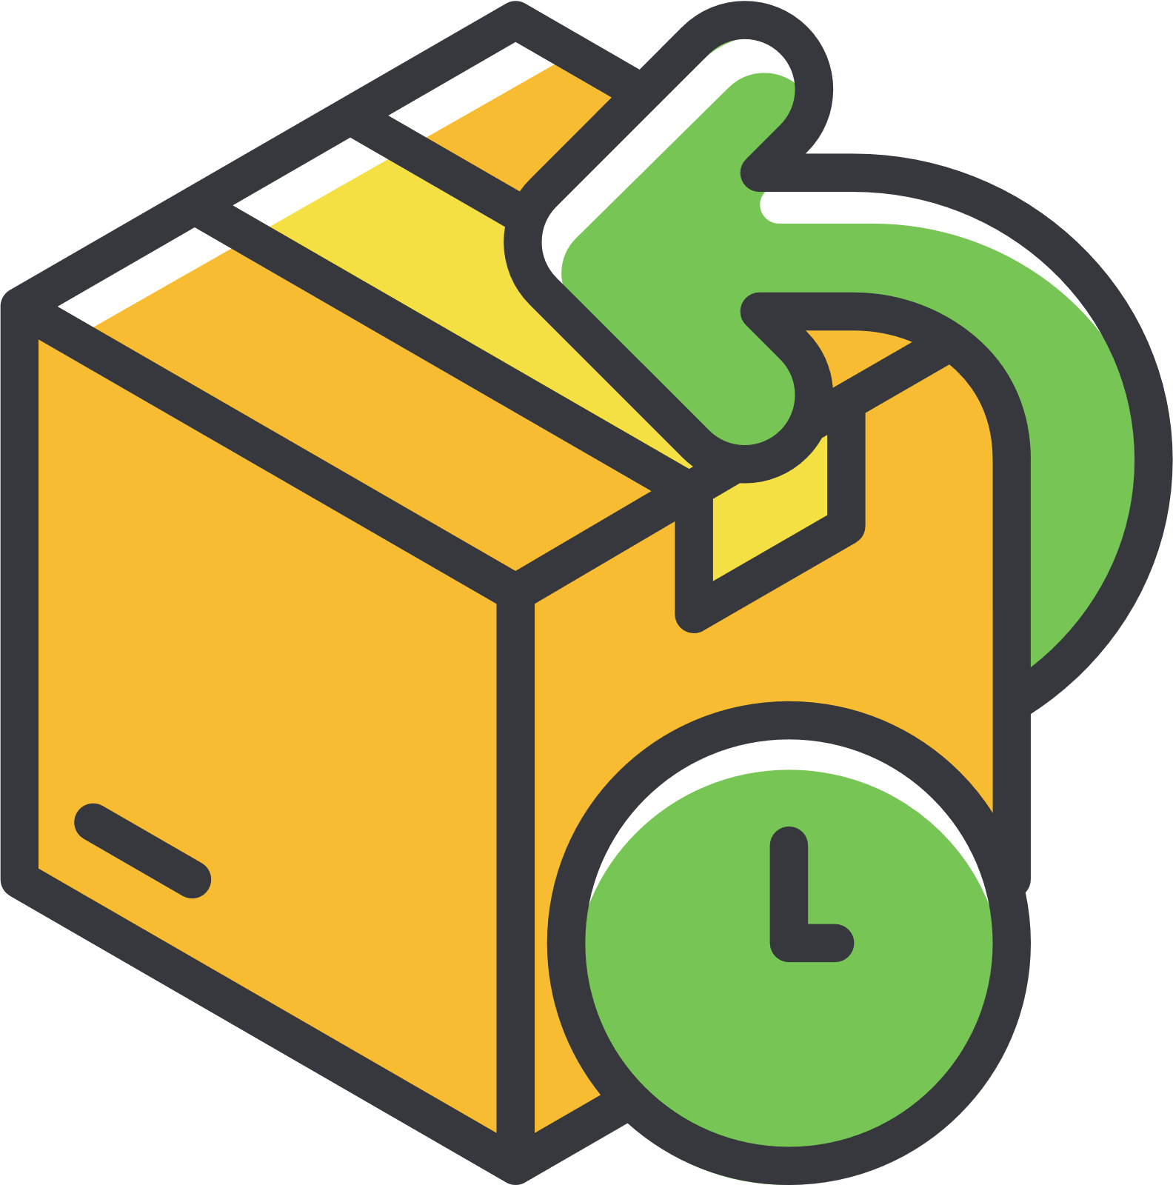
Consumer remedies continued
Refunds and Returns Policies
  Faulty Goods - You must offer a full refund if an item is faulty, not as described, or doesn’t do what it’s supposed to.
  Change of Mind – Generally, (see note below on distance selling) there’s no legal obligation to accept returns or provide refunds if a customer simply changes their mind, unless your own returns policy offers this option.
Displaying Return Policies
It’s illegal to display notices that mislead consumers about their rights, such as signs stating, "No refunds” or “Goods can only be exchanged.” Such notices can constitute a criminal offence.
Proof of Purchase
While consumers should provide proof of purchase when returning goods, this doesn’t necessarily mean a receipt. Other evidence, like a bank statement or packaging, can suffice.
Distance Selling Regulations
For sales conducted online, by mail, or over the phone, consumers have the right to cancel their order within 14 days of receiving the goods (even if they are not faulty). They then have another 14 days to return the items. You must issue a refund within 14 days of receiving the returned goods.
Adhering to these legal obligations ensures fair treatment of consumers and helps maintain trust in your business.
For comprehensive guidance, consult official resources like the UK government’s page on the Consumer Rights Act 2015.

Slide 8
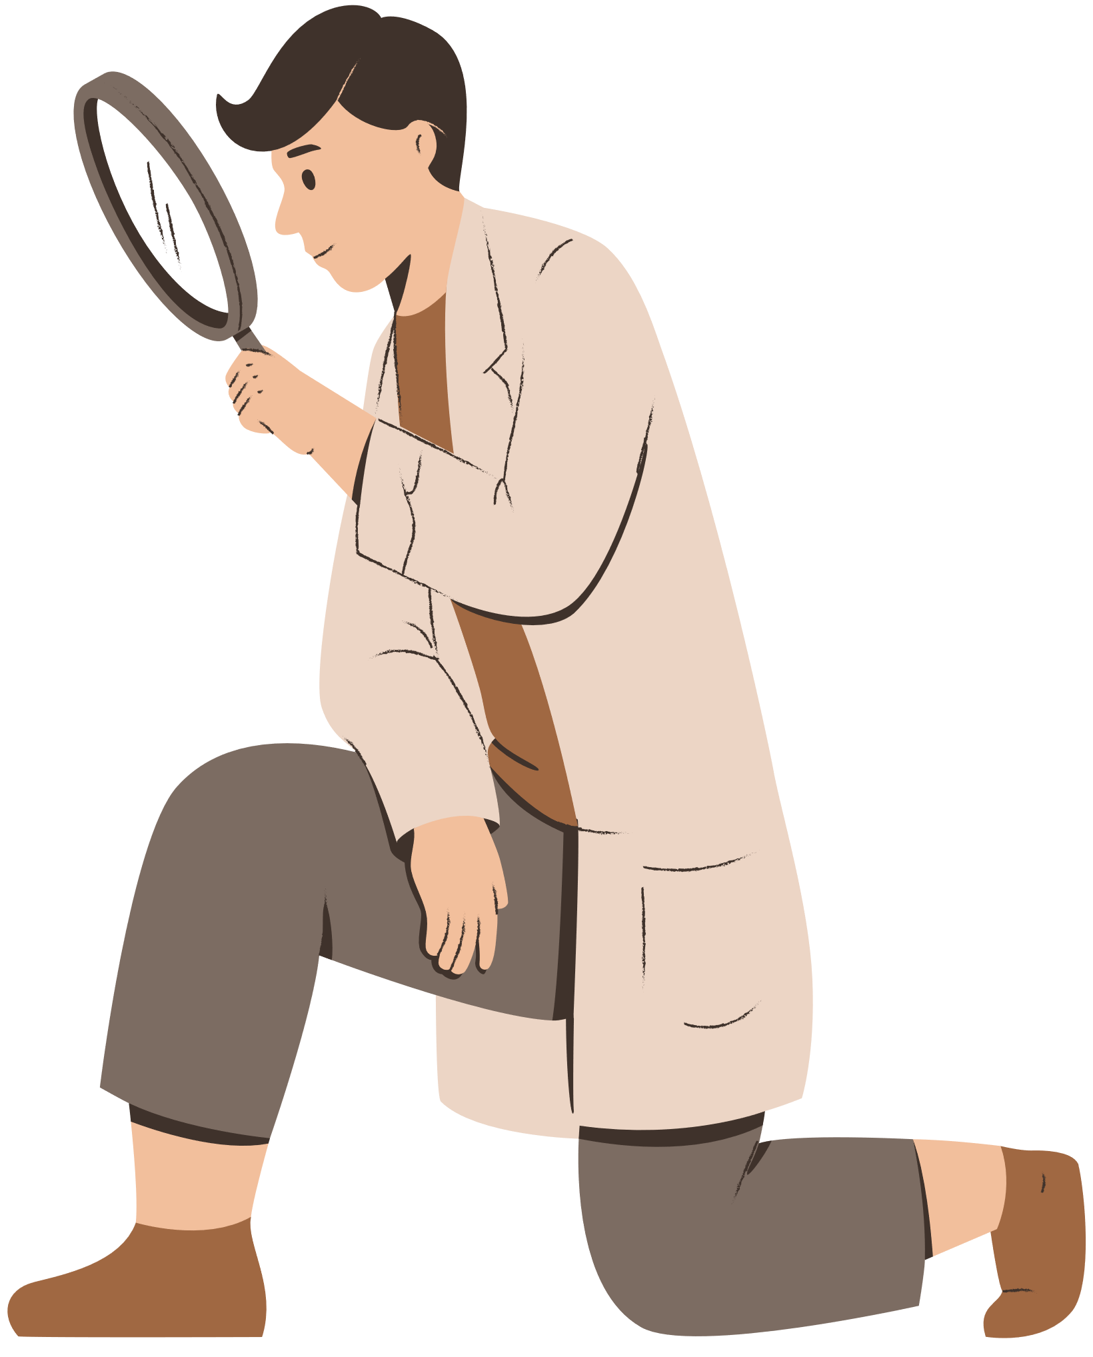



Product safety and quality
Product safety and quality
The General Product Safety Regulations 2005 (GPSR) require all products to be safe in their normal or reasonably foreseeable usage and enforcement authorities have powers to take appropriate action when this obligation isn’t met.
It is important to consider that certain industries have additional regulations which detail specific further requirements.
Please see Specific Industry Guidance to see what additional requirements might apply to your business.
Who is responsible for product safety and quality?
  Manufacturer – Is responsible for the overall safety of their products throughout the design process. This includes conducting risk assessments, implementing appropriate safety measures, and providing clear instructions for product use. This will also include cooperating with any investigations or recall actions initiated by the Office for Product Safety Standards (OPSS).
  Importer – Is responsible for ensuring that imported products comply with UK safety regulations and verifying that the product complies with general product safety regulations.
  Distributors/retailers – Are responsible for exercising due diligence to ensure that the products they supply are safe and comply with regulations. This includes checking product documentation, verifying compliance with labelling requirements, and reporting any safety concerns to the manufacturer or OPSS.
Some specific regulations relevant to products include:
Toys | Toys (Safety) Regulations 2011
Electronics | Electrical Equipment (Safety) Regulations 2016
Food & Drink | Food Information Regulations 2014 | Food Safety Act 1990 | Food Safety Order 1991
Furniture | The Furniture and Furnishings (Fire) (Safety) Regulations 1988
Clothing | Textile Products (Labelling and Fibre Composition) Regulations 2012

Slide 9






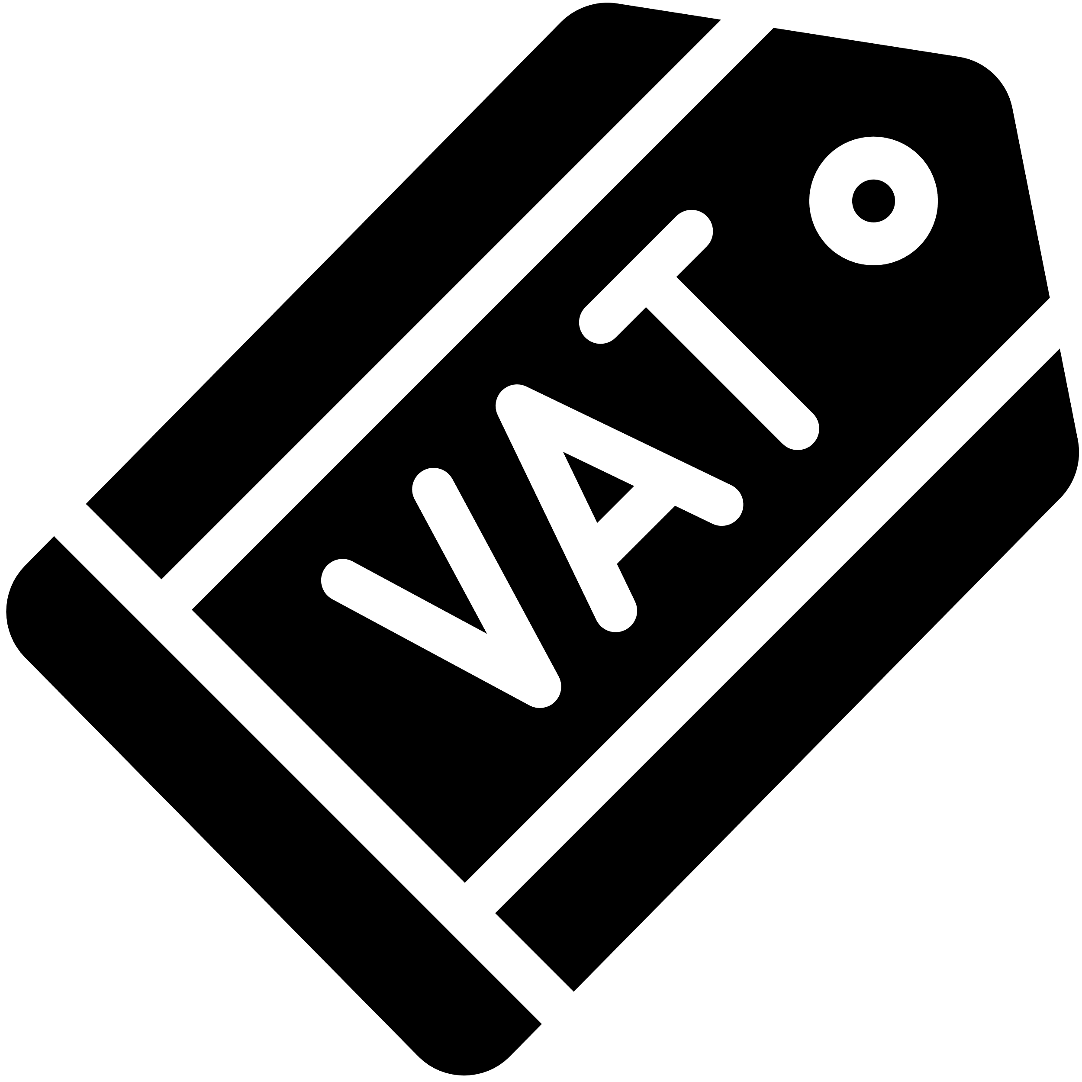

Product safety and quality continue
The UKCA mark (previously CE mark)
The UKCA mark is a certification mark that indicates a product meets UK safety, health, and environmental regulations. It is the equivalent of the CE mark and is required for most products sold in England, Scotland, and Wales since the UK left the European Union.
It is mandatory for goods, including electronics, toys, machinery, food contact materials (utensils, packaging or appliances), textiles (any product containing 80% or more fibres), and medical devices.
For further information please see UKCA Guidance
Labelling requirements
There are labelling requirements across industries which need to be complied with to ensure product safety and quality for consumer consumption or use.
For example, there are specific regulations covering food and drink, cosmetics, household cleaning products, electronic products, clothing and textiles, and toys.
Specific regulations cover specific products such as allergen information for food and drink, or flammability warning labels for electronics, toys, clothing and furniture.
Further information on labelling
For further information on labelling requirements specifically relevant to the sale of your goods, please contact your local Trading Standards office.

Slide 10




Product liability
Product Liability
Product liability is the area of law where manufacturers, distributers, suppliers and retailers are held responsible for any injury caused by their products.
The Consumer Protection Act 1987 specifies who is liable for any damage caused, wholly or partly, by a defect in a product:
  The manufacturer (producer) or processor
  Any person who has put their name or mark on the product (supermarket for own brand products)
  Importers
  Anyone else in the supply chain, if they cannot identify where the product has come from
The legal responsibility is on each entity within the supply chain, depending upon the type of defect that led to liability, including:
  Manufacturing defect
  Design defect
  Failure to warn
If two or more parties are liable for the same damage, their liability will be joint and several, meaning that a claim could be made against either or both parties.
Liability and consequences of non-compliance
Failing to comply with product safety laws and regulations can lead to serious legal, financial, and reputational consequences for businesses.
The product liability provisions of the Consumer Protection Act 1987 create strict liability for damage caused by defective products. This means that the injured party would not need to prove negligence, only that the product caused the harm. Damage includes death, personal injury, or any loss or damage to property, including land.
Consequences of non-compliance can include:
Fines
Product
recalls
Financial compensation

Slide 11
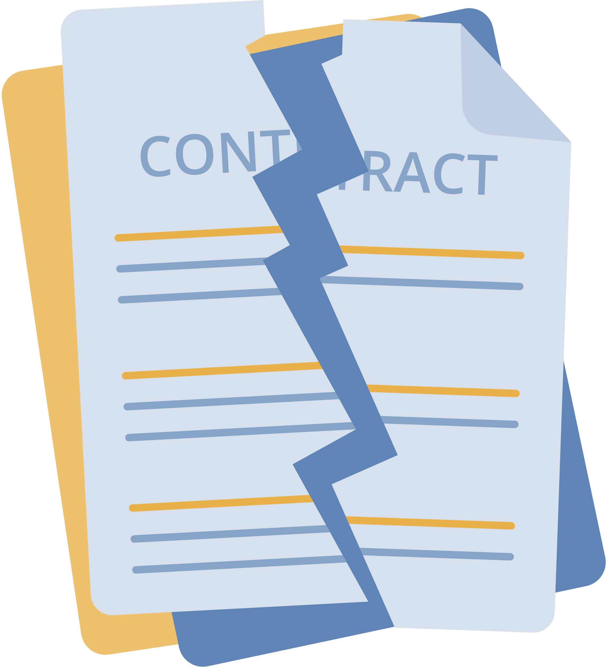
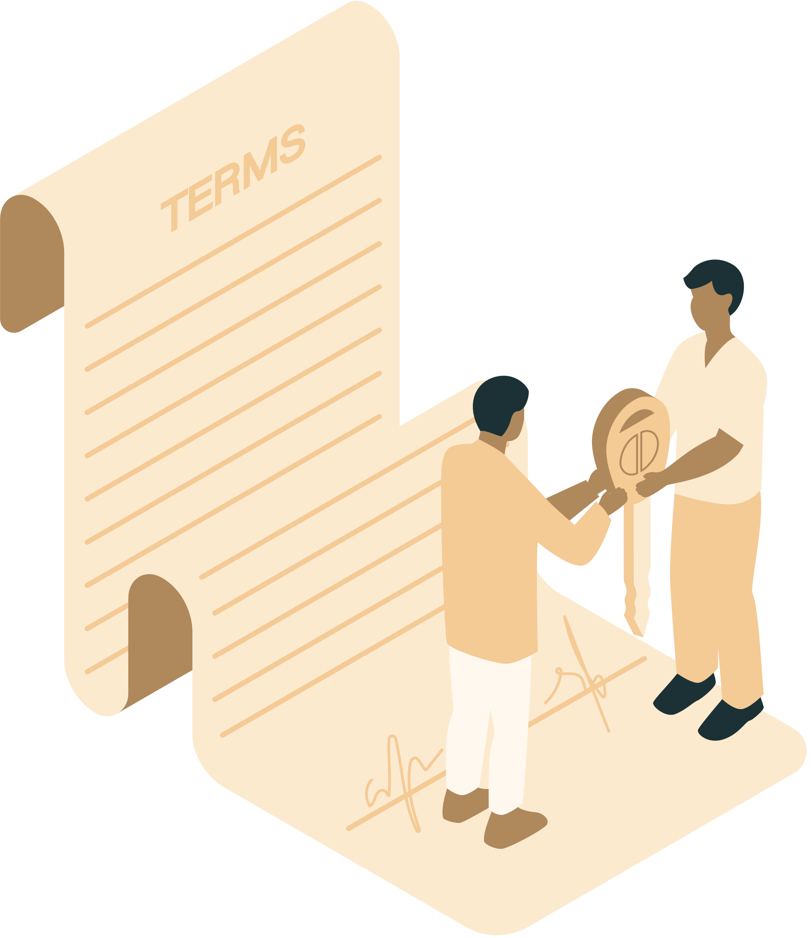

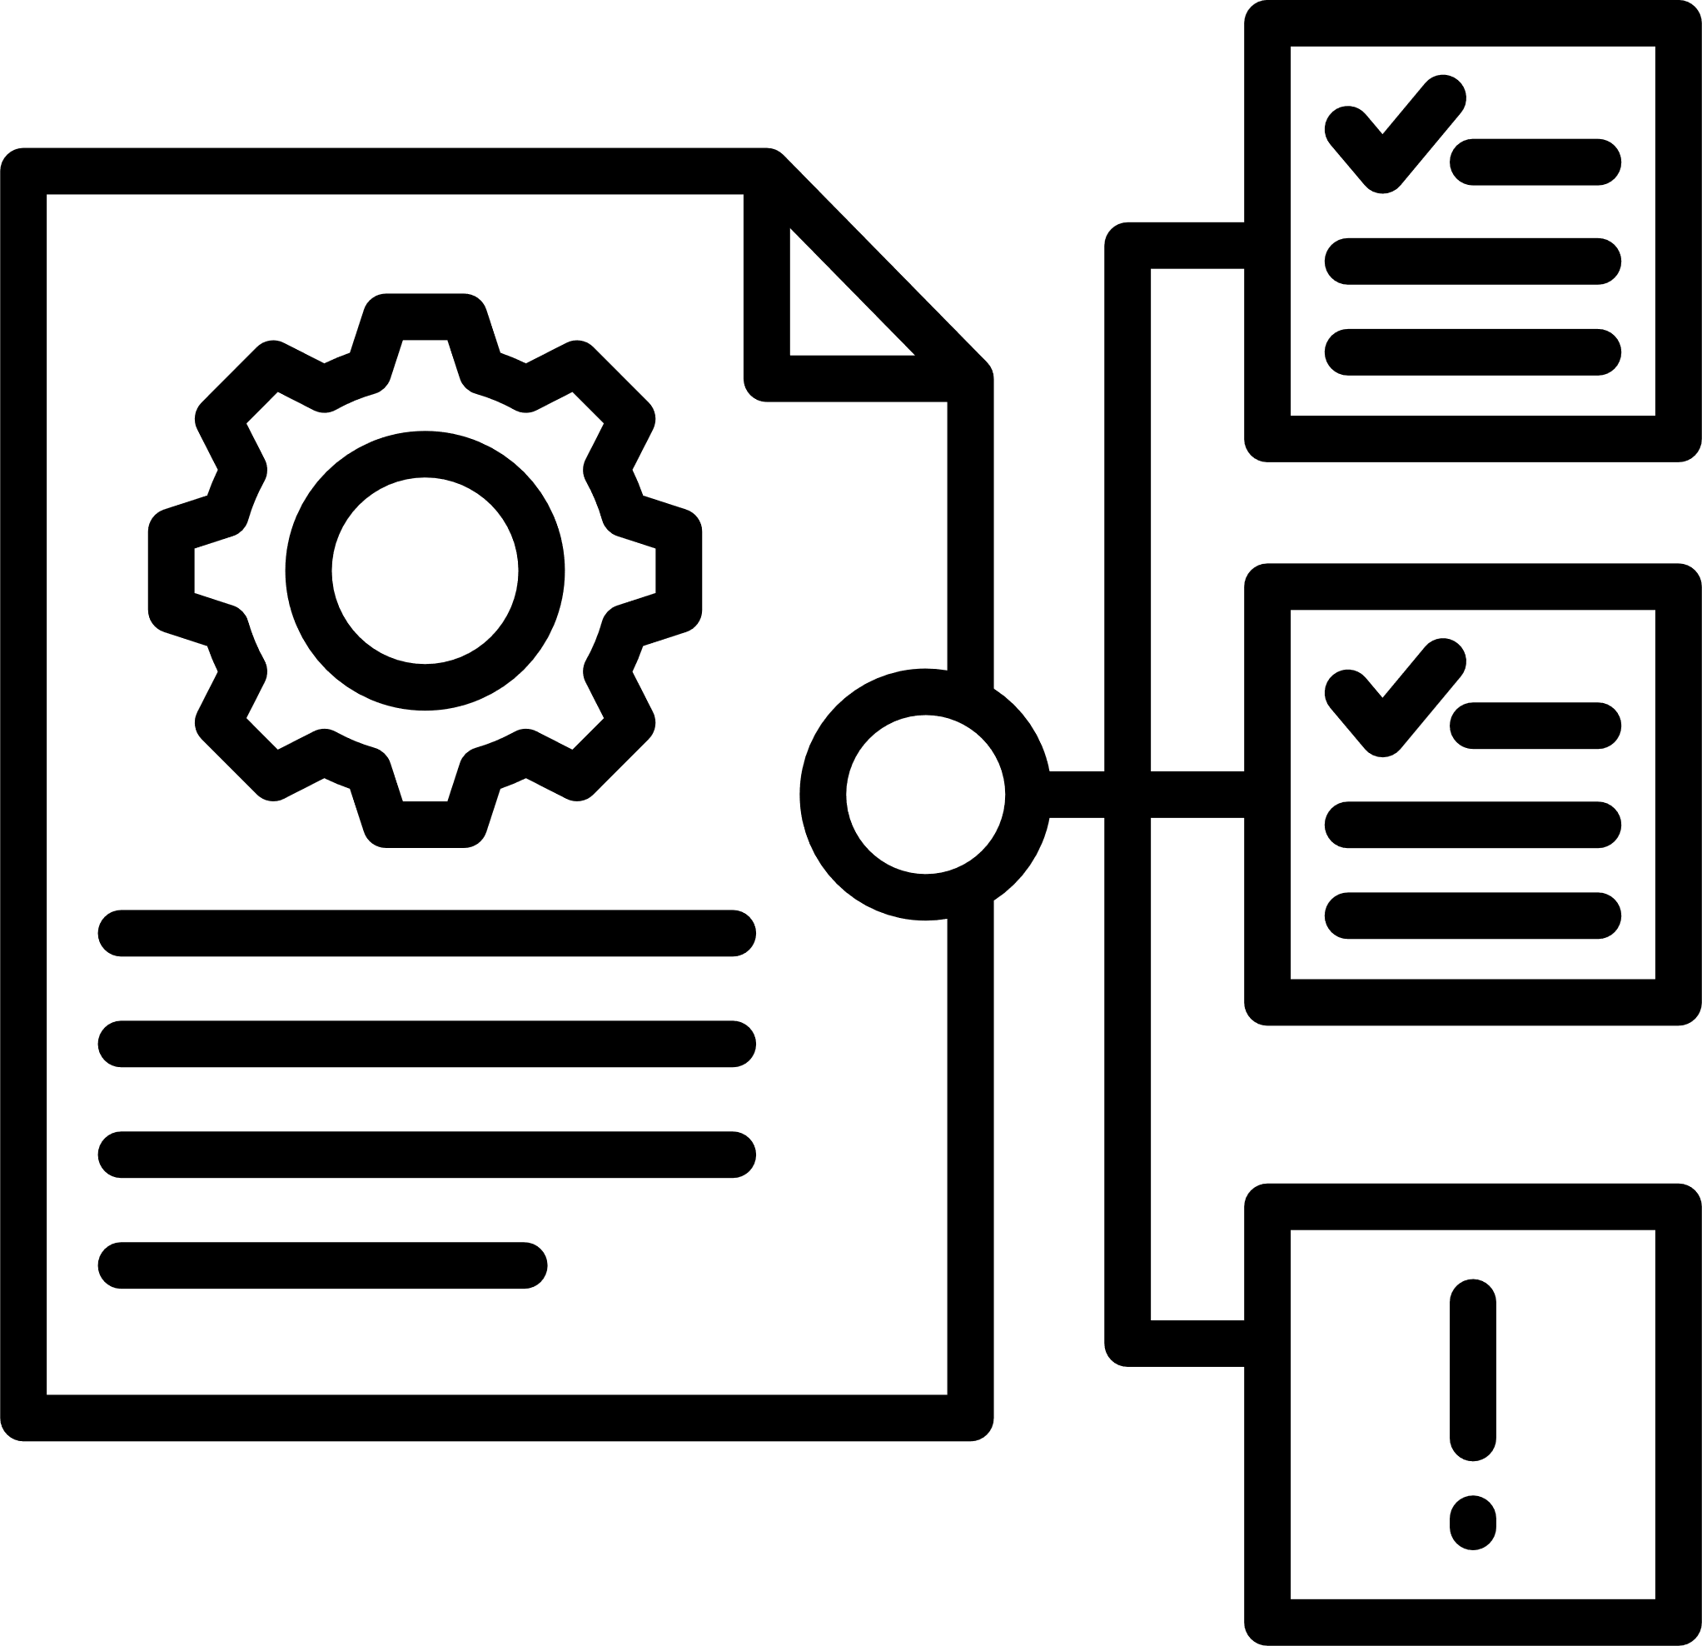
Liability in contract and negligence
Liability in contract and negligence
You can also be held liable for products you sell in contract law and negligence.
Breach of contract
When you sell goods, it is a contractual requirement between the seller and the consumer that the goods are of satisfactory quality and are safe to use. Otherwise, a consumer can claim compensation for any damages that the goods caused.
There is no minimum claim amount for breach of contract. It is usual that a consumer (buyer) can make a claim for breach of contract and that claim be made against the direct supplier.
Negligence claims
A consumer may also be able to make a claim for negligence against any person in the supply chain who has breached a duty of care. This can therefore become a mixed claim, whereby alternative claims under legislation and the law of negligence,
as well as a contractual claim, will be made for compensation.
No individual is entitled to compensation twice over for the same loss and the courts will have regard to that principle when deciding the compensation payable.

Slide 12

Insurances
Insurances
As a small business, there are several insurances you will need to be aware of, some of which are compulsory.
Further details of insurances for small business can be found here.
One of the insurances relevant to the material covered in this toolkit is product liability insurance.
Product liability insurance
If your business sells goods (or even gives them away for free), whether new or second-hand, it is highly recommended that you purchase product liability insurance.
Further information on product liability insurance can be found here.

Slide 13





Regulatory bodies
Regulatory Bodies
Regulatory Bodies
Regulatory bodies exist to ensure safety, fairness, and compliance across various industries. This includes consumer protection to ensure that products and services are safe, fair, and of high quality. There are industry-specific regulatory bodies and general regulatory bodies.
Trading Standards
Trading standards is one of the main general regulatory and enforcement bodies.
Under Schedule 5 of the Consumer Rights Act 2015, Trading Standards have certain enforcement powers.
Trading Standards main powers are:
  To enter a premises
  Inspection
  Secure or seize material
Whilst Trading Standards cannot prevent you from trading, they can apply to the courts for orders to restrict your activities.
Many breaches of trading standards law are resolved through remedial actions by the business, such as changing products, systems, or arranging redress for customers who have been affected. Serious breaches can lead to prosecution for criminal offences and significant consequences.
Some other regulatory specific industry bodies:
  Toys, Electronics, Furniture, Clothing, Software | Office for Product Safety and Standards (OPSS)
  Food & Drink | Food Standards Agency (FSA) in England and Wales, Food Standards Scotland (FSS)

Slide 14




Regulatory bodies continued
Office for Product Safety and Standards (OPSS)
OPSS was created in 2018 to regulate the safety of consumer products and goods at a national level (excluding food products). OPSS works with other organisations to protect consumers from harm.
You can find more information here: Office for Product Safety and Standards
Food Standards Agency (FSA)
The FSA was established in 2000 and protects public health from risks relating to food. Their role involves providing policy advice to ministers, policy makers, and the general public.
You can access Food Standards Safety Agency website for more information.
Food Standards Scotland (FSS)
FSS was established in 2015 as a public sector body for Scotland to protect public health from risks in relation to food consumption.
The objectives are set out in Food (Scotland) Act 2015 and their role is parallel to that of the FSA except it is responsible for Scotland.
You can access Food Standards Scotland website for more information.

Slide 15
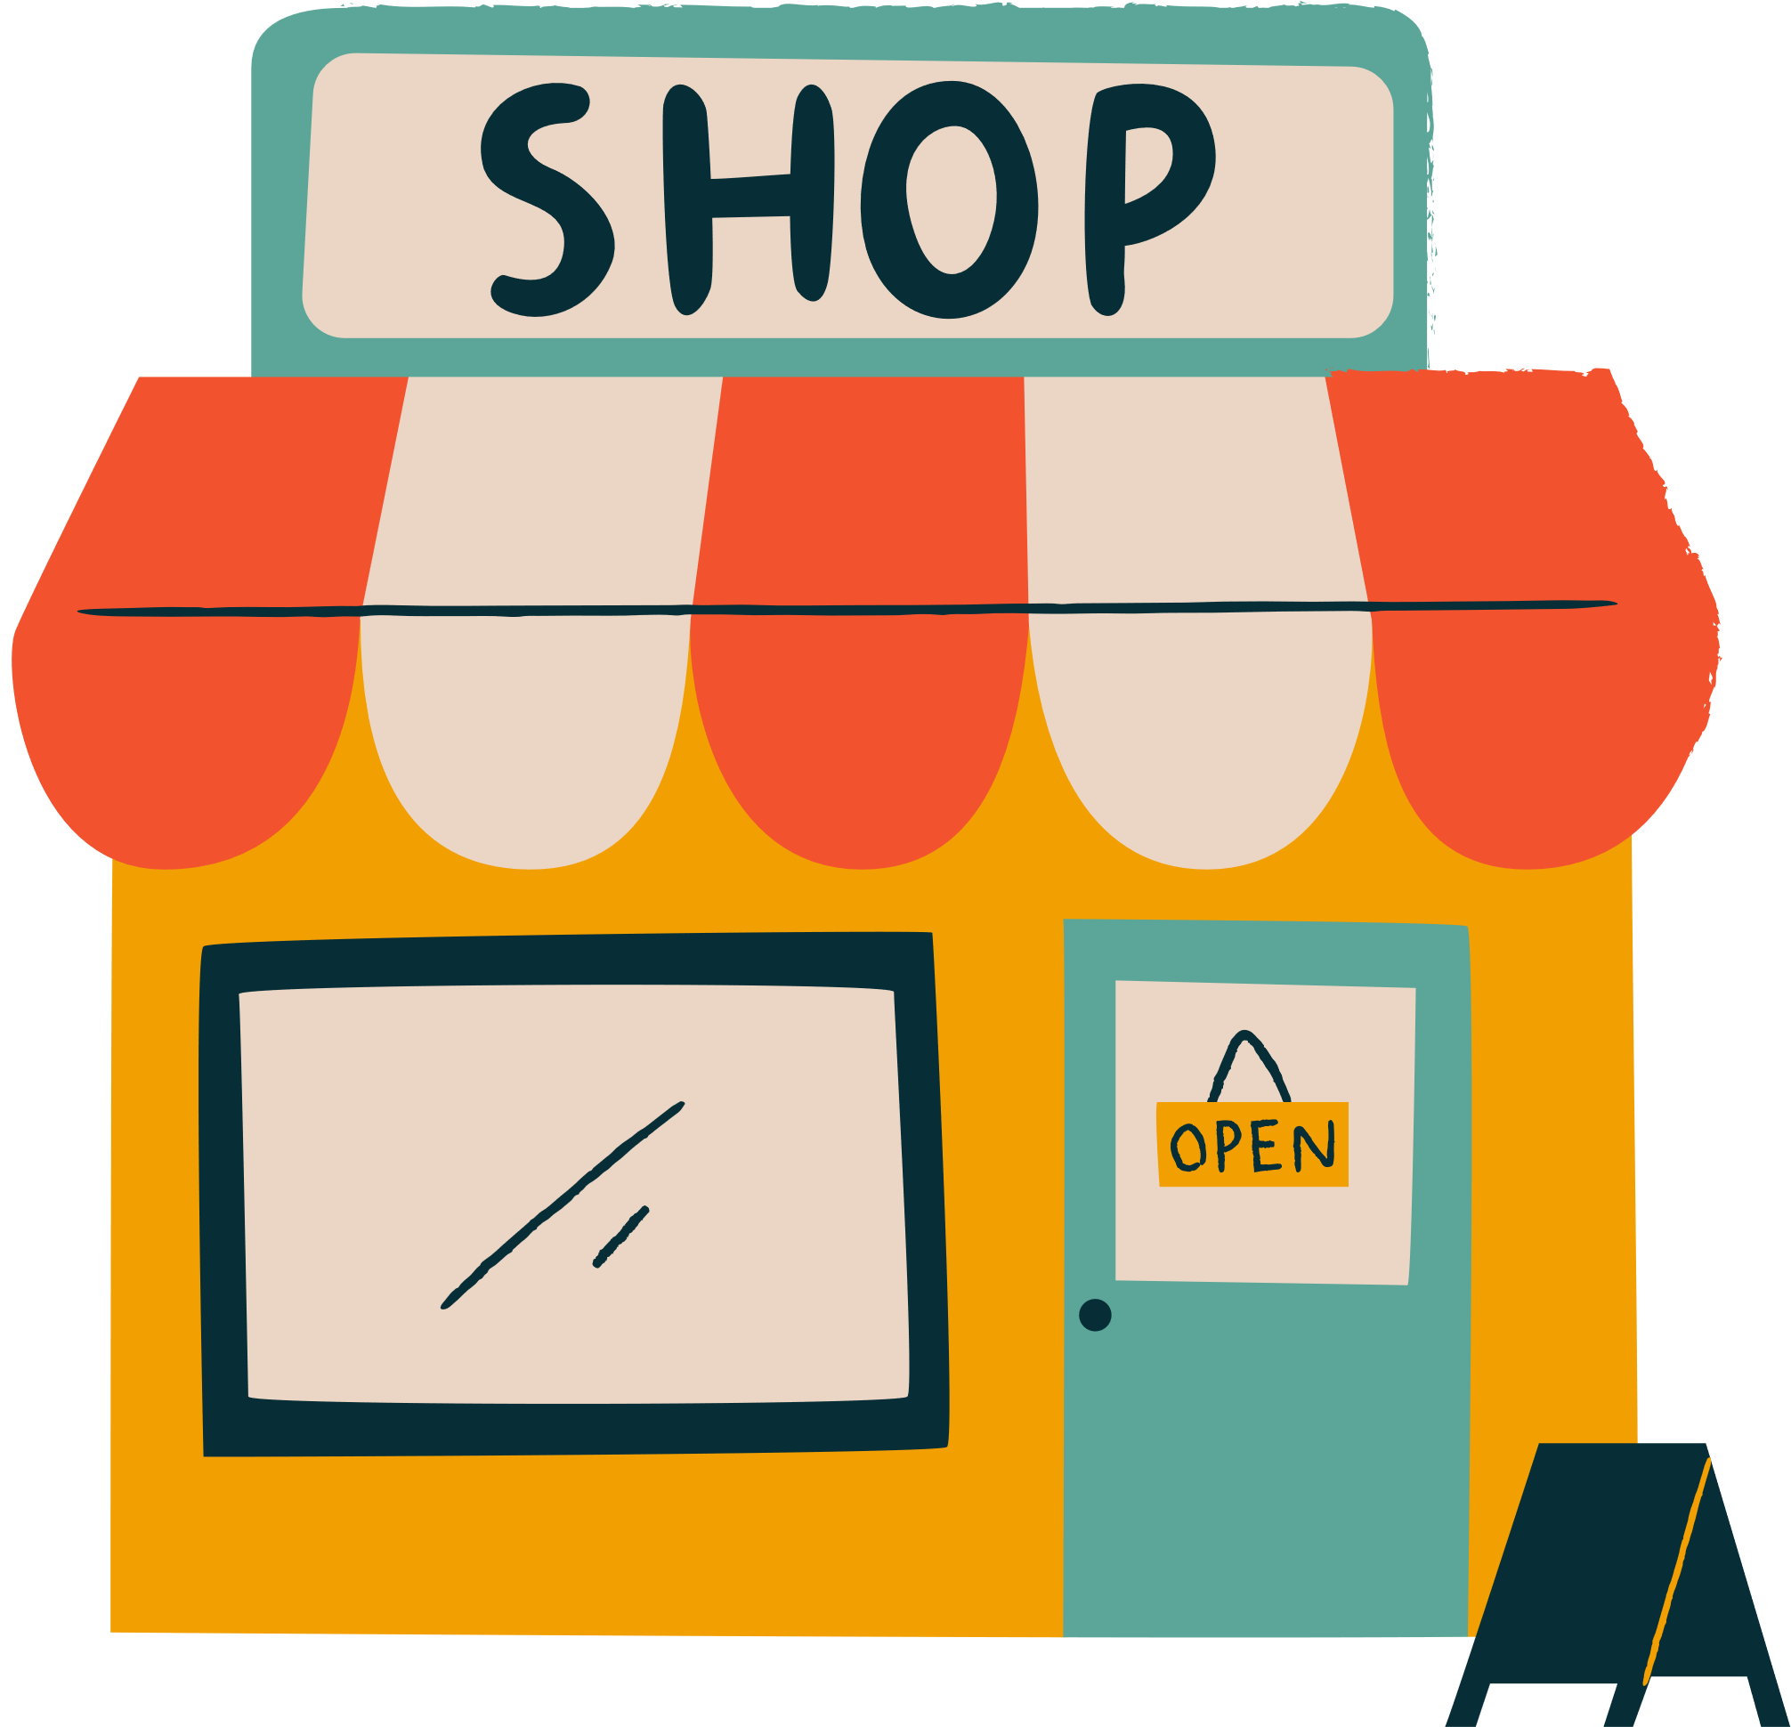
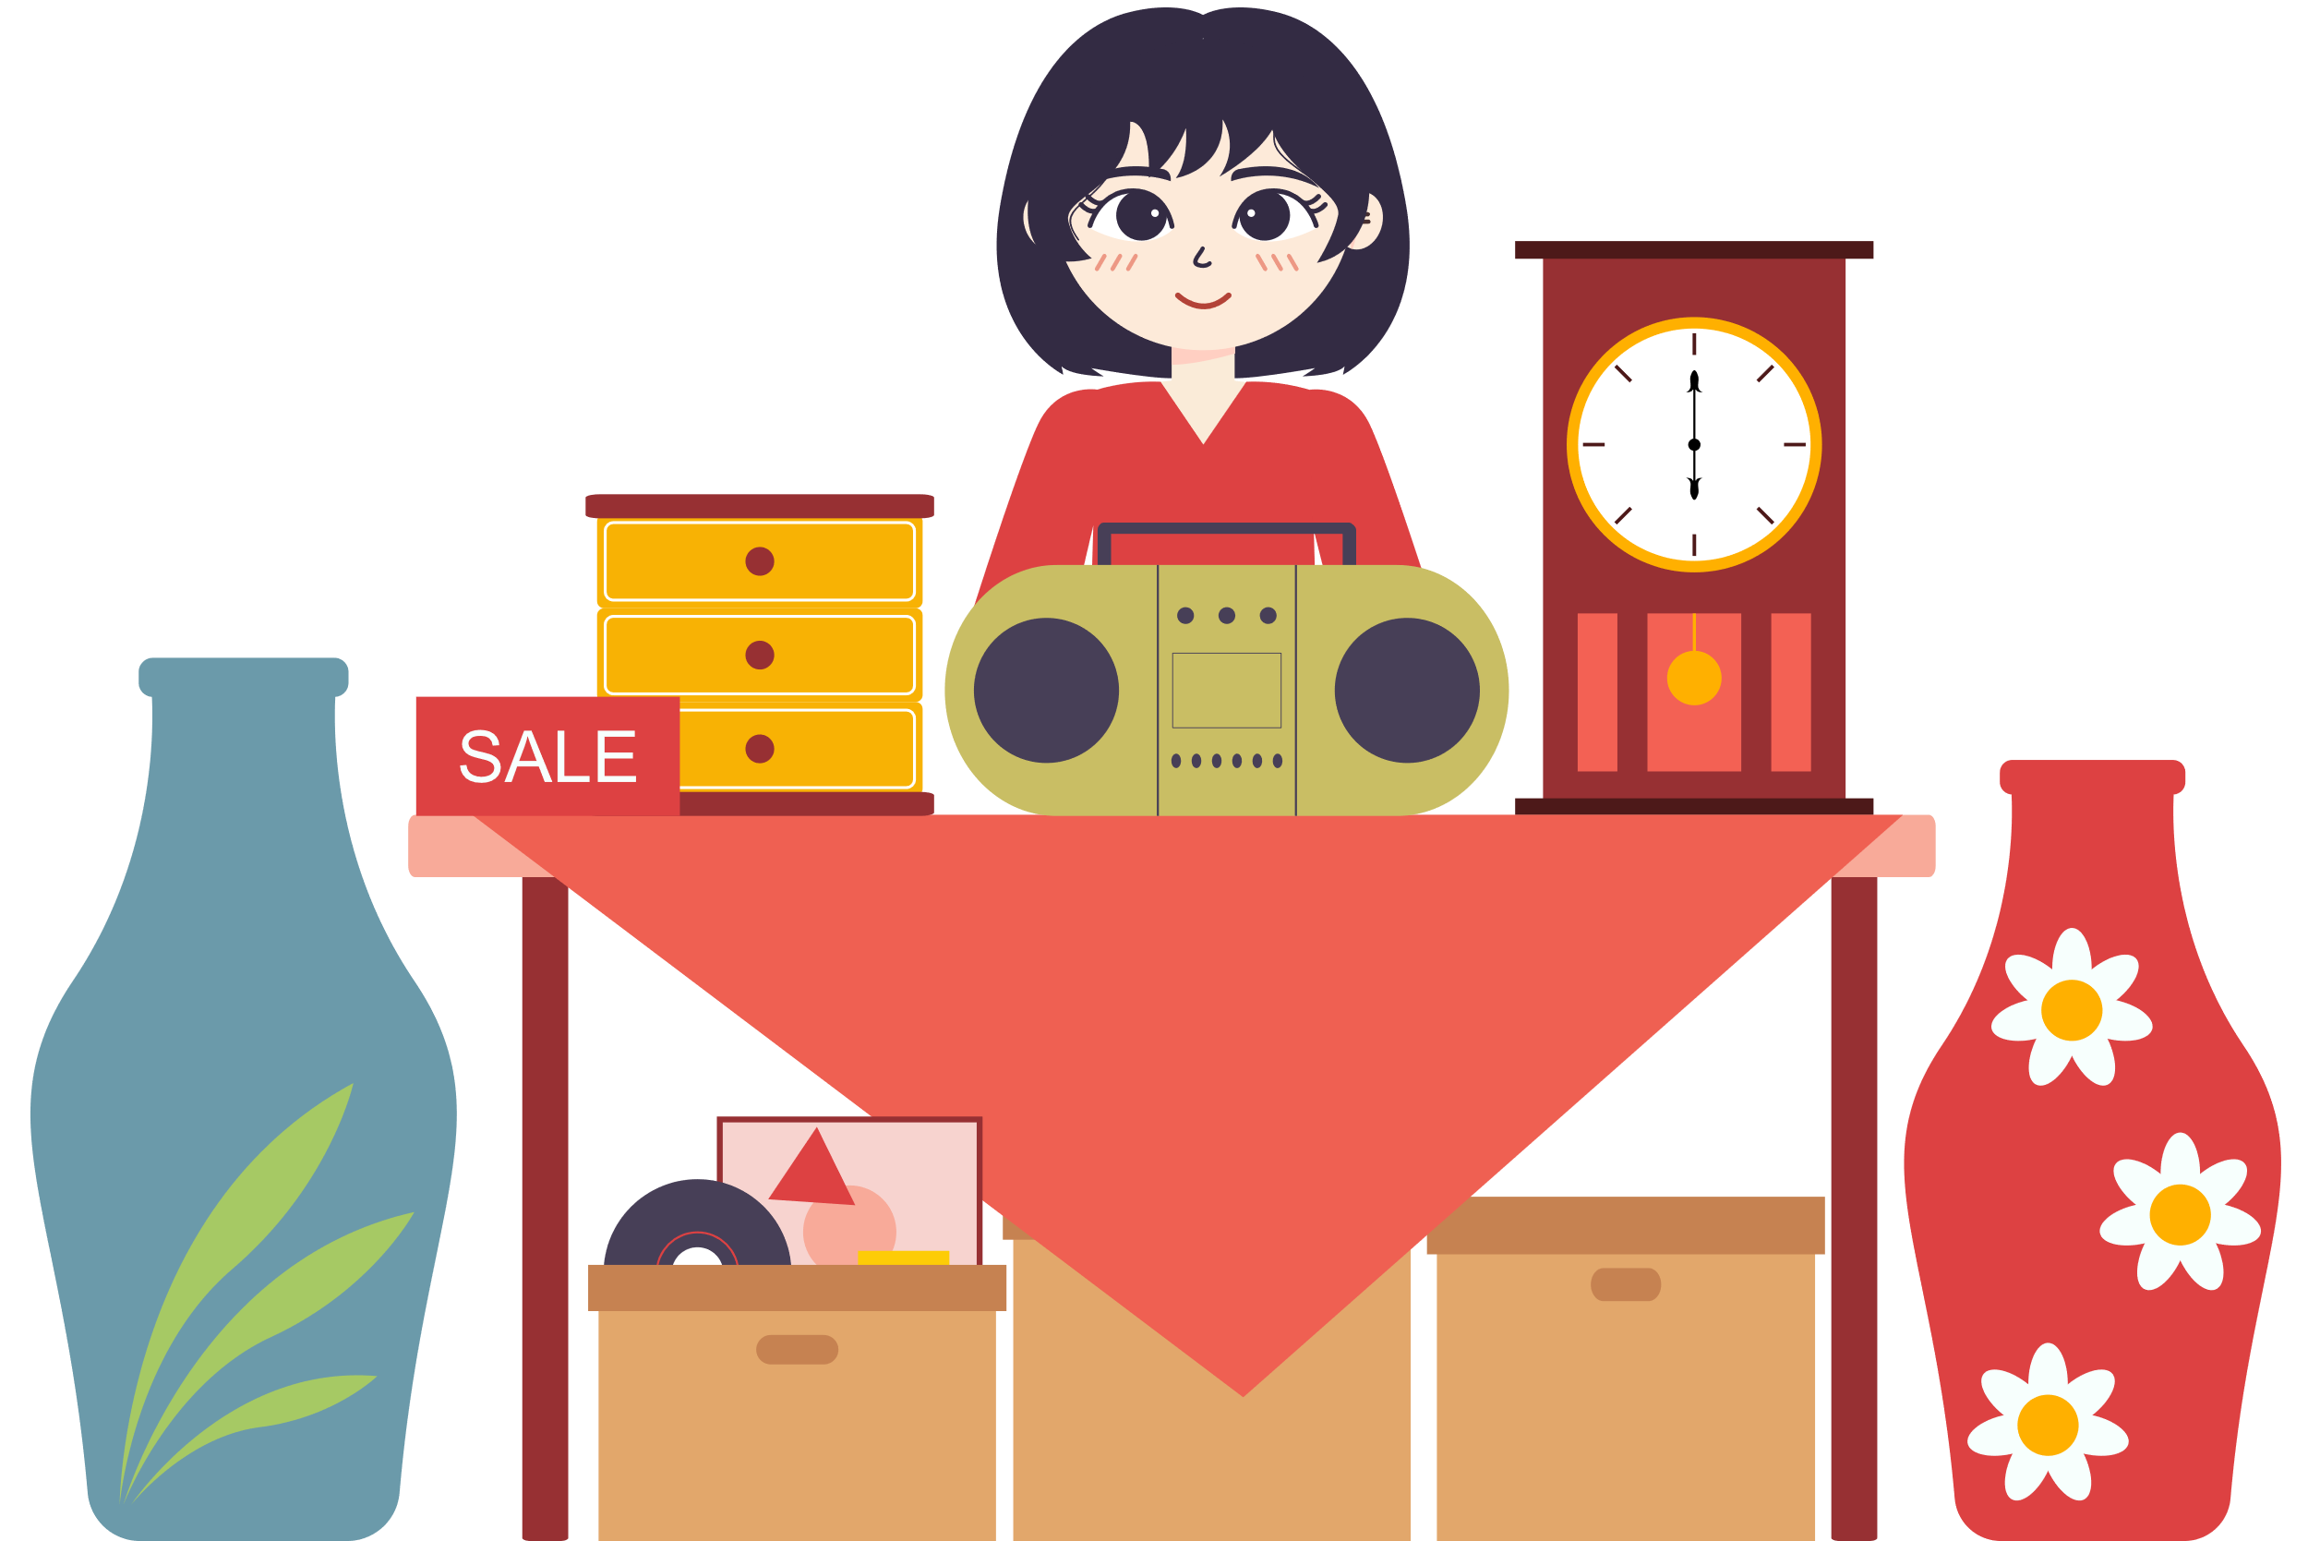
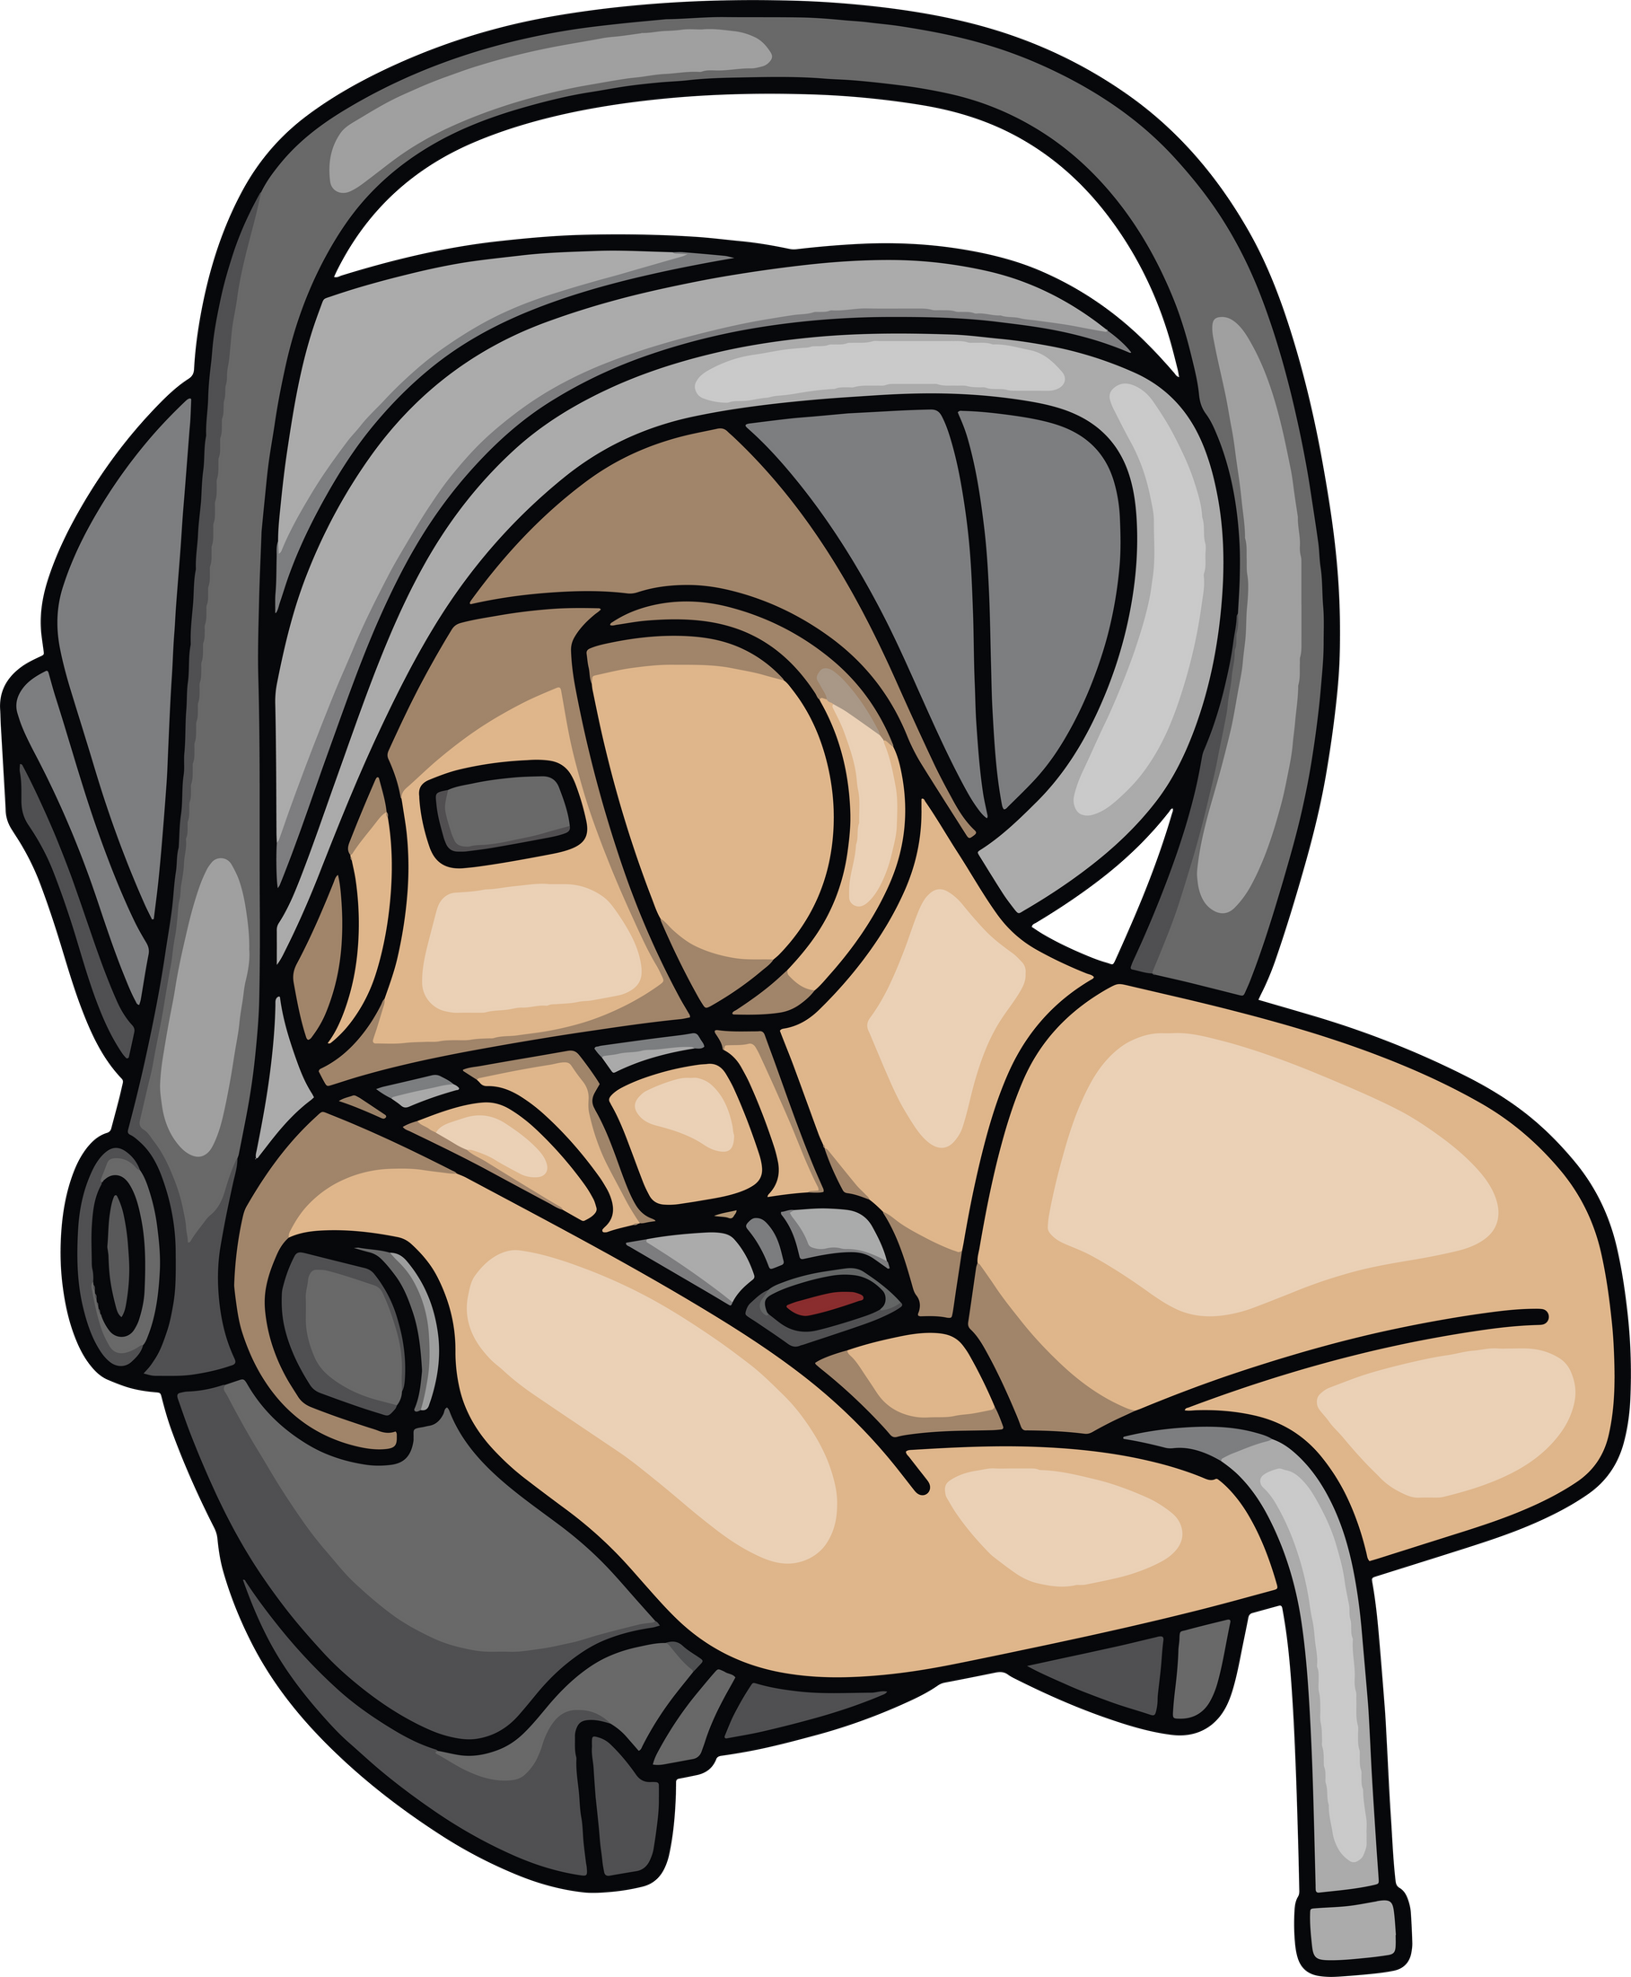

Case study – second hand goods
Case study: Selling second-hand goods
Second-hand sales
Whenever selling or re-selling second-hand goods, there are legal requirements and regulations to ensure that this is accomplished safely.
This section only covers some examples of the rules. If you sell second-hand products, you should check detailed guidance here.
Satisfactory quality
The requirements for new and second-hand goods are the same in that they should be of satisfactory quality. However, a reasonable person’s expectations may be lower for second-hand goods than they would be for brand new items.
Second-hand goods should still work, unless their lack of functionality or fault has been made clear or should have been discovered.
You cannot re-sell
Some commonplace items cannot be resold, as they may not be safe to use. Second-hand goods could contain hidden damage, or components of the goods could have expired.
For example, the following items cannot be re-sold:
  Children’s car seats
  Crash helmets, cycle helmets, protective headgear, or riding hats.
Can be sold but only if they meet certain requirements
Some other goods can be re-sold but have strict requirements, e.g.,
  Prams and pushchairs as long as they meet certain standards.

Slide 16




Case study continued
Furniture
Additional regulations apply to any upholstered domestic furniture including sofas, cushions and pillows.
.
Domestic upholstered furniture
Fire label
You can only sell furniture that complies with the regulations. It can usually be identified by a fire label attached to the item. The label normally reads ‘carelessness causes fire’ and contains details of the product.
Upholstered seating
Sofa-beds, futons
Chairs, sofas
Scatter cushions
Clothing
Regulations also restrict the sale of certain items of clothing due to flammability. For example, nightwear without a flammable warning label should not be sold.
This includes children and adult pyjamas and nightdresses, dressing
gowns and bathrobes.
Additionally, fancy dress items for children or adults should contain
a flammability warning label.

Slide 17

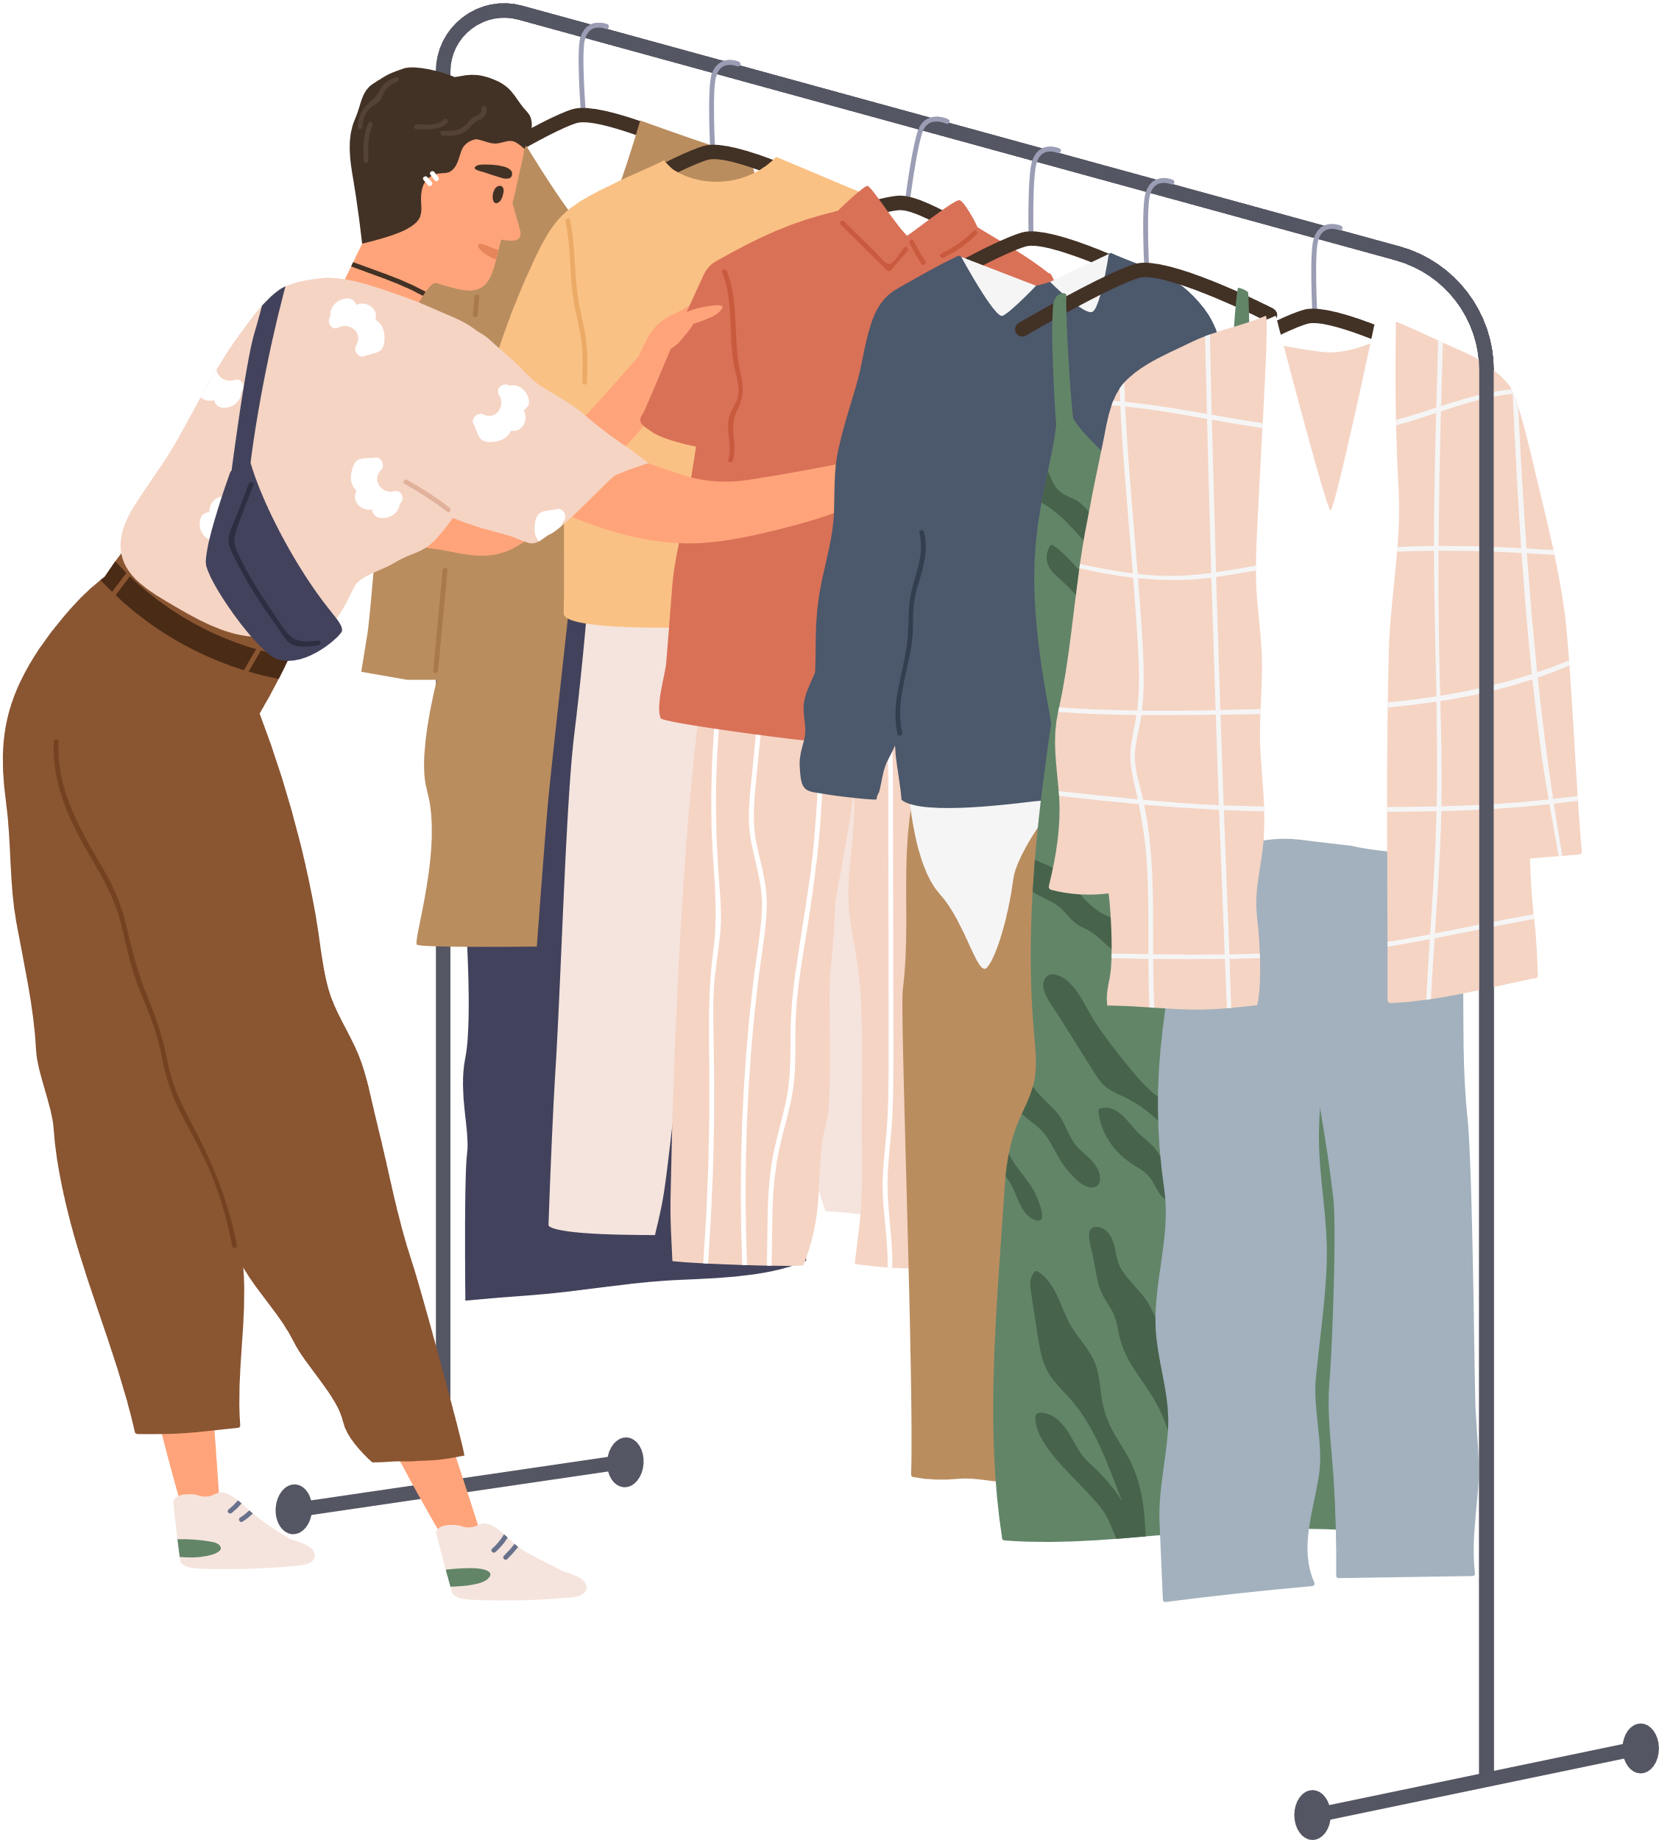

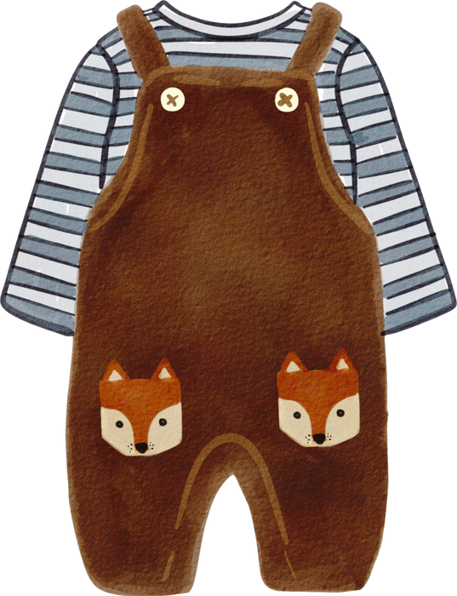

Case study continued
Selling second-hand children’s clothing
Regulations cover many areas of children’s clothing. For example, it is prohibited to sell an outer garment with a hood, where a hood cord is fitted. This is to prevent injury and risk of strangulation.
What garments are included?
A raincoat, overcoat, anorak, or other garments suitable for use as outwear, are best avoided for re-sale. This includes tracksuit tops and jumpsuits. It is applicable to anything with a hood intended as outwear.
Other considerations with children’s clothing
It is necessary to be cautious when re-selling children’s clothing. You need to consider the safety risks that could be present with the garment.
For example, you should consider things like:
  Whether the clothing includes any loose buttons, press studs or other fastenings.
  Whether baby clothing has pompoms or toggles near the neck.
Regulations change regularly and it is sensible to always check the up-to-date guidance on Trading Standard’s Business Companion website

Slide 18

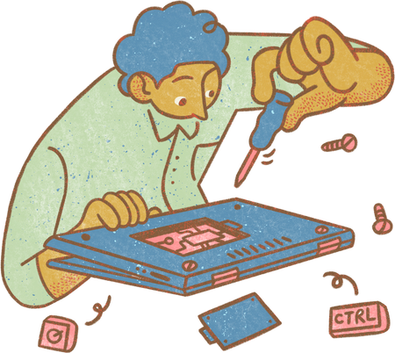


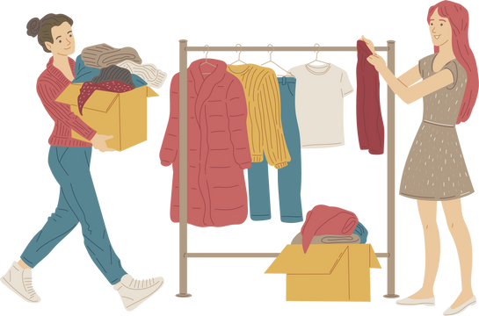
Case study continued
Electrical goods
There are further regulations which cover the resale of electrical goods. These includes things like ensuring the appliance is fitted with an approved plug, have a UKCA/CE mark and a recent PAT test has been conducted.
Product recalls
Trading standards recommends checking if an appliance has been subject to a product recall before it is sold. A useful resource for checking UK product recalls is Product Recalls & Safety Notices | Electrical Safety First .
Further information
You can find more information and guidance via the Charity Retail Association.

Slide 19





Advertising, marketing and pricing
Advertising, marketing and pricing
The Digital Markets, Competition and Consumers Act 2024
New legislation has recently been introduced to strengthen consumer protection. The Act builds on existing consumer protection and regulations. It contains 32 banned commercial practices, including:
Stating a product will only be available for a limited time, or on certain terms for a limited time, which deprives consumers of the opportunity to make an informed choice
Creating the impression an item can be legally sold when it cannot
Submitting a fake review or commissioning or incentivising others to submit a fake review
Providing access to product reviews without taking reasonable and proportionate steps to protect consumers from fake reviews
Claiming a business is about to cease trading, e.g., with a ‘closing down sale’ sign when it is untrue
The Act also brings in controls around drip-pricing - this is where only part of the price is shown at first to the consumer with added amounts near the time of buying
There will also be additional controls introduced in relation to subscription contracts, such as sending consumers reminders for renewals and allowing them to exit the contract in a straightforward way.
More guidance on these changes including a range of short videos can be accessed here.
Advertising Standards Authority (ASA) Guidelines
The ASA enforces the UK Code of Advertising which sets standards for advertisers. Some important aspects include the following:
Ads must be legal, decent, honest and truthful in nature. Full adherence is expected and is reinforced through fines or reputational damage.
Digital Marketing
Additional specific standards apply to digital advertisements., including provisions for honesty, responsibility, and the protection of children
For example, from 1 October 2025, paid digital advertising for High Fat Salt and Sugar (HFSS) products will be banned entirely.

Slide 20
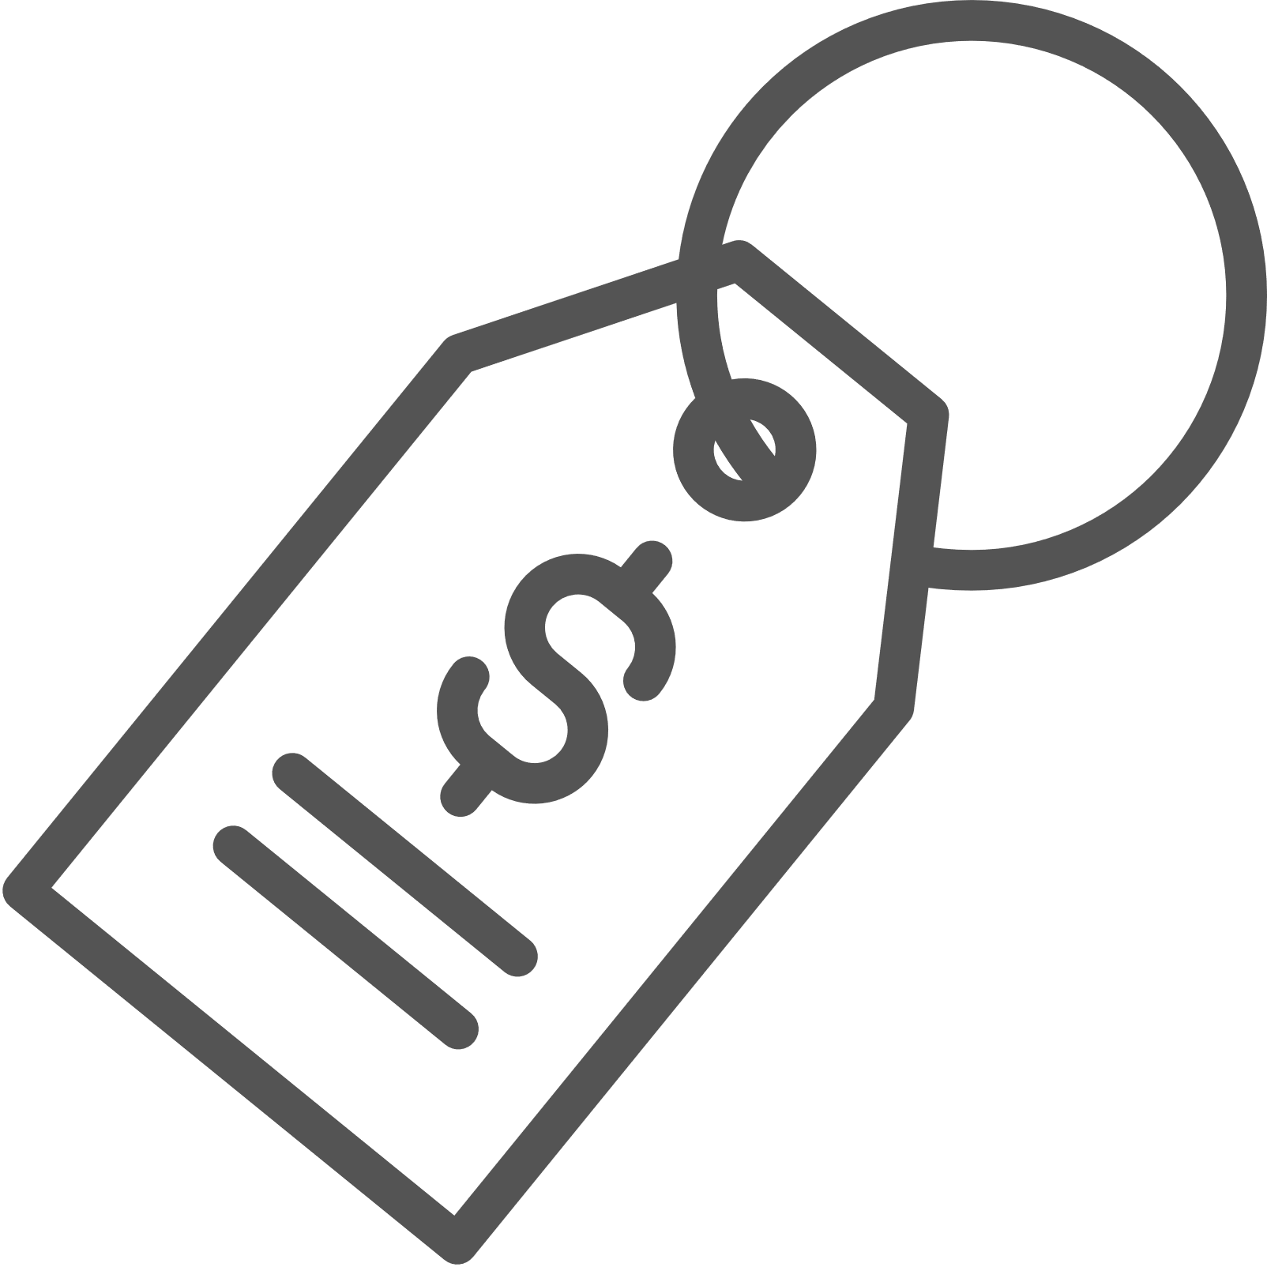


Pricing
Pricing
Pricing regulations aim to ensure transparency and fairness for consumers. Key laws and regulations include following:
Price Marking
  Clear pricing
  When selling to consumers, businesses must display the full selling price, including VAT
  Unit pricing
  For certain products sold from bulk or pre-packaged in constant quantities, unit prices must be shown (e.g., price per kilogram)
  Price indications
  All price indications must be unambiguous, easily identifiable, clearly legible, and include taxes
  Misleading prices
  It is a criminal offence to give misleading price indications about goods, whether written or verbal
  Price increases
  Sellers cannot increase the price of goods after an order has been placed unless agreed upon in advance

Slide 21




Enforcement and penalties
Enforcement and Penalties
The Competition and Markets Authority (CMA) has powers to enforce consumer protection laws. These include the ability to impose turnover-based fines for breaches of consumer law.
Businesses that break these regulations could be reported to a local Trading Standards office, potentially leading to fines, prosecution or imprisonment in worst case scenarios.
Unfair terms in consumer contracts may not be legally binding on consumers, with businesses facing possible enforcement action if they fail either the fairness or transparency tests.

Slide 22
Accessibility obligations
Accessibility Obligations
Under UK consumer rights law, particularly the Equality Act 2010, businesses selling goods must ensure accessibility for consumers with disabilities. Failure to do so may be considered unlawful discrimination. Here is an overview of your key obligations:
Reasonable adjustments
The Equality Act 2010 requires businesses to make “reasonable adjustments” to ensure that individuals with disabilities can access their goods and services. This obligation applies to:
  Physical premises (e.g., shops, showrooms, markets)
  Digital services (e.g., websites, mobile apps, online stores)
  Customer service and staff interactions
Physical Accessibility Adjustments
You must take reasonable steps to remove physical barriers that could prevent
disabled consumers from accessing their premises. Adjustments may include:
  Providing step-free access, such as ramps or lifts, where possible
  Widening doorways to accommodate wheelchair users
  Installing clear signage for visually impaired customers
  Ensuring accessible toilets where facilities are provided
  Providing alternative ways to access goods, such as home
  Businesses should assess their premises regularly to identify and remove accessibility
barriers. (Gov.uk - Access for disabled people)
Digital Accessibility Obligations
If your business operates online, your website and mobile applications must be accessible to people with disabilities. While the Public Sector Bodies (Websites and Mobile Applications) Accessibility Regulations 2018 primarily apply to public sector websites, the Equality Act 2010 still requires private businesses to avoid discriminating against disabled customers.
Key Digital Accessibility Adjustments:
  Making your website compatible with screen readers for visually impaired users
  Ensuring text is clearly readable with high contrast options
  Providing keyboard navigation options for those who cannot use a mouse
  Including captions or transcripts for video and audio content
  Avoiding reliance on colour alone to convey meaning (e.g., error messages should not rely solely on red text)
A good benchmark for compliance is the Web Content Accessibility Guidelines. (W3C Web Accessibility Initiative).

Slide 23

Accessibility obligations continued
Reasonable Adjustments & Customer Service
The reasonable adjustments duty under the Equality Act 2010 is an ongoing responsibility. It means businesses must take proactive steps to remove barriers for disabled customers before a complaint is made.
This could include:
  Offering alternative shopping methods (e.g., telephone orders, assisted shopping,
click-and-collect)
  Allowing guide dogs and assistance dogs on premises
  Providing customer assistance to help disabled customers navigate the store or
access products
EHRC - Reasonable Adjustments
Staff Training on Accessibility Obligations
To ensure compliance, businesses should train their staff on how to assist disabled
customers effectively. This includes:
  Understanding disability rights under the Equality Act 2010
  Providing respectful and inclusive customer service (e.g., knowing how to
communicate with deaf customers or those with speech impairments)
  Assisting with physical access needs, such as opening doors or guiding visually
impaired customers
  Operating any accessibility features (e.g., hearing loops, accessible payment
terminals)
  Knowing how to respond to reasonable adjustment requests
Regular training sessions can help ensure staff are aware of their legal responsibilities and can provide the best service to disabled customers.
(EHRC - Staff Training Guide)
Monitoring and Improving Accessibility
Accessibility is an ongoing commitment, not a one-time fix. Businesses should:
  Conduct accessibility audits of their physical and digital environments
  Seek customer feedback on accessibility issues
  Regularly update their policies to reflect best practices and legal changes
By prioritising accessibility, businesses not only comply with UK law but also create a more inclusive and welcoming environment for all customers.

Slide 24


Data protection
Data Protection
This section of the toolkit aims to introduce your obligations under the Data Protection Act 2018 and the General Data Protection Regulation (GDPR). Further guidance can be found here.
It provides basic guidance on key areas of data protection, including data collection, storage, security, and data breaches.
Data Collection
You may collect data from your customers in a number of ways, for example:
  Website forms
  Online purchases
  Phone calls
  Social media
  In-person forms and interactions
Transparency and Consent
You must be transparent with your customers about how their data is collected and used.
Lawful Basis for Processing
Data Storage
Businesses must have a lawful basis for processing personal data. These bases include:
  Consent
  Contractual necessity
  Legal obligation
  Vital interests
  Public task
  Legitimate interests
You must store data securely to prevent unauthorised access, use, or disclosure.
E.g., by:.
  Choosing reputable cloud providers with strong security measures
  Encrypting data both in transit and at rest
  Implementing access controls to limit who can access data
  Regularly backing up data
  Securely disposing of data when it is no longer needed

Slide 25


Data protection continued
Data Security
Businesses should implement a range of security measures, including:
  Strong passwords and multi-factor authentication
  Up-to-date software and security patches
  Firewalls and antivirus software
  Regular security audits and vulnerability assessments
  Staff training on data protection and security best practices
Subject Access Requests (SARs)
Individuals have the right to access the personal data that a business holds about them. Businesses must respond to these requests. More information can be found here
Data Breaches
You should take steps to prevent data breaches by:
  Implementing strong security measures (as outlined in Data Security)
  Regularly backing up data
  Monitoring systems for suspicious activity
  Having a data breach response plan in place
  If you experience a data breach, acting quickly is crucial. Further information on data breaches and reporting requirements can be found here
Data Protection Officer
In some cases, you may be required to appoint a Data Protection Officer (DPO). This is typically required if you:
  Process special category data (e.g., health data, racial or ethnic origin data)
  Carry out large-scale monitoring of individuals (e.g., CCTV monitoring)
  Are a public authority
The DPO's role is to advise you on your data protection obligations, monitor your compliance, and act as a point of contact for individuals and the ICO.
If you're unsure whether you need a DPO, you can consult with the ICO or a legal professional.

Slide 26


End page
This toolkit has aimed to support you by introducing the core principles of consumer law, for businesses selling goods.
The following pages contain links to further resources.

Slide 27
Further resources
Further Resources
https://www.gov.uk/consumer-protection-rights
https://www.gov.uk/guidance/product-safety-advice-for-businesses
https://www.fsb.org.uk/resources/business-guides
https://www.businesscompanion.info/
https://ico.org.uk/
https://www.gov.uk/government/organisations/competition-and-markets-authority
https://www.abi.org.uk/products-and-issues/choosing-the-right-insurance/business-insurance/

