Slide 1
Intro Slide Title 1
INFORMATION WEBINAR
The Open University BSc Nursing Degree Programme
Stephanie Foster Professional Lead, OU Nursing Programme (NI)
Meg Hughes: Staff Tutor
Dr Una St Ledger: Staff Tutor
Keri Finlay: Faculty Coordinator
Aurelia Iannotta: Faculty Coordinator
Rachel Mattheson: Practice Learning Assistant
FACULTY OF WELLBEING EDUCATION & LANGUAGES
12th & 13th January 2026

Slide 2
Welcome to OU Nursing Programme Webinar 2026
Outline of Presentation
Welcome
Introduction and setting the scene
Who we are
Key links, contacts
Structure
OU BSc Nursing Programme
Part 1
Brief Overview of Part 1 of the programme
2026 Recruitment
Application processes, key dates and entry criteria
Trust perspective
Patrick Johnston Sheridan, SHSCT (12th Jan); Carly Thompson, NHSCT(13th Jan)
Student perspective
Kate McEvoy , SHSCT (12th Jan) and Cheryl Mogey, BHSCT (13th Jan)
Q&A
Opportunity to ask questions

Slide 3
Introduction
The Pre-Registration Nursing Degree BSc Programme
The Open University has offered a pre-registration nursing programme since 2004 in Northern Ireland, working in partnership with all five Health and Social Care Trusts and the Independent Sector.
The Programme offers the following pathways:
Adult
Mental Health
Learning Disabilities
Children and Young People

Slide 4
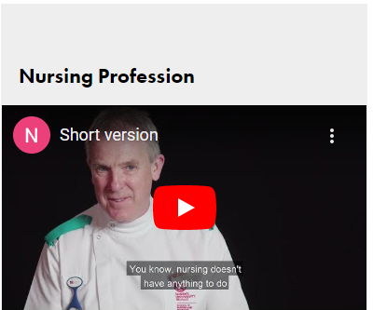
Setting the scene
Nursing: a career for all
OU Future Nurse Programmes | The Open University in Northern Ireland
You will be sent a link in the next two weeks which will give you access to a recording of the webinar, a copy of this presentation and an FAQ document.

Slide 5
Who we are
Key links and contacts

Slide 6
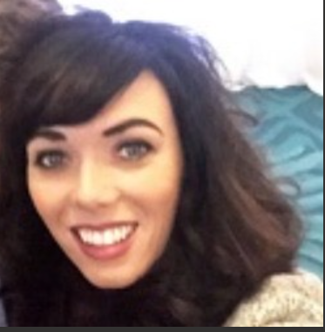
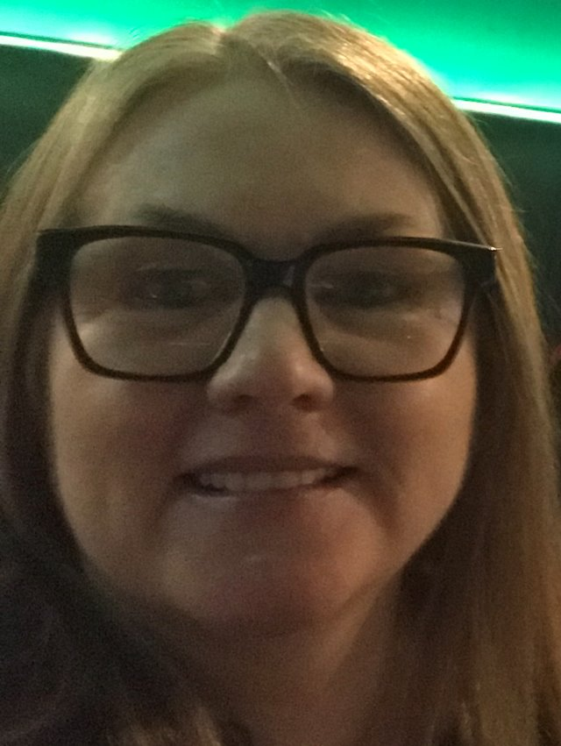

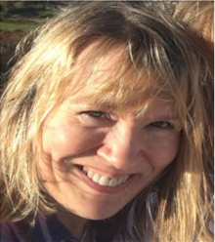
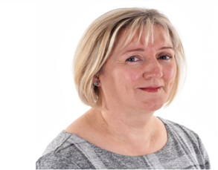

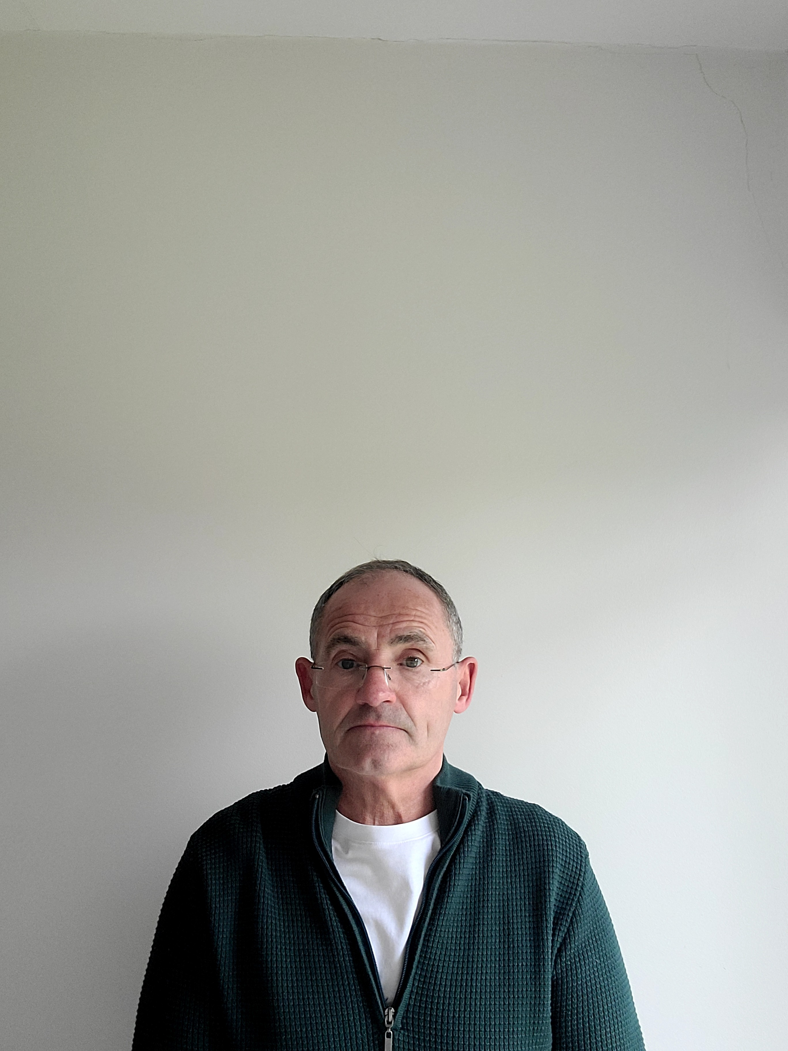
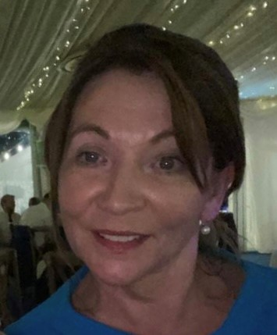
NI Professional Lead
Stephanie Foster
Interim Nation Manager
The Open University Nursing Team in Ireland
Staff Tutors
Monica
Karen
Siobhan
Una
Paul
Robert
Stephanie
Meg

Slide 7
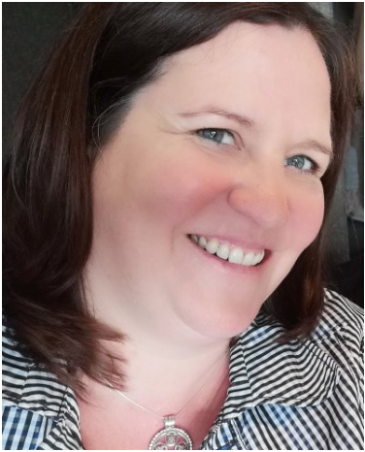

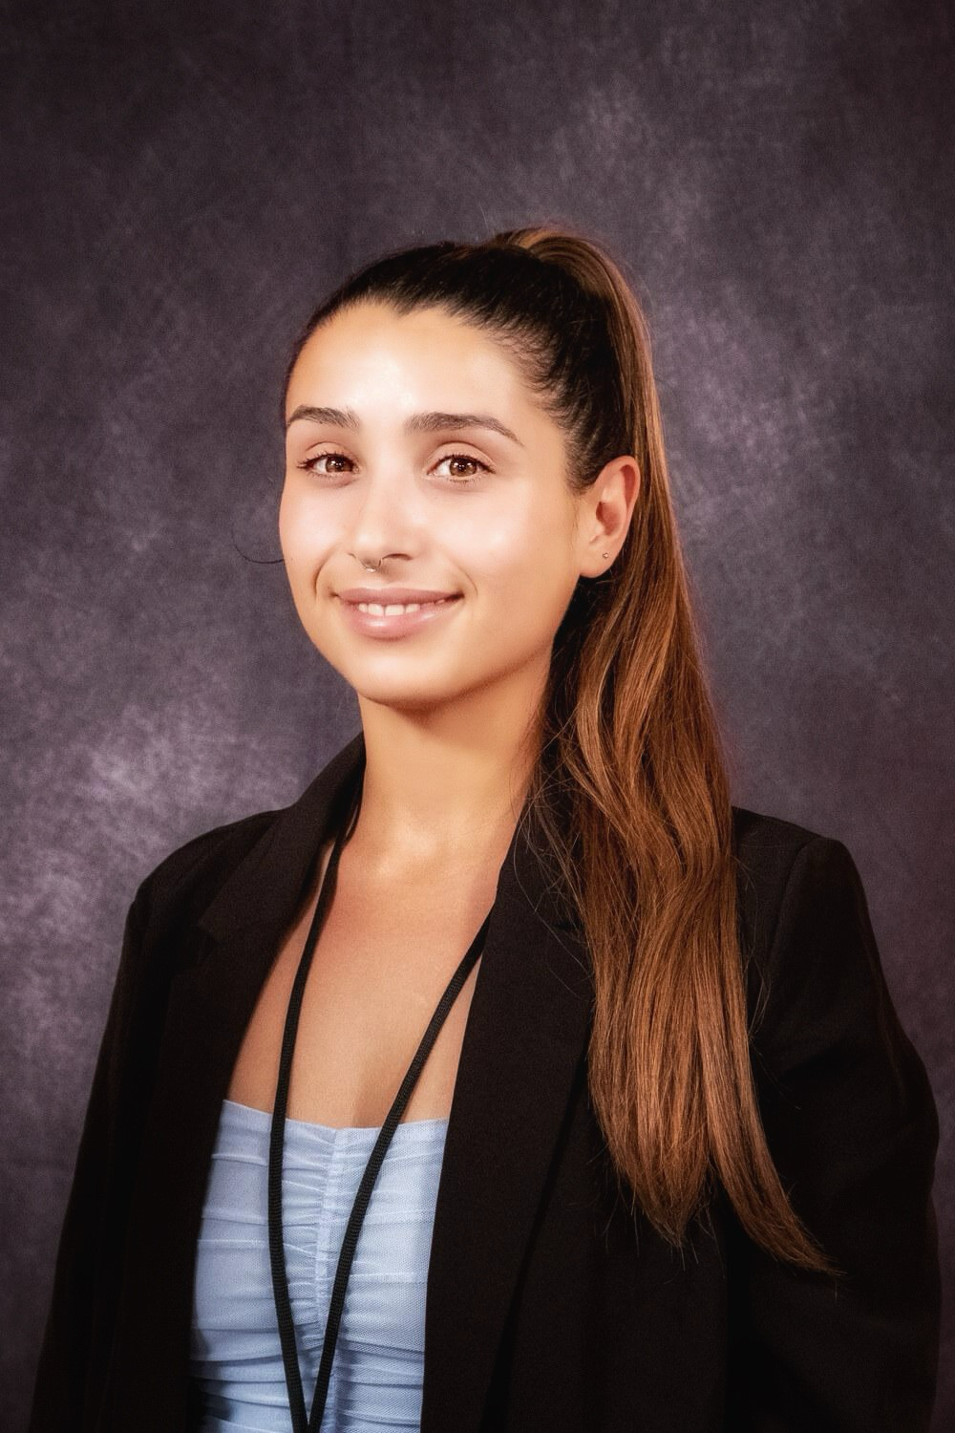
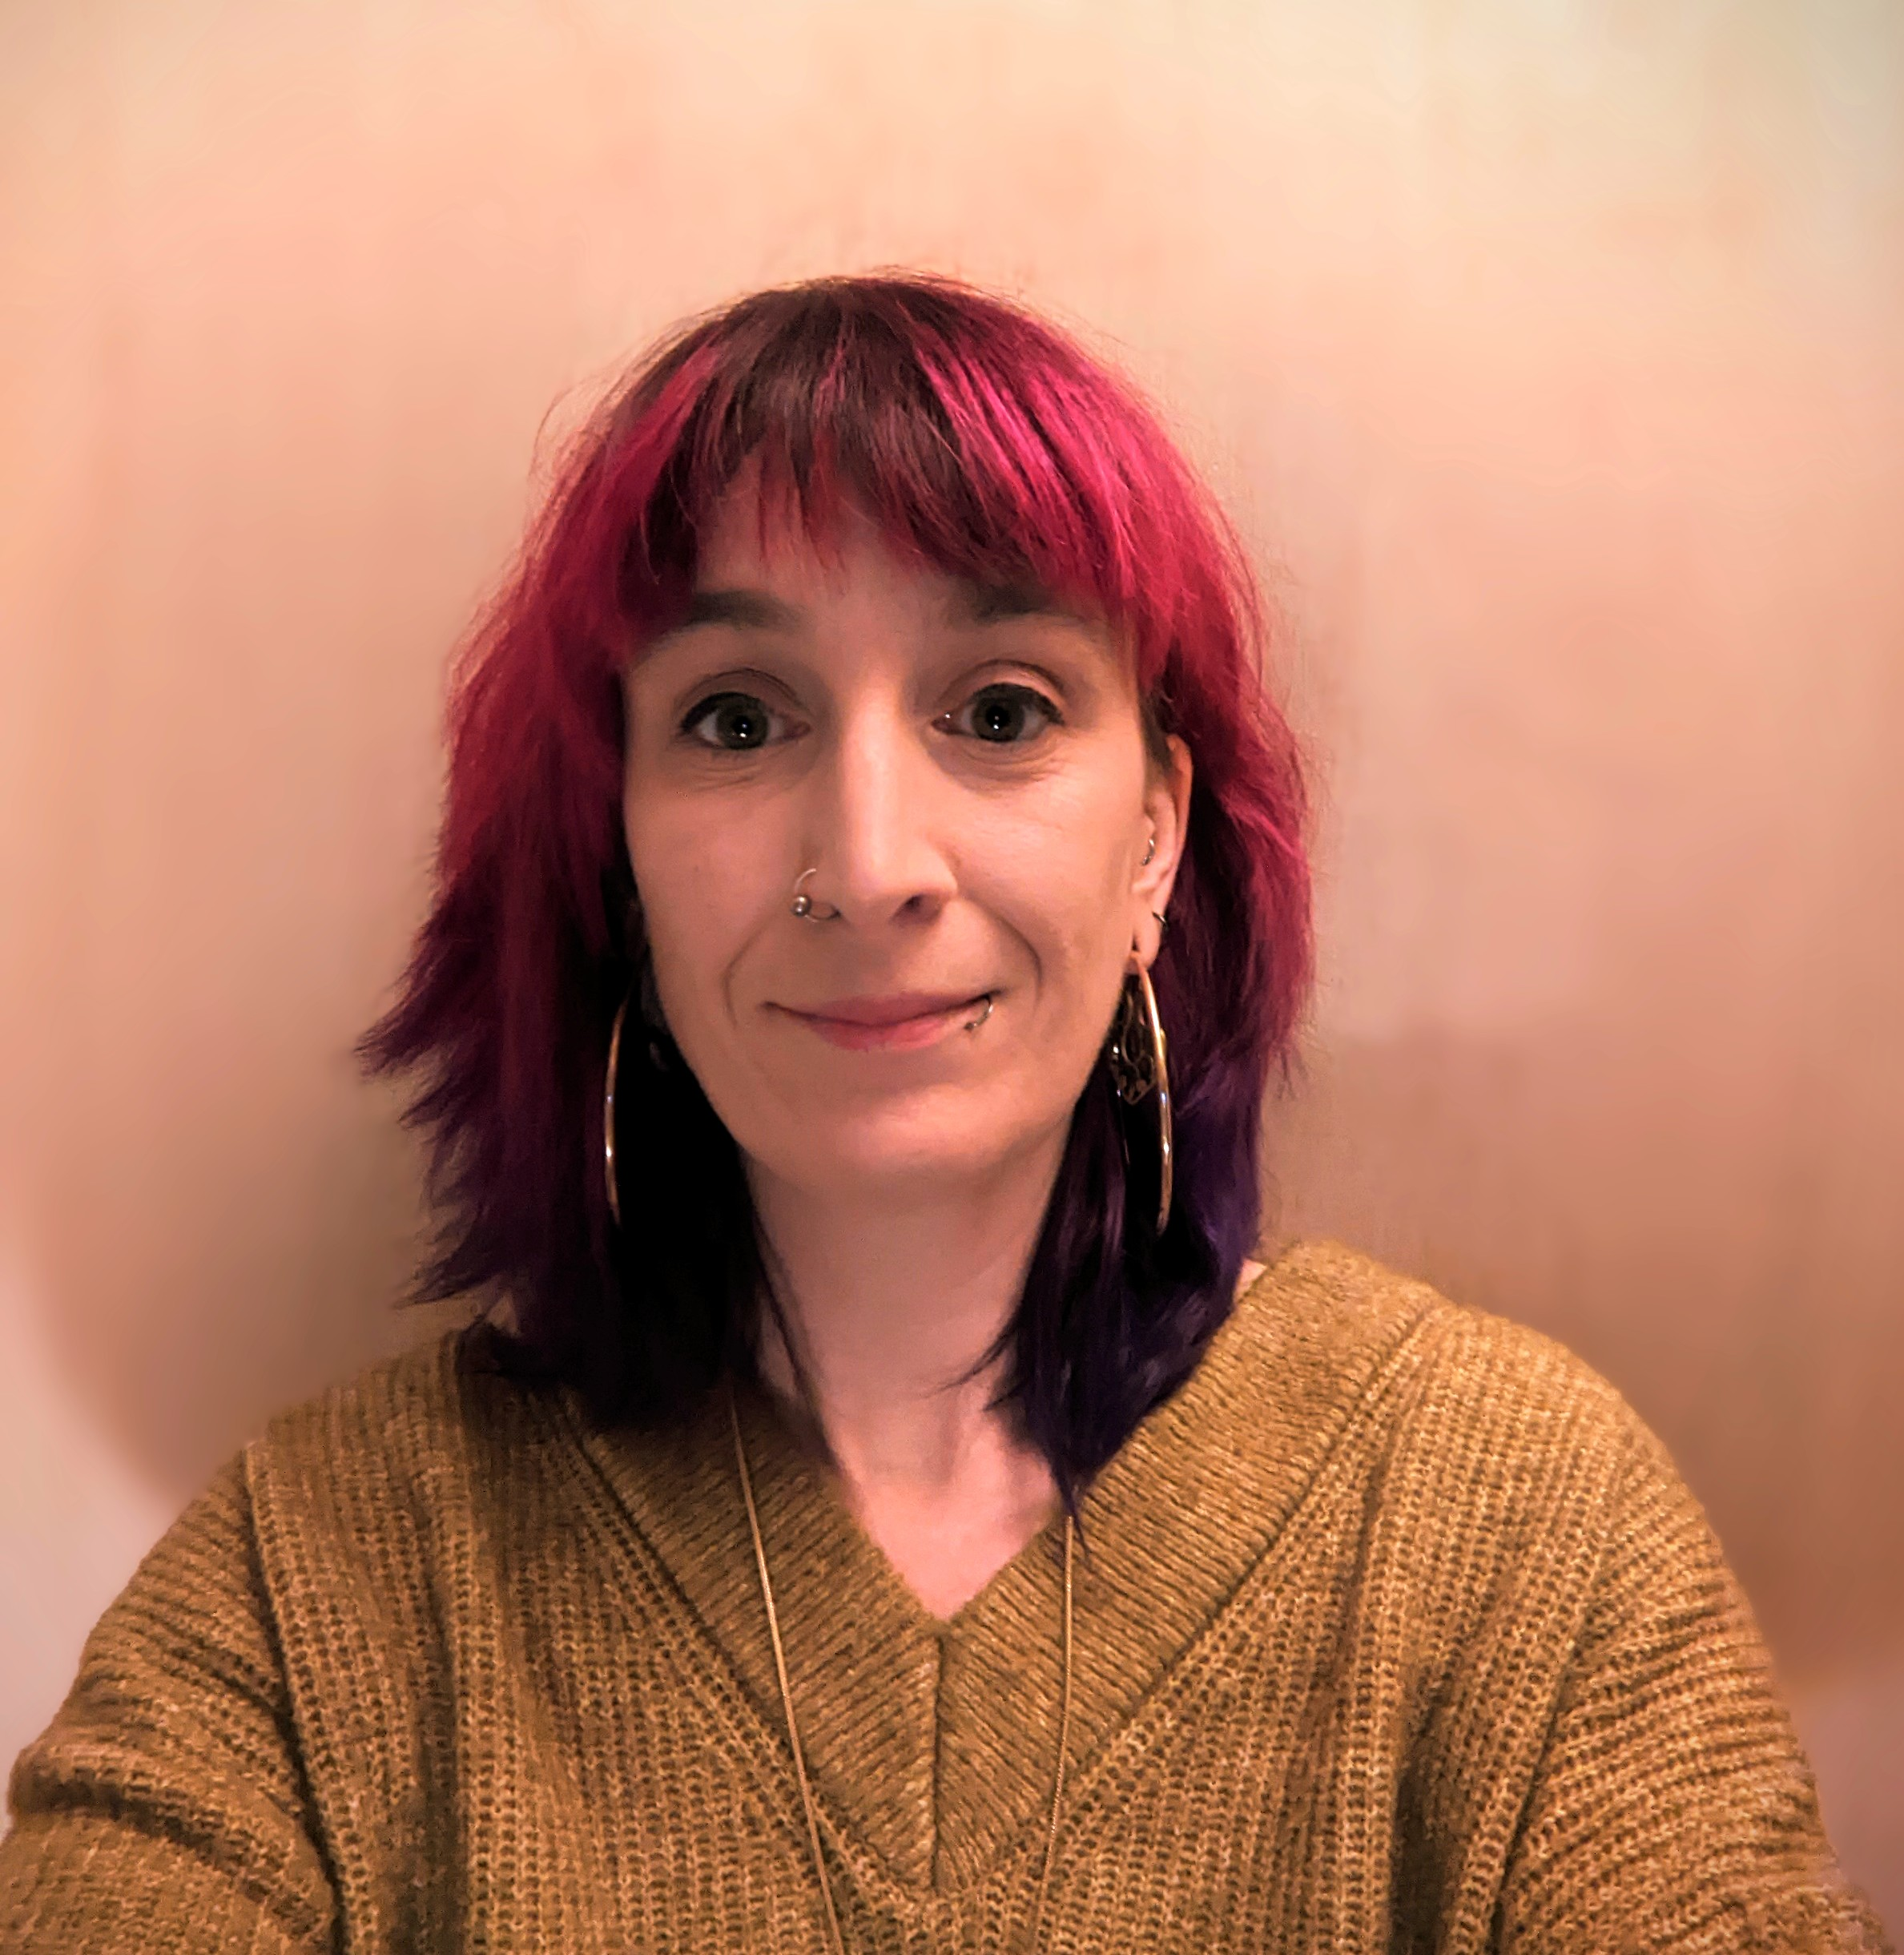
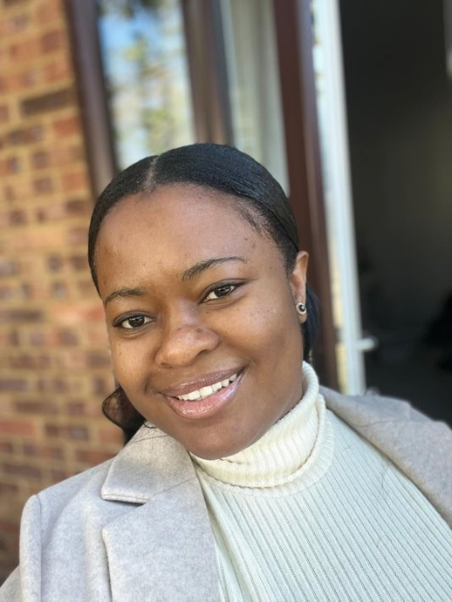
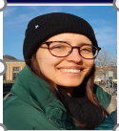
The Open University Nursing Team in Ireland
Faculty Team
Faculty Coordinators
Keri Antonia
Aurelia
Faculty Assistants
Practice Based Learning Assistants
Rachel
Nana
Emma Kate
Eunice

Slide 8
Practice Education Coordinators/ Education Leads
BHSCT
Carol Chambers
SHSCT
Patrick Johnston-Sheridan
SEHSCT
Tracy Gibney
NHSCT
Carly Thompson
WHSCT
Tracy McGilligan

Slide 9
Structure
Open University BSc Nursing Programme

Slide 10

Programme Structure
4 Year Part Time Programme
 |  | Theory | Practice
Part 1 |  | K102 Introduction to health and social care (60 credits) | K104 Introduction to healthcare practice (60 credits)
Part 2 |  | K210 Understanding Nursing: knowledge and theory (60 credits) | K211 developing nursing practice (60 credits)
Part 3 |  | K325 Assimilating nursing: knowledge and theory (60 credits) | Becoming an autonomous practitioner: K326 Adult K327 Mental Health K328 Learning Disability K329 Children and Young People (60 credits)

Slide 11
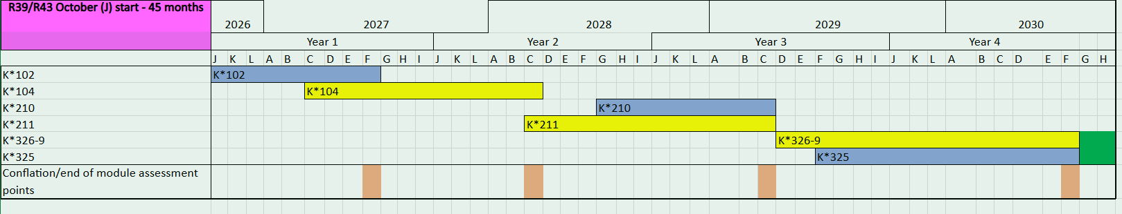
Potential programme structure from 26J onwards for illustration
( K102 26J and K104 27C)
Blue- theory modules
Conflation period
Yellow practice modules
Results awarded

Slide 12
Student Timetables
You will receive a student timetable at the start of each ‘Part’ (i.e: Part 1/Part 2/Part 3) of your study.
Timetables illustrate what weeks and how many hours you will:
Work in your base
Complete in your placement area
Be entitled to take time-off to study

Slide 13
Part 1 of The Programme
Consists of 2 modules
K102: Introduction to health and social care (starts Oct 2026). Theory module.
K104: Introduction to healthcare practice
(starts March 2027). Practice based module.

Slide 14

K102 Introduction to health and social care
Part 1 of the programme
60 credit module
8 month duration
Four nations approach to content
Online delivery
Strong focus on theory that underpins care delivery
Nursing and social work activities to reflect integrated care delivery

Slide 15
K102 Assessment
Five tutor marked assignments (TMA’s)
One end of module assessment (EMA)

Slide 16

K104: Introduction to healthcare practice
60 credit module
Practice-based module
16 learning guides alongside placement
Supported by and work closely with your OU Practice Tutor
Supported in practice by Practice Supervisors (PS)
Assessed in practice by Practice Assessor (PA)

Slide 17
K104 Assessment
2 tutor-marked assignments (TMAs)
A practice assessment interview (PAI)
An interactive computer-marked quiz (iCMA 43)
An end-of-module assessment (EMA)
Successful completion of the electronic Northern Ireland practice assessment document (eNIPAD) of your practice learning.

Slide 18
Learning in practice
2300 hours of practice experience must be achieved across the entire qualification.
770 hours to be completed in each Part of the programme.
3 placements in each Part of Programme totalling 9 placements across the 3 Parts of programme over 4 Years.

Slide 19
Practice Learning Experiences (Placements)
Placements are predominantly within the boundaries of your employing Trust and when allocated, will not be changed (only in exceptional circumstances)
Placement allocations are limited, and students will have to travel to placements across their respective trust sites
Required commitment to travel to placements
Annual leave is not permitted during placement weeks (only in very exceptional circumstances)

Slide 20
2026 Recruitment
Application key dates, processes, and eligibility
Keri Finlay: Faculty Coordinator

Slide 21
When do I apply?
To obtain an online application pack, send your name and email address to:
Ireland-nursing-applications@open.ac.uk or click on QR Code.
Applications will be released 14th January 2026
Deadline for application submission 28th February 2026
Screening of applications will take place 3rd - 31st March 2026
Interviews will take place between 13th April – 19th May 2026
Notification of success in gaining a place end of June/early July 2026
Commence Programme Oct 2026

Slide 22
Am I eligible to apply?
You must be working in one of the five HSC Trusts in Northern Ireland.
It is an essential requirement that you hold a permanent contract of 26 hours or more.
IMPORTANT NOTE: Term time contracts cannot be supported. If you are on leave during ‘term times’, you will not be able to fulfil your academic and placement requirements. You will need to discuss this further with your line manager if applying.

Slide 23
Am I eligible to apply: English/Maths criteria
You must have English and Maths G.C.S.E. grade C (or equivalent) and be able to evidence your qualification with certificates (or Unique Learner Number – ULN) when submitting your application.
The OU must ensure that the entry criteria set by the Nursing and Midwifery Council (NMC) Standards, are met at the point of application to the programme.
The minimum English and Mathematics standards for entry to the Pre-registration Nursing Programme are either: GCSE Grades A – C or equivalent, for example, Essential Skills, Key Skills, Level 2 in adult literacy and application of number.
K102 (if completed and passed before the application deadline) will be accepted as an equivalent qualification for G.C.S.E. English.
If you have international qualifications that you believe are equivalent to English or Maths G.C.S.E grade C in the UK, you must supply a certificate from UK ENIC (previously NARIC) to support your application. The ENIC statement must state the subjects it is evidencing.
Notes:
UK National Information Centre for global qualifications and skills

Slide 24
Am I eligible to apply?
You must have support from your line manager and budget holder when submitting your application, including approval and support for the field of practice you have chosen to study (signatures will be required).
Good character, evidenced through self-declaration (at the point of application) and an enhanced criminal record disclosure (should you be offered a place on the programme).
Good health, evidenced through self-declaration of health status, occupational health screening, review of previous sickness and absence record.
One reference – must be from your current line manager.
One Academic reference - if previously started but did not complete a professional programme at another university.

Slide 25
Important things to note
Once you start the programme you cannot switch to another field of practice (AD / MH / LD / CYP) at any stage during the programme.
Commissioned numbers for each field of practice are agreed with the Department of Health. It is important that you make a well-informed decision, talking with your line manager, before applying to the programme.
The application form for the 2026 intake will be online and guidance will be issued to help you navigate the online form.
A personal statement is no longer required as part of the application.

Slide 26
The Online Application Form
Please consult all guidance notes before starting the online application.
The online application process is divided into 2 parts:
Online Form to be completed in full in one sitting and electronically submitted.
Supporting documents to be completed in full and sent in one email to Ireland-Nursing-Applications@open.ac.uk

Slide 27
The Online Application Form
PART 1
Part 1 is online and has 9 sections; (1) personal details; (2) education history; (3) qualifications; (4) credit transfer; (5) current employment; (6) employment history; (7) additional information; (8) declaration of character; (9) Your confirmation and signature.
It is important you gather all information required in Part 1 of the application before you start the form. The form must be completed in one sitting and cannot be saved as you go along. Do not leave your application open and come back to it at different times as it may not complete correctly and at the end of the form it may not submit.

Slide 28
The Online Application Form
PART 1
Information to prepare before submitting the online application:
Have a complete overview of your employment history since leaving full time education (including months and years). If there is a gap (even a month) please state, why; i.e. I was seeking employment, or I was a carer etc. Failing to explain gaps may affect the progress of your application.
Have a complete overview of your education history, including dates (secondary and higher education if applicable).

Slide 29

The Online Application Form
Part 2
Please consult the guidance notes for more information on the documents below and on how to save and send these documents to the OU.
You are required to submit the following documents to ireland-nursing-applications@open.ac.uk before the closing date, 28th February 2026.
Application Part 2, Manager and Senior Manager/Budget Holder Support
Employer Reference
Maths/Numeracy Certificate
English/Literacy Certificate
Photographic Evidence
Evidence of Name Change (if applicable)

Slide 30
The Application: Important points
Where there are gaps in your education or employment history, please make a note in your application of why that is.
There must be NO unexplained gaps in your education.
There must be NO unexplained gaps in your employment history.

Slide 31

A complete application form must include:
Application Part 1 (COMPLETED ONLINE)
Application Part 2, Manager and Senior Manager/Budget Holder Support (EMAILED)
Maths Certificate (EMAILED)
English Certificate (EMAILED)
Employer Reference (EMAILED)
Photographic Evidence (EMAILED)
Evidence of Name Change (if applicable, EMAILED)

Slide 32
Slide Title 30
Student Perspective

Slide 33
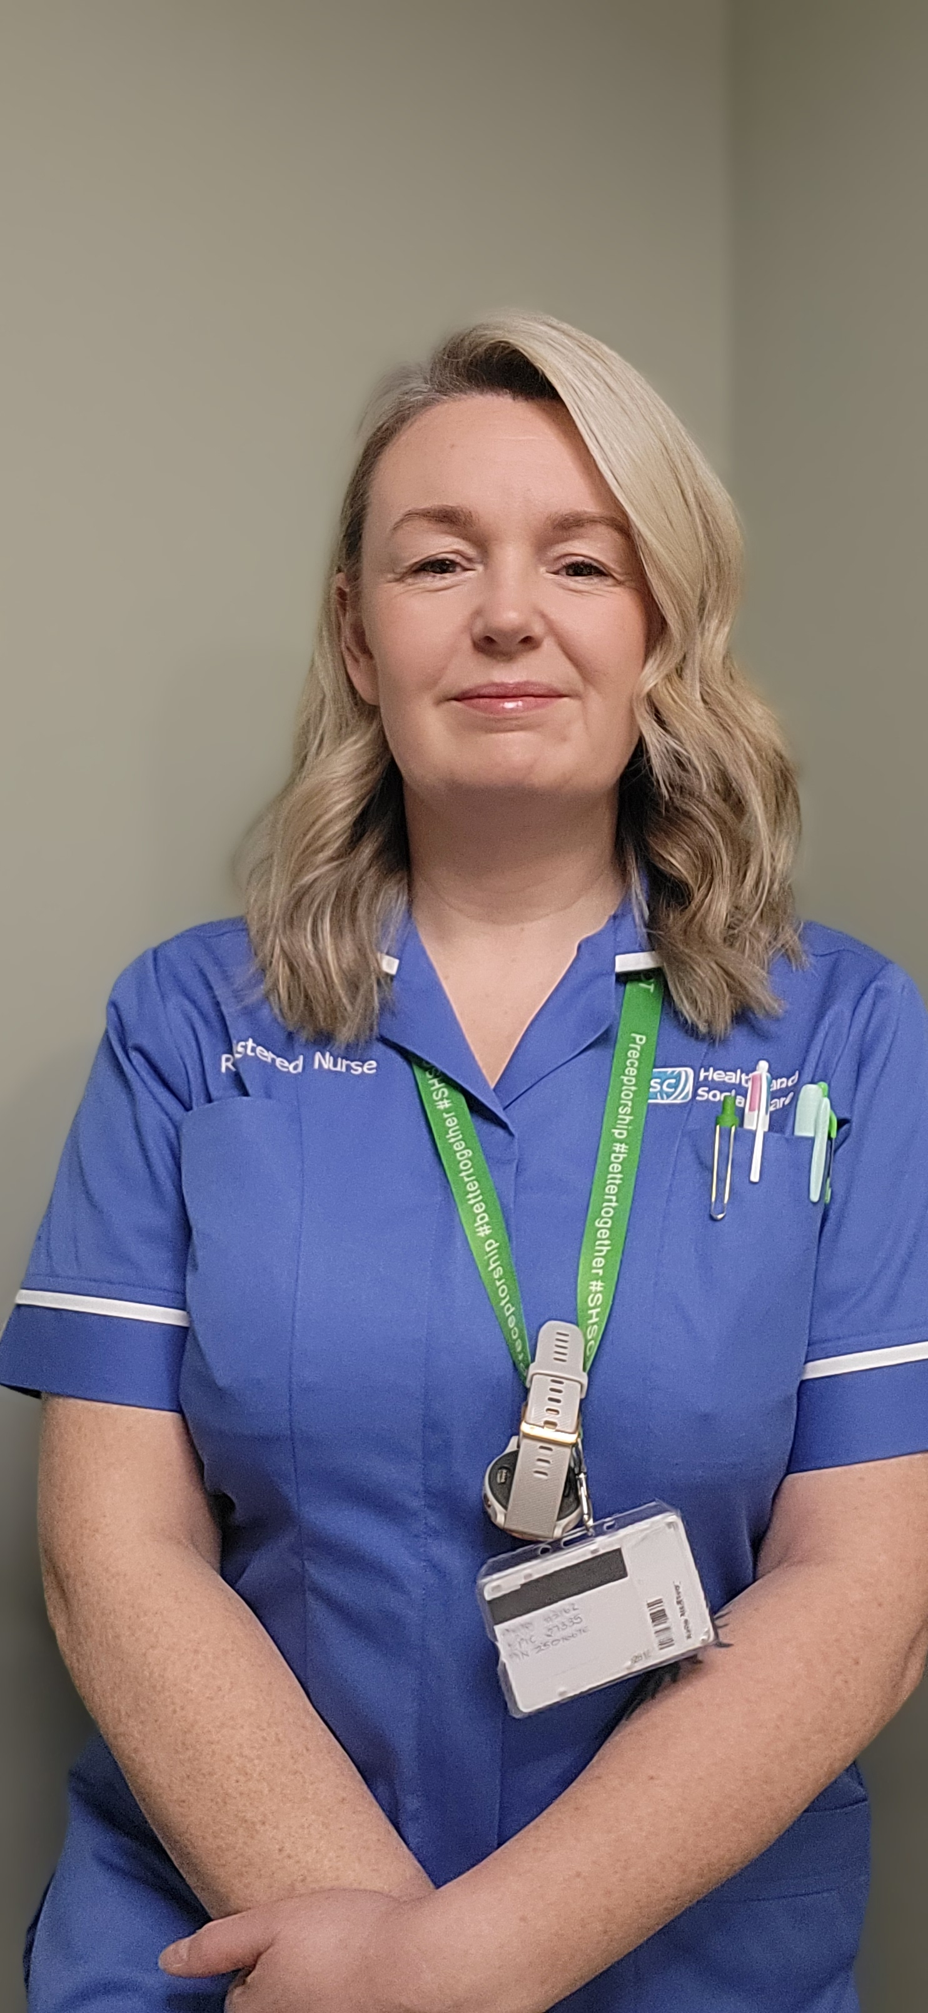


The Open University Nursing Programme Kate McEvoy BSc. Nursing -First Class Hons.
Taken up RN Post in Craigavon Area Hospital in Ward 1 West

Slide 34

Why choose the Open University?
4 year course
Earn as you learn
OU resources
Amazing support from tutors
Other opportunities e.g. Student Leadership Challenge, Masterclass Tutorials
Study leave on and off placement and mileage expenses
Working for the trust

Slide 35

Your Application
Be prepared, don’t rush
Complete every section
TIPS: Proof-read, Text-to-speech, another set of eyes
Have all your supporting documents ready – including qualification certs
Evidence-base your answers with NMC/Trust Values/6 C’s

Slide 36

Your Interview
Review your application form, why do you want to study nursing?
Answer all the questions
Structure answers using NMC Code (2018)/Trust Values/6 C’s
Reflective experience
Seek out tips for interviews – OU page have great examples
Deep breaths and stay calm

Slide 37

When you are Successful
Practice placements within your own trust area
Study theorical knowledge and apply it to your practice
Make the most of contact with other students
Make the most of all your placements
Beginning of your journey
Enjoy – 4 years goes so fast
I’m now a NQN working in ENT/Urology in CAH in my Preceptorship

Slide 38


Slide 39

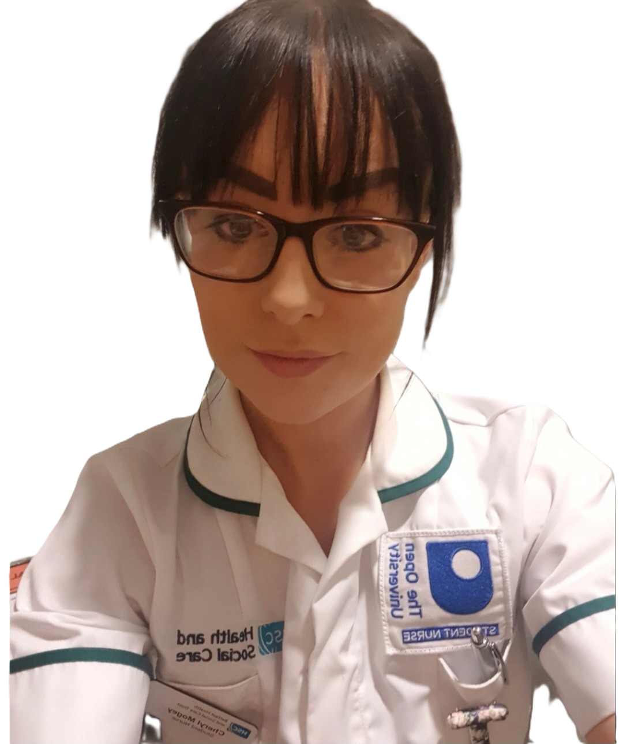

The Open University Nursing Programme Cheryl Mogey Final Year Pre-Registration Nursing Student (Mental Health) NIPEC Student Excellence Award Winner 2025

Slide 40
Why Choose The Open University?
Flexible Learning
Earn while you learn
Support from tutors & managers
Study from home
Work/Life balance

Slide 41

The Application Form
Read all guidance, carefully and repeat.
Give yourself plenty of time
Familiarize yourself with NMC code.
Read the Trust Values
Read "Future Nurse, Future Midwife" proficiencies.
(Available on NMC website)
Ask a nurse to proof-read
Ensure to include ALL documentation required

Slide 42
The Interview
Panel interview, be prepared
Know the 6 C's of Nursing
Familiarize yourself with the
degree content and what
will be expected from you.
Trust Values
Support from line manager
Practice
You tube

Slide 43

If Successful
Try not to get overwhelmed with course content.
Time management is vital
Get excited, this is an incredible opportunity.
Be proud of yourself :)
Get to know other students in your cohort.

Slide 44

Nervous about the workload?
Haven't studied in years.
Never studied at degree level
Don't let this put you off.
The Open University have a fantastic Student Support wrap-around service.
You will be offered additional tutorials on academic writing & feedback to help you.
You can do this!

Slide 45
Good Luck!

Slide 46
Slide Title 30
Trust Education Lead Perspective

Slide 47
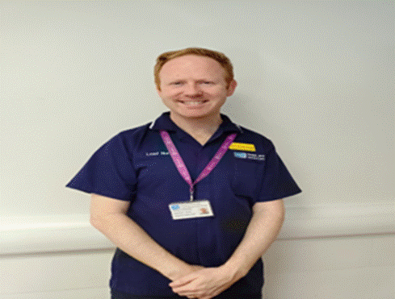
Patrick Johnston Sheridan
Interim Lead Nurse for Education and Workforce Development (Southern Trust)

Slide 48
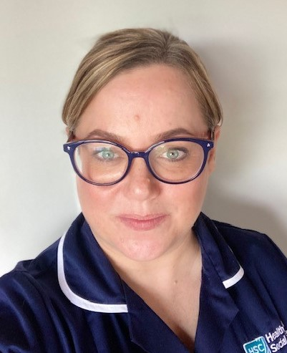
Carly Thompson
Lead Nurse Education and Development (Northern Trust)

Slide 49


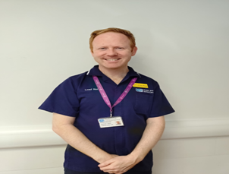
Trust Education Lead Perspective
Patrick Johnson Sheridan ( 12th Jan)
Carly Thompson (13th Jan)

Slide 50





5 Trust Education Leads
Patrick Sheridan Johnston
Carly Thompson
Carol Chambers
Tracy McGilligan
Tracy Gibney

Slide 51

Questions to ask yourself?
Am I ready to become a student nurse?
Is this the right time for me?
What do I need to do to prepare myself? Think application, think interview, think commencing the programme.
Have I discussed this with my family and friends?
Who should I reach out to now? Current OU students
Have I discussed this with my line manager prior to application?
Have I reached out to my Trusts Practice Education Team or a Practice Education Facilitators?
Have I read the OU ‘Frequently Asked Questions’ document and do I fully understand what I am signing up for?
What transferable skills do I have?

Slide 52




Who’s here to support you?
OU Team
Practice & Staff Tutor
Academic Module Tutor
OU Student Support Team
Library support
OU Students
Peer Support
Your Manager
Trust Practice Education Team
Lead Nurse Education or Practice Education Coordinator
Placement
Practice Assessor
Practice Supervisor
Nominated person
Practice Education Facilitator

Slide 53


Points to Remember
Trust employee reminders
Financial reminders
You remain a Trust employee throughout your programme.
All annual leave is planned within the programme and cannot be taken when on placement.
All sickness must be reported to your line manager.
Uniform is provided and uniform policy applies.
You will receive your baseline salary. Enhanced payments will be paid for any unsocial hours worked whilst on placement.
Travel expenses can be claimed if accrued whilst on placement and where Agenda for change terms are met for such payments.
The programme takes 4 years to complete.

Slide 54


Good Luck with your applications and interviews
Next step: Have the conversations

Slide 55
Support with additional needs
If you are successful and receive an offer to join the programme, please be advised of the following:
A wealth of support for study-related needs is readily available for all students, such as support from a tutor with assignments and accessible module materials.
All learners are entitled to additional specialist services from OU, but you will need to provide supporting evidence of your disability.
You are entitled to support and adjustments to teaching, assessments and study materials and activities if you have: a physical or sensory disability; an ongoing health condition; an ongoing mental health difficulty; a specific learning difficulty such as dyslexia; an autistic spectrum condition; a speech or language difficulty.
Useful contacts for disability support can be found by following the link:
Contacts for disability support | Help Centre | The Open University

Slide 56
Slide Title 2
Questions
Any follow up questions, please direct these to: Ireland-nursing-applications@open.ac.uk

Slide 57
Slide Title 30
Thank you and good luck

Slide 58
Slide Title 31

