Slide 1
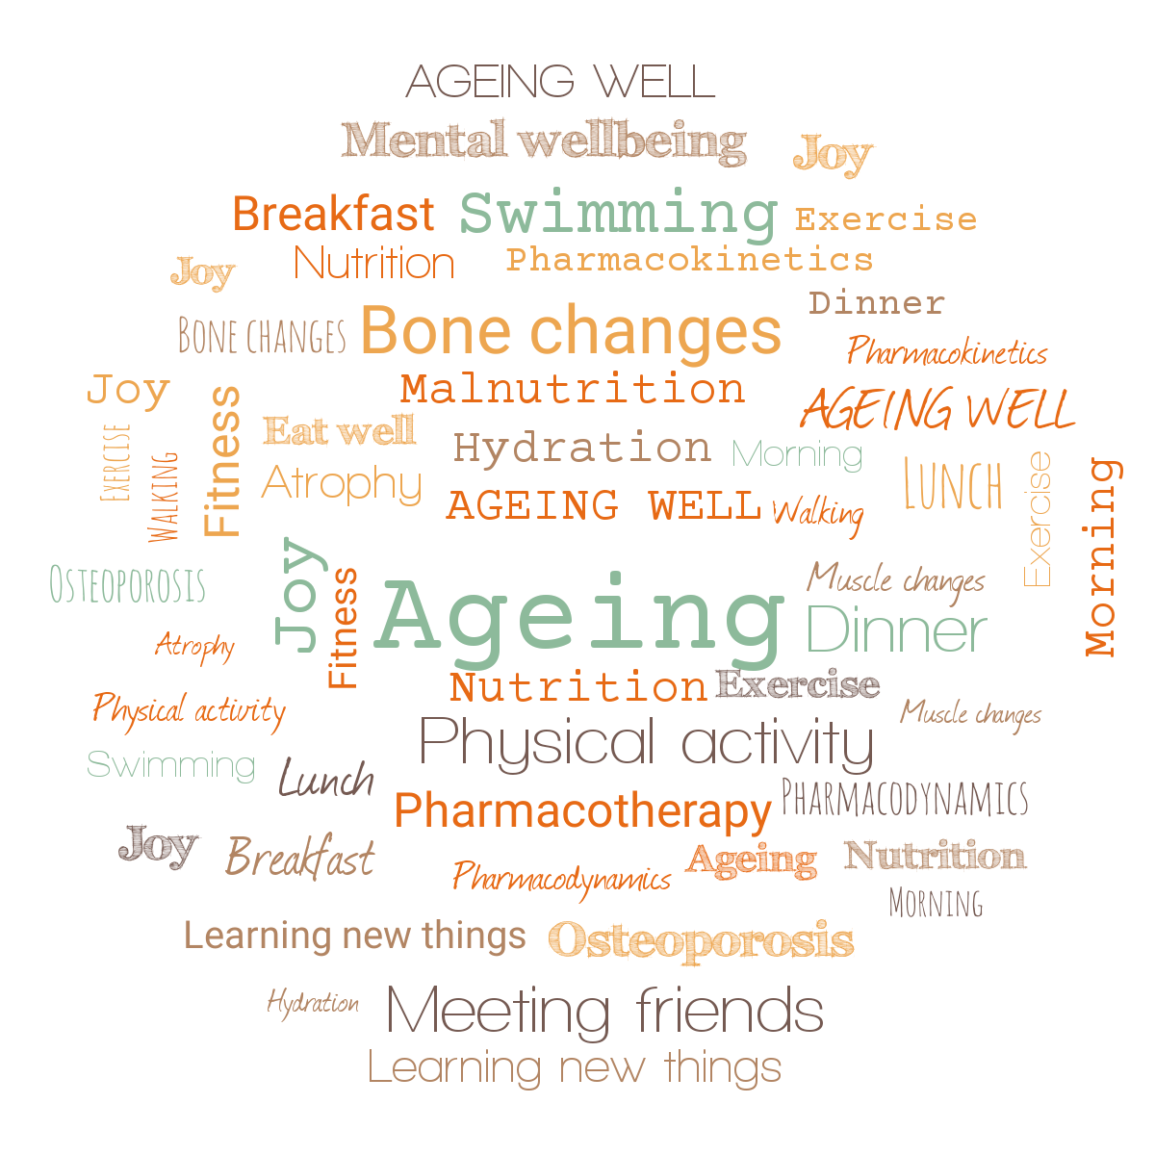

Ageing Well Public Talk Series
Jitka Vseteckova, PhD, D.Prof., SFHEA
Knowledge Exchange and Enterprise Lead (HWSC), Deputy Chair Carers Research Group OU,
Associate Editor BMC (Springer Nature)

Slide 2





Talk 2. Nutritional needs while ageing

Slide 4
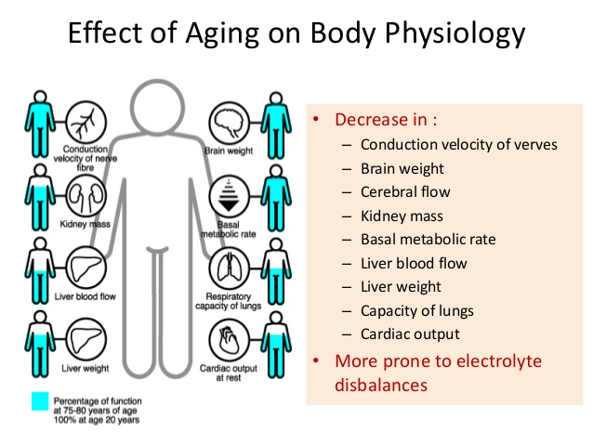

Slide 5
Pharmacotherapy while ageing
Changes related to physiological ageing (muscle, metabolism, kidney, liver)
Comorbidity / poly-morbidity resulting in poly-pharmacy
Dehydration
Malnutrition/undernutrition
Pharmacokinetics
Pharmacodynamics
Polypharmacy & drug interaction & severe drug side effects
Exercise & Five Pillars of Ageing Well
THE LESS TIME THE DRUG STAYS IN THE BODY THE BETTER

Slide 6
Biology & ageing
Mechanisms of changes in basal metabolism during ageing. A considerable number of physiological functions are known to show a gradual decline with increasing age
Muscle mass and total body water are reduced, which can affect pharmacokinetics, especially of hydrophilic drugs- water soluble drugs
Conversely, body fat increases from 20 to 40% with age, affecting absorption and metabolism especially of lipophilic drugs – fat soluble drugs
Age-related CARDIO-VASCULAR CHANGES decrease in the overall blood flow – heart rate, heart function, flexibility of vessels and arteries
LOWER HEART RATE AT REST
Decrease in kidney function and liver blood flow
As a consequence, drug clearance decreases
DEHYDRATION & LACK OF EXERCISE

Slide 7
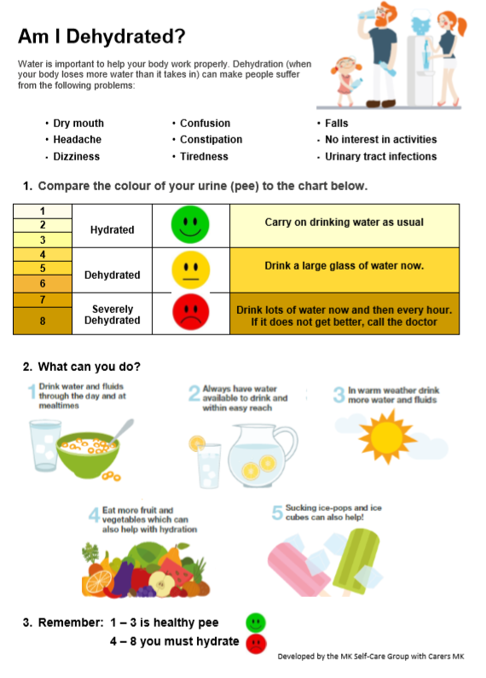
TO SUM UP
Many of the effects of aging on the heart and blood vessels can be reduced, slowed down by regular exercise
Helps people maintain cardiovascular fitness as well as muscular fitness as they age.
EXERCISE is beneficial regardless of the age at which it is started.
Dehydration

Slide 8
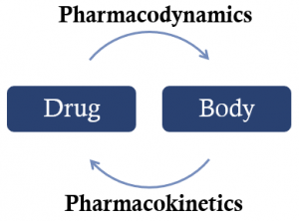
Impact of ageing on the drug journey and its action

Slide 9
Drug journey
Absorption
Elimination
Distribution
Metabolism

Slide 10
Drug absorption
Ageing may slow down the rate at the which drugs are absorbed, but it is rarely considered clinically significant. However, absorption might be influences by our nutrition, hydration, physical activity, sleep and what else we do (e.g. smoking).
Drug distribution
Decreased muscle mass and dehydration leads to higher concentration of water soluble drugs for a given dose.
Lipophilic drugs concentrate in adipose tissue and the brain. Drugs are slower to clear from fatty tissue – accumulation more likely, CNS effects.
Certain drugs are highly protein bound. Liver damage and malnourishment lead to lower circulation proteins and increase in concentration of drug.
Blood flow to tissues and organs and active uptake of drugs into tissues may also be influenced by ageing.
The blood-brain barrier may be more permeable as we age.

Slide 11
Drug metabolism
The liver is the major organ responsible for drug metabolism.
Some amount of age-related decline due to reduced hepatic volume and reduced activity of certain hepatic enzymes is possible especially in conjunction with dehydration and sedentary lifestyle.
Could be significant in case of liver disease.
Ability of the liver to withstand stress decreases – increased injury due to hepatotoxic medicines.
Some drugs have the ability to induce or inhibit enzymes.
Liver function is not easily measurable.

Slide 12
Drug elimination
Excretion via the kidneys is the most significant age related change – kidney function is measurable.
Slowed clearance leads to accumulation – can happen very slowly and signs of toxicity may take a while to appear.
Certain drugs rely on good renal functioning to exert their effect.
Some drugs are actually nephrotoxic and the overall risks and benefits may need balancing.
Regular blood tests support decision making on dose and appropriateness.
Older people are at a higher risk of acute kidney injury – occurs quickly but can be managed if identified early. Causes can include dehydration, acute illness, infection, drug interactions.

Slide 13
Kidney and age related changes
Irreversible structural and functional changes - loss of renal mass due to glomerular loss
Ability to secrete potassium and excrete hydrogen is impaired
Reduction in renal blood flow
Clearance in the aged kidney is also reduced
These changes impair the ability of the kidney to control water and electrolyte balance, predisposing to dehydration and electrolyte abnormalities, particularly in situations of physiological stress.

Slide 14
Pharmacodynamics
Drug action in the body is affected by receptor binding, post receptor effects, and chemical interactions, residence time.
Pharmacological effect can be therapeutic or undesirable (side effects and drug interactions).
Homeostatic changes associated with ageing can be manageable until the introduction of a medicine.
Ageing and polypharmacy increases the risk of adverse drug reactions (ADRs) and exacerbations of chronic conditions.
The consequences are more serious in older people – ADRs account for 5-17% of hospital admissions.
Balancing the risks and benefits of prescribing in the older population is an art not a science!

Slide 16
STANDING UP / SITTING DOWN
Raising up principle - STRAIGHTENING YOUR SPINE
Proprioception – feeling different parts of your feet on the floor
Slightly pressing the inner side of your foot to the floor
Stretching your toes
Pushing yourselves away from the ground
Moving head or arms should not necessarily change the way we stand

Slide 17
Drug related problems in older adults
Dehydration
Overuse – polypharmacy – may lead to cumulative effect – TOXICITY (brain, kidneys, CV system, liver)
Inappropriate prescribing (inappropriate prescribing can be defined as prescribing drugs whose use should be avoided because their risk outweighs their potential benefit) - may lead to cumulative effect – TOXICITY (brain, kidneys, CV system, liver)
Underuse or omission – may not get you treated for the specific condition

Slide 18
It doesn’t work!!! – the same drug and the same amount of it can take longer to take its effect when we are older…wait for it… don’t take another pill – TOXICITY (brain, kidneys, CV system, liver).
Diuretics
A study showed that 25% of the adverse drug reactions reported in an older adult population were related to diuretic therapy, and all those admitted to hospital with medication-related falls were on diuretics.
Dehydration of as little as 2% of total body water can result in a significant impairment in physical, visuomotor, psychomotor and cognitive performances.

Slide 19
Drug related effects in the older adults
Analgesia & increased sedation
Decreased BP, decreased heart rate
Vasoconstriction / vasodilatation – blood circulation not ideal
Psychomotor dysfunction, confusion
Sedation, slowed reaction time & LACK OF EXERCISE
Dizziness, worsened coordination
Massively increased risk of falls!!!!!
More regular blood tests by the GP might be desirable.

Slide 20
Accumulation of age related changes results:
Drugs take longer to act and stay for longer (2– 3 times)
Drugs accumulation & drug to drug interaction
Increased sedation effect
Increased risk of falls and fractures
Cognitive dysfunction
Dependence – withdrawal syndrome
Limited mobility, limited
Independence, limited engagement as cognitive functions and/or attention span may be impaired
Adding DEHYDRATION and LACK OF EXERCISE…

Slide 21
Hormonal changes associated with ageing
Affect fluid and electrolyte homeostasis electrolyte abnormalities usually caused by loss of bodily fluids & dehydration & use of diuretics (symptoms include: irregular heartbeat, fatigue, lethargy, nausea, diarrhoea) – can easily lead to falls
Antidiuretic hormone ADH - in older adults there is loss of the nocturnal rise in ADH, high prevalence of nocturia

Slide 22
The thirst response while ageing
Feel less thirsty
Is blunted and we may forget to drink or not remember whether we drank…
Spontaneous consumption of fluids decreases
Extreme vulnerability to dehydration in a state of physiological stress

Slide 23
Personalised Care
Dosing & frequency.
Regular blood tests & medication reviews to determine ongoing need, efficacy and potential harm.
Combination of factors to consider – physiology, multimorbidity, polypharmacy.
Heath status can change quickly - symptom relief & quality of life v. prevention.
Practical issues/inequalities – dexterity, sight, cognition, swallow, housebound, complex regimens, adherence, carers…
Self management & shared decision making.

Slide 24
What we need to keep an eye on?
Alcohol
Very little research has been done, and there are some particular problems for the older person. Alcohol may decrease treatment effect and increase side effect.
Health problems in older age can make us more susceptible to alcohol and can interfere with the effectiveness of many medicines. Check with your doctor about whether it is safe for you to drink with your particular health problem or medication.
Hidden dehydration

Slide 25
Drinking too much can damage many parts of the body and increase the risk of health problems including: Stomach lining – ulcers or bleeding; Liver – cirrhosis; Cancer – mouth
Malnutrition - alcohol has calories but can not provide the essential nutrients a balanced varied diet provides to keep us healthy.
Excessive alcohol intake can also affect mental health including increasing anxiety, depression, confusion.
Excessive alcohol intake is toxic to brain cells, and alcohol abuse leads to memory loss. Over time, alcohol abuse may also increase the risk of dementia.

Slide 26
Dehydration
Ageing produces a decrease in our thirst sensation so it is easy for dehydration to go unnoticed. So as we age, it is especially important to drink plenty of water and other non-alcoholic beverages.
Early signs of dehydration include dizziness, tiredness, headaches, drowsiness, memory loss, and other symptoms that look like dementia.
Long-term mild dehydration increases the risk of kidney stones, constipation and cholesterol problems, as well as diminished physical and mental performance.
Severe dehydration can cause ‘dementia like’ symptoms
It’s important to stay hydrated (aim for 6-8 cups per day, strict minimum 1.5 l / day). Be particularly vigilant if you take diuretics or laxatives or suffer from diabetes, high blood sugar, or diarrhoea.

Slide 27
Exercising regularly
Reduces bone loss and strengthen muscle – reducing your risk of falling and fracturing bones
Improves your sleep, mood and sense of well-being
Helps with joint stiffness and pain associated with arthritis
The more of the above the less medication you need.
Increases the metabolic rate
Increases life expectancy
Helps protect against heart
disease, stroke, diabetes, some cancers, depression and dementia
Helps you to maintain a good appetite
Help you to keep mobile

Slide 28
Thank you for your attention
Jitka
evaluation
Jitka.vseteckova@open.ac.uk

Slide 29
Summary of related resources to The Ageing Well Public Talk Series
Podcasts
Vseteckova J & King J (2020) COVID-19 Interview podcast for The Retirement Café: ‘Ageing Well Under Lockdown’
Vseteckova J & Broad E (2020) Podcast – Open University & The Parks Trust Keep Me Walking - researching with people living with dementia and their carers –
Vseteckova J (2020) Podcast - Areas of research with The Open University
Broad E, Methley A & Vseteckova J (2021) Podcast OU & The Parks Trust & Northamptonshire Healthcare NHS Foundation Trust - Spotter sheet and mindful walking.
Vseteckova J, Methley A, Broad E (2021) Podcast OU & The Parks Trust & Northamptonshire Healthcare NHS Foundation Trust Preventing brain decline while ageing

Slide 30
Methley A, Broad E, Vseteckova J (2021) Podcast OU & The Parks Trust & Northamptonshire Healthcare NHS Foundation Trust Walking therapy
Vseteckova J, Methley A, Broad (2021) Podcast OU & The Parks Trust & Northamptonshire Healthcare NHS Foundation Trust Understanding our memory
Araya Y , Broad E, Vseteckova J (2022) Engaging with our environment
Joannidi H, Araya Y, Broad E & Vseteckova J (2022) Sense of self during aging: how mindfulness and nature can help
The above podcasts can be also seen on The Parks Trust YouTube Channel

Slide 31
OpenLearn Resources:
Vseteckova J (2020) Ageing Well Public Talk Series https://www.open.edu/openlearn/health-sports-psychology/health/the-ageing-well-public-talks
Vseteckova J (2019) 5 reasons why exercising outdoors is great for people who have dementia https://www.open.edu/openlearn/health-sports-psychology/mental-health/5-reasons-why-exercising-outdoors-great-people-who-have-dementia
Vseteckova J (2019) Depression, mood and exercise https://www.open.edu/openlearn/health-sports-psychology/mental-health/depression-mood-and-exercise?in_menu=622279
Vseteckova J (2019) Five Pillars for Ageing Well https://www.open.edu/openlearn/health-sports-psychology/mental-health/five-pillars-ageing-well
Vseteckova J (2020) Ageing Brain https://www.open.edu/openlearn/health-sports-psychology/health/the-ageing-brain-use-it-or-lose-it
Vseteckova J (2020) Ageing Well Public Talks Series II. Plan for 2020 – 2021 https://www.open.edu/openlearn/health-sports-psychology/health/ageing-well-public-talk-series-plan-2020/2021

Slide 32
Vseteckova J, Broad E, Andrew V (2021) The impact of walking and socialising through 5 Ways Café on people living with dementia and their carers: A volunteer’s perspective https://www.open.edu/openlearn/health-sports-psychology/health/the-impact-walking-and-socialising-through-5-ways-cafe-on-people-living-dementia-and-their-carers
Vseteckova J, Methley A, Lucassen M (2021) The benefits of mindfulness and five common myths surrounding it https://www.open.edu/openlearn/health-sports-psychology/mental-health/the-benefits-mindfulness-and-five-common-myths-surrounding-it
Methley A, Vseteckova J, Broad E (2021) Outdoor Therapy: The Benefits of Walking and Talking https://www.open.edu/openlearn/health-sports-psychology/mental-health/outdoor-therapy-the-benefits-walking-and-talking
Vseteckova J, Methley a, Broad E (2021) What happens to our brain as we age and how we can stop the fast decline https://www.open.edu/openlearn/health-sports-psychology/health/what-happens-our-brain-we-age-and-how-can-we-stop-the-decline
Methley A & Vseteckova J & Jones K (2020) Green & Blue & Outdoor spaces https://www.open.edu/openlearn/health-sports-psychology/mental-health/the-benefits-outdoor-green-and-blue-spaces
Vseteckova J, Borgstrom E, Whitehouse A, Kent A, Hart A (2021) Advance Care Planning (ACP ) - Discuss, Decide, Document and Share Advance Care Planning (ACP ) - Discuss, Decide, Document and Share - OpenLearn - Open University

Slide 33
Vseteckova J (2020) Walking the Parks with The OU and The Parks Trust https://www.open.edu/openlearn/health-sports-psychology/social-care-social-work/keep-me-walking-people-living-dementia-and-outdoor-environments
Vseteckova J, Methley A, Broad E (2021) Understanding our memory What do we need to know about our memory? - OpenLearn - Open University
Araya Y , Broad E, Vseteckova J (2022) Engaging with our environment
https://www.open.edu/openlearn/health-sports-psychology/mental-health/engaging-our-environment-what-are-the-benefits
Vseteckova J (2022) Pharmacotherapy while ageing https://www.open.edu/openlearn/health-sports-psychology/pharmacotherapy-while-ageing
Joannidi H, Araya Y, Broad E & Vseteckova J (2022) Sense of Self during ageing – how mindfulness and nature can help https://www.open.edu/openlearn/health-sports-psychology/sense-self-during-ageing-how-mindfulness-and-nature-can-help
Mehta S (2022) Medicines and personalisation while ageing Medicines and personalisation - OpenLearn - Open University
Gale B (2022) How can we prepare for death while ageing? Ageing Well Public Talk Series related - https://www.open.edu/openlearn/health-sports-psychology/health/valuing-death

Slide 34
COVID-19 related
Vseteckova J, How to age well, while self-isolating (2020) https://www.open.edu/openlearn/health-sports-psychology/how-age-well-while-self-isolating
Vseteckova J, (2020) SHORT FILM - Ageing Well in Self-Isolation https://youtu.be/LU4pXFgcGos
Vseteckova J, (2020) ANIMATION - Keeping healthy in Self-Isolation https://youtu.be/M9yUC-MUugA
Vseteckova J et al (2020) COVID-19 The effects of self-isolation and lack of physical activity on carers https://www.open.edu/openlearn/health-sports-psychology/social-care-social-work/the-effects-self-isolation-and-lack-physical-activity-on-carers
Taverner P, Larkin M, Vseteckova J, et al. (2020) Supporting adult carers during COVID-19 pandemic https://www.open.edu/openlearn/health-sports-psychology/social-care-social-work/how-can-adult-carers-get-the-best-support-during-covid-19-pandemic-and-beyond
Robb M, Penson M, Vseteckova J, et al. (2020) Young carers, COVID-19 and physical activity https://www.open.edu/openlearn/health-sports-psychology/social-care-social-work/young-carerscovid-19-and-physical-activity
Penson M, Vseteckova J et al. (2020) Older Carers, COVID-19 and Physical Activity https://www.open.edu/openlearn/health-sports-psychology/social-care-social-work/older-carers-covid-19-and-physical-activity
Vseteckova J & Methley A (2020) Acceptance Commitment Therapy (ACT) to help carers in challenging COVID-19 times https://www.open.edu/openlearn/health-sports-psychology/health/how-can-acceptance-and-commitment-therapy-help-carers-challenging-times-such-the-covid-19-pandemic

Slide 35
AGEING WELL PUBLIC TALK SERIES WEBSITE
‘Ageing Well Public Talks’ Series 2022/2023 repository on ORDO Collections
‘Ageing Well Public Talks’ Series 2021/2022 repository on ORDO Collections
‘Ageing Well Public Talks’ Series 2020/2021 repository on ORDO Collections
‘Ageing Well Public Talks’ Series 2019/2020 repository on ORDO Collections
Midlife MOT OpenLearn Course
OpenLearnCreate Course on ‘Ageing Well’ 2019/2020
Home exercise no equipment – no problem Blog

Slide 36

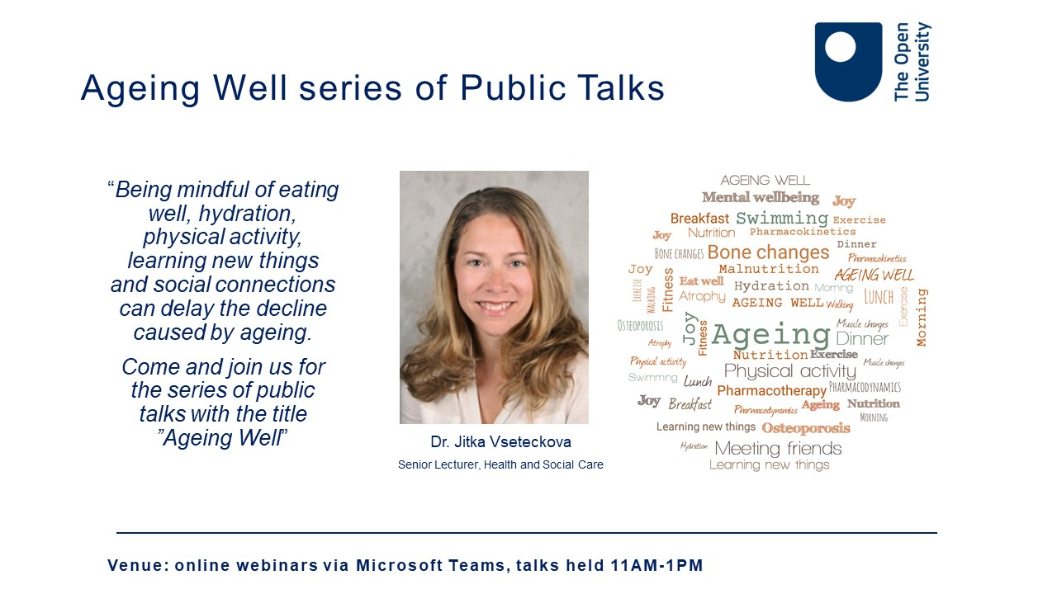
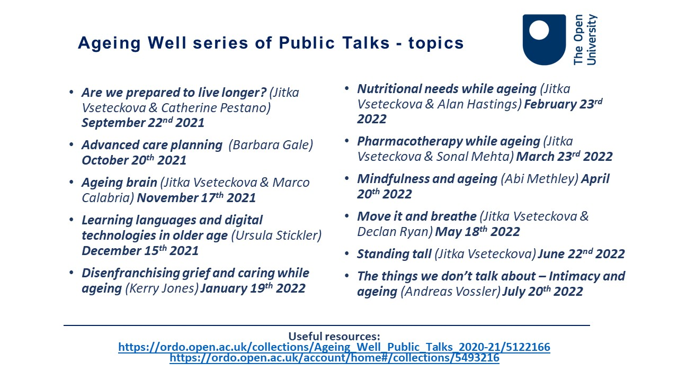

Slide 37
Ageing Well series of Public Talks 2022/23- topics
Are we prepared to live longer? (Jitka Vseteckova & Catherine Pestano) September 14th 2022
Taking control of dying (Barbara Gale & Amanda Whitehouse) October 19th 2022
Memory and ageing (Jitka Vseteckova & Helen Joannidi & Ellie Broad) November 16th 2022
Equality, diversity & geography of ageing (Carlos M Lequizamon) December 14th 2022
General Practices ‘COVID-19 and beyond’ (Andrew Potter) January 18th 2023
Living with diabetes and nutrition while ageing (Jitka Vseteckova & Alan Hastings) February 22nd 2023
Relationships and couple intimacy while ageing (Andreas Vossler) March 15th 2023
Lets’ talk about sleep (Abi Methley) April 19th 2023
Health Inequalities and Ageing (Sonal Mehta) May 17th 2023
Biomechanics of ageing (Jitka Vseteckova & David Curry) June 14th 2023
Ageing, later life and caring in LGBTQ communities (Joseph DeLappe & Tony Collins) July 12th 2023
Useful resources:
https://ordo.open.ac.uk/collections/Ageing_Well_Public_Talks_2020-21/5122166
https://ordo.open.ac.uk/collections/Ageing_Well_Public_Talks_2021-22/5493216

Slide 38




Slide 39

Notes:
39

