Slide 1
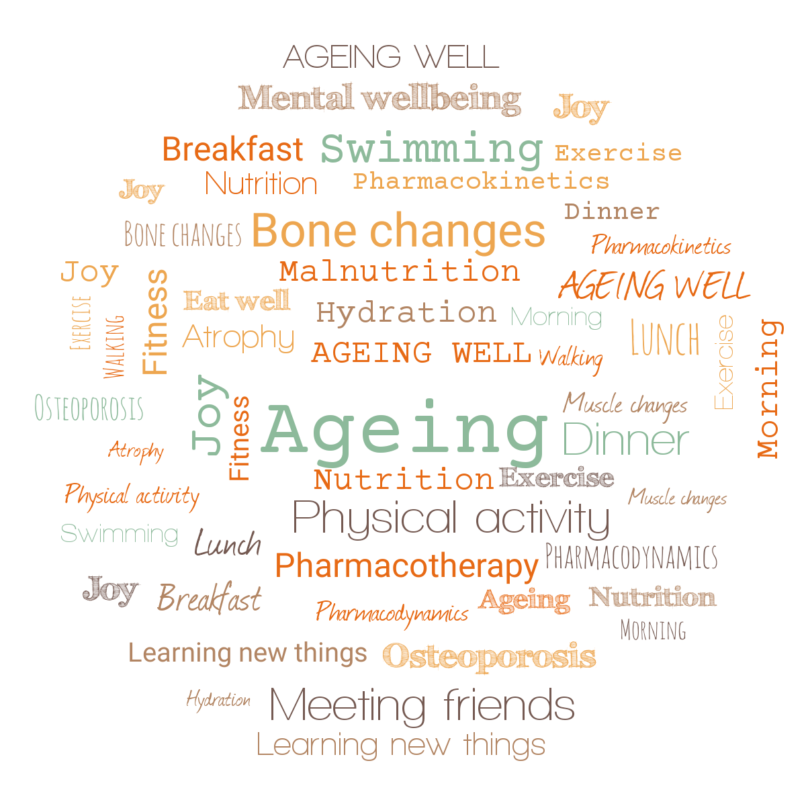

Ageing Well Public Talk Series
Jitka Vseteckova, PhD, D.Prof., SFHEA
Knowledge Exchange and Enterprise Lead (HWSC), Deputy Chair Carers Research Group OU,
Associate Editor BMC (Springer Nature)

Slide 2





Talk 1. Are we prepared to live longer?

Slide 3
Why are we here today…
The world population is rapidly ageing - ageing since the day we are born.
Ageing processes are in general very difficult to predict – different speed for different individuals
Genetic predispositions and/or what we actually do about it?
USE IT OR LOSE IT - in other words, both cognitive and physical stimulation while ageing, help to preserve cognitive and physical functions we don’t want to lose – throughout our lifespan
Staying well, keeping well, ageing well

Slide 4
Ageing well – facilitated learning
During the ‘Ageing Well’ series, we explore approaches which may enable us to live longer and healthier lives.
Theories of ageing, its biomedical and psychosocial aspects, the most common comorbidities, and the ageing brain are some of the concepts that are explored in the series.
As part of the AWPT Series we are exploring how important it is, over our lifespan, to maintain a well-balanced nutrition and hydration as well as regular physical and social activity in the older age (also known as Five Pillars for Ageing Well).
Nutrition Hydration, Physical Activity, Social and Cognitive Stimulation

Slide 6
Building bridges
Building bridges
Lifelong need for education - how to stay healthy, how to keep active, how to keep our brains in good shape so that we can enjoy good quality of life for longer.
The internet is full of materials and information - but do we know what to pick?
Jargon, validity, reliability / research /evidence base / accessibility & diverse communities

Slide 7
Are we prepared to live longer?
Ageing brain
Nutritional needs while ageing
Pharmacotherapy while ageing
Move it and breathe
Standing tall
ORDO collections https://ordo.open.ac.uk/collections/Ageing_Well_Public_Talks_2022-23/5982802
AWPT Series website https://wels.open.ac.uk/research/projects/ageing-well-public-talks

Slide 8
All the way through the ‘Ageing Well’ talks we explore how using this knowledge might facilitate self-management, become partners in our care and stay well in a sustainable way.
The emphasis of the ‘Ageing Well’ series is on optimizing cognitive and physical well-being, physiological ageing and self-management. To a lesser extent, on pathological processes while ageing.
Promoting physical activity, social activity, networking, learning and healthy lifestyle
Easy stretching during each lecture

Slide 9
Messages to be taken home today
The famous motto about ageing goes as: Use it or lose it! In other words both cognitive and physical stimulation while ageing, help to preserve the functions we don’t want to lose.
Small steps/bite-size portions – do make a good difference longitudinally
Myths about physical exercise and people who exercise.

Slide 10
Ageing & Epidemiology – basic facts
Ageing processes bring a decline in physical and cognitive domain. This decline proceeds at variable speed for different organs and different individuals. This is why the ageing in general is so difficult to predict.
There are some genetic predispositions that may slightly speed up or slow down the ageing processes or show us what we need to be aware of in terms of age related conditions in our predecessors.

Slide 11
However, the genetic predisposition does not affect 100% of how our ageing might look like especially if we decide to help it.
Ageing is a process and this process starts when we are born, therefore ageing does not affect us only from 60 or 65 years onwards (although most often discussed age cut off when it comes to ageing – just manifesting faster)
Ageing well has become increasingly important also because we live older for longer

Slide 12
The majority of epidemiologic studies have found slower rates of cognitive and physical decline among those who routinely engage in more cognitively and or physically demanding tasks compared to those with a more mentally and physically sedentary lifestyles.
Nutrition, hydration, physical, social & cognitive stimulation (includes learning) – five pillars of ageing well
The way we live our lives will affect the way we age – Are we ready to make those choices?

Slide 14
Basic biomedical aspects of ageing
Ageing processes bring about decline to which we try to adapt
Ageing influences the decline of organs and tissues as well as whole systems
The way our organs age is different for each and every one of us
The way the systems age is different for each and every one of us
Main influences:
Genetics
Epigenetics

Slide 15
Genetics – are we victims of our genes?
Increases/may increase the predisposition to certain types of diseases or conditions
We cannot change the genetic set we have
We still don’t know enough about genetics & how it works
We can get some conditions as our parents and grandparents had but we may also only carry forward the specific gene these conditions are linking to …
We don’t know enough about our predecessors
…but we can influence to some extent if it manifests, how soon and in which way it might manifest
What we have versus what we actually do with it

Slide 16
Epigenetics – are we victims of our nurture?
The families we are born into, their habits, their friends and other people and places that surround them, the places and people we surround ourselves with, the habits we form …
Influence of the environment from the day of conception
We have some degree of control over this

Slide 17
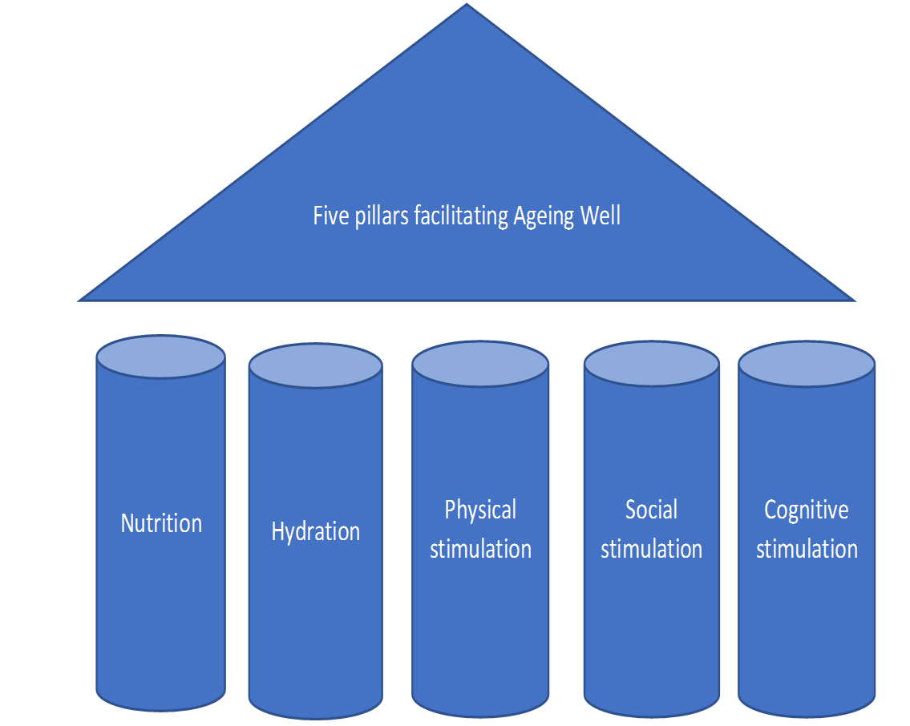
Winners by choice

Slide 19
STANDING UP / SITTING DOWN
Raising up principle - STRAIGHTENING YOUR SPINE
Proprioception – feeling different parts of your feet on the floor
Slightly pressing the inner side of your foot to the floor
Stretching your toes
Pushing yourselves away from the ground
Moving head or arms should not necessarily change the way we stand

Slide 20
When physiological processes turn pathological
Physiological ageing equals normal and is expected
“Normal” ageing is a result of natural maturational processes and expected part of the ageing process whereas
“pathological” aging is due to non-normative factors such as disease, injury or trauma to the brain.
In these series we will focus mostly on physiological ageing and how we can optimise cognitive and physical ageing.
Physiological can turn pathological

Slide 21
No matter what ageing theory we work with the age-related changes resulting from ageing processes are at physical, psychological, cognitive and systemic levels
Immune system (is a network of cells, tissues, and organs that work together to defend the body against attacks by “foreign” invaders. These are primarily microbes—tiny organisms such as bacteria, parasites, and fungi that can cause infections (low grade infections)
Self repair mechanisms are also impaired (one of the reasons why cancers happen in later life)

Slide 22
Nervous system (is a complex network of nerves and cells that carry messages to and from the brain and spinal cord to various parts of the body. Proprioception example – develop linking Central nervous system and Peripheral nervous system (tripping over an obstacle as a delayed response from the brain)
Endocrine system The endocrine system is the collection of glands of an organism that secrete hormones directly into the circulatory system to be carried towards distant target organs
Chain of hormones e.g thyroxine, diabetes and insulin and pancreas, testosterone, (estrogen and osteoporosis)

Slide 23
Musculoskeletal system – muscle atrophy, bone fragility, tendon & joint stiffness,
Cardiovascular system – veins and arteries, atherosclerosis and ageing, regularity of circulation (brain, other organs, respiratory system etc.)
Lifestyle is crucial
‘Five pillars of ageing well’

Slide 25
Cognitive ageing – tiredness of our systems
Diminished ability to remember names, find the correct word, remember where objects are located, concentrate
Is this “normal”? Yes
Ageing Brain talk
Tiredness of our systems – when young we have it too but we can sleep it off – not so easy while ageing as many things come together

Slide 26
Stress management
Lifestyle – some of the changes could be slowed down (Five Pillars to Ageing Well)
Cognitive sphere influences physical and vice versa
Physical wellbeing is affected by worsening mental wellbeing and vice versa
Exercise improves our sleep
Important to do it all when we are still well

Slide 27
Hormonal changes at midlife
These affect many at the midlife transition both directly and indirectly.
Changes to the sex hormones in the body can also be brought on early through surgery or a condition.
Substantial series of changes which give rise to a large range of menopause/andropause symptoms, affecting every aspect of living.

Slide 28
Andropause
Though not paralleling women’s intensity of experience, men have hormone changes at this time of life, with negative and / or positive impacts.
A key difference is that testosterone decline is gradual not sudden. Negative symptoms such as depression, lethargy, loss of sex drive can be treated with replacement hormones. However these are often unrelated to hormones, more to society’s attitudes to men.
Help can be offered for existential or lifestyle related negative symptoms, through therapy, CBT, diet, exercise.

Slide 29
Menopause - main symptoms might include:
Physical – exhaustion, genito-urinary & atrophy, joint pain, excessive bleeding, palpitations, bone loss, dry eye, tinnitus, burning tongue, restless legs
Emotional – anxiety, depression, flatlining, anger, mood flux, tears, rage, irrational fear, fluctuating mood
Cognitive/Psychological – brain fog, sleeplessness, sensory overload, hard to concentrate
Relational – family, work, sexual responsiveness/libido loss

Slide 30
Onset is varied
Treatable – Systemic and localised Hormonal replacement therapy (HRT) as a first response, along with T4 thyroid testing and testosterone.
Lifestyle changes, especially around ‘Five Pillars for Ageing Well’ to reduce stress and renegotiate social roles, along with medical interventions.

Slide 31
Healthy bones vs Osteoporosis
Osteoporosis is a condition of fragile bone (increased porosity of the bone)
Osteoporosis weakens bone and increases risk of bones breaking
Low levels of physical activity, malnutrition, smoking, decreased levels of calcium and other minerals, menopause / andropause - decrease of hormones
Bone mass (bone density) starts decreasing after 35 years of age, and bone loss occurs more rapidly in women after menopause.
Manifests via back pain, sometimes decrease in height, decreased mobility
Physical activity, nutrition, hydration, supplementation of vitamin D (D3 – active form – calcium binding protein)

Slide 32
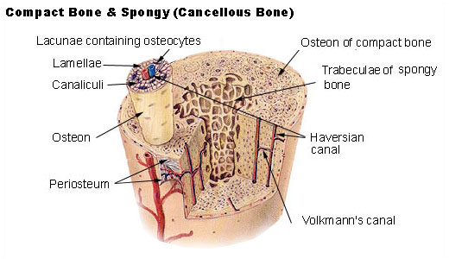
Osteoporosis

Slide 33
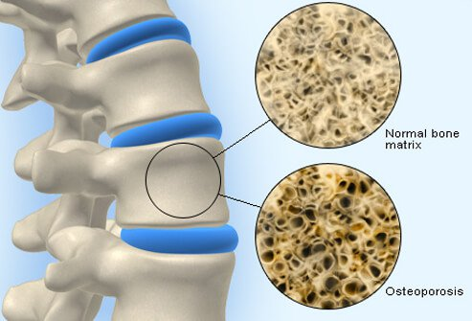

Slide 34
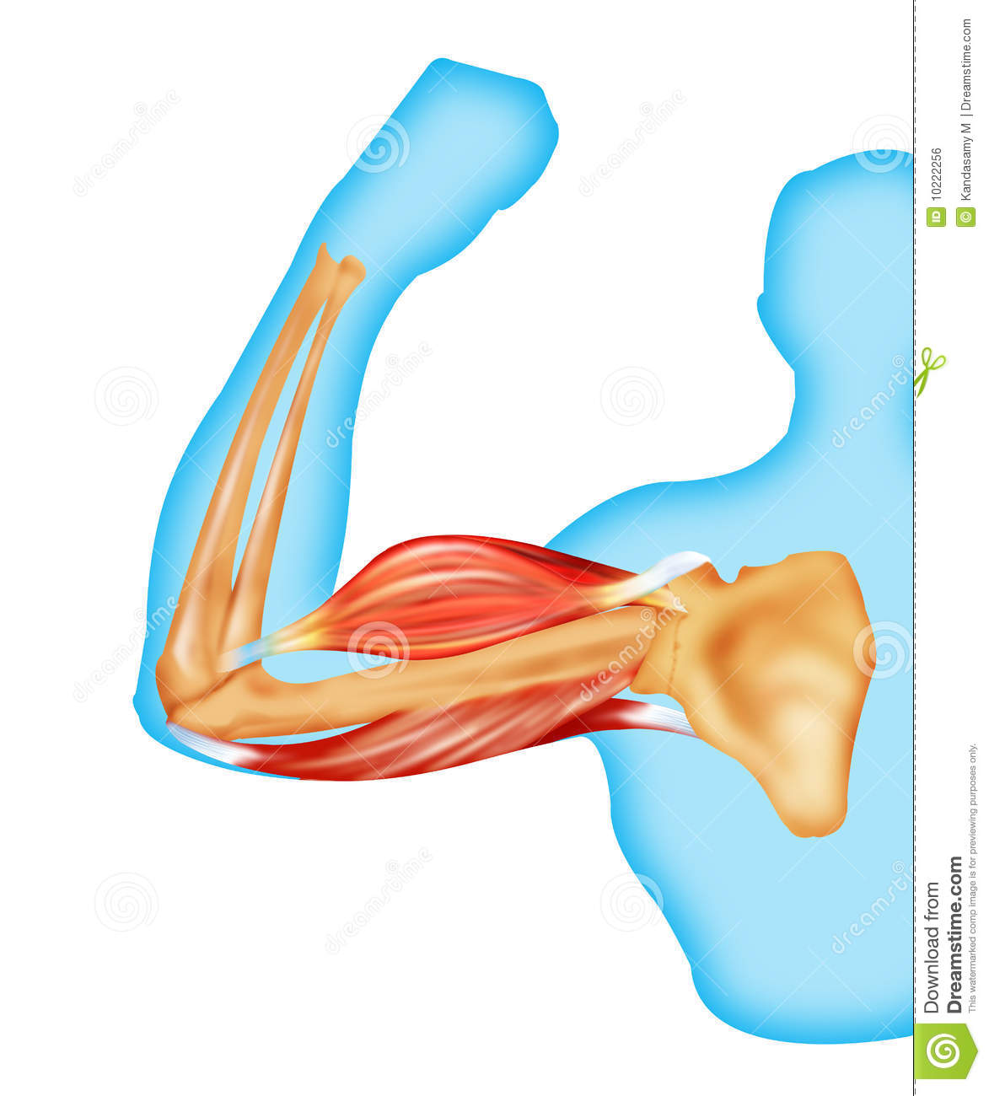
Bone is very important as it protects internal organs, creates support for the body, muscles are attached to it
Healthy bone is very important to healthy ageing
Muscle atrophy is a big problem while ageing as it affects directly our postural stability, sitting long hours in from of the pc, overall mobility, appetite/capacity for regular exercise and later in life also falls - all this affects bone health
more details Move it and Breathe & Standing tall talks

Slide 35
Thank you for joining today & questions
Jitka
jitka.vseteckova@open.ac.uk http://www.open.ac.uk/people/jv2595

Slide 36
Hormonal midlife changes - resources
International menopause awareness day 18th Oct, use the following resources to raise awareness: https://www.imsociety.org/education/world-menopause-day/
NICE guidance on the menopause https://www.nice.org.uk/guidance/NG23
Pausivity free poster campaign and resources https://www.pausitivity.co.uk/
Dr Louise Newson Free CPD for GP surgeries https://www.menopausedoctor.co.uk/
Activism and magazine https://www.menopausematters.co.uk/
Case law on Henpicked menopause hub https://henpicked.net/menopause-hub/
British Menopause Society https://thebms.org.uk/
Andropause https://www.nhs.uk/conditions/male-menopause/

Slide 37
Summary of related resources to The Ageing Well Public Talk Series
Podcasts
Vseteckova J & King J (2020) COVID-19 Interview podcast for The Retirement Café: ‘Ageing Well Under Lockdown’
Vseteckova J & Broad E (2020) Podcast – Open University & The Parks Trust Keep Me Walking - researching with people living with dementia and their carers -
Vseteckova J (2020) Podcast - Areas of research with The Open University
Broad E, Methley A & Vseteckova J (2021) Podcast OU & The Parks Trust & Northamptonshire Healthcare NHS Foundation Trust - Spotter sheet and mindful walking.
Vseteckova J, Methley A, Broad E (2021) Podcast OU & The Parks Trust & Northamptonshire Healthcare NHS Foundation Trust Preventing brain decline while ageing
Methley A, Broad E, Vseteckova J (2021) Podcast OU & The Parks Trust & Northamptonshire Healthcare NHS Foundation Trust Walking therapy
Vseteckova J, Methley A, Broad (2021) Podcast OU & The Parks Trust & Northamptonshire Healthcare NHS Foundation Trust Understanding our memory
Araya Y , Broad E, Vseteckova J (2022) Engaging with our environment
The above podcasts can be also seen on The Parks Trust YouTube Channel

Slide 38
OpenLearn Resources:
Vseteckova J (2020) Ageing Well Public Talk Series https://www.open.edu/openlearn/health-sports-psychology/health/the-ageing-well-public-talks
Vseteckova J (2019) 5 reasons why exercising outdoors is great for people who have dementia https://www.open.edu/openlearn/health-sports-psychology/mental-health/5-reasons-why-exercising-outdoors-great-people-who-have-dementia
Vseteckova J (2019) Depression, mood and exercise https://www.open.edu/openlearn/health-sports-psychology/mental-health/depression-mood-and-exercise?in_menu=622279
Vseteckova J (2019) Five Pillars for Ageing Well https://www.open.edu/openlearn/health-sports-psychology/mental-health/five-pillars-ageing-well
Vseteckova J (2020) Ageing Brain https://www.open.edu/openlearn/health-sports-psychology/health/the-ageing-brain-use-it-or-lose-it
Vseteckova J (2020) Ageing Well Public Talks Series II. Plan for 2020 – 2021 https://www.open.edu/openlearn/health-sports-psychology/health/ageing-well-public-talk-series-plan-2020/2021

Slide 39
Vseteckova J, Broad E, Andrew V (2021) The impact of walking and socialising through 5 Ways Café on people living with dementia and their carers: A volunteer’s perspective https://www.open.edu/openlearn/health-sports-psychology/health/the-impact-walking-and-socialising-through-5-ways-cafe-on-people-living-dementia-and-their-carers
Vseteckova J, Methley A, Lucassen M (2021) The benefits of mindfulness and five common myths surrounding it https://www.open.edu/openlearn/health-sports-psychology/mental-health/the-benefits-mindfulness-and-five-common-myths-surrounding-it
Methley A, Vseteckova J, Broad E (2021) Outdoor Therapy: The Benefits of Walking and Talking https://www.open.edu/openlearn/health-sports-psychology/mental-health/outdoor-therapy-the-benefits-walking-and-talking
Vseteckova J, Methley a, Broad E (2021) What happens to our brain as we age and how we can stop the fast decline https://www.open.edu/openlearn/health-sports-psychology/health/what-happens-our-brain-we-age-and-how-can-we-stop-the-decline
Methley A & Vseteckova J & Jones K (2020) Green & Blue & Outdoor spaces https://www.open.edu/openlearn/health-sports-psychology/mental-health/the-benefits-outdoor-green-and-blue-spaces
Vseteckova J, Borgstrom E, Whitehouse A, Kent A, Hart A (2021) Advance Care Planning (ACP ) - Discuss, Decide, Document and Share Advance Care Planning (ACP ) - Discuss, Decide, Document and Share - OpenLearn - Open University

Slide 40
Vseteckova J (2020) Walking the Parks with The OU and The Parks Trust https://www.open.edu/openlearn/health-sports-psychology/social-care-social-work/keep-me-walking-people-living-dementia-and-outdoor-environments
Vseteckova J, Methley A, Broad E (2021) Understanding our memory What do we need to know about our memory? - OpenLearn - Open University
Araya Y , Broad E, Vseteckova J (2022) Engaging with our environment https://www.open.edu/openlearn/health-sports-psychology/mental-health/engaging-our-environment-what-are-the-benefits
Vseteckova J (2022) Pharmacotherapy while ageing https://www.open.edu/openlearn/health-sports-psychology/pharmacotherapy-while-ageing
Joannidi H, Araya Y, Broad E & Vseteckova J (2022) Sense of Self during ageing – how mindfulness and nature can help https://www.open.edu/openlearn/health-sports-psychology/sense-self-during-ageing-how-mindfulness-and-nature-can-help
Mehta S (2022) Medicines and personalisation while ageing Medicines and personalisation - OpenLearn - Open University
Gale B (2022) How can we prepare for death while ageing? Ageing Well Public Talk Series related - https://www.open.edu/openlearn/health-sports-psychology/health/valuing-death

Slide 41
COVID-19 related
Vseteckova J, How to age well, while self-isolating (2020) https://www.open.edu/openlearn/health-sports-psychology/how-age-well-while-self-isolating
Vseteckova J, (2020) SHORT FILM - Ageing Well in Self-Isolation https://youtu.be/LU4pXFgcGos
Vseteckova J, (2020) ANIMATION - Keeping healthy in Self-Isolation https://youtu.be/M9yUC-MUugA
Vseteckova J et al (2020) COVID-19 The effects of self-isolation and lack of physical activity on carers https://www.open.edu/openlearn/health-sports-psychology/social-care-social-work/the-effects-self-isolation-and-lack-physical-activity-on-carers
Taverner P, Larkin M, Vseteckova J, et al. (2020) Supporting adult carers during COVID-19 pandemic https://www.open.edu/openlearn/health-sports-psychology/social-care-social-work/how-can-adult-carers-get-the-best-support-during-covid-19-pandemic-and-beyond
Robb M, Penson M, Vseteckova J, et al. (2020) Young carers, COVID-19 and physical activity https://www.open.edu/openlearn/health-sports-psychology/social-care-social-work/young-carerscovid-19-and-physical-activity
Penson M, Vseteckova J et al. (2020) Older Carers, COVID-19 and Physical Activity https://www.open.edu/openlearn/health-sports-psychology/social-care-social-work/older-carers-covid-19-and-physical-activity
Vseteckova J & Methley A (2020) Acceptance Commitment Therapy (ACT) to help carers in challenging COVID-19 times https://www.open.edu/openlearn/health-sports-psychology/health/how-can-acceptance-and-commitment-therapy-help-carers-challenging-times-such-the-covid-19-pandemic

Slide 42
‘Ageing Well Public Talks’ Series 2022/2023 repository on ORDO Collections
https://ordo.open.ac.uk/collections/Ageing_Well_Public_Talks_2022-23/5982802
‘Ageing Well Public Talks’ Series 2021/2022 repository on ORDO Collections
https://ordo.open.ac.uk/collections/Ageing_Well_Public_Talks_2021-22/5493216
‘Ageing Well Public Talks’ Series 2020/2021 repository on ORDO Collections
https://ordo.open.ac.uk/collections/Ageing_Well_Public_Talks_2020-21/5122166
‘Ageing Well Public Talks’ Series 2019/2020 repository on ORDO Collections
https://doi.org/10.21954/ou.rd.c.4716437.v1
OpenLearnCreate Course on ‘Ageing Well’ 2019/2020
https://www.open.edu/openlearncreate/course/view.php?id=5016
Home exercise no equipment – no problem Blog
https://selsdotlife.wordpress.com/2020/04/01/home-exercises-for-older-adults-no-equipment-no-problem/

Slide 43
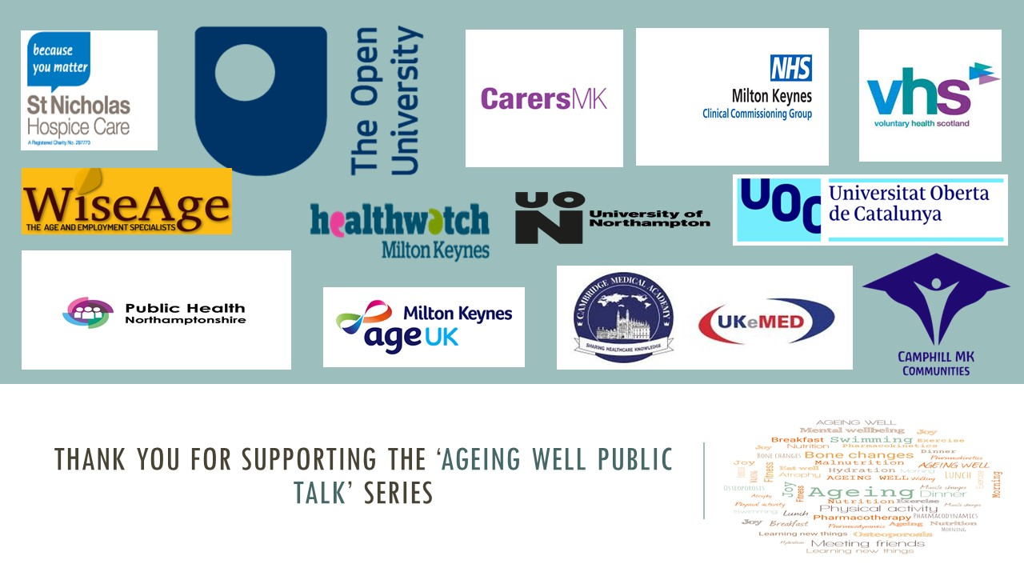
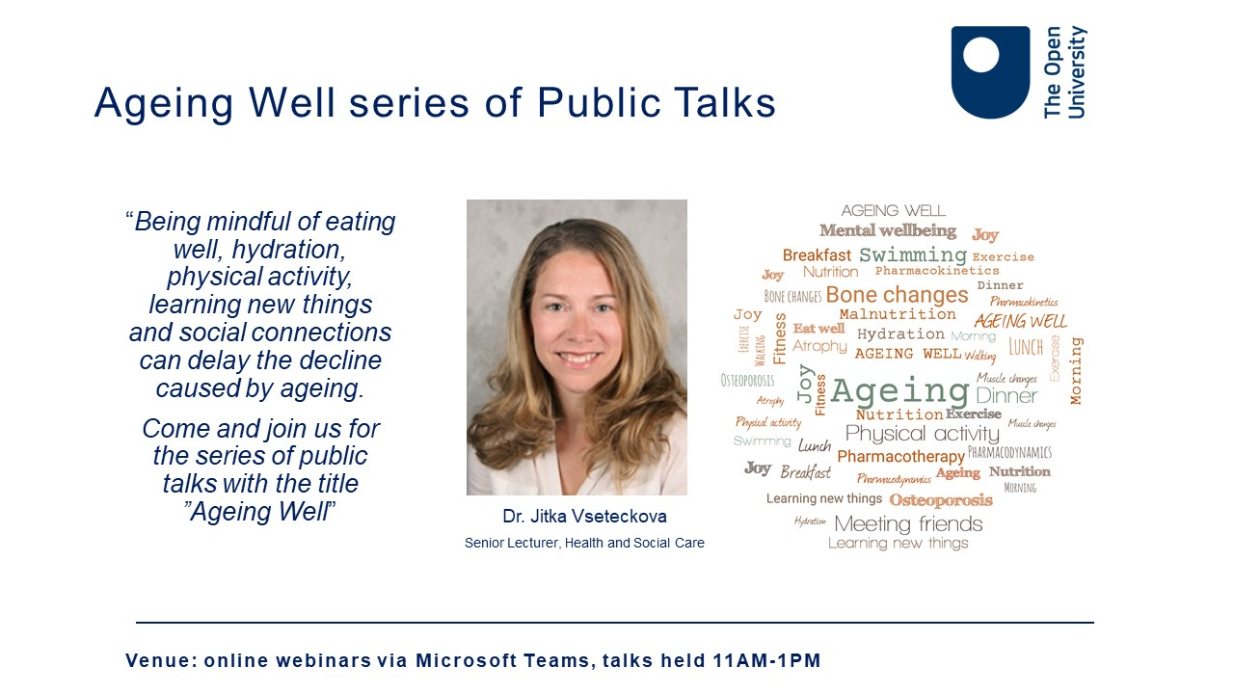
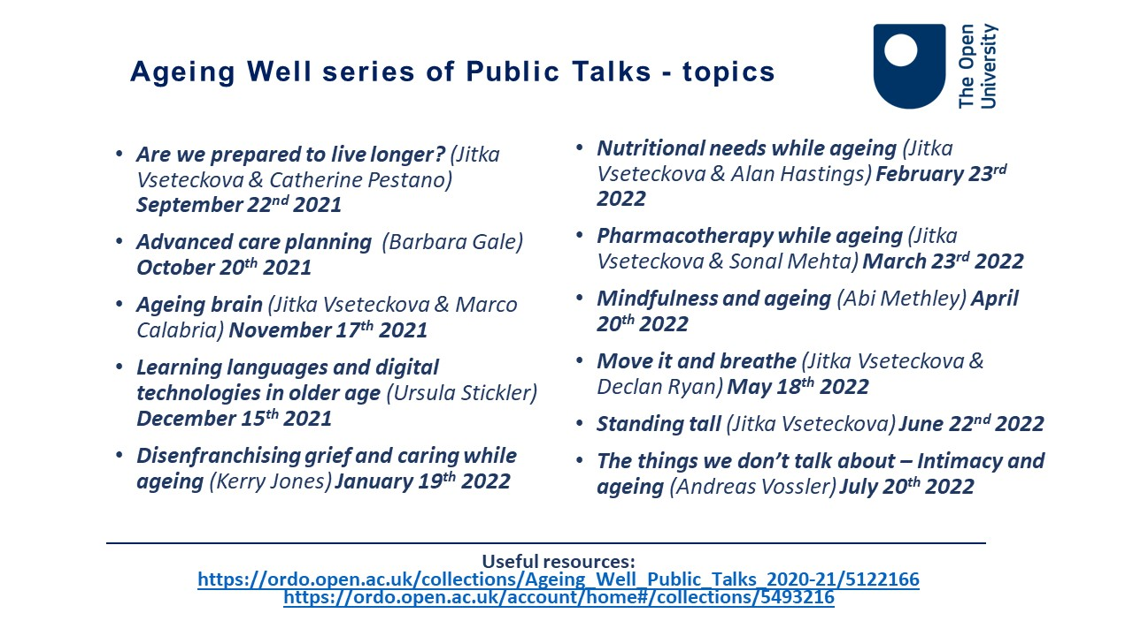

Slide 44
Ageing Well series of Public Talks 2022/23- topics
Are we prepared to live longer? (Jitka Vseteckova & Catherine Pestano) September 14th 2022
Taking control of dying (Barbara Gale & Amanda Whitehouse) October 19th 2022
Memory and ageing (Jitka Vseteckova & Helen Joannidi & Ellie Broad) November 16th 2022
Equality, diversity & geography of ageing (Carlos M Lequizamon) December 14th 2022
General Practices ‘COVID-19 and beyond’ (Andrew Potter) January 18th 2023
Living with diabetes and nutrition while ageing (Jitka Vseteckova & Alan Hastings) February 22nd 2023
Relationships and couple intimacy while ageing (Andreas Vossler) March 15th 2023
Lets’ talk about sleep (Abi Methley) April 19th 2023
Health Inequalities and Ageing (Sonal Mehta) May 17th 2023
Biomechanics of ageing (Jitka Vseteckova & David Curry) June 14th 2023
Ageing, later life and caring in LGBTQ communities (Joseph DeLappe & Tony Collins) July 12th 2023
Useful resources:
https://ordo.open.ac.uk/collections/Ageing_Well_Public_Talks_2020-21/5122166
https://ordo.open.ac.uk/collections/Ageing_Well_Public_Talks_2021-22/5493216

Slide 45













Thank you for supporting the ‘Ageing Well Public talk’ series

Slide 46
OUR NEXT Talk – AGEING BRAIN

