Slide 1
The NGO experience in South Sudan
Prof Jean Hartley, The Open University
Martina Yanga, University of Juba both Trustees of an NGO working in South Sudan: Friends of Ibba Girls School (FIGS)
Kampala Conference, December 2019

Slide 2
South Sudan is NGO-land
Context of war and internal conflict over 50 years. Fragile peace recently
Lack of infrastructure – roads, markets, hospitals, schools. Many live by subsistence farming.
Loss of skills and capacity through displacement and violence. 73% adult illiteracy. Over 70% of children not in school
1 in 4 of the population are refugees or internally displaced
Large role for NGOs - filling the gap left by absent institutions, and also doing work that should be done by government

Slide 3
Humanitarian and development needs in South Sudan:
Overview
Total estimated population 11-13 million
People in need – 7.5M (over 50%)
6.4M people are acutely food insecure
Annual budget 1.6Bn USD – of which only 6% allocated to education and health combined
NGOs contribute to basic service provision

Slide 4
NGOs mainly working in humanitarian relief – less in development though changing
Tough environment for NGOs – have to pay to work in South Sudan if they employ staff.
Government concerned about NGO movements – are they supporting the opposition? Lot of paperwork to complete. Hard to move goods and people around.
No decent road infrastructure – so lots of movement of people and goods by planes - expensive and surprising for such a poor country.
Lack of manufacturing, retail and local skills means goods and services from Uganda and Kenya – expensive
Hard to raise donations – costs so high and continuing uncertainty about conflict.
These barriers make it difficult for all NGOs but particularly the smaller ones.

Slide 5
Why bother?
Local communities very grateful for help and support – rewarding
Small funding has big leverage – e.g. salaries mean more children in school
Major area to support – education, building the leaders of the future.
Once working there, commitment grows in spite of the difficulties.
“The coming year offers great hope that South Sudan will begin the long road to recovery from years of conflict and violence.” Humanitarian 2020 Plan

Slide 6
NGO example. Friends of Ibba Girls School
Supports Ibba Girls Boarding School
Established at request of a community leader and supported by the whole community
A school for girls from Primary 4 to end of secondary – creating “pull-through” and avoiding drop out at secondary.
Started in 2014 with 40 P4 girls, now at 220. Final size in 2022 with 360 girls.
Catchment area the size of Scotland. Careful allocation of vacancies to localities, 40 new intake per year. “Education without elitism” so selection on the basis of tests.
97% of funding from NGO. Rest is parental contribution and DfID/EU
Education with “the pen and the hoe”. Academic and vocational.
Boarding to provide safety and security to girls otherwise at risk from domestic labour, early marriage and pregnancy.

Slide 7
4 roles of Ibba Girls School and
FIGS as the NGO supporting it
To provide high quality teaching and learning, to equip citizens and leaders for the future. By the time the first 40 girls leave school at end of secondary, they will constitute 5% of girls with secondary education in that year.
To provide a model of what can be achieved. Raise standards and sights for students, parents, communities and nation. Many have not seen good education
To provide a hub for community social and economic development. The school provides jobs, skill development, opportunities for suppliers. Support staff are learning English, driving, computing skills, cooking skills. Their salaries support better education and health for relatives and some run micro-businesses.
To be a beacon to share good practices through improvement science methods. Sharing workshops and learning with other schools, both locally and in the longer-term nationally.

Slide 8
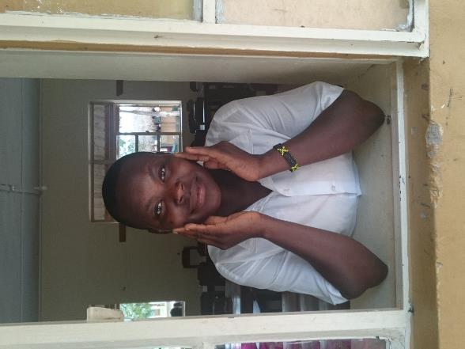

Slide 9
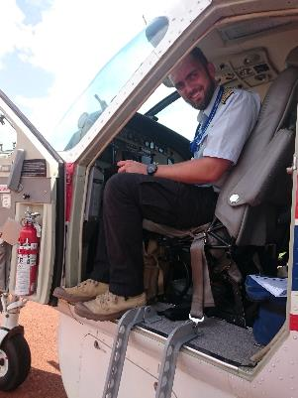
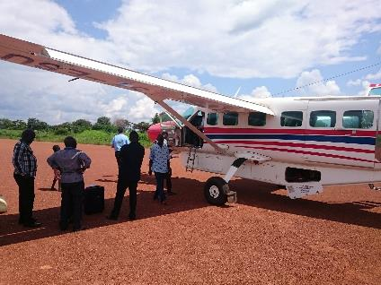

Slide 10
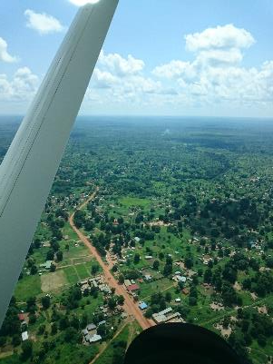
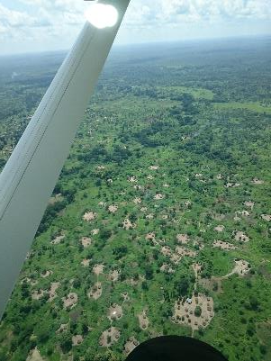
Aerial views of Ibba

Slide 11
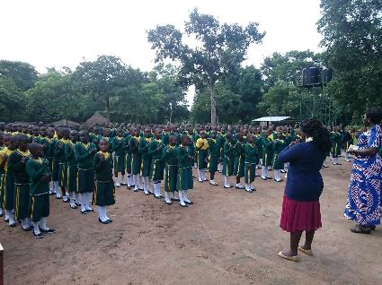
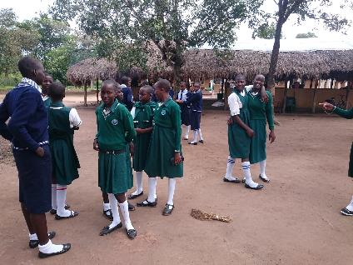

Slide 12
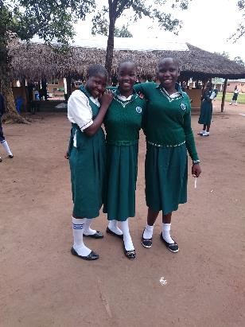
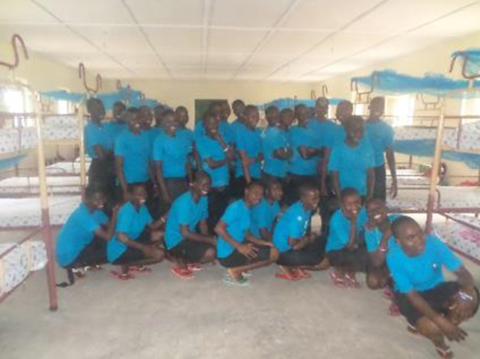

Slide 13
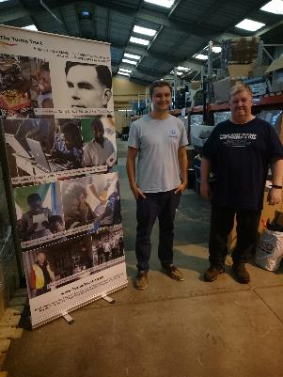
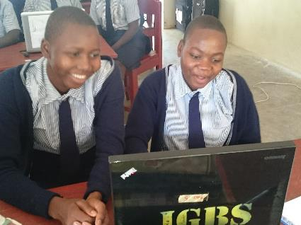
Learning IT skills
Turing Trust computers

Slide 14
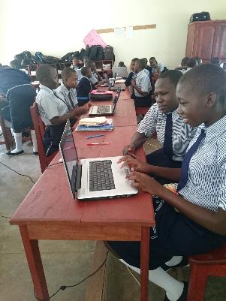
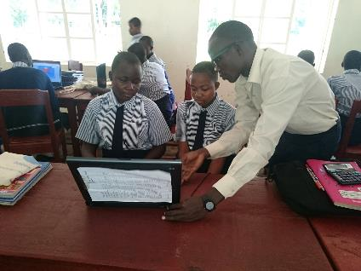

Slide 15
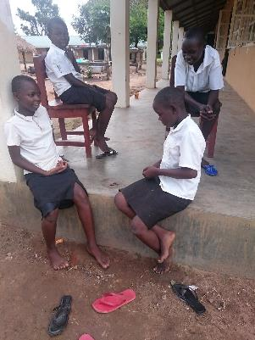
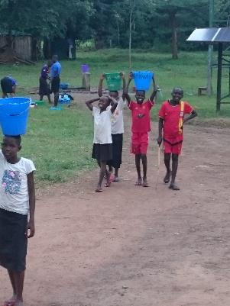
Time to be a child out of lessons
Washing clothes

Slide 16
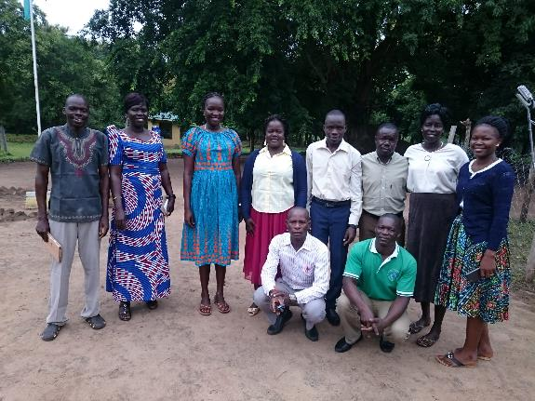
The teaching staff and finance assistant

Slide 17
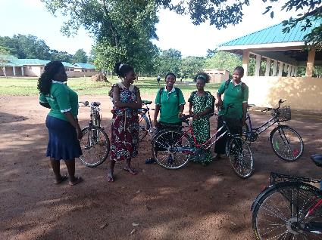
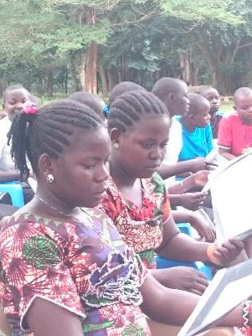
Bicycles help support staff get to work
Two of the matrons

Slide 18
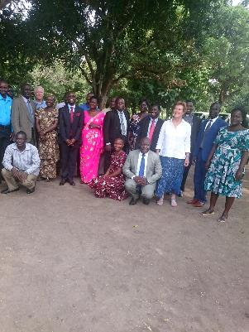
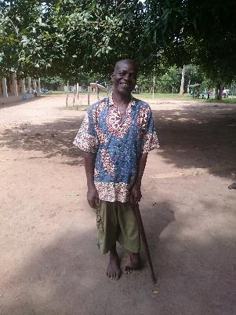
Community leaders meeting about the school
Elder Tito Manga

Slide 19
Working across a whole system
Working with state and local government is crucial – community support, security and safety of the school, state protection, collaboration, cultural and political context, and leveraging resources from other NGOs
Engaging with national government for spreading good practices
Working with higher education is important – open and other learning at university level for teachers and other educators – in discussion

Slide 20
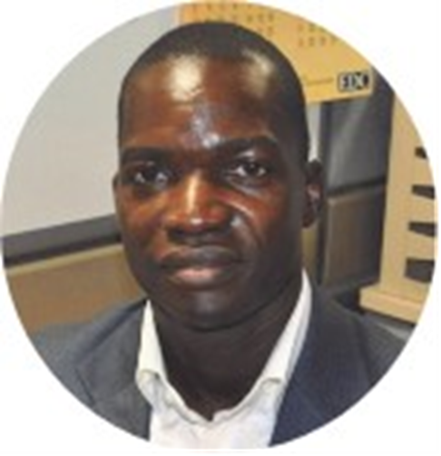
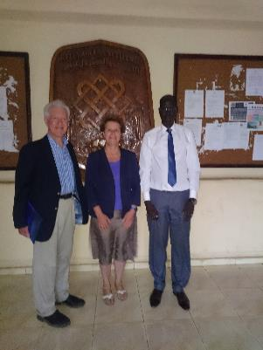
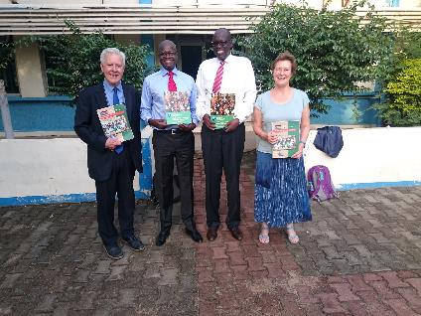
Working with other institutional actors
Gbudue State government minister Hon Pia Philip
With the Minister and Under-Secretary of Education, Juba
With the Vice Chancellor, Juba University

Slide 21
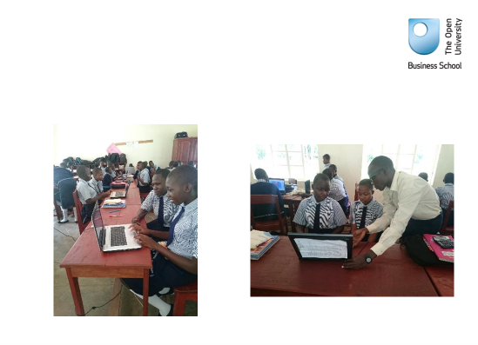
So……
Become a Friend of Ibba Girls School, South Sudan and help to educate a nation.
https://www.friendsofibba.org/
Sign up for the FIGS newsletter and follow the progress of the school or donate via Treasurer or on-line.

Slide 22
Further information:
Jean Hartley jean.Hartley@open.ac.uk
Martina Yanga ml49yanga@hotmail.com

