Slide 1
Case Study in Independence
Dan and Marion Stanton with Steve Halse and Ian Mallinson

Slide 2
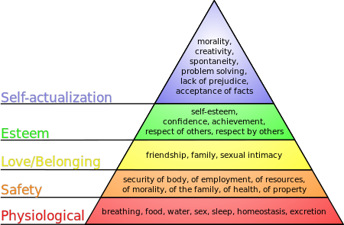
Maslow’s Hierarchy of needs – Starting with the basics

Slide 3
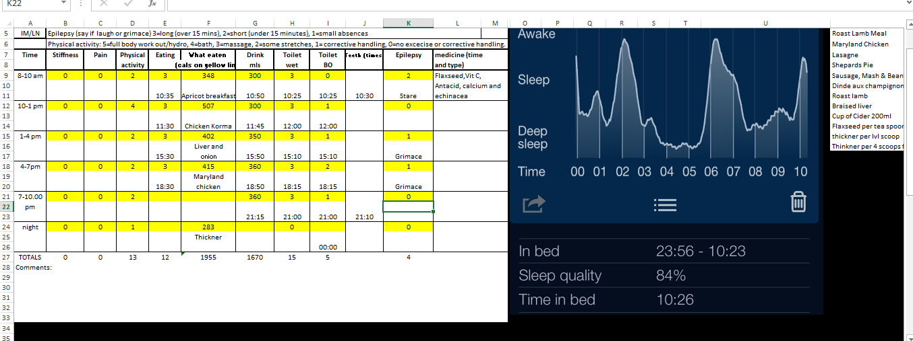
Record keeping

Slide 4
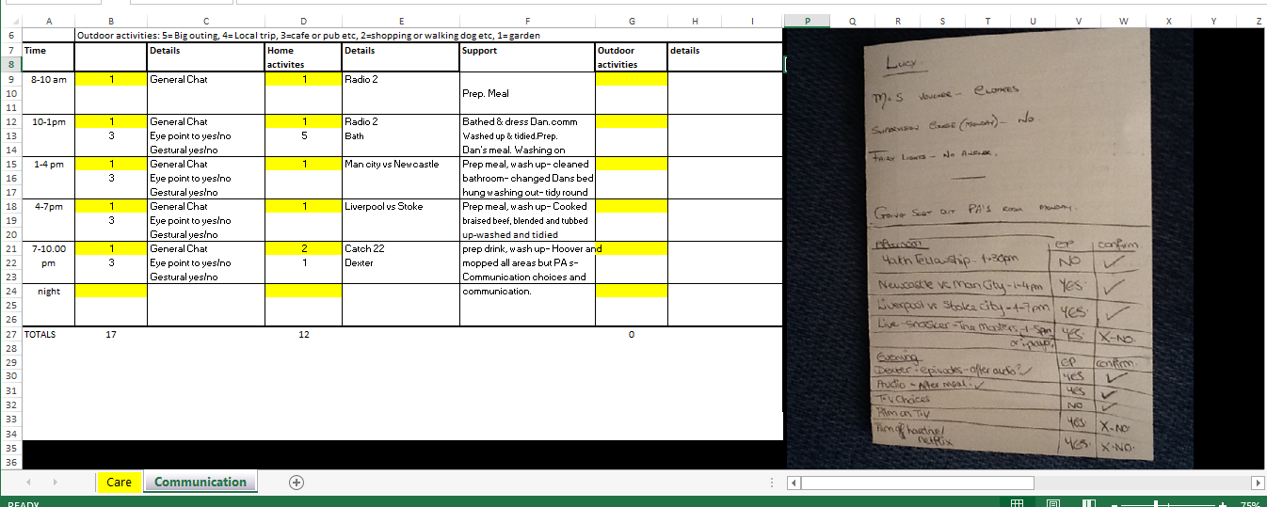
Communication record

Slide 5
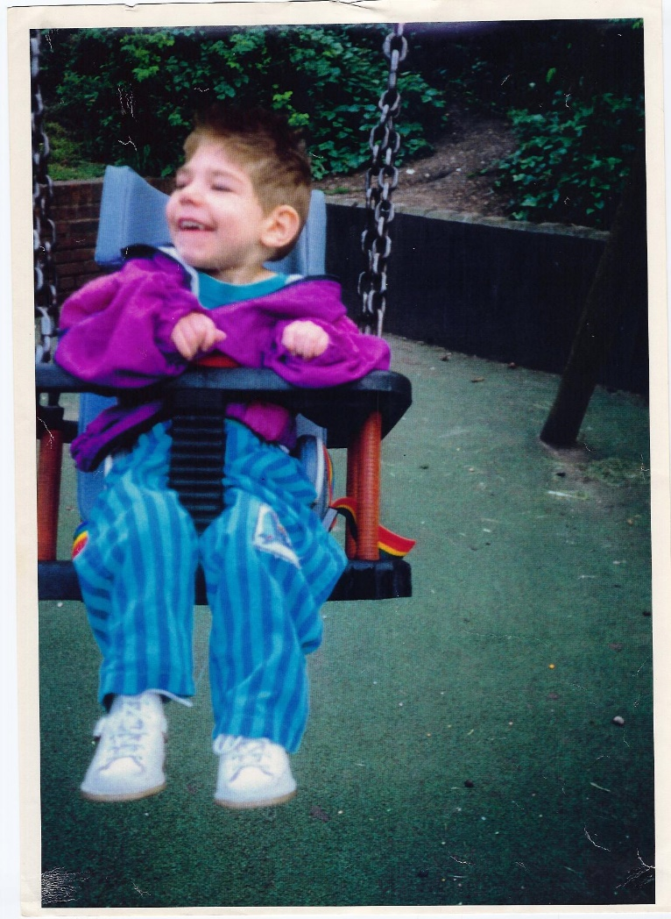
Living an ordinary life.

Slide 6
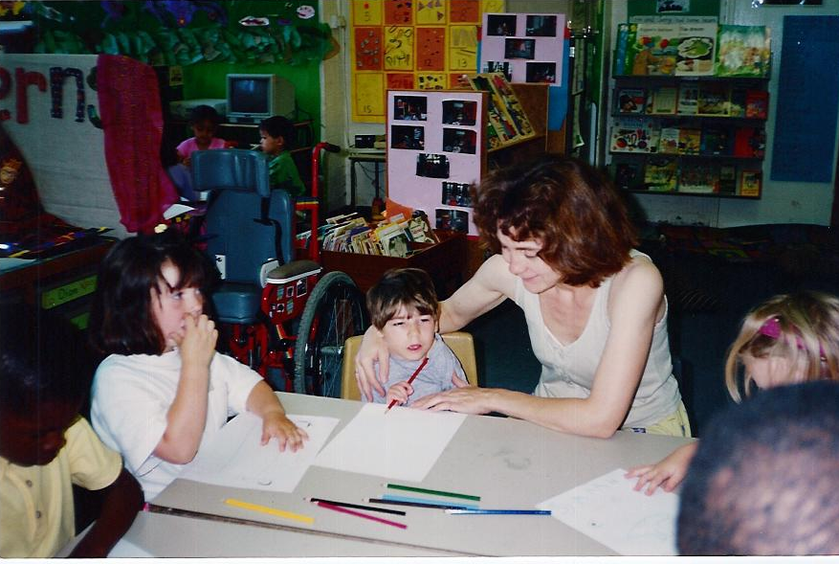
Going to an ordinary school.

Slide 7
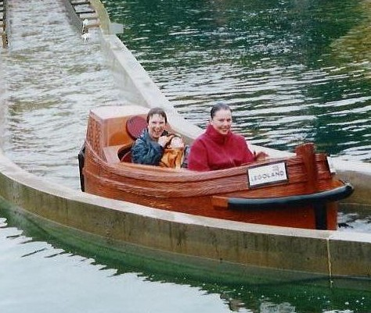
Having ordinary fun – in the days before Health and Safety bans! Dan with his teacher and teaching assistant in 1999.

Slide 8
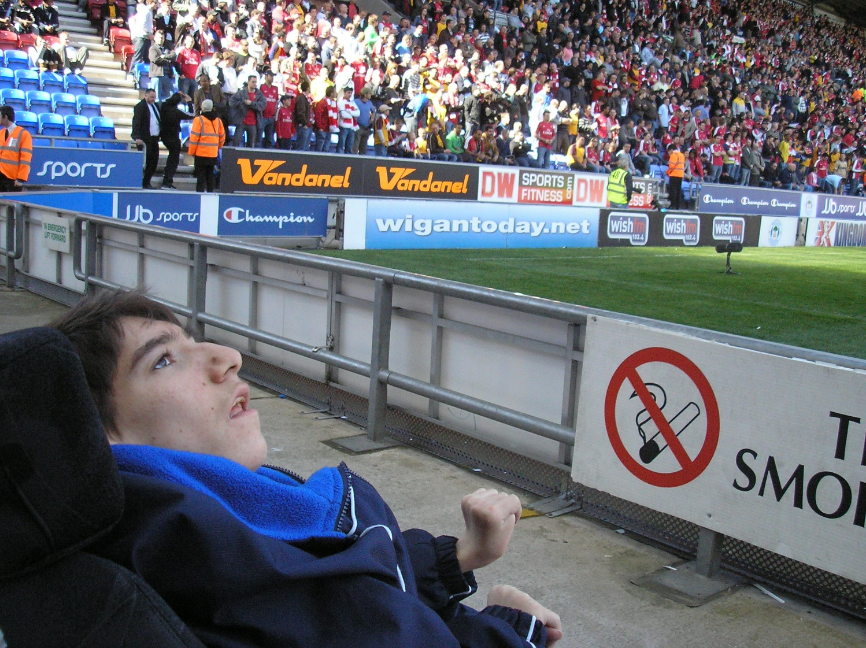
Enjoying an ordinary hobby – Dan loves football.

Slide 9
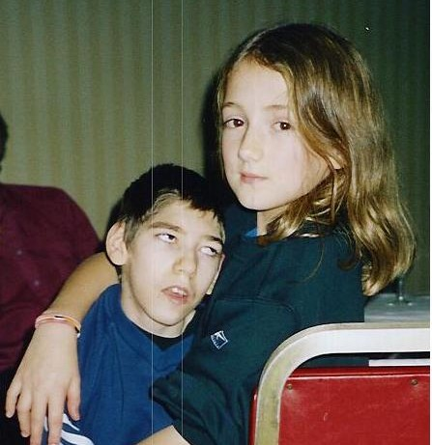
Supportive sibling

Slide 10
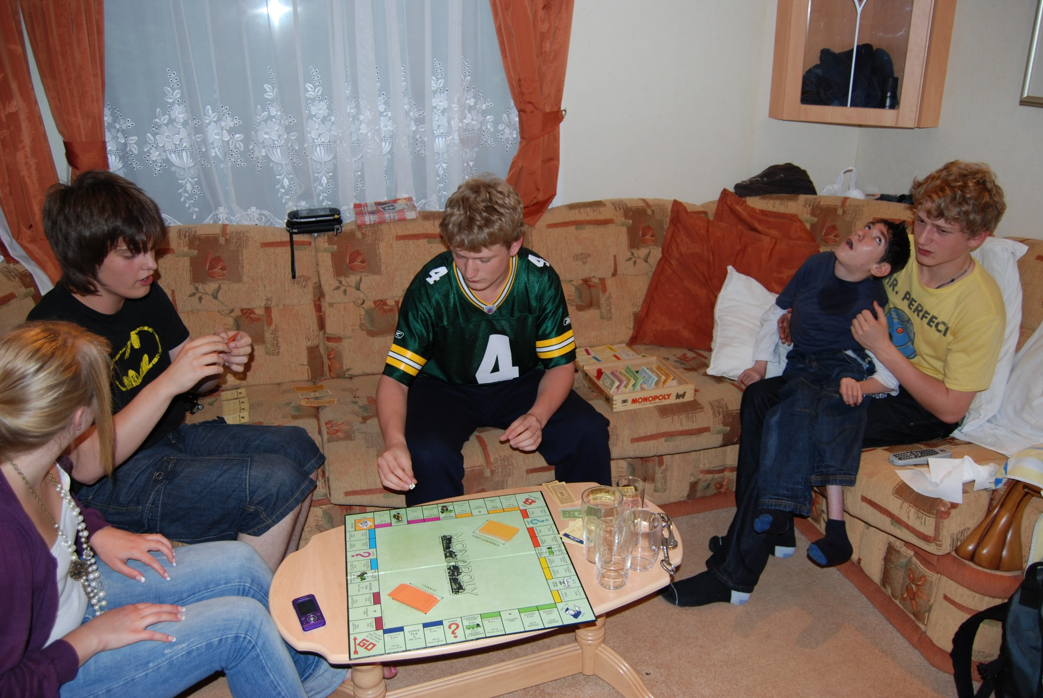
Circle of friends

Slide 11
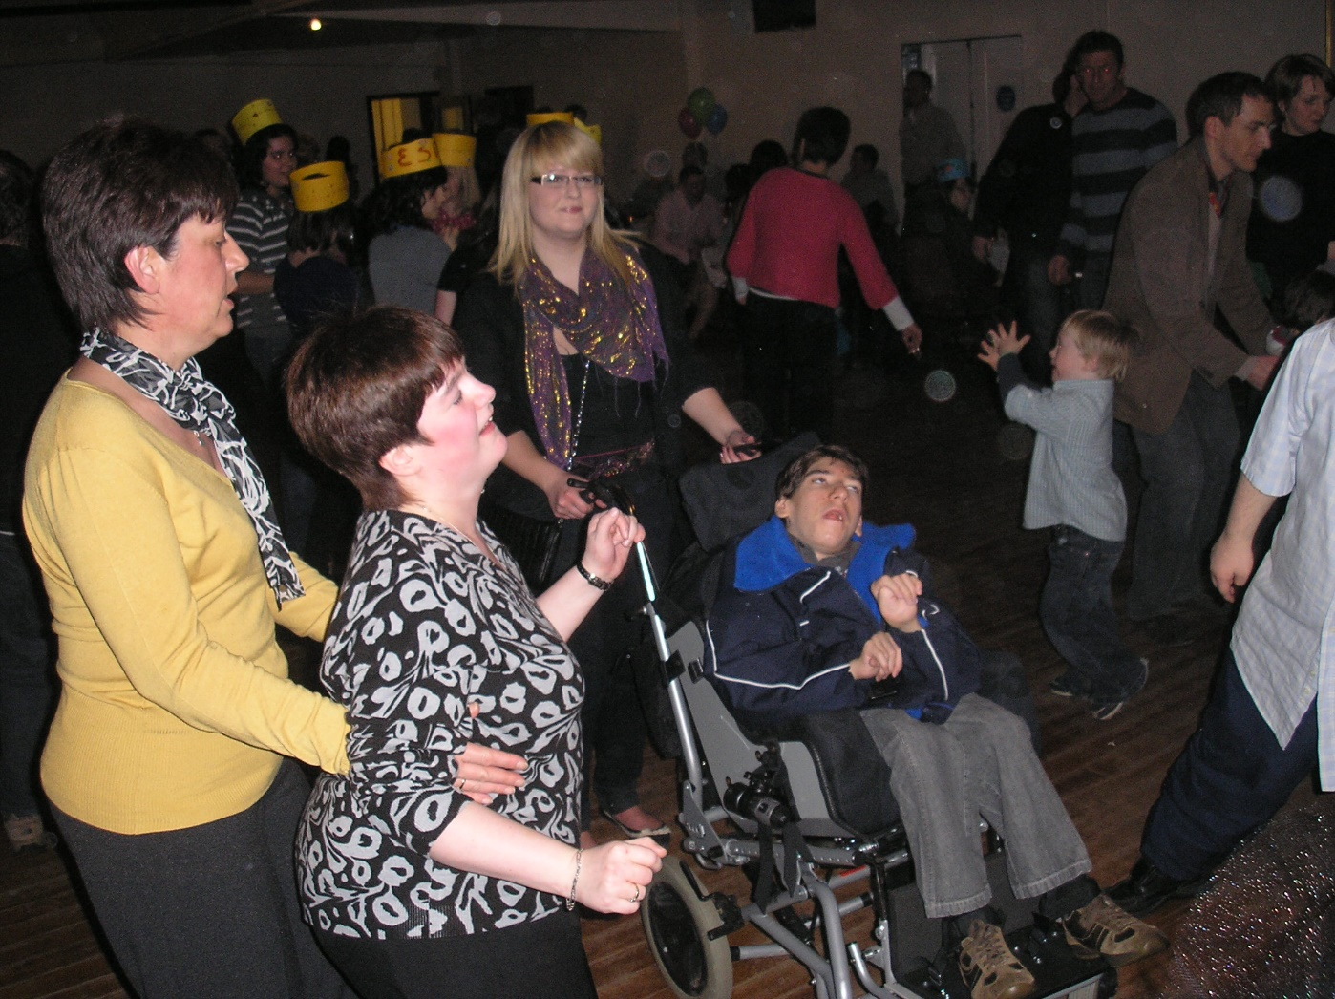
Partying

Slide 12
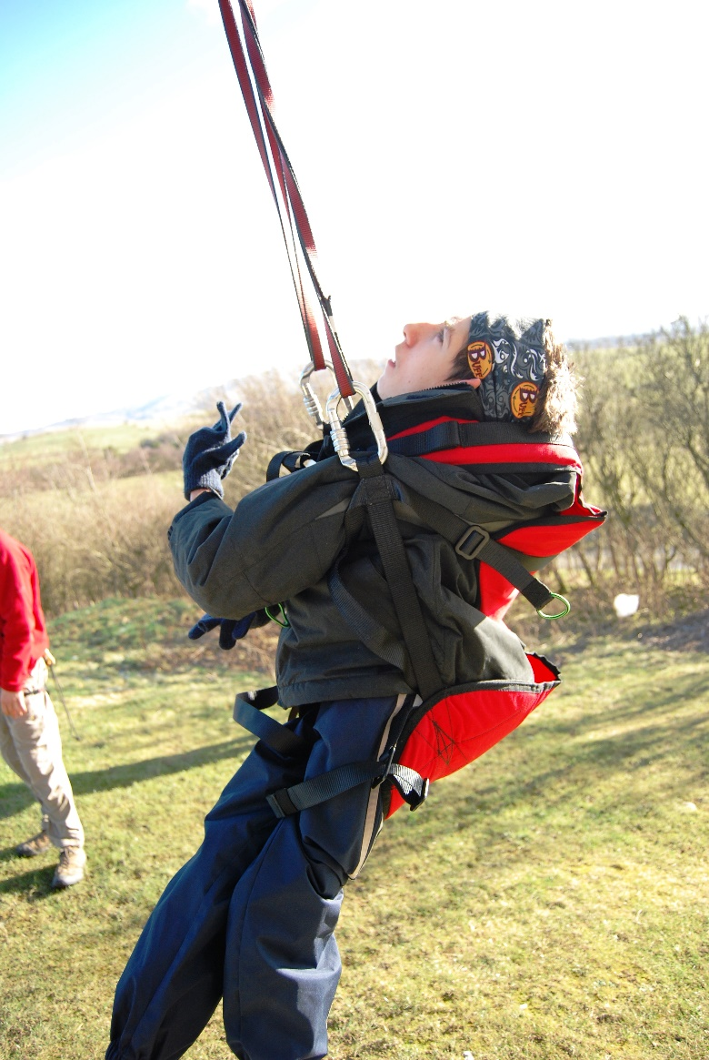
Extreme sports

Slide 13
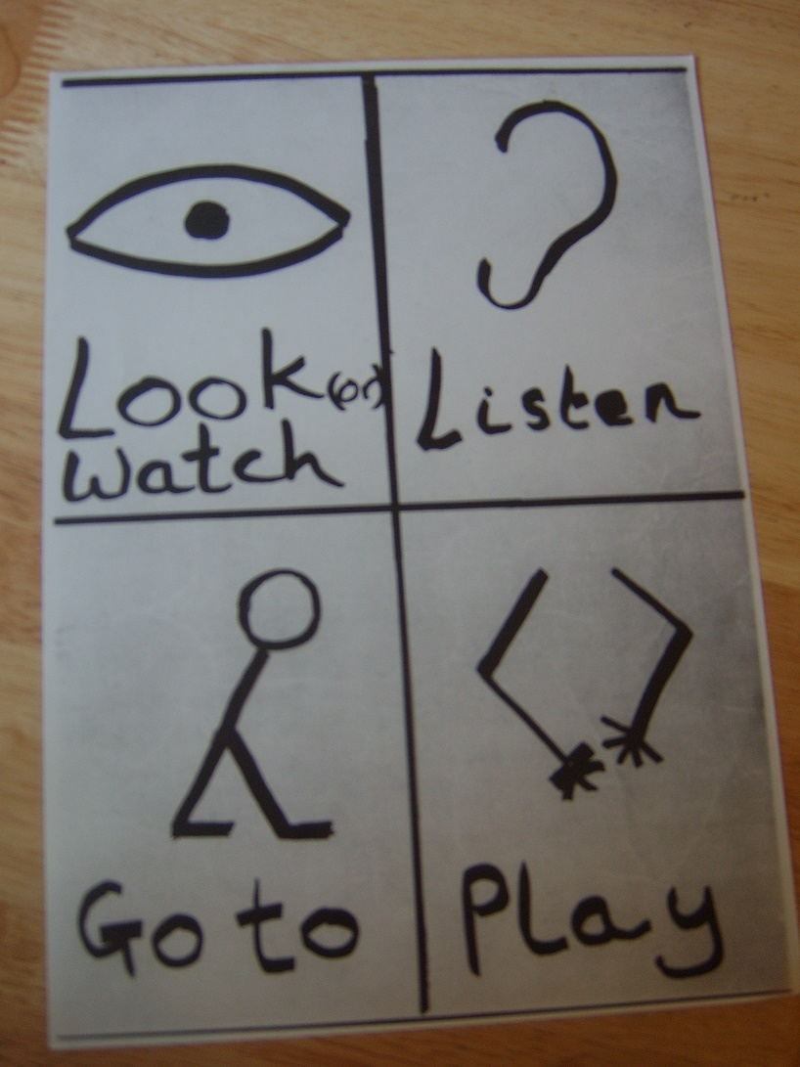
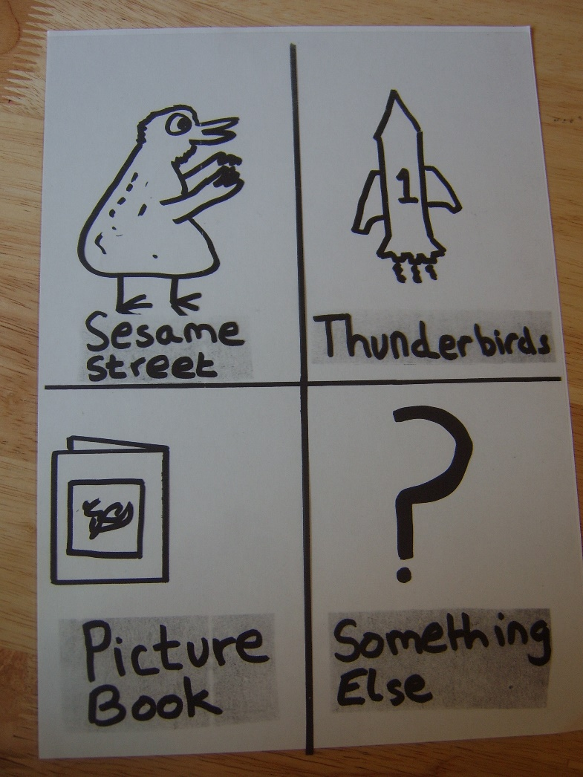
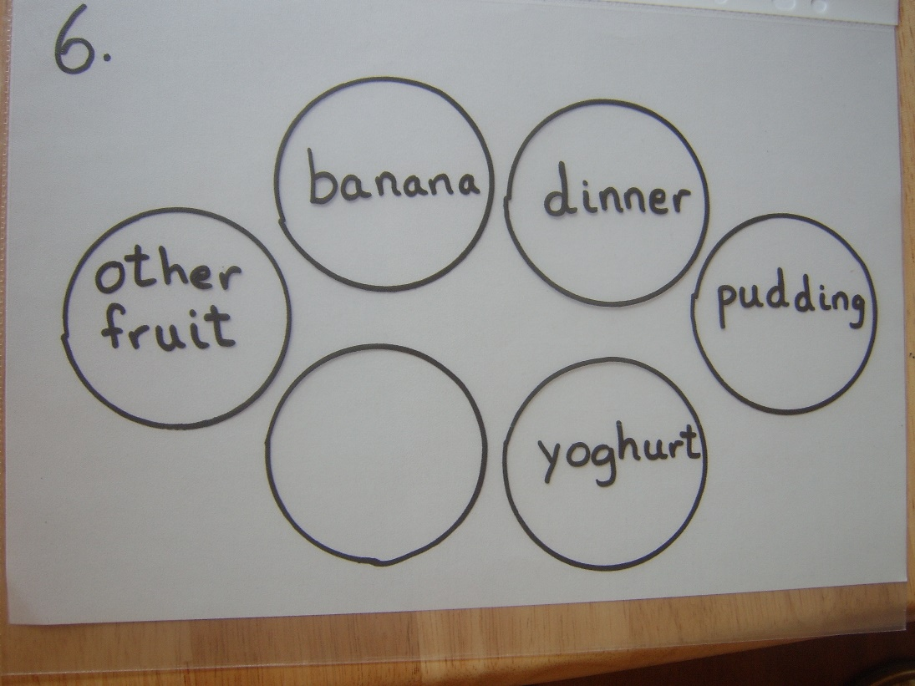
Early attempts at communication support. Also Arnie – crude voice output using a Sega Keyboard

Slide 14
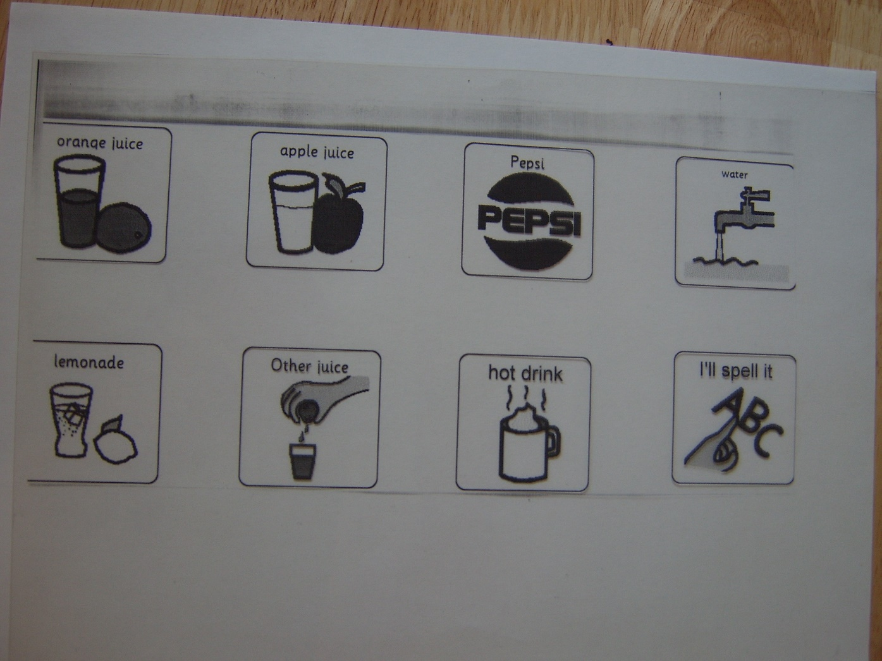
Using specialist software to make communication aids – Boardmaker.

Slide 15
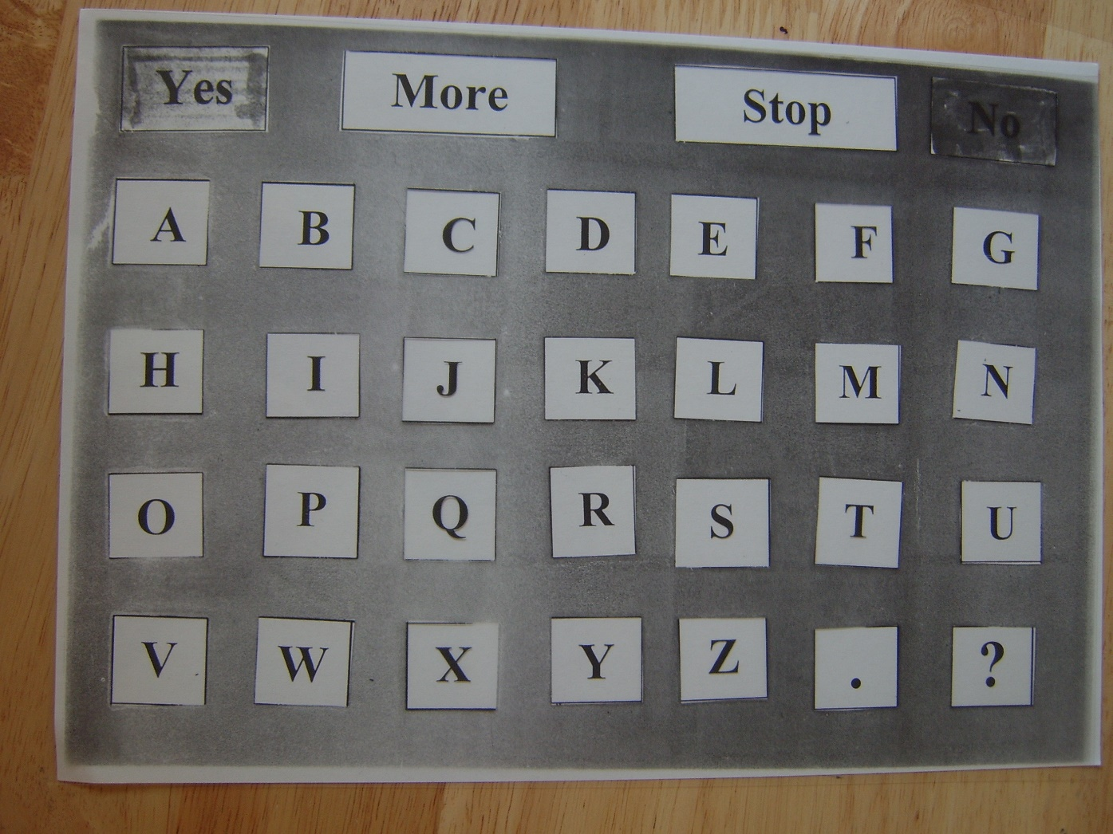
Teaching Dan to spell

Slide 16
Teen Alien
(Please see the video file on the presentation page)

Slide 17
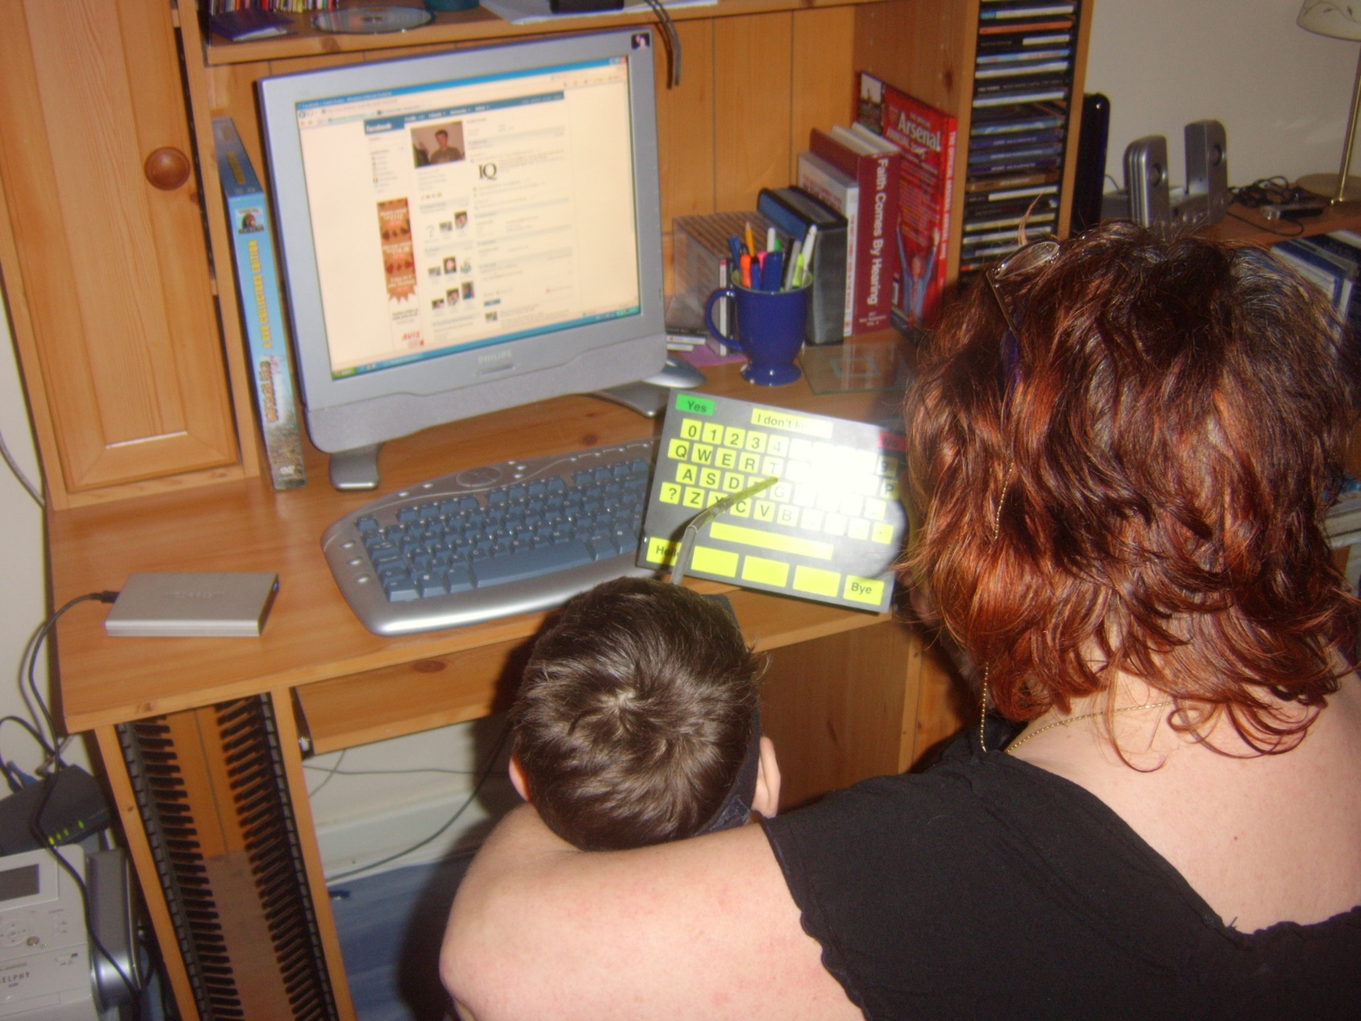
Using Facebook

Slide 18
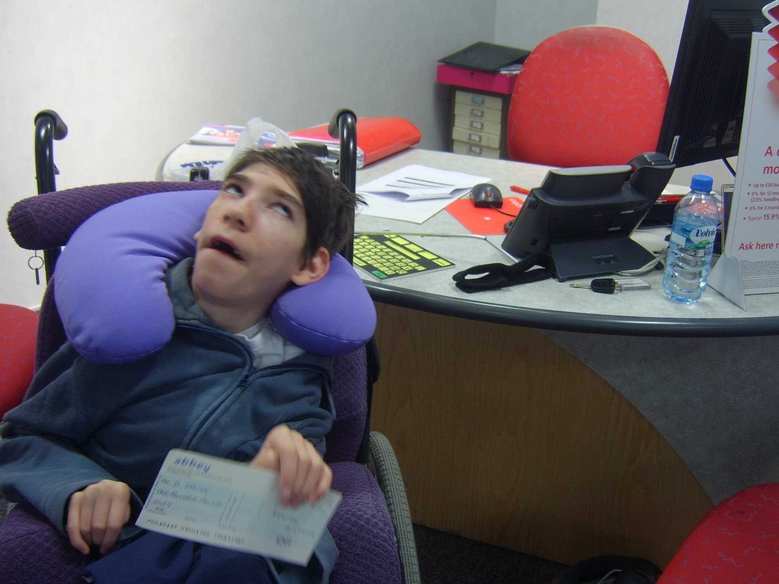
Opening his own bank account

Slide 19
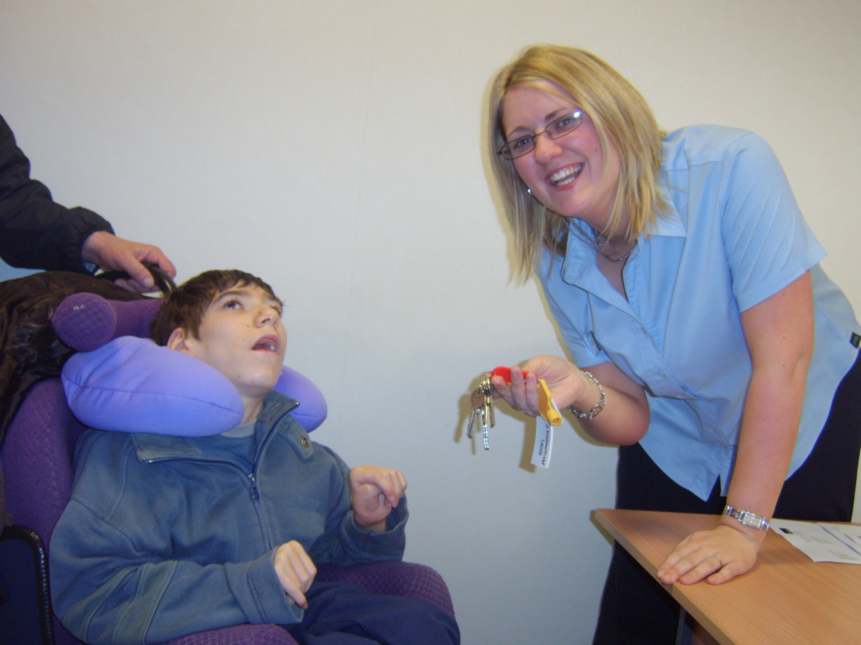
Getting his own home

Slide 20
Starting Again with Communication using Talking Mats
(Please see the separate video on the presentation page)

Slide 21
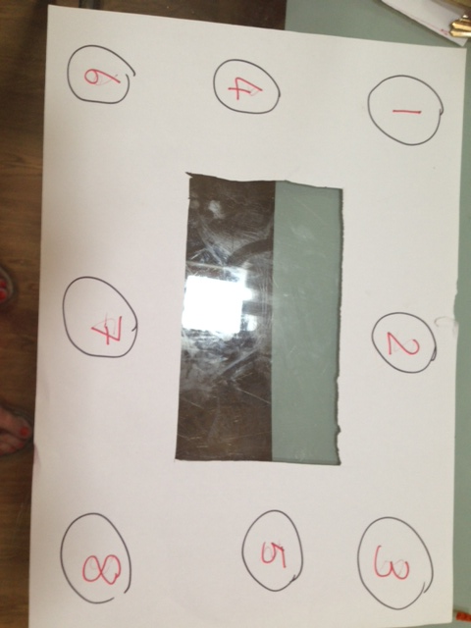
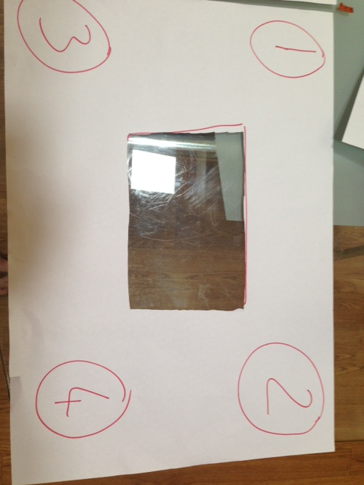
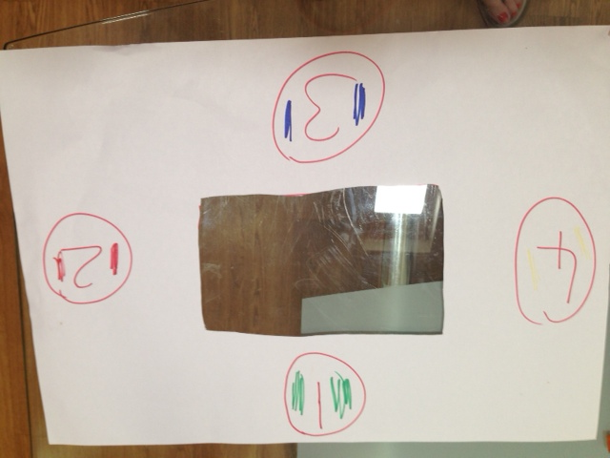
The future – Something like Podd http://www.lburkhart.com/podd.htm

Slide 22
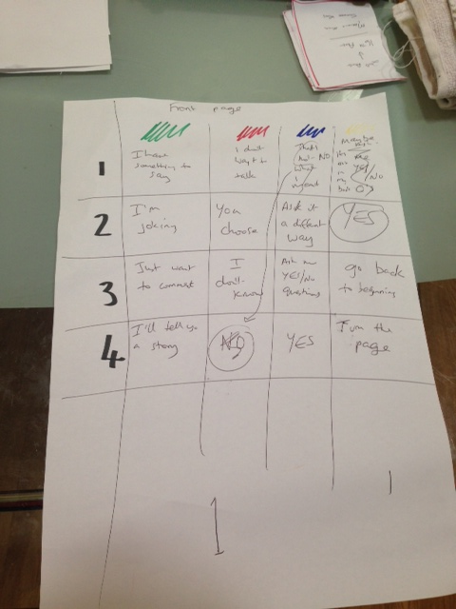
Saying more with less.

Slide 23
Organisations that Dan is involved with
http://www.palaceforall.org.uk/
http://www.candleaac.com/
http://dpac.uk.net/2014/05/quiet-riota-voice-that-will-be-heard-a-voice-to-be-reckoned-with/
http://www.communicationmatters.org.uk/

