Slide 1
„...and there you are allowed to stay throughout your life!“ Life history research with people with learning difficulties in total institutions
Gertraud Kremsner and Benjamin Emberger
SHLD-Conference, Open University, Milton Keynes, June 18th & 19th 2015

Slide 2
Überschrift Cambria 31 (Layout Textfolie)

Slide 3
It all started with...

Slide 4
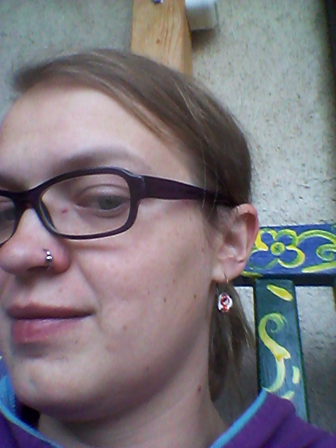
Life History Research
Research as inclusive as possible
People with Learning Difficulties living in institutions: How do they experience power and violence?
How have these experiences changed throughout their life?

Slide 5
GESAMT:
41 Interviews
Notes:
Team introduction
3 men, 3 women
Short introduction of the people involved
All of them used to live in so-called total institutions and now live in residential care

Slide 6
Searching for listeners: ELLA
Born in 1970
Hardly remembers her family
Children‘s homes
Sporadic parental visits:
stopped because of alcohol abuse
Had to move to a psychiatric hospital during primary special school
Was one of the first ones to move out in 1993
Group home
Now lives in her own apartment with part-time support
Attends a sheltered workshop

Slide 7
Notes:
Video hier einfügen

Slide 8
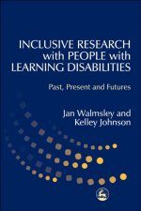
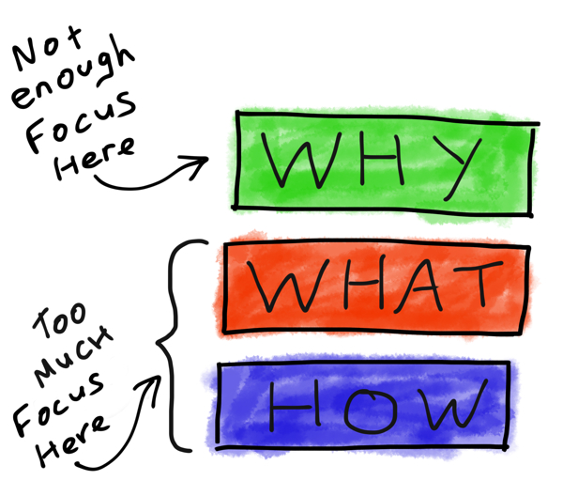

Slide 10
