Slide 1

Changing Scenes Project Supported By

Slide 2
Defining Moments
Sharing Life Experiences of Family Carers

Slide 3
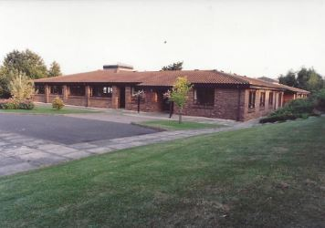
Ann Prior’s Story
The Story of Families Creating Charlton Day Services
In Oxfordshire

Slide 4
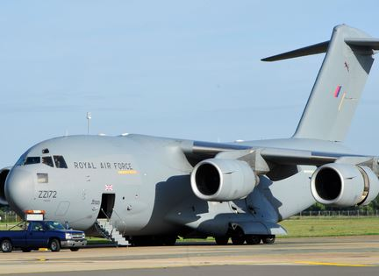
Cyprus

Slide 5
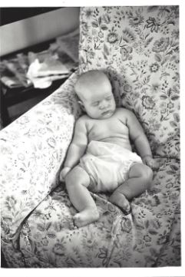
Floppy baby

Slide 6
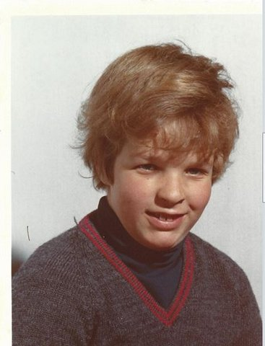
Dick Aged 7

Slide 7
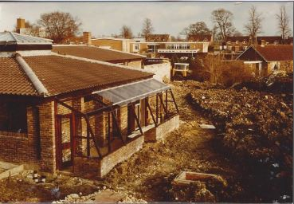
The day centre -getting started

Slide 8
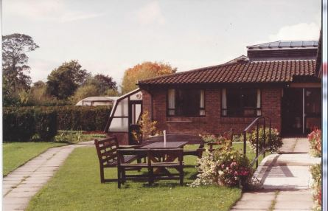
Finished Centre

Slide 9
The New Centre

Slide 10
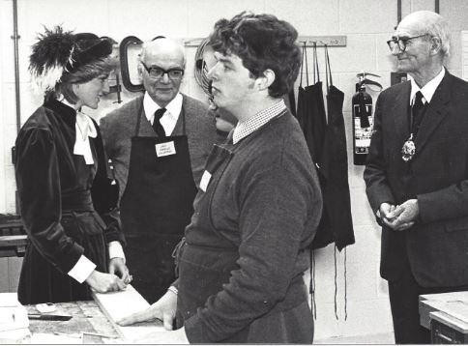
Dick looking bored when Princess Diana came!

Slide 11
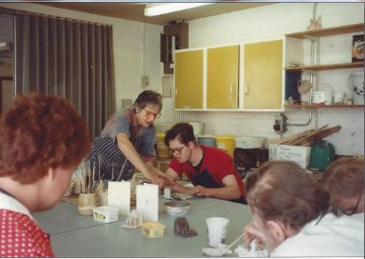
A hive of activity

Slide 12
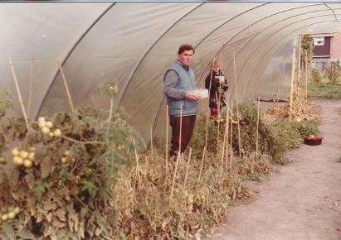
Working in the Polytunnel

Slide 13
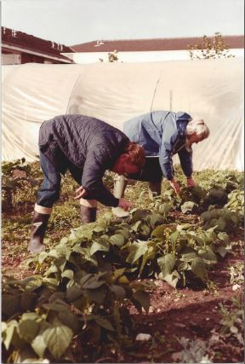
Looking after the garden

Slide 14
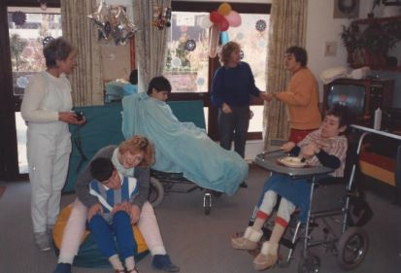
People who came to the Centre

Slide 15
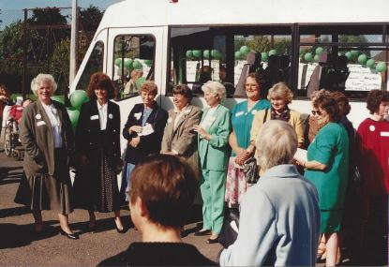
Fundraising for the Mini-Bus

Slide 16
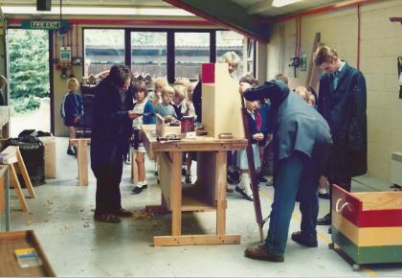
Woodworking

Slide 17
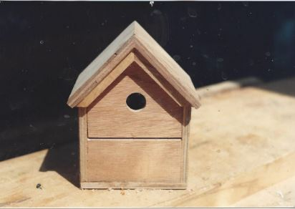
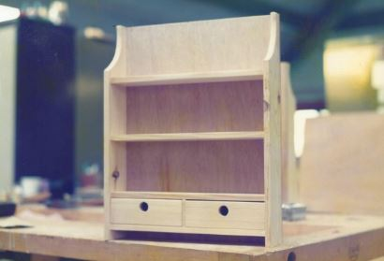
Some of our handy work

Slide 18
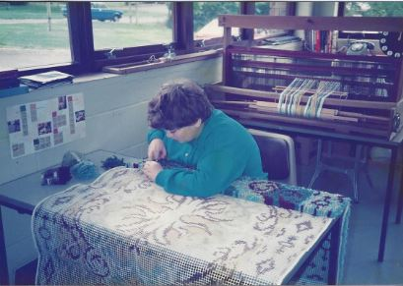
Rug Making

Slide 19
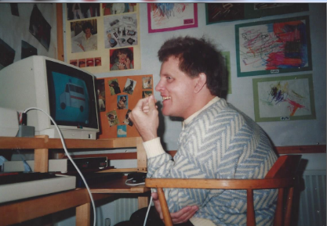
New Computer

Slide 20
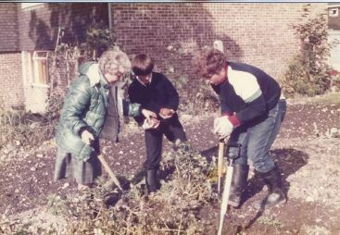
Preparing the Garden

Slide 21
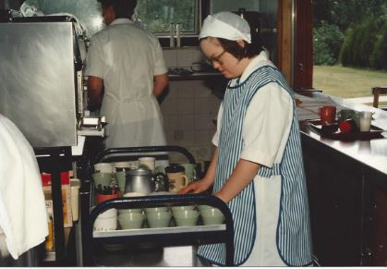
In the Tea Garden

Slide 22
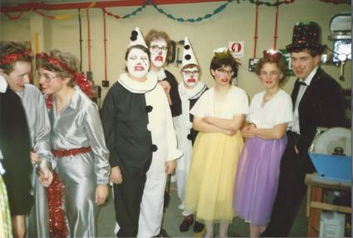
Show 1986

Slide 23
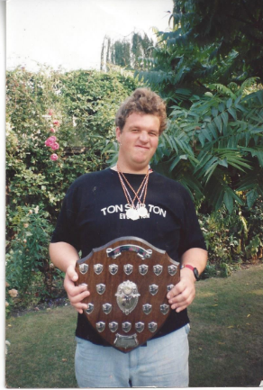
Dick with his Medals and Shield

Slide 24
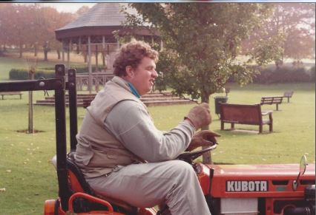
Dick Driving the Mower

Slide 25
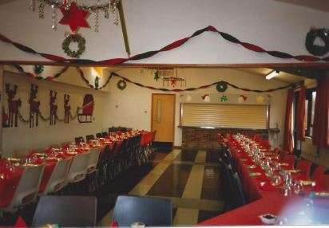
Christmas Party !

Slide 26
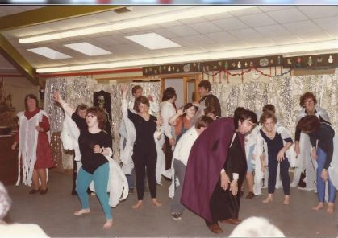
And More Parties!

Slide 27
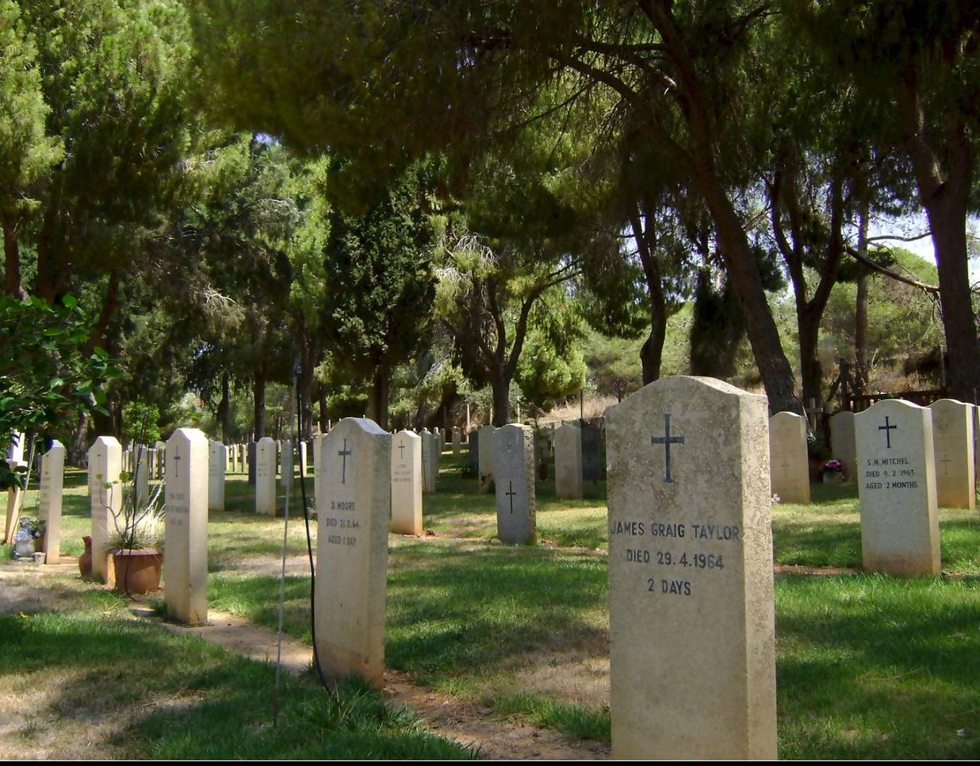
A footnote to this story…..
Dhekelia Cemetery

