Slide 1


Work, Life, Welfare & Greedy Organizations
Richard Harding, Linda Maguire & SJ Lennie
CPRL & POP

Slide 2
Today’s NLN
Introduction to Soteria Bluestone
Overview of Methods
Workload, welfare and bleed over - investigator perspectives
  Review of qualitative data from Learning and Wellbeing survey
  Review of Qualitative data
Introduction to Greedy Organizations
The flip side of workload, welfare and bleed over – family perspectives from other research
Concluding remarks & questions

Slide 3

Project Bluestone Soteria
Home Office funded collaboration between academics & police to identify the ‘as is’ of rape investigations in England and Wales. The aim is to create a National Operating Model and transform investigations.
Pillar 1: Suspect-focused investigations
Pillar 2: Disrupting repeat offenders
Pillar 3: Engaging victims & embedding ‘procedural justice’
Pillar 4: Promoting better learning, development, and wellbeing for Investigators
Pillar 5: Data-led performance monitoring & understanding of outcomes
Pillar 6: Digital forensics

Slide 4
Methods
L&D learning material review
Files reviewed
SOIT, SSAIDP, IPLDP, ICIDP, PCDA reviewed in detail
Development of analysis framework and structured analysis of lesson plans & content
Inter-rater review of analysis
Cross thematic analysis and outcome synthesis
Results and analytical products
Wellbeing approach review
Review of welfare approaches in other forces and A&S. Interview with welfare lead
Comparative analysis between organization’s approaches
Review of literature to identify promising practice
5 Policing Organizations in England & Wales
Interviews & Focus Groups
5 x Pathfinder: Interviews (n=58), focus groups (n=28, n=123 participants): Strategic, policy, learning, leadership frontline
Thematic analysis using NVIVO
Inter-rater review of analysis
Survey
18 Forces: n=2108 responses
(n=828 free text)
Themes: L&D, wellbeing, workload, burnout (MBI), attitudes
Quantitative analysis using SPSS and Stata; Qualitative analysis using NVIVO
Regression modelling, SD analysis and hypothesis testing

Slide 5
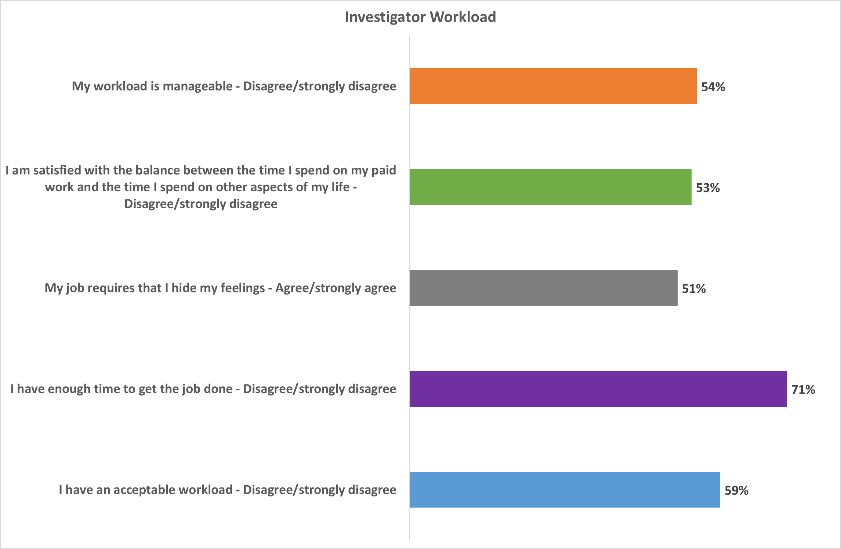

Slide 6
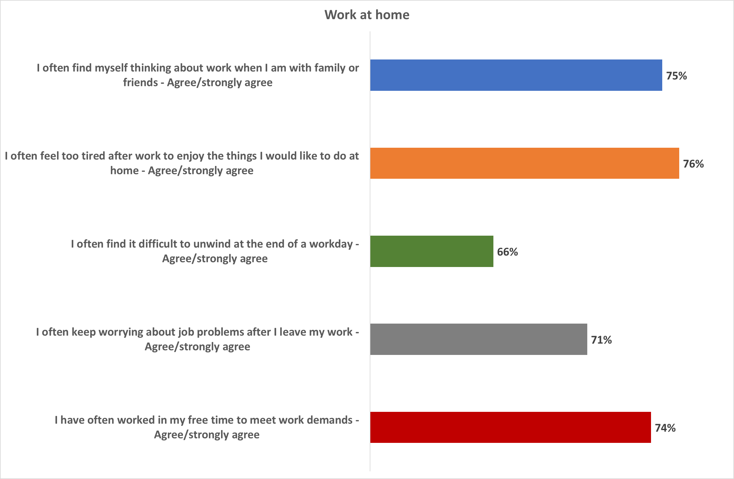

Slide 7
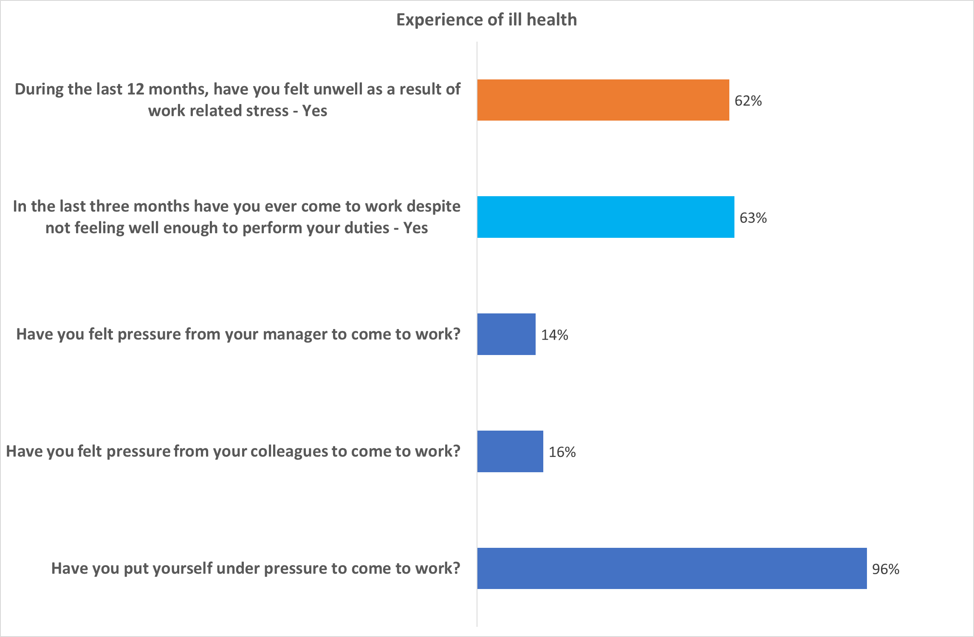

Slide 8
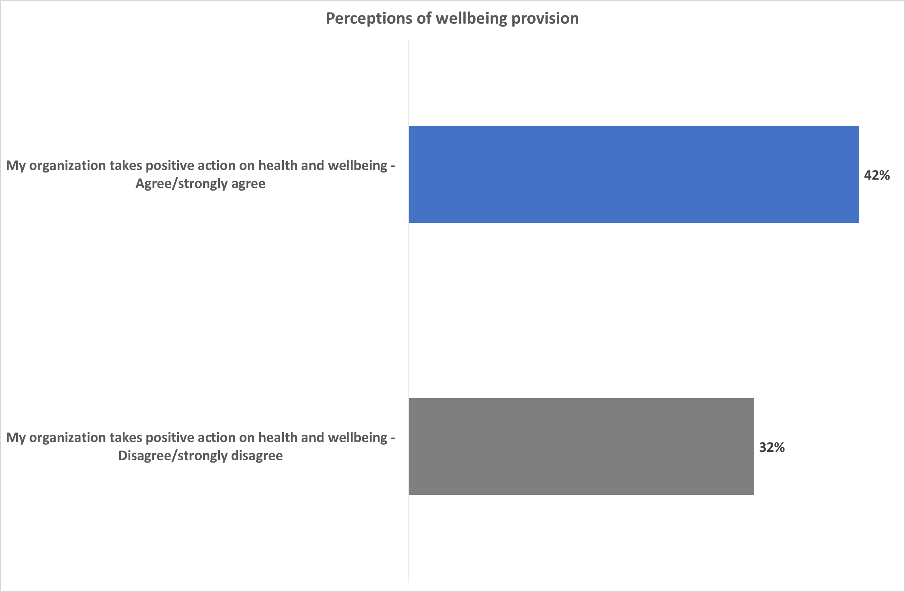

Slide 9
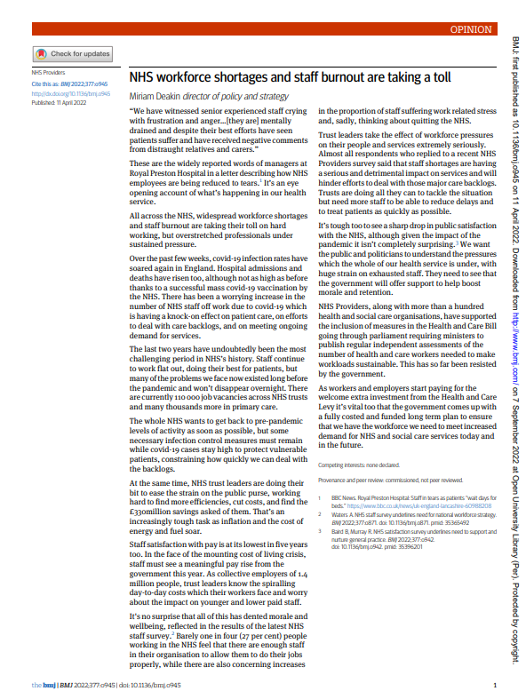
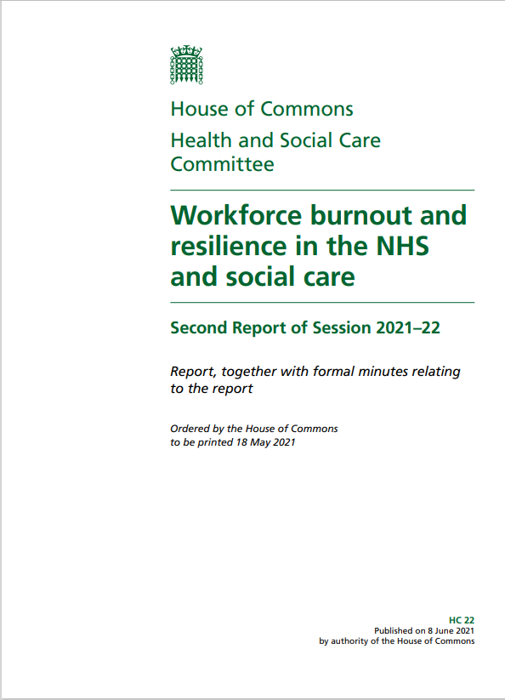
‘Burnout’ as an emergent issue in front-line public sector organisations

Slide 10
Burnout Measurements: Definitions
Three dimensions as defined Maslach’s Burnout Inventory (MBI):
Feelings of energy depletion or exhaustion (Emotional Exhaustion [EE])
Increased mental distance from one’s job, or feelings of negativism or cynicism related to one's job (Depersonalisation [DP] measuring an ‘internal’ focus towards colleagues and an ‘external’ focus towards victims)
Reduced professional efficacy (Lack of Personal Accomplishment [LPA])

Slide 11
Burnout Measurements
 | Maslach Burnout Inventory
Occupational Groupings | Emotional Exhaustion (EE) | Depersonalisation (DP) |  | Lack of Personal Accomplishment (LPA)
Operation Soteria-Bluestone Sites | 23.1 | Colleagues | 5.4 | Colleagues | 19.4
 |  | Victims | 5.4 | Victims | 28.0**
Medicine Front-Line COVID-19* | 19.7 - 22.7 | 6.1 - 7.3 |  | 32.5 - 37.5
There are three indicators of burnout as measured by the Maslach Burnout Inventory: EE is a feeling of being emotionally depleted to the extent there is nothing to give; High DP equates to a strong sense of disconnect and cynicism towards a) colleagues and b) victims; LPA reflects a perception the respondent has not achieved anything at work in relation to a) colleagues and b) Victims. Higher EE and DP and lower LPA are associated with burnout symptoms (Maslach et al., 2003).
*Source: Orru et al. (2021); Barello et al (2020).

Slide 12
GREEDY ORGANIZATIONS
The effect on officers of achieving target related outcomes
Organizations who place demands on employees beyond reasonable parameters (Sullivan, 2014)
Greedy organizations foster internal collegiality to demonstrate commitment and loyalty, enforcing the culture
Guilt at letting down colleagues and victim-survivors
Officers work longer and more dedicated hours
The greedy organization creates competing demands between work and home life
Reference
Sullivan, T., 2014. Greedy institutions, overwork and work-life balance. Sociological Inquiry. 84:1, 1-15.

Slide 13

GREEDY ORGANIZATIONS (Interview and focus group data)
Pressure on competing demands between work and home life
‘It sounds wrong, but if you do leave on time over a weekend, you almost feel as if you’re getting away with something, like it’s not quite right’
‘Staff are making it work because they’re doing things on their rest days on their own time and it’s hidden, it’s time that they’re not being paid or even getting that time back off’
‘I will log on every rest day or every other rest day, just to check that nothing important has happened, because otherwise it’ll be in the back of my mind all through my rest days until I’m back on duty’
‘I dread going on holiday, genuinely. Last year on holiday, at 4am, I was logged-on on holiday doing my work because I felt sick at the idea of coming back to another 2-3,000 emails’
My daughter says, she’s adult now, that you were never there at the school gate. The childminder was their mum’

Slide 14
FURTHER CONSEQUENCES ON MANAGING WORKLOAD
Job Demands Resource (JD-R) and Conservation of Resources Theory (COR)
COR theory suggests individuals absorb discomfort to minimize the pressure on others
JD-R and COR are altruistic approaches (George, 2017) – putting the needs of the wellbeing others first, to the detriment of themselves and their home lives
The introduction of targets creates a greater demand on officers and reflects negatively on the victim (Evetts, 2008)
The sustained effort caused by excessive workloads has a psychological cost on officers and impacts on their families
References
Evetts, J., 2009. New professionalism and new public management: changes, continuities and consequences. Comparative Sociology. 8: 247-266.
George, M., 2017. How traditional management approaches damage staff wellbeing. Nursing Times. 113:7, 35-38.

Slide 15
EFFECTS ON FAMILY LIFE – (Interview and focus group data)
Taking work home: being there … but not being there
‘I can find quite often I’m thinking about something. I should be talking to the kids and get told off regularly when I don’t reply because I haven’t listened to a single word they’re saying, because I’m considering what I’m doing tomorrow’
‘My husband will say to me ‘you’re here and you’re looking at the TV but your not actually here, are you? I start talking generically about the job and he’s like, this is the wrong time, this is our time, family time’
‘My son makes comments, he’s 14 and says ‘you’re always on that phone’. It didn’t matter where I was, my phone rings morning, noon to night. I do get comments like, ‘you’re always at work’ or ‘who’s this? Do you recognise this person’? They joke and pass comment and then you realise it really does have an impact’

Slide 16

Police Families Wellbeing Needs
The College of Policing & The Police Covenant
It is intended to ensure that officers, staff, volunteers and their families are not disadvantaged as a result of their service in the police and seeks to mitigate the impact that this may have on day to day life.
In practical terms the covenant will: Provide support to the families of those working in policing
Survey: Non-police service family members 1406 responses. Main concerns: mental health of serving family member, impact of day to day police duties on family, physical health of serving family member. positive statistical relationship between the respondents concern for their own psychological wellbeing and that of their serving family member
Focus Groups: Four focus group – three non-serving family members including grandparents and an adult child, one of serving officers. Analysis: Single Parenting, Logistics, Psychological Impact, Support Needs
Autobiographical Interviews: Four interviews – serving police officers, three married to officers, one also child of officer, all with children. Analysis: Intergenerational trauma – children repeating the lives of their parents, children anxious and traumatised by parents trauma, domestic violence, police families not as victims, stigma of the police parent.

Slide 17
Findings
Family/Work conflict
Single Parenting – impact of day to day of police life is second cause of concern for partners of serving police. Non-police partners become single parents (police officers solo parenting) as the unpredictable nature of policing (rolling shift patterns, regular late finishes, cancelled rest days and annual leave, court warnings on rest days) means police parents are unreliable and absent. Non-police partners rely on child care (though not police appropriate) and grandparents often step in to pick up the role of the absent police parent.
Mental health of non-police partners is eroded as they carry the burden of the complexity of arranging childcare and family life alongside their own careers, which must be flexible enough to accommodate the ever changing commitments of their partner.
Unpredictability and unreliability also erodes non-police partners support networks and opportunities for self care, as they can’t commit to classes (gym or other) or friendship gatherings.

Slide 18
Findings
Family/Work Conflict
Organisational Injustice Police officer perspective: Stigma of getting pregnant, having a family, parental leave, flexi-plans, accommodating family. Seen as less than & end of career.
There is no compatibility between having a family and having a police career – it can’t be done. Parents often change roles – not just women, not just for child care – risk also a factor, and wishing to be more present for children. Fear of loss of promotion prospects – impact on family planning – impact on pregnancy.
Lack of support or accommodation of family by job – family do all of the compromise for the job – flexible working plans based on luck and compassion of supervisor. – lottery. Job share not possible – expectation of third party child care (which most can’t afford or access).
Third party child care or other support services not compatible with policing (drop off/collection times, rolling shift patter, unpredictable finish times.
Victim support for police families, are they less than other members of the public? Assuming the identity of police officer, no recognition. Comparable to police officer mental health – secondary citizen.

Slide 19
Survey:
‘A very anti family organisation. I have experienced an incredible burden of managing home/children and my own job since my partner signed up which has been further exasperated by covid. Everything falls to me now. The shift patterns, partners constant tiredness, unpredictable nature of each shift end time - it’s hard work. We cannot plan holidays or days out. His leave can be cancelled and we have no say. Important training courses are staged over half terms with no regard to impact on families. He loves the job, he’s brilliant at it and we support him - but it’s had an immeasurable impact on family life and my personal well-being. I often feel like a machine now and my children miss out on many things without their Dad. He is also constantly torn between a career that is his passion and the family he loves. It is a hard life - I have never felt so lonely.’
Focus Group:
‘the police dominates every aspect of our lives in one way or another, really… his job kind of dominates every aspect. So every decision we have to make or I make or make around the kids, it's got to kind of run through his work and his shifts or his commitments and so on.’

Slide 20
Findings
Psychological Wellbeing
Secondary Trauma of partners – non-police partners are so concerned about their police partners mental health that they are actively tracking their mental health and stepping in as counselling support – they hear all of the details of an officer’s day, yet they have no where to off load their burden.
Unaddressed MH issues in officers impacts police family, impact on parent of officer, impact on partner – impact on child development. Agitated behaviours, irritability and aggression – redirection of not coping onto family, impacts partner, parent, child.
No recognition of impact on police family even when it is identified that a serving member is significantly unwell
Statistical relationship between partner and police family member psychological wellbeing.
Non-police partners are isolated from society and family friends and often partners, but also still considered as outsiders from the police service. No sense of belonging or support.

Slide 21
Survey:’ ‘You never get used to shift work and the impact this has on family and quality time. I have anxiety/PTSD and my husbands job has certainly impacted me, there have been far too many times that I have needed him and he’s not been there, you know it’s not their fault but it’s hard to see that at times…The mental strain on the officer is hard too, even for the strongest which does in turn pass on to the family as we always discuss his day but at times it can be quite draining for all involved but we know he needs to talk. ‘
Focus Group: ‘And he's also been diagnosed with PTSD at work, and I very much share in a lot of his trauma. And again, there's no. Reach out or just consideration for how it affects families UM, and I'm aware that as my children get older, these are all risk factors for them as well.’’
Focus Group: ‘A lot of the time he's a very angry man and it can. It can make life very difficult at home. You know, you can start walking on eggshells sometimes, you know, can just cross their path and you’re in my way you all that sort of. Because they're not. They're not. They're not dealing with the root cause of something, so they're taking it out on you.’
Focus Group: ‘But sometimes he has an incredibly short temper. You can tell when there's stuff going on. You do have to sometimes be on eggshells. And he does. He carries this shift around with him that he shouldn't have to be like his job. His job is damaging him like he is not the person that I was in my teenage years in 20s with.’

Slide 22
Findings
Children
Intergenerational Trauma
Children reflecting behaviour of police officers – children are very aware of their police parents jobs and are interested in this – often wanting (and becoming) police officers but also aware of the risks that their parents are involved in.
Children recognise the absence of their parents – are they secondary to police work too?
Children are affected by parent’s mental health – two children state this, non-police parents of children witness this, parents admit to their behaviours, describing and witnessing anxiety and vulnerability.
Children learn to suppress emotions either to protect already stressed parent, or due to agitated mood or inaccessibility of parent.

Slide 23
Survey: ‘Child required wellbeing / psychological support when aged 10 due to serving family member was working on numerous murder enquiries and working away from family, child became fearful of dangers presented and needed some support . Obtained via GP’
Focus Group: ‘I worry about his relationship with my little boy because, like, there will be times when [child], like, Mommy, don't tell Daddy that or is Daddy home or is Daddy in bed or don't tell Daddy this happened. Umm. Because he's worried about him, like snapping or getting cross or…And then other times I do worry about [child’s] ability to express his emotions, cause if he's. Umm, like [partner] just doesn't deal with emotion that well generally. So he tends to be told to be like your stop being silly or you know it doesn't hurt that much or. Some, and I mean we all, we all do it... But I feel like it happens in our house, maybe more than it should..’

Slide 24
Interview ‘I didn't. I didn't really…You know, I felt like I didn't have anyone to protect me…I suppose II couldn't be honest with him. I couldn't. like I didn't want him to think that I was weak… But he was never really there to, to talk to and didn’t.’
Interview ‘Sometimes not venting my feelings and views and then may be taken out my children. When I shouldn't and they don't understand why I might be a bit more snappy with them.’
Interview ‘I definitely see my husband becoming stressed because he's in a high-ranking role and I see it quite frequently and I sort of say to him, OK, that's good that you recognize you are stressed. But what you gonna do about it and he doesn't do anything about it. And again, he will just take it out in a negative way in the home with me or my children and that's, you know, I know when he's stressed because he will be become what agitated...’

Slide 25
‘…they use the term police family, don't they as a way to try and get people into the job…but it's kind of, yeah, become part of this family because you're about to destroy your one at home...’

Slide 26
In Summary
Policing is intrinsically greedy
Organizational stressors appear much more significant than occupational ones
Investigators at all levels bridge the gap in organizational capacity and capability with their own.
This is often to their own detriment and those closest to them
They are often ‘absent’ outside work
Investigators live in fear of taking time off because of workload pressures and not wanting to let colleagues or victim survivors down
The impacts on their welfare and that of their family and friends may be significant
These impacts have real world implications for investigators and degrade the support mechanisms which might otherwise help them cope

Slide 27
‘Staff are making it work because they’re doing things on their rest days on their own time and it’s hidden, it’s time that they’re not being paid or even getting that time back off’
‘Rather than using a lack of ‘resilience’ as a cudgel to ignore what might be genuine complaints, leaders from successful organisations should be focused on scalable solutions……..Instead of trying to train each and every individual in resilience so that as many as possible recover from adversity, organisations should be looking at how they can structure cultures, policies and behaviours to help everyone thrive when adversity comes. We shouldn’t help people beat the odds, we should change the odds.’
(Dorney, G. (2020). "We have to stop misusing the word ‘resilience’." Retrieved 19 February, 2021, from https://www.hrmonline.com.au/culture/misusing-word-resilience/.)

Slide 28
Slide Title 30
Thank you

